Slide 1
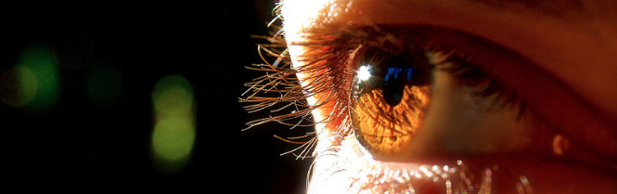
Reconocimiento de Patrones
Domingo Mery
Departmento de Ciencia de la Computación
Escuela de Ingeniería
Universidad Católica de Chile
Neural Networks
[ Capítulo 4 ]

Slide 2
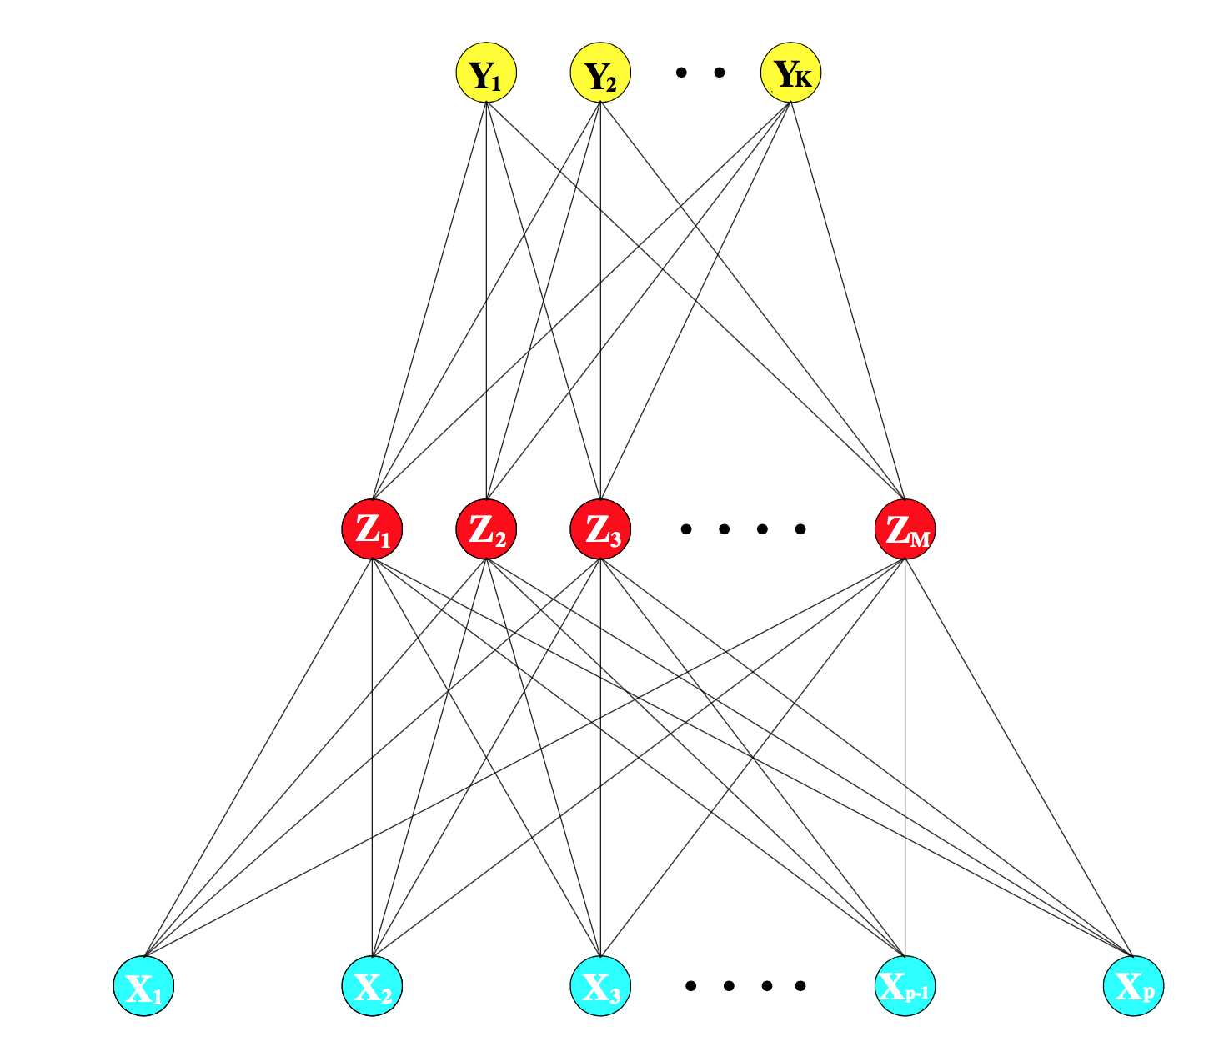

Slide 3
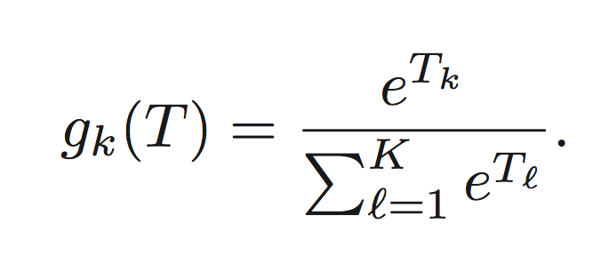
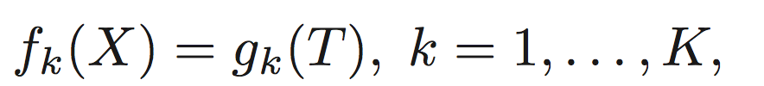
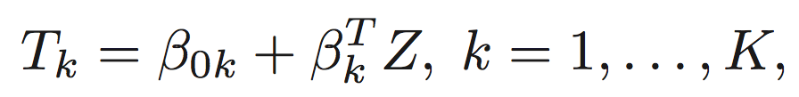
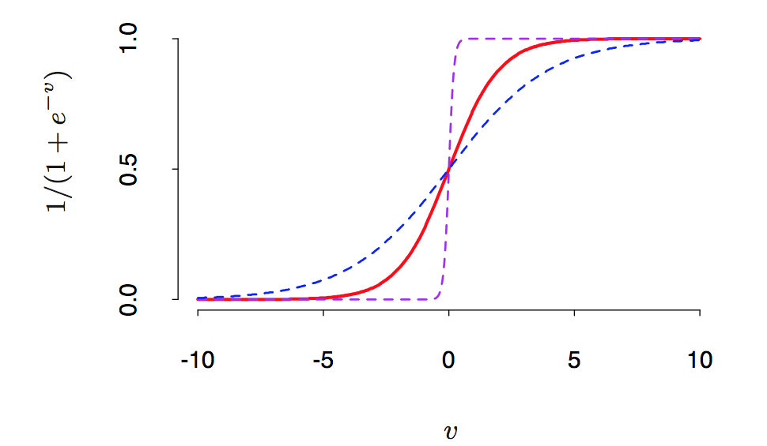
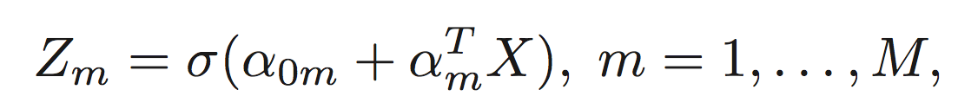

Slide 4
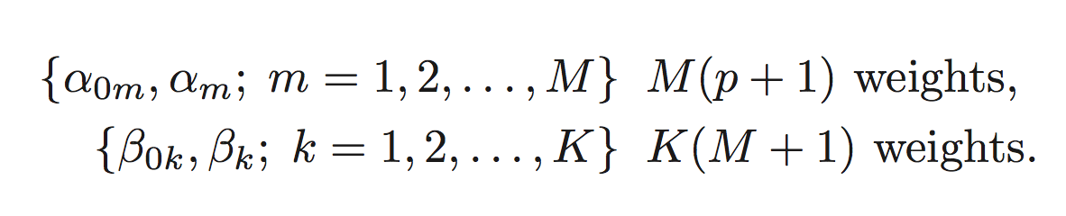
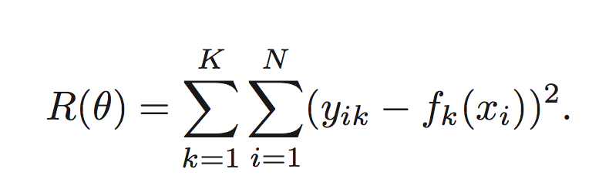
TRAINING for K classes
Parameters:
Objective function with N samples:

Slide 5
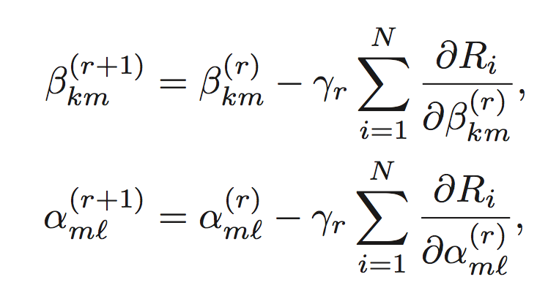
Using gradient descent at the (r+1) iteration:
Learning rate

Slide 6
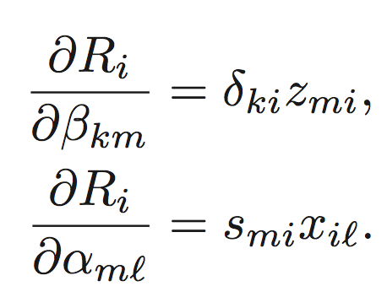
Back-propagation:
0) Starting values for
Computation of
Computation of
(repeat from step 1 until convergence)

Slide 7
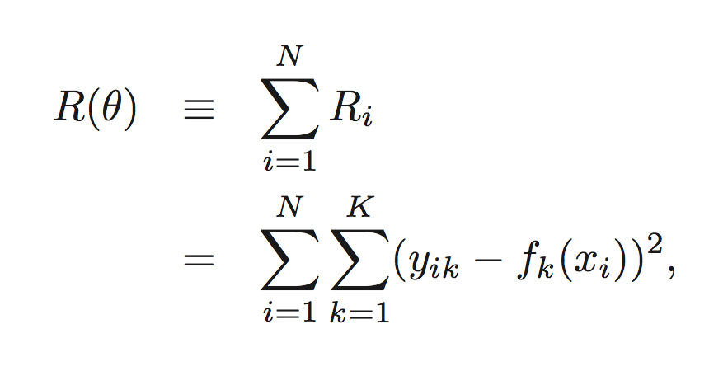

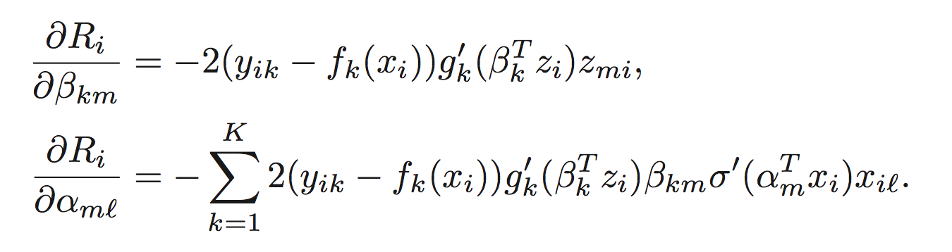
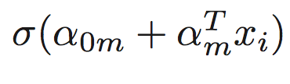
Objective function:
Derivatives:

Slide 8


Objective function:
Derivatives:

Slide 9
Objective function:
Derivatives:

Slide 10
Using gradient descent at the (r+1) iteration:
Learning rate

Slide 11
Back-propagation:
0) Starting values for
Computation of and
Computation of and
Computation of
Computation of
(repeat from step 1 until convergence)

