Slide 1

Reconocimiento de Patrones
Domingo Mery
Departmento de Ciencia de la Computación
Escuela de Ingeniería
Universidad Católica de Chile
Sparse Representations
[ Capítulo 4 ]

Slide 2
Images of different
known classes
Pattern Recognition Schema
Class 1
Feature Feature Design of
Extraction Selection Classifier
Class 2
Class n
Stage 1: TRAINING
Stage 2: TESTING
Extraction of
selected
features
InputA: Test Image
Class
Classification
Output:
PAT04_SparseRepresentations.pptx

Slide 3
Images of different
known classes
Pattern Recognition Schema
Using Feature Transformation
Class 1
Feature Feature Design of
Extraction Transformation Classifier
Class 2
Class n
Stage 1: TRAINING
Stage 2: TESTING
Extraction and
transformation
of features
InputA: Test Image
Class
Classification
Output:
GOAL: Classification could be easier in the transformed feature space.
PAT04_SparseRepresentations.pptx

Slide 4
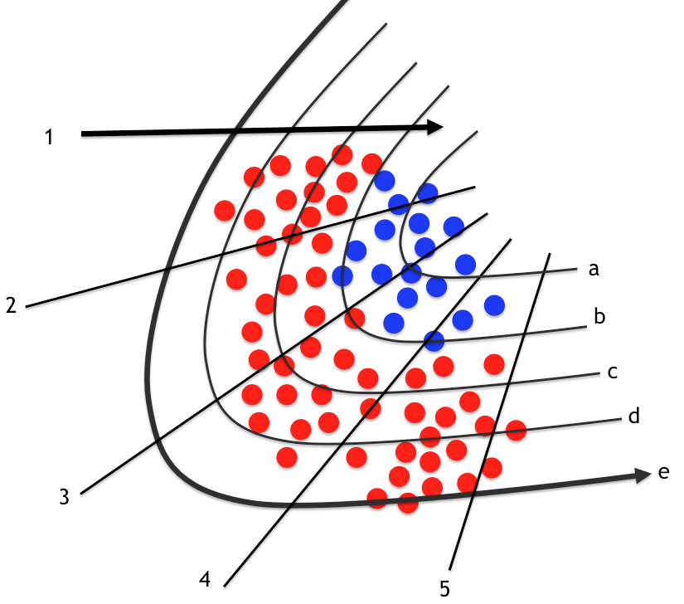
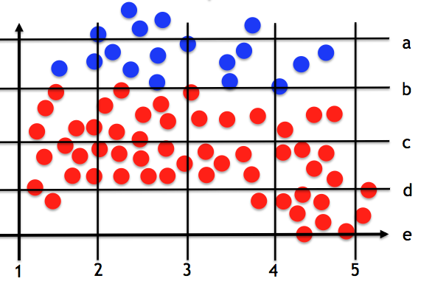
Original Feature Space Transformed Feature Space
. (new features)
PAT04_SparseRepresentations.pptx

Slide 5
General Linear Transformation
y = [ y₁ y₂ … y_{n} ]^{T} original features
x = [ x₁ x₂ … x_{K} ]^{T} transformed features
^{where}
x₁ = a₁₁y₁ + a₁₂y₂ + … a_{1n}y_{n}
x₂ = a₂₁y₁ + a₂₂y₂ + … a_{2n}y_{n}
:
x_{K} = a_{K1}y₁ + a_{K2}y₂ + … a_{Kn}y_{n}
x = Ay
PAT04_SparseRepresentations.pptx

Slide 6

General Linear Transformation
y = [ y₁ y₂ … y_{n} ]^{T} original features
x = [ x₁ x₂ … x_{K} ]^{T} transformed features
Example with K = 2
y₂
x₂
x = Ay
y₁
x₁
PCA: Principal Component Analysis
PAT04_SparseRepresentations.pptx

Slide 7

General Linear Transformation
y
x
n
K
y
x = Ay
x
y
y = Dx
x
Signal y can be represented as a linear combination of a set of elementary signals:
dictionary
atoms
PAT04_SparseRepresentations.pptx

Slide 8


General Linear Transformation: Traditional Dictionaries
y
x
n
K ≤ n
y
y = Dx
x
There are many known Dictionaries:
Name | Size | Type
Fourier | K = n | Fixed
Haar | K = n | Fixed
DCT | K = n | Fixed
Wavelets | K = n | Fixed
Gabor | K = n | Fixed
PCA | K ≤ n | Learned
Properties:
x = y

Slide 9
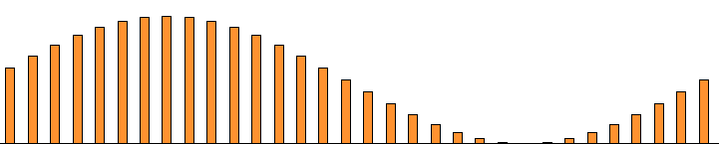
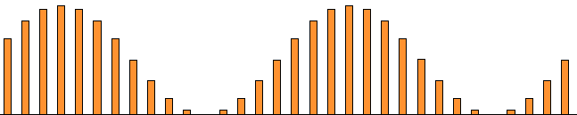
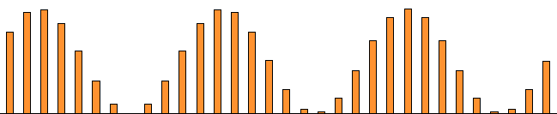
General Linear Transformation: Example Fourier (1D)
y
x
y
x
y
x
y
x
PAT04_SparseRepresentations.pptx

Slide 10

How can we work with 2D signals?
Column 1
(11 elements)
Column 5
(11 elements)
Column 9
(11 elements)
:
:
y =
110x90 11x9 99x1
Down-sampling Stacking
PAT04_SparseRepresentations.pptx

Slide 11

General Linear Transformation
y
x
n
K ≤ n
Sparse Linear Transformation
y
x
n
K>n
PAT04_SparseRepresentations.pptx

Slide 12
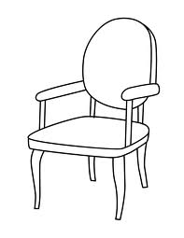
Sparse Representations – Example
What is this if we don’t have the word ‘chair’ in our dictionary?
A piece of furniture consisting of a seat, legs, back, and arms, designed to accommodate one person.
y
[ REPRESENTATION WITHOUT WORD ‘CHAIR’ ]
x
What is this?
A chair.
x
[ REPRESENTATION WITH WORD ‘CHAIR’ ]
PAT04_SparseRepresentations.pptx

Slide 13
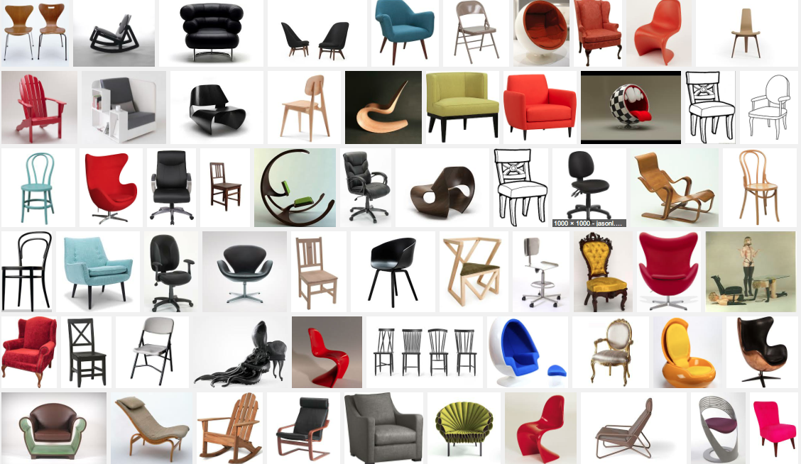
Sparse Representations – Example
However, what is this if we don’t have the word chair?
A piece of furniture consisting of a seat, legs, back, and arms, designed to accommodate one person.
y
x
What is this?
A chair.
x

Slide 14



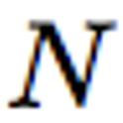
Sparse Representation Methodology
dictionary
[ 1. SPARSE DICTIONARY LEARNING ]
transformed features
(new representation)
original features
...
...
PAT04_SparseRepresentations.pptx

Slide 15
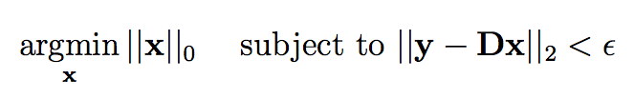
Sparse Representation Methodology
dictionary
[ 1. SPARSE DICTIONARY LEARNING ]
transformed features
(new representation)
original features
If we have a signal y and a learned dictionary D,
its sparse representation is
x* =
[ 2. SPARSE REPRESENTATION ]

Slide 16
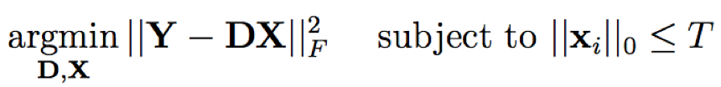
Sparse Representations – Classification – Strategy ‘A’
LEARNING
Y₁
Y₂
Y₃
Y_{k}
a) Collect signals from each class
b) Compute a dictionary for each one
D₁
i i i
i i
D₂
D₃
D_{k}
c) Concatenate all dictionaries
D = [D₁, D₂, …, D_{k}]
D =

Slide 17

Sparse Representations – Classification – Strategy ‘A’
TESTING
a) Test signal
y = ???
b) Compute sparse representation of y using D
×
y
D
x
PAT04_SparseRepresentations.pptx

Slide 18
Sparse Representations – Classification – Strategy ‘A’
TESTING
x
x
PAT04_SparseRepresentations.pptx

Slide 19
Sparse Representations – Classification – Strategy ‘A’
TESTING
x
PAT04_SparseRepresentations.pptx

Slide 20

Sparse Representations – Classification – Strategy ‘A’
TESTING
1
PAT04_SparseRepresentations.pptx

Slide 21
Sparse Representations – Classification – Strategy ‘A’
TESTING
2
PAT04_SparseRepresentations.pptx

Slide 22
Sparse Representations – Classification – Strategy ‘A’
TESTING
3
PAT04_SparseRepresentations.pptx

Slide 23
Sparse Representations – Classification – Strategy ‘A’
TESTING
k
PAT04_SparseRepresentations.pptx

Slide 24


Sparse Representations – Classification – Strategy ‘A’
TESTING
x
1
2
3
k
c) Compute the residuals for each class
D
d) Classify according the minimal residual
PAT04_SparseRepresentations.pptx

Slide 25
Sparse Representations – Classification – Strategy ‘B’
LEARNING
Y₁
Y₂
Y₃
Y_{k}
a) Collect signals from each class
b) Compute a dictionary for each one
D₁
i i i
i i
D₂
D₃
D_{k}
PAT04_SparseRepresentations.pptx

Slide 26
Sparse Representations – Classification – Strategy ‘B’
TESTING
a) Test signal
y = how is y represented by each dictionary?
b) Compute sparse representation of y using D_{i}
c) Compute the residuals for each class
D
x
i
i
i
i
i
×
d) Classify according the minimal residual
y
D
x
i
i
PAT04_SparseRepresentations.pptx

Slide 27
Face Recognition using
Sparse Representation Classification
(SRC)
PAT04_SparseRepresentations.pptx

Slide 28
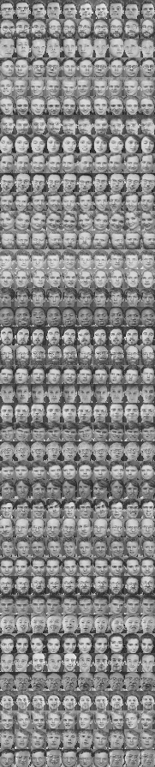
Sparse Representation Classification
LEARNING
In the training set there are k subjects.
For each subject we have n training images.
In this example there are 40 subjects with 9 images each.
Each image is downsampled to h × w = m pixels
Each downsampled image is represented as a vector d of m elements (by stacking its columns)
:
:
d =
Wright, et. Al. Robust Face Recognition via Sparse Representation. PAMI 2009

Slide 29
Sparse Representation Classification
LEARNING
For each subject i (for i=1,…k) we have a dictionary
D_{i} = [d_{i1}, d_{i2}, …, d_{in}]
We define a new matrix D by concatenating all individual dictionaries
D = [D₁, D₂, …, D_{k}]

Slide 30


Sparse Representation Classification
TESTING
How is a test image classified?
A new test image I^{t} is represented as vector y of m elements (using the same representation of the training images)
Now, we look for a sparse representation x of y using -minimization approach:
I^{t}
We classify y by minimizing the residuals (we follow the explained algorithm)

Slide 31
SRC Example on LFW
PAT04_SparseRepresentations.pptx

Slide 32
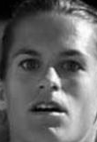
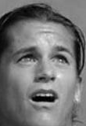
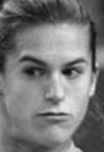
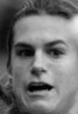
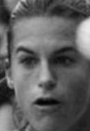
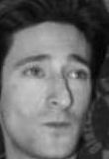
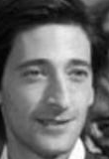
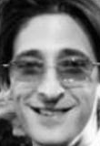

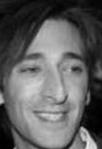
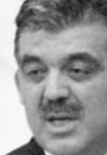

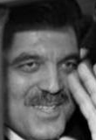

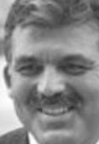
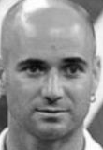
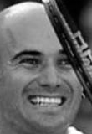
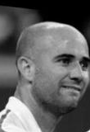
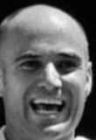

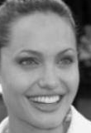
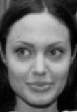

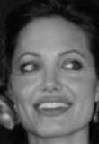
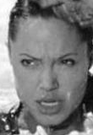
Gallery
Subject-1 Subject-2 Subject-3 Subject-4 Subject-k
. . .
PAT04_SparseRepresentations.pptx

Slide 33
Gallery = Dictionary
Subject-1 Subject-2 Subject-3 Subject-4 Subject-k
. . .
PAT04_SparseRepresentations.pptx

Slide 34
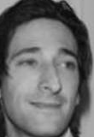
Gallery = Dictionary
Subject-1 Subject-2 Subject-3 Subject-4 Subject-k
. . .
Sparse
Representation
Query

Slide 35
Gallery = Dictionary
Subject-1 Subject-2 Subject-3 Subject-4 Subject-k
. . .
0.6
0.3
0.1
Sparse
Representation
Query

Slide 36
Gallery = Dictionary
Subject-1 Subject-2 Subject-3 Subject-4 Subject-k
. . .
0.6
0.3
0.1
Sparse
Representation
Query

Slide 37
Gallery
Subject-1 Subject-2 Subject-3 Subject-4 Subject-k
. . .
0.6
0.3
0.1
Sparse
Representation
+ +
0.3 0.6 0.1
Query
It is represented as a linear combination of few images of the gallery.

Slide 38
+ +
0.3 0.6 0.1
Query

Slide 39
+ +
0.3 0.6 0.1
Query
-
Not similar: reconstruction error is high
PAT04_SparseRepresentations.pptx

Slide 40
+ +
0.3 0.6 0.1
Query
-
Very similar: reconstruction error is very low
PAT04_SparseRepresentations.pptx

Slide 41
Query
Query is classified as this subject
In SRC, the query is classified as the subject with the lowest reconstruction error
PAT04_SparseRepresentations.pptx

Slide 42

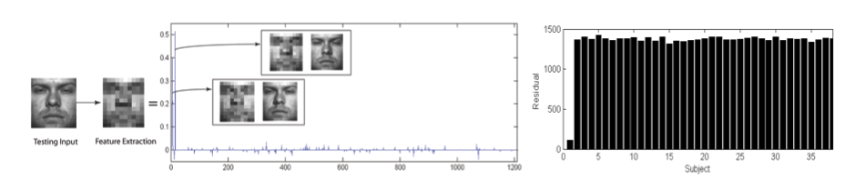
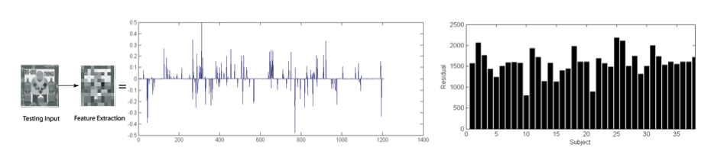
Sparse Representation Classification
TESTING
How good is the classification?
We use the Sparsity Concentration Index (SCI)
SCI = 0.8
SCI = 0.1

