Slide 1
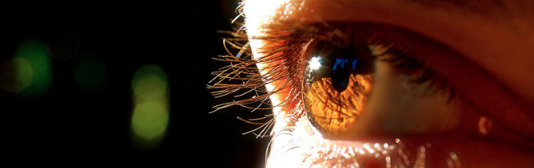
Reconocimiento de Patrones
Domingo Mery
Departmento de Ciencia de la Computación
Escuela de Ingeniería
Universidad Católica de Chile
Genuine - Impostor
[ Capítulo 5 ]

Slide 2
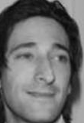
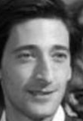
Face Verification Schema
Image A
Feature
Extraction
Vectors of n
elements
(1 x n)
Image B
Feature
Extraction
If image-A and image-B are from the same person
score s is high
Similarity using
cos - similarity
If image-A and image-B are from different persons
score s is low

Slide 3
Set of Images A
Set of Images B
Face
1
Face
1
Face i of set A and Face i of Set B are from the same person.
Face i of set A and Face j of set B for i=j are from different persons.
Face
2
Face
2
:
:
:
:
Face
m
Face
m
:
:
m x n elements
m x n elements

Slide 4
m x m elements
Similarity between Face-i of set A and Face-j of set B
d⁺: Diagonal : positive pairs (genuines)
d⁻: Non-Diagonal: negative pairs (impostors)

Slide 5
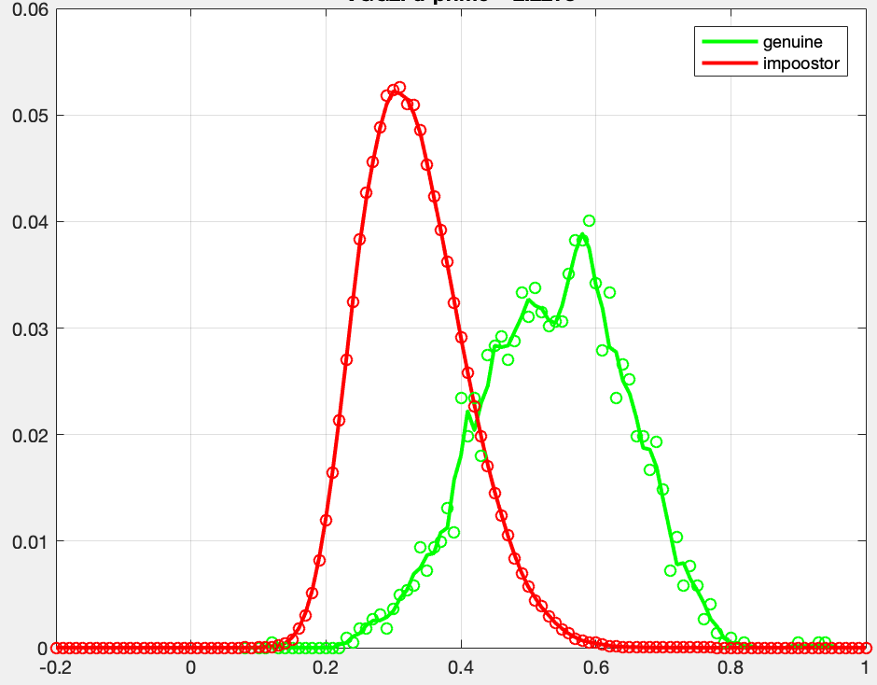
Distribution of d-
Distribution of d+
Probability density frequency
S
Performance:
Area of each distribution = 1

Slide 6
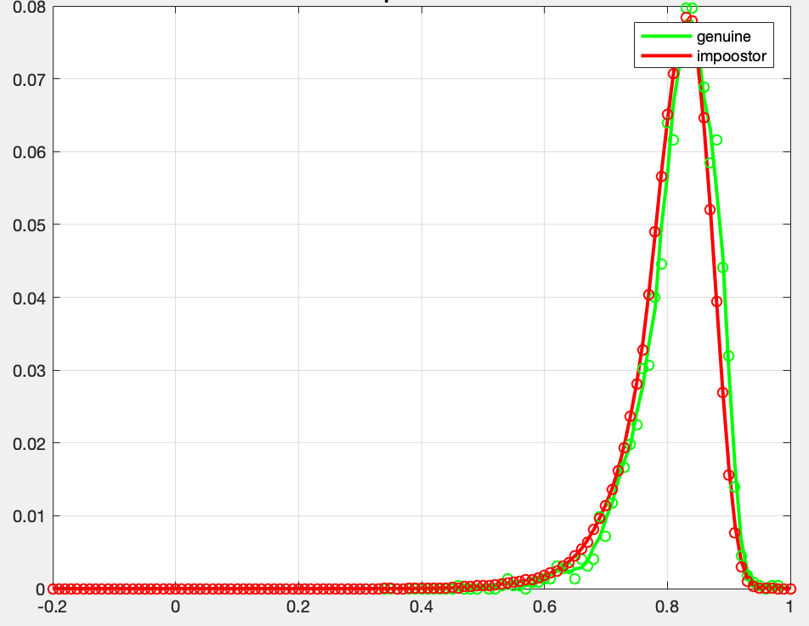
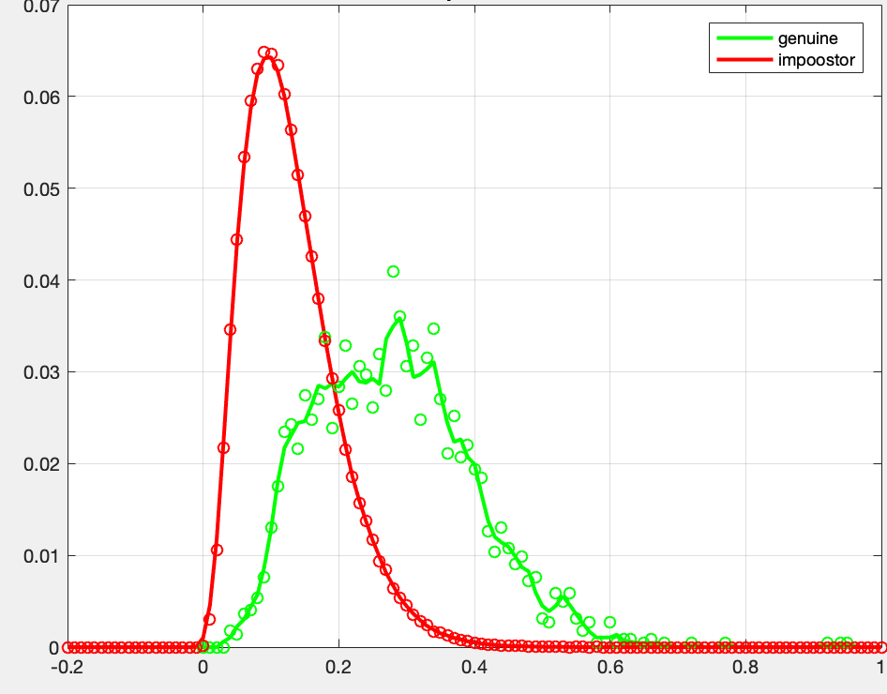
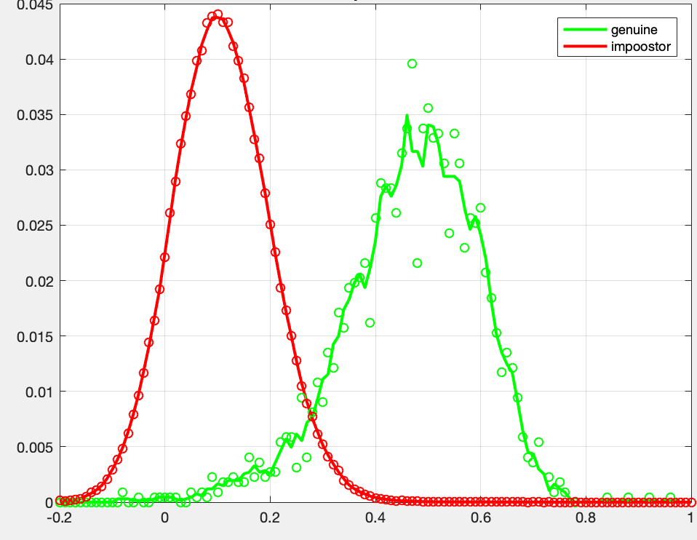
Examples of d’
for different algorithms
d’ = 0.20
d’ = 1.59
d’ = 2.22
d’ = 3.23
The best one

Slide 7
Other metrics
For Euclidean distance:
For other metrics, matrix is learned from negative and positive pairs
If image-A and image-B are from the same person the distance is low
If image-A and image-B are from different persons the distance is high
Genuine distribution is at the left side
Impostor distribution is at the right side

Slide 8
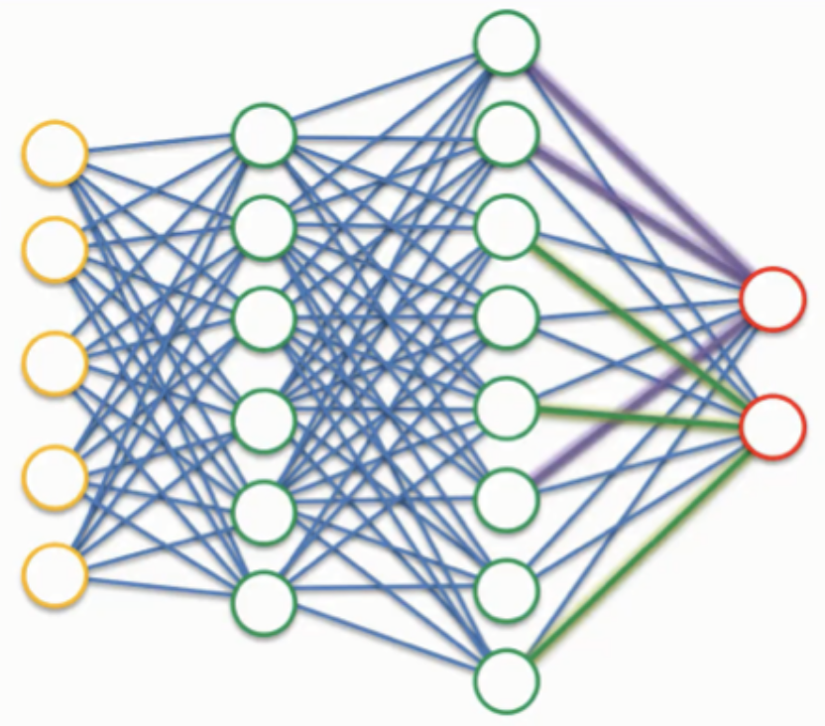
Other metrics
Sometimes the metric is obtained from the output of a classifier (for example SVM or neural network). In this case, there are two classes, ‘1’ for genuine (same person) and ‘0’ for impostor (different persons). Typically, the classifier has a score at the output that is compared with a threshold. If the score is greater than the threshold the classification is ‘1’, otherwise is ‘0’. The score can be used in this case as a similarity metric.
score
A
same: 0.95
different: 0.05
B
If image-A and image-B are from the same person the score s is high.
If image-A and image-B are from different persons the score s is low

