Slide 1
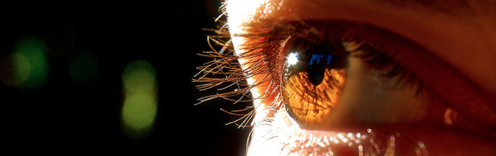
Reconocimiento de Patrones
Domingo Mery
Departmento de Ciencia de la Computación
Escuela de Ingeniería
Universidad Católica de Chile
Semestre 2018-1
Accuracy Estimation
[ Capítulo 5 ]

Slide 2
Estimating the Accuracy of a Classifier
[ AVAILABLE DATA ]
[ USED DATA ]
N
N₀
PAT05_AccuracyEstimation.pptx

Slide 3
Estimating the Accuracy of a Classifier
[ AVAILABLE DATA ]
[ USED DATA ]
TRAINING DATA
TESTING DATA
NOT
USED
Model
Parameters
MODEL LEARNING
CLASSIFICATION
(ideal)
(prediction)
Accuracy
Sampling: [ Random / Non random ]
[ Stratified / Non stratified ]
PAT05_AccuracyEstimation.pptx

Slide 4
Estimating the Accuracy of a Classifier
[ AVAILABLE DATA ]
[ USED DATA ]
η
TRAINING DATA
TESTING DATA
NOT
USED
PAT05_AccuracyEstimation.pptx

Slide 5
Estimating the Accuracy of a Classifier
η
PAT05_AccuracyEstimation.pptx

Slide 6
Estimating the Accuracy of a Classifier
HO: HOLD OUT
η
PAT05_AccuracyEstimation.pptx

Slide 7
Estimating the Accuracy of a Classifier
CV: CROSS VALIDATION – n folds
η₁
η₂
η₃
:
η_{n}
η = (η₁+ η₂+ η₃+ . . . + η_{n})/n
PAT05_AccuracyEstimation.pptx

Slide 8
Estimating the Accuracy of a Classifier
L1: LEAVE ONE OUT (N folds) (N is the number of used samples)
1
η₁
η₂
η₃
:
η_{N}
η = (η₁+ η₂+ η₃+ . . . + η_{N})/N
PAT05_AccuracyEstimation.pptx

Slide 9
Estimating the Accuracy of a Classifier
L1*: LEAVE ONE OUT (n folds) (with n<N)
1
η₁
η₂
η₃
:
η_{n}
η = (η₁+ η₂+ η₃+ . . . + η_{n})/n
PAT05_AccuracyEstimation.pptx

Slide 10
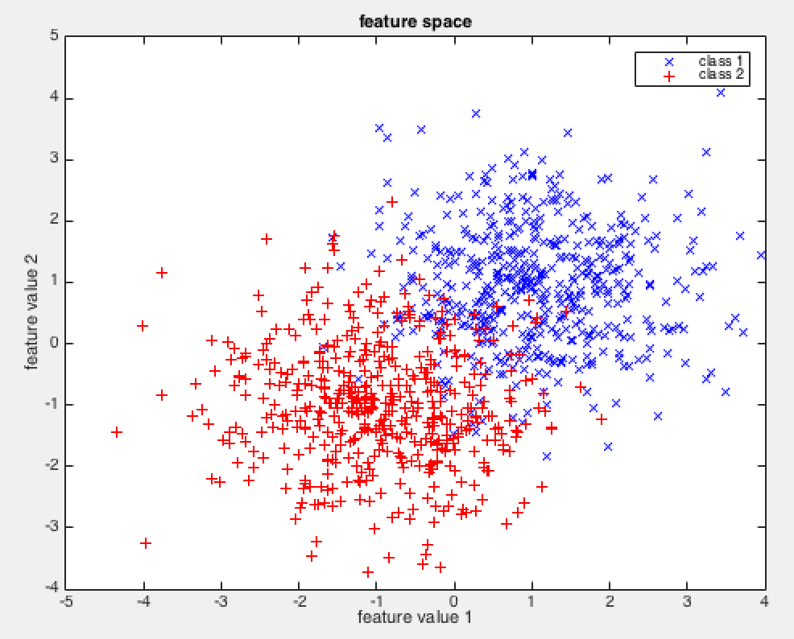
Estimating the Accuracy of a Classifier
[ SIMULATED DATA ]
2 Classes
2 Gaussian Distributions
μ₁ = (1,1)
μ₂ = (-1,-1)
σ₁ = σ₁ = 1
500 samples /class
N₀ = 1000 (available data)
[ CLASSIFIER ]
Linear SVM (LibSVM)
[ SAMPLING ]
Random / Stratified
1000 Repetitions!
PAT05_AccuracyEstimation.pptx

Slide 11
Method: Parameters N/N_{O} mean std min max
HO: 90%-10% : 1 : acc = 92.73 +/- 2.49 [ 83.00, 99.00 ]
HO: 80%-20% : 1 : acc = 92.66 +/- 1.69 [ 86.50, 97.50 ]
HO: 75%-25% : 1 : acc = 92.67 +/- 1.48 [ 87.60, 96.40 ]
HO: 67%-33% : 1 : acc = 92.66 +/- 1.24 [ 88.86, 96.69 ]
HO: 50%-50% : 1 : acc = 92.71 +/- 0.95 [ 90.00, 95.40 ]
HO: 90%-10% : 0.5 : acc = 92.52 +/- 3.73 [ 80.00,100.00 ]
HO: 80%-20% : 0.5 : acc = 92.48 +/- 2.47 [ 84.00, 99.00 ]
HO: 75%-25% : 0.5 : acc = 92.61 +/- 2.25 [ 83.87, 99.19 ]
HO: 67%-33% : 0.5 : acc = 92.60 +/- 1.92 [ 84.94, 98.80 ]
HO: 50%-50% : 0.5 : acc = 92.50 +/- 1.57 [ 87.20, 97.20 ]
HO: 90%-10% : 0.1 : acc = 91.97 +/- 8.55 [ 60.00,100.00 ]
HO: 80%-20% : 0.1 : acc = 92.37 +/- 6.03 [ 70.00,100.00 ]
HO: 75%-25% : 0.1 : acc = 92.01 +/- 5.34 [ 75.00,100.00 ]
HO: 67%-33% : 0.1 : acc = 91.84 +/- 4.72 [ 78.12,100.00 ]
HO: 50%-50% : 0.1 : acc = 91.67 +/- 3.98 [ 72.00,100.00 ]
CV: 5-fold : 1 : acc = 92.76 +/- 0.23 [ 92.00, 93.30 ]
CV: 10-fold : 1 : acc = 92.84 +/- 0.17 [ 92.00, 93.30 ]
CV: 5-fold x 20 : 1 : acc = 92.76 +/- 0.05 [ 92.61, 92.90 ]
CV: 5-fold x 10 : 1 : acc = 92.76 +/- 0.08 [ 92.54, 92.98 ]
CV: 5-fold x 5 : 0.5 : acc = 92.54 +/- 0.84 [ 89.60, 95.40 ]
CV: 10-fold : 0.5 : acc = 92.64 +/- 0.82 [ 89.20, 95.20 ]
CV: 5-fold x 20 : 0.5 : acc = 92.59 +/- 0.82 [ 89.90, 95.06 ]
CV: 5-fold x 10 : 0.5 : acc = 92.63 +/- 0.82 [ 89.88, 95.36 ]
CV: 5-fold : 0.1 : acc = 91.95 +/- 2.75 [ 81.00, 99.00 ]
CV: 10-fold : 0.1 : acc = 92.16 +/- 2.49 [ 81.00,100.00 ]
CV: 5-fold x 20 : 0.1 : acc = 92.03 +/- 2.49 [ 83.30, 98.90 ]
CV: 5-fold x 10 : 0.1 : acc = 92.06 +/- 2.42 [ 84.80, 98.60 ]
L1: : 1 : acc = 92.90 +/- 0.00 [ 92.90, 92.90 ]
L1: : 0.5 : acc = 92.63 +/- 0.84 [ 89.60, 95.20 ]
L1: : 0.1 : acc = 91.93 +/- 2.65 [ 83.00,100.00 ]
L1*: 200-fold : 1 : acc = 92.91 +/- 1.29 [ 88.50, 96.00 ]
L1*: 100-fold : 1 : acc = 92.86 +/- 1.82 [ 87.00, 98.00 ]
L1*: 50-fold : 1 : acc = 92.99 +/- 2.60 [ 83.00,100.00 ]
After 1000 Repetitions!
N = 1000 (available data)
N₀ used data
PAT05_AccuracyEstimation.pptx

