Slide 1
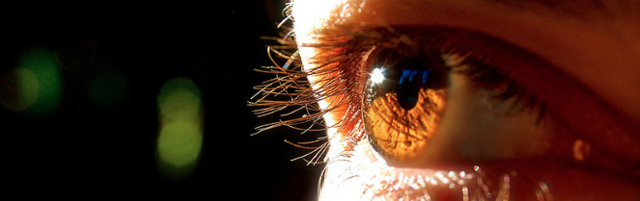
Reconocimiento de Patrones
Domingo Mery
Departmento de Ciencia de la Computación
Escuela de Ingeniería
Universidad Católica de Chile
Bag of Words
[ Capítulo 6 ]

Slide 2

PAT06_BoW.pptx

Slide 3
PAT06_BoW.pptx

Slide 4
descriptor
PAT06_BoW.pptx

Slide 5
10 | 30 | 11 | 12 | 13 | 29 | 22 | 12 | 13 | 30
descriptor
PAT06_BoW.pptx

Slide 6
10 | 30 | 11 | 12 | 13 | 29 | 22 | 12 | 13 | 30
10 | 10 | 12 | 34 | 12 | 10 | 12 | 34 | 12 | 9
12 | 29 | 11 | 10 | 12 | 10 | 12 | 34 | 12 | 14
3 | 10 | 12 | 34 | 12 | 10 | 12 | 34 | 12 | 14
12 | 12 | 3 | 10 | 12 | 12 | 3 | 10 | 12
12 | 10 | 12 | 34 | 12 | 10 | 12 | 34 | 12 | 14
11 | 10 | 12 | 34 | 12 | 10 | 12 | 34 | 12 | 14
12 | 29 | 11 | 10 | 12 | 10 | 12 | 34 | 12 | 14
3 | 10 | 12 | 34 | 12 | 12 | 12 | 3 | 10 | 12
12 | 12 | 3 | 10 | 12 | 12 | 12 | 3 | 10 | 12
10 | 10 | 12 | 34 | 12 | 10 | 12 | 34 | 12 | 14
10 | 10 | 12 | 34 | 12 | 10 | 12 | 34 | 12 | 9
12 | 29 | 11 | 10 | 12 | 10 | 12 | 34 | 12 | 14
3 | 10 | 12 | 34 | 12 | 10 | 12 | 34 | 12 | 14
12 | 12 | 3 | 10 | 12 | 12 | 3 | 10 | 12 | 15
12 | 10 | 12 | 34 | 12 | 10 | 12 | 34 | 12 | 14
11 | 10 | 12 | 34 | 12 | 10 | 12 | 34 | 12 | 14
12 | 29 | 11 | 10 | 12 | 10 | 12 | 34 | 12 | 14
3 | 10 | 12 | 34 | 12 | 12 | 12 | 3 | 10 | 12
12 | 12 | 3 | 10 | 12 | 12 | 12 | 3 | 10 | 12
10 | 10 | 12 | 34 | 12 | 10 | 12 | 34 | 12 | 14
12 | 12 | 3 | 10 | 12 | 12 | 3 | 10 | 12 | 17
description
PAT06_BoW.pptx

Slide 7
N
10 | 30 | 11 | 12 | 13 | 29 | 22 | 12 | 13 | 30
10 | 10 | 12 | 34 | 12 | 10 | 12 | 34 | 12 | 9
12 | 29 | 11 | 10 | 12 | 10 | 12 | 34 | 12 | 14
3 | 10 | 12 | 34 | 12 | 10 | 12 | 34 | 12 | 14
12 | 12 | 3 | 10 | 12 | 12 | 3 | 10 | 12
12 | 10 | 12 | 34 | 12 | 10 | 12 | 34 | 12 | 14
11 | 10 | 12 | 34 | 12 | 10 | 12 | 34 | 12 | 14
12 | 29 | 11 | 10 | 12 | 10 | 12 | 34 | 12 | 14
3 | 10 | 12 | 34 | 12 | 12 | 12 | 3 | 10 | 12
12 | 12 | 3 | 10 | 12 | 12 | 12 | 3 | 10 | 12
10 | 10 | 12 | 34 | 12 | 10 | 12 | 34 | 12 | 14
10 | 10 | 12 | 34 | 12 | 10 | 12 | 34 | 12 | 9
12 | 29 | 11 | 10 | 12 | 10 | 12 | 34 | 12 | 14
3 | 10 | 12 | 34 | 12 | 10 | 12 | 34 | 12 | 14
12 | 12 | 3 | 10 | 12 | 12 | 3 | 10 | 12 | 15
12 | 10 | 12 | 34 | 12 | 10 | 12 | 34 | 12 | 14
11 | 10 | 12 | 34 | 12 | 10 | 12 | 34 | 12 | 14
12 | 29 | 11 | 10 | 12 | 10 | 12 | 34 | 12 | 14
3 | 10 | 12 | 34 | 12 | 12 | 12 | 3 | 10 | 12
12 | 12 | 3 | 10 | 12 | 12 | 12 | 3 | 10 | 12
10 | 10 | 12 | 34 | 12 | 10 | 12 | 34 | 12 | 14
12 | 12 | 3 | 10 | 12 | 12 | 3 | 10 | 12 | 17
description
.
.
.
.
.
.
.
.
.
.
.
.
.
.
.
.
.
.
.
.
.
.
.
.
PAT06_BoW.pptx

Slide 8
.
.
.
.
.
.
.
.
.
.
.
.
.
.
.
.
.
.
.
.
.
.
.
.

Slide 9

.
.
.
.
.
.
.
.
.
.
.
.
.
.
.
.
.
.
.
.
.
.
.
.
.
.
.
.
.
.
.
.
.
.
.
.
.
.
.
.
.
.
.
.
.
PAT06_BoW.pptx

Slide 10

.
.
.
.
.
.
.
.
.
.
.
.
.
.
.
.
.
.
.
.
.
.
.
.
.
.
.
.
.
.
.
.
.
.
.
.
.
.
.
.
.
.
.
.
.
.
.
.
.
.
.
.
.
.
.
.
.
.
.
.
.
.
.
.
.
.
PAT06_BoW.pptx

Slide 11
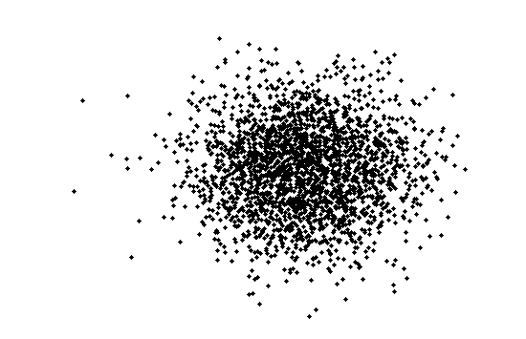
for all images
PAT06_BoW.pptx

Slide 12
Description of
all parts
PAT06_BoW.pptx

Slide 13
Description of
all parts
Description of
one part
PAT06_BoW.pptx

Slide 14
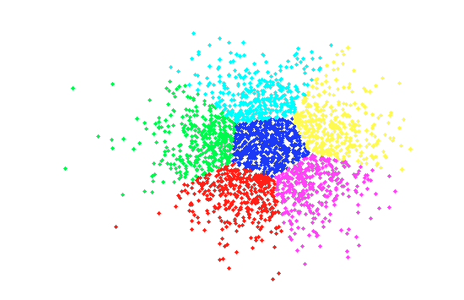
Visual Vocabulary
K-Means with K clusters
PAT06_BoW.pptx

Slide 15
Visual Vocabulary
K-Means with K clusters
PAT06_BoW.pptx

Slide 16
Visual Vocabulary
N
12 | 12 | 3 | 10 | 12 | 12 | 12 | 3 | 10 | 12
10 | 10 | 12 | 34 | 12 | 10 | 12 | 34 | 12 | 14
10 | 10 | 12 | 34 | 12 | 10 | 12 | 34 | 12 | 9
12 | 29 | 11 | 10 | 12 | 10 | 12 | 34 | 12 | 14
3 | 10 | 12 | 34 | 12 | 10 | 12 | 34 | 12 | 14
12 | 12 | 3 | 10 | 12 | 12 | 3 | 10 | 12 | 15
K
(coordinates of the centroids)
K-Means with K clusters
PAT06_BoW.pptx

Slide 17
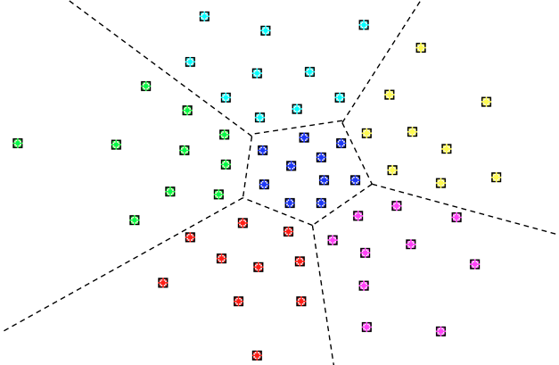
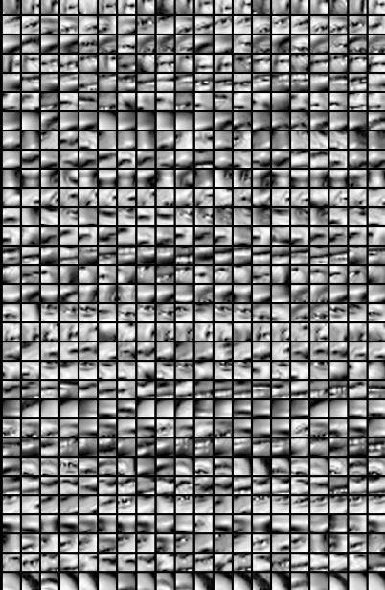

Example
John
K
PAT06_BoW.pptx

Slide 18






Example: More Dictionaries
Julio
Miguel
John
Ana
PAT06_BoW.pptx

Slide 19
Visual Vocabulary
N
12 | 12 | 3 | 10 | 12 | 12 | 12 | 3 | 10 | 12
10 | 10 | 12 | 34 | 12 | 10 | 12 | 34 | 12 | 14
10 | 10 | 12 | 34 | 12 | 10 | 12 | 34 | 12 | 9
12 | 29 | 11 | 10 | 12 | 10 | 12 | 34 | 12 | 14
3 | 10 | 12 | 34 | 12 | 10 | 12 | 34 | 12 | 14
12 | 12 | 3 | 10 | 12 | 12 | 3 | 10 | 12 | 15
1
2
3
4
5
6
K
2
3
1
4
5
6
Example with K=6 clusters
PAT06_BoW.pptx

Slide 20

descriptor
10 | 11 | 11 | 32 | 11 | 13 | 12 | 31 | 13 | 15
PAT06_BoW.pptx

Slide 21
10 | 11 | 11 | 32 | 11 | 13 | 12 | 31 | 13 | 15
PAT06_BoW.pptx

Slide 22
10 | 11 | 11 | 32 | 11 | 13 | 12 | 31 | 13 | 15
2
3
1
4
5
6
PAT06_BoW.pptx

Slide 23
10 | 11 | 11 | 32 | 11 | 13 | 12 | 31 | 13 | 15
2
3
1
4
5
6
PAT06_BoW.pptx

Slide 24
10 | 11 | 11 | 32 | 11 | 13 | 12 | 31 | 13 | 15
2
This part is represented by word 3
3
1
4
5
6
[ Encoding ]
PAT06_BoW.pptx

Slide 25
12 | 12 | 3 | 10 | 12 | 12 | 12 | 3 | 10 | 12
10 | 10 | 12 | 34 | 12 | 10 | 12 | 34 | 12 | 14
10 | 10 | 12 | 34 | 12 | 10 | 12 | 34 | 12 | 9
12 | 29 | 11 | 10 | 12 | 10 | 12 | 34 | 12 | 14
3 | 10 | 12 | 34 | 12 | 10 | 12 | 34 | 12 | 14
12 | 12 | 3 | 10 | 12 | 12 | 3 | 10 | 12 | 15
1
2
3
4
5
6
10 | 11 | 11 | 32 | 11 | 13 | 12 | 31 | 13 | 15
2
This part is represented by word 3
3
1
4
5
6
[ Encoding ]
PAT06_BoW.pptx

Slide 26
3
[ Encoding ]
PAT06_BoW.pptx

Slide 27
4
3
[ Encoding ]
PAT06_BoW.pptx

Slide 28
4
3
1
[ Encoding ]
PAT06_BoW.pptx

Slide 29
6
4
3
1
3
5
4
3
1
2
[ Encoding ]
PAT06_BoW.pptx

Slide 30
6
4
3
1
3
5
4
3
1
2
How many words ‘1’ are in this image?
PAT06_BoW.pptx

Slide 31
6
4
3
1
3
5
4
3
1
2
How many words ‘1’ are in this image?
Answer: 2
PAT06_BoW.pptx

Slide 32
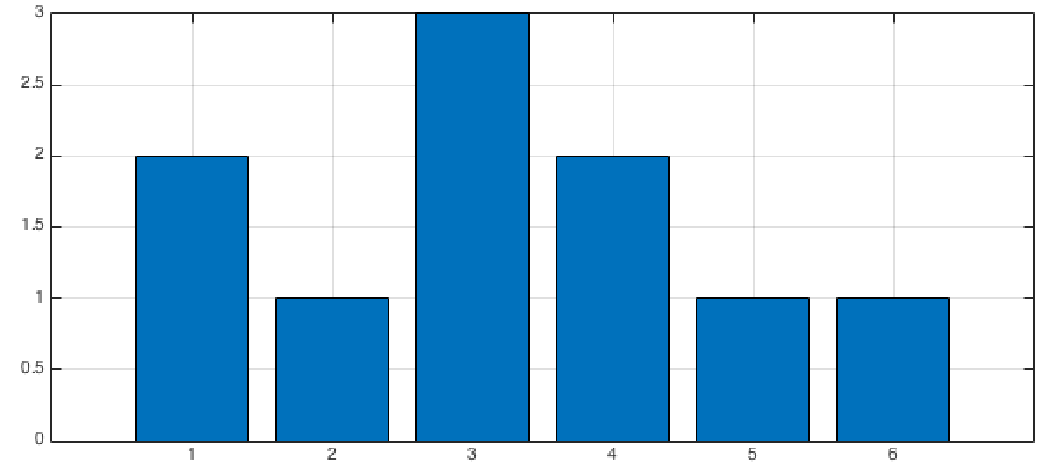
6
4
3
1
3
5
4
3
1
2
Histogram
PAT06_BoW.pptx

Slide 33
6
4
3
1
3
5
4
3
1
2
Histogram
PAT06_BoW.pptx

Slide 34

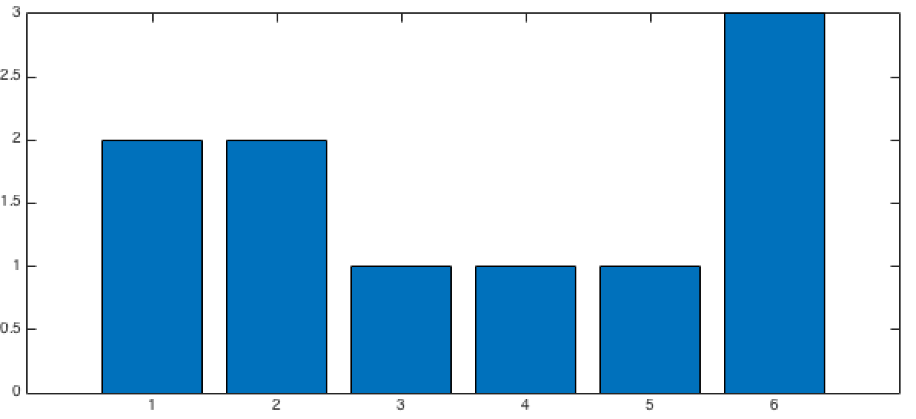
Histogram
different objects have different histograms
Histogram
PAT06_BoW.pptx

Slide 35

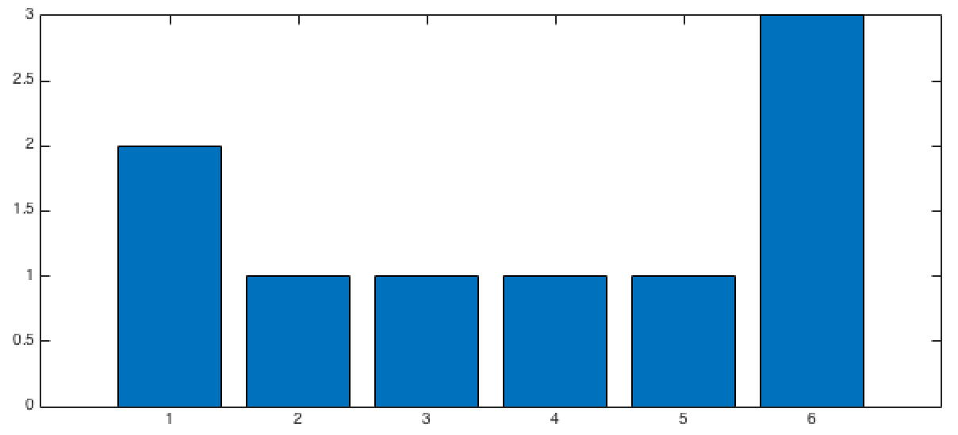
Histogram
Histogram
same objects have similar histograms
Histogram
PAT06_BoW.pptx

Slide 36
Summary
PART 1: VISUAL VOCABULARY
Collect representative images
Extract descriptors
K-means (Visual Vocabulary of K words)
PAT06_BoW.pptx

Slide 37
Summary
PART 1: VISUAL VOCABULARY
Collect representative images
Extract descriptors
K-means (Visual Vocabulary of K words)
PART 2: CLASSIFIER DESIGN
1. For each image of the training set
- Extract descriptors and encode them using the Visual Vocabulary
- Build the histogram
Train a classifier using the new representation (histogram) of each image
Repeat for testing set and test the classifier
PAT06_BoW.pptx

