Slide 1
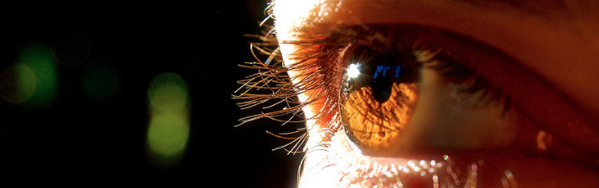
Reconocimiento de Patrones
Domingo Mery
Departmento de Ciencia de la Computación
Escuela de Ingeniería
Universidad Católica de Chile
Clustering: Mean Shift
[ Capítulo 6 ]

Slide 2
PAT06_MeanShift.pptx

Slide 3
1. Select a point
PAT06_MeanShift.pptx

Slide 4
1. Select a point
2. Compute neighborhood
PAT06_MeanShift.pptx

Slide 5
1. Select a point
2. Compute neighborhood
3. Compute centroid
PAT06_MeanShift.pptx

Slide 6
1. Select a point
2. Compute neighborhood
3. Compute centroid
4. Compute mean shift
PAT06_MeanShift.pptx

Slide 7
1. Select a point
2. Compute neighborhood
3. Compute centroid
4. Compute mean shift
5. Update neighborhood
PAT06_MeanShift.pptx

Slide 8
1. Select a point
2. Compute neighborhood
3. Compute centroid
4. Compute mean shift
5. Update neighborhood
PAT06_MeanShift.pptx

Slide 9
1. Select a point
2. Compute neighborhood
3. Compute centroid
4. Compute mean shift
5. Update neighborhood
:
repeat until convergence
PAT06_MeanShift.pptx

Slide 10
1. Select a point
2. Compute neighborhood
3. Compute centroid
4. Compute mean shift
5. Update neighborhood
:
repeat until convergence
PAT06_MeanShift.pptx

Slide 11
1. Select a point
2. Compute neighborhood
3. Compute centroid
4. Compute mean shift
5. Update neighborhood
:
repeat until convergence
PAT06_MeanShift.pptx

Slide 12
1. Select a point
2. Compute neighborhood
3. Compute centroid
4. Compute mean shift
5. Update neighborhood
:
repeat until convergence
we detected a mode
PAT06_MeanShift.pptx

Slide 13
1. Select a point
2. Compute neighborhood
3. Compute centroid
4. Compute mean shift
5. Update neighborhood
:
repeat until convergence
we detected a mode
PAT06_MeanShift.pptx

Slide 14
A new example:
1. Select a point
2. Compute neighborhood
3. Compute centroid
4. Compute mean shift
5. Update neighborhood
:
repeat until convergence
PAT06_MeanShift.pptx

Slide 15
A new example:
1. Select a point
2. Compute neighborhood
3. Compute centroid
4. Compute mean shift
5. Update neighborhood
:
repeat until convergence
PAT06_MeanShift.pptx

Slide 16
A new example:
1. Select a point
2. Compute neighborhood
3. Compute centroid
4. Compute mean shift
5. Update neighborhood
:
repeat until convergence
PAT06_MeanShift.pptx

Slide 17
A new example:
1. Select a point
2. Compute neighborhood
3. Compute centroid
4. Compute mean shift
5. Update neighborhood
:
repeat until convergence
PAT06_MeanShift.pptx

Slide 18
A new example:
1. Select a point
2. Compute neighborhood
3. Compute centroid
4. Compute mean shift
5. Update neighborhood
:
repeat until convergence
PAT06_MeanShift.pptx

Slide 19
A new example:
1. Select a point
2. Compute neighborhood
3. Compute centroid
4. Compute mean shift
5. Update neighborhood
:
repeat until convergence
PAT06_MeanShift.pptx

Slide 20
A new example:
1. Select a point
2. Compute neighborhood
3. Compute centroid
4. Compute mean shift
5. Update neighborhood
:
repeat until convergence
PAT06_MeanShift.pptx

Slide 21
A new example:
1. Select a point
2. Compute neighborhood
3. Compute centroid
4. Compute mean shift
5. Update neighborhood
:
repeat until convergence
PAT06_MeanShift.pptx

Slide 22
A new example:
1. Select a point
2. Compute neighborhood
3. Compute centroid
4. Compute mean shift
5. Update neighborhood
:
repeat until convergence
we detected a mode
PAT06_MeanShift.pptx

Slide 23
Mean Shift Algorithm
For each sample point compute its mean shift mode
Cluster the sample points that have the same mean shift mode
PAT06_MeanShift.pptx

Slide 24
PAT06_MeanShift.pptx

Slide 25
PAT06_MeanShift.pptx

Slide 26
PAT06_MeanShift.pptx

Slide 27
Mean Shift Algorithm
For each sample point compute its mean shift mode
Cluster the sample points that have the same mean shift mode
Variation
When compute the centroid weight the distances according a kernel function (eg. Gaussian)
PAT06_MeanShift.pptx

Slide 28
Example
Comaniciu, D., & Meer, P. (2002). Mean shift: A robust approach toward feature space analysis. IEEE Transactions on pattern analysis and machine intelligence, 24(5), 603-619. [ PDF ]
PAT06_MeanShift.pptx

Slide 29
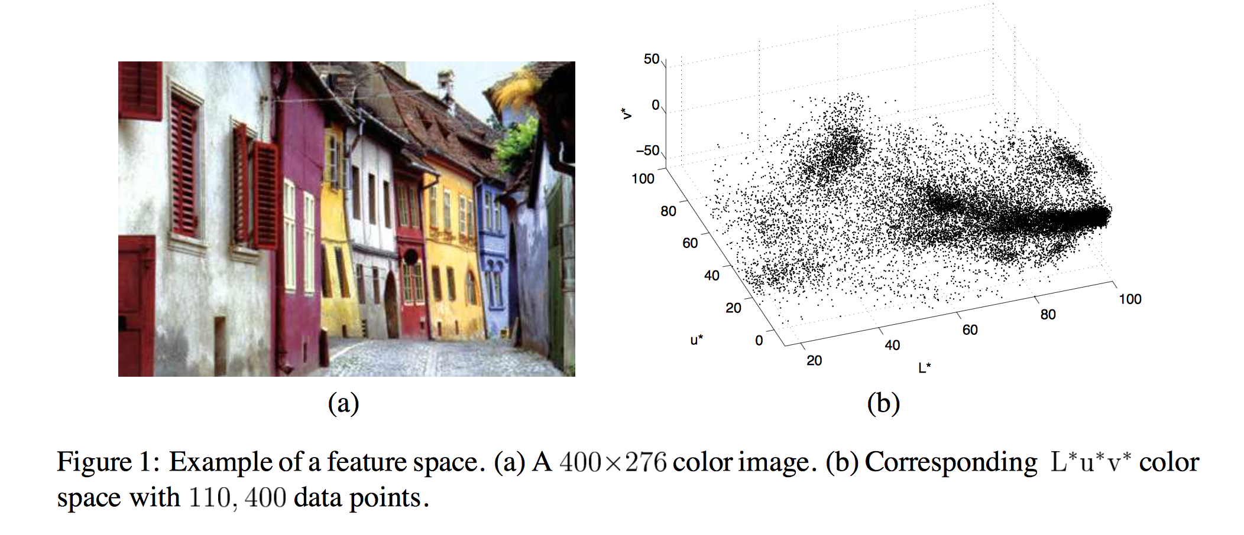
PAT06_MeanShift.pptx

Slide 30
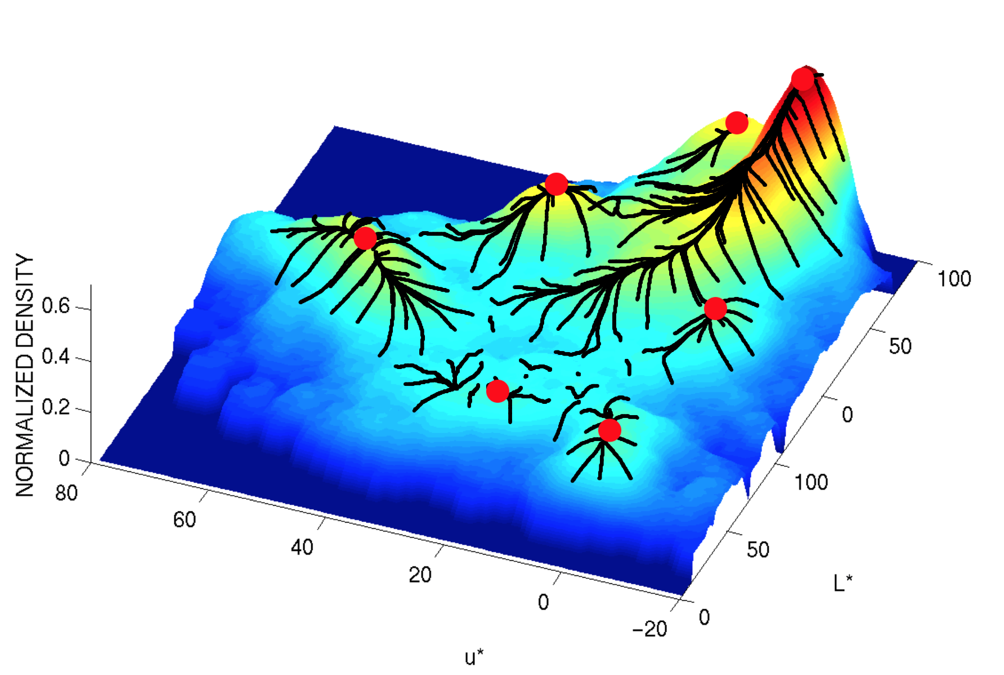
PAT06_MeanShift.pptx

Slide 31
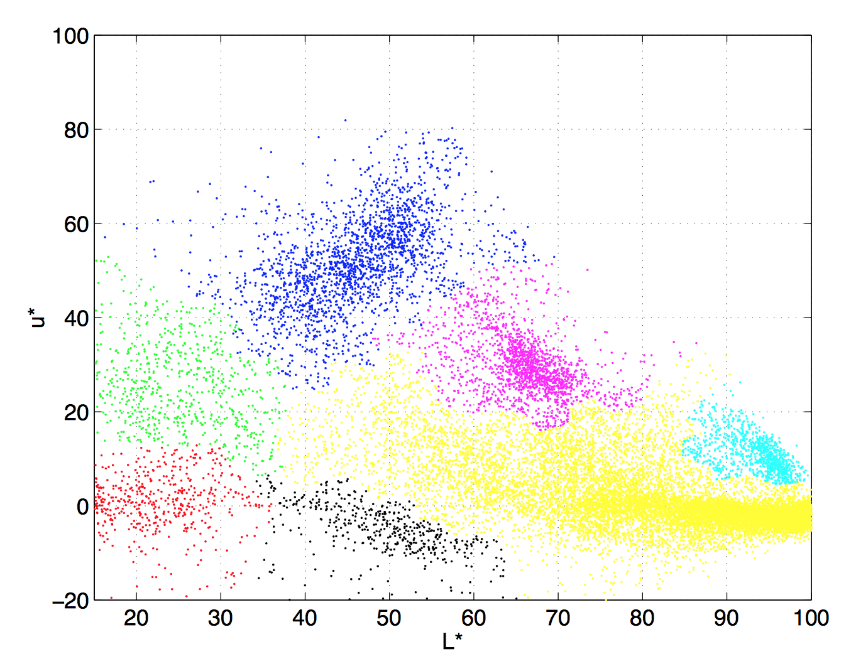
PAT06_MeanShift.pptx

Slide 32
In Balu
Use function Bct_meanshift:
[X,d] = Bds_gaussgen([10 1;1 10;15 15],4*ones(3,3),100*ones(3,1)); figure(1) Bio_plotfeatures(X,d);
ds = Bct_meanshift(X,2); figure(2) Bio_plotfeatures(X,ds);
PAT06_MeanShift.pptx

Slide 33
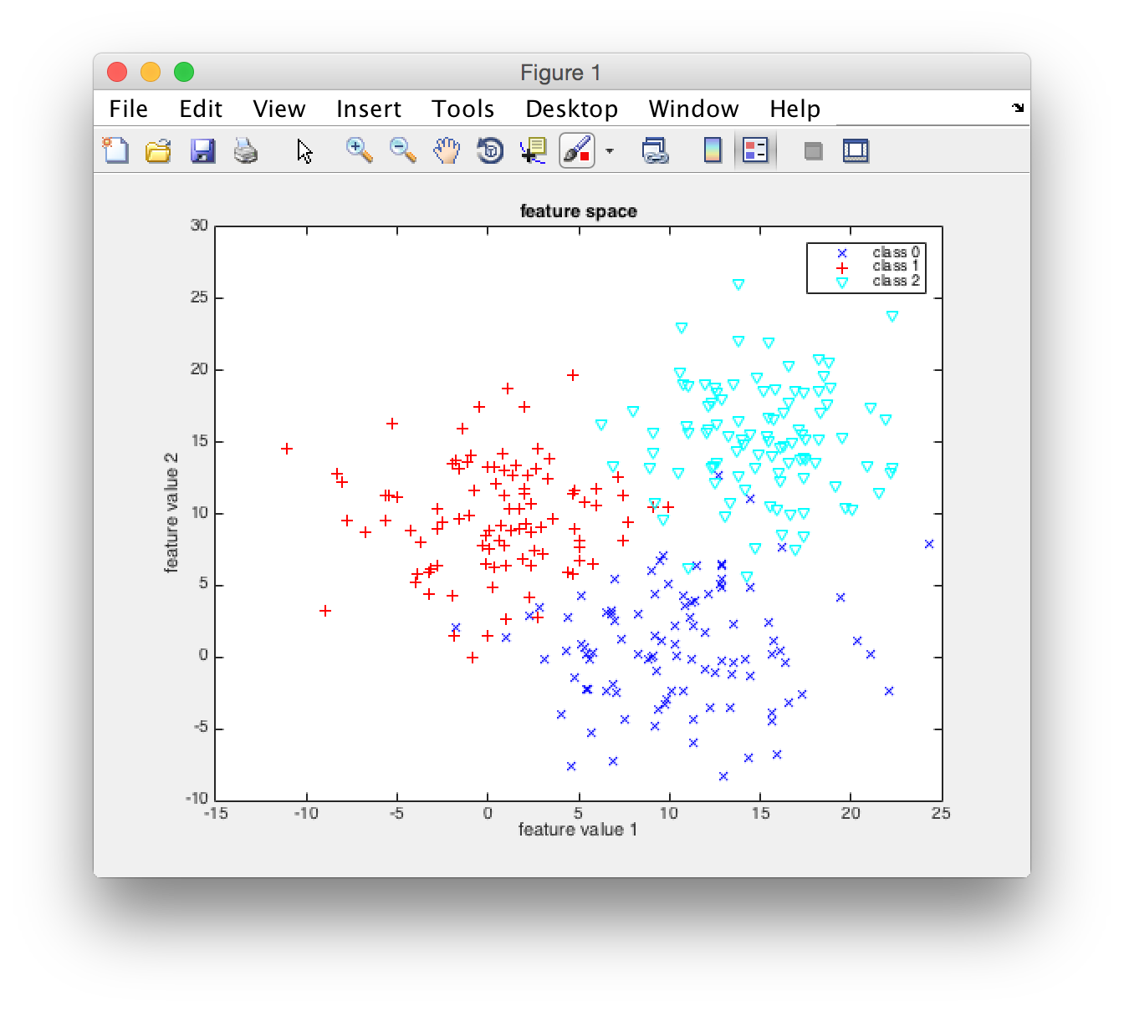
Original Samples
PAT06_MeanShift.pptx

Slide 34
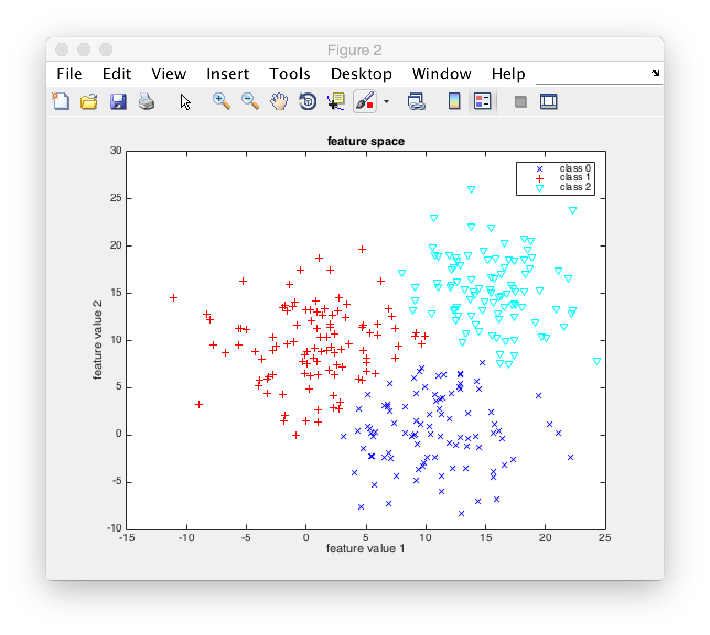
Clustered Samples
PAT06_MeanShift.pptx

Slide 35
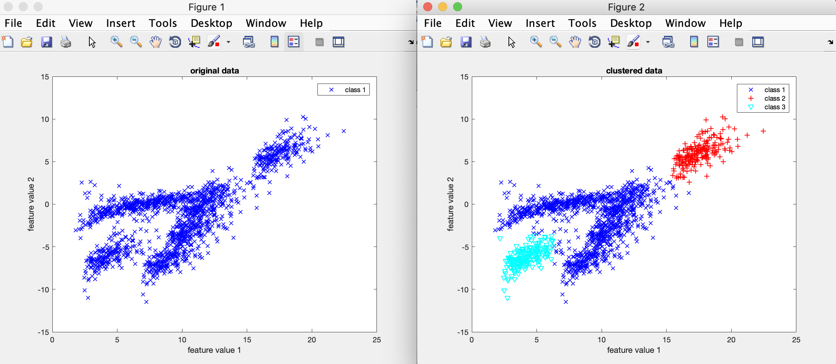
INPUT OUTPUT
PAT06_MeanShift.pptx

