Slide 1
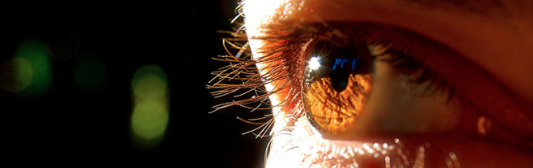
Reconocimiento de Patrones
Domingo Mery
Departmento de Ciencia de la Computación
Escuela de Ingeniería
Universidad Católica de Chile
Texturas de Haralick
[ Capítulo 2 ]

Slide 2
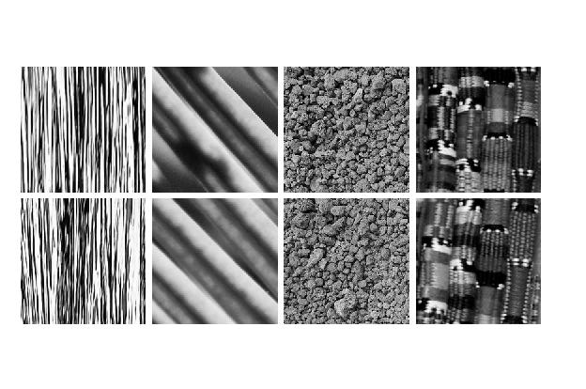
Different Textures ➔
Same Textures ➔

Slide 3
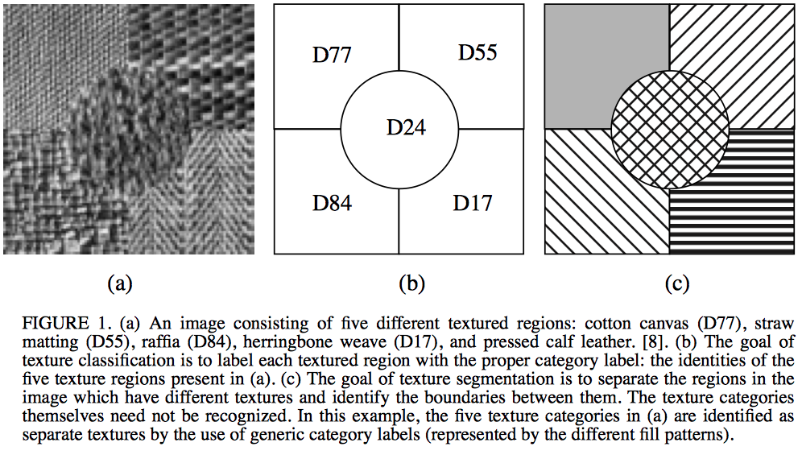
What are texture images?
The Handbook of Pattern Recognition and Computer Vision (2nd Edition), by C. H. Chen, L. F. Pau, P. S. P. Wang (eds.), pp. 207-248, World Scientific Publishing Co., 1998.

Slide 4
Co-occurrence matrices
They measure how is the distribution of co-occurring of pairs of pixels in an image.
Haralick, R.M., K. Shanmugan, and I. Dinstein (1973): Textural Features for Image Classification, IEEE Transactions on Systems, Man, and Cybernetics, SMC-3:610-621.

Slide 5
Co-occurrence matrices
They measure how is the distribution of co-occurring of pairs of pixels in an image.
Example:
Given an imagen I, the co-ccurrence matrix P₁₀ is computed as follows:
1 0 1 2
1 1 0 0
0 2 1 0
0 2 0 2
I =

Slide 6
Co-occurrence matrices
They measure how is the distribution of co-occurring of pairs of pixels in an image.
Example:
Given an imagen I, the co-ccurrence matrix P₁₀ is computed as follows:
10 indicates 1 ⬇ and 0 ➔:
1 0 1 2
1 1 0 0
0 2 1 0
0 2 0 2
I =
first pixel
second pixel
v
second pixel is located 1 pixel down,
and 0 pixels to the right of the first pixel.

Slide 7
Co-occurrence matrices
They measure how is the distribution of co-occurring of pairs of pixels in an image.
Example:
Given an imagen I, the co-ccurrence matrix P₁₀ is computed as follows:
10 indicates 1 ⬇ and 0 ➔:
1 0 1 2
1 1 0 0
0 2 1 0
0 2 0 2
I =
first pixel
second pixel
v
second pixel is located 1 pixel down,
and 0 pixels to the right of the first pixel.
For direction 10, there are 12 possible pairs
pixels that can be analized.

Slide 8
Co-occurrence matrices
They measure how is the distribution of co-occurring of pairs of pixels in an image.
Example:
Given an imagen I, the co-ccurrence matrix P₁₀ is computed as follows:
value of the
second pixel
1 0 1 2
1 1 0 0
0 2 1 0
0 2 0 2
0 1 2
0 ? ? ?
1 ? ? ?
2 ? ? ?
I =
P₁₀ =
value of the
first pixel

Slide 9
Co-occurrence matrices
They measure how is the distribution of co-occurring of pairs of pixels in an image.
Example:
Given an imagen I, the co-ccurrence matrix P₁₀ is computed as follows:
value of the
second pixel
1 0 1 2
1 1 0 0
0 2 1 0
0 2 0 2
0 1 2
0 ? ? ?
1 ? ? ?
2 ? ? ?
I =
1
12
P₁₀ =
value of the
first pixel
normalization

Slide 10
Co-occurrence matrices
They measure how is the distribution of co-occurring of pairs of pixels in an image.
Example:
Given an imagen I, the co-ccurrence matrix P₁₀ is computed as follows:
value of the
second pixel
1 0 1 2
1 1 0 0
0 2 1 0
0 2 0 2
0 1 2
0 ? ? ?
1 ? ? ?
2 ? ? ?
I =
1
12
P₁₀ =
value of the
first pixel
¿how many there are in image I ?

Slide 11
Co-occurrence matrices
They measure how is the distribution of co-occurring of pairs of pixels in an image.
Example:
Given an imagen I, the co-ccurrence matrix P₁₀ is computed as follows:
value of the
second pixel
1 0 1 2
1 1 0 0
0 2 1 0
0 2 0 2
0 1 2
0 ? ? ?
1 ? ? ?
2 ? ? ?
I =
1
12
P₁₀ =
value of the
first pixel
0
0
¿how many there are in image I ?

Slide 12
Co-occurrence matrices
They measure how is the distribution of co-occurring of pairs of pixels in an image.
Example:
Given an imagen I, the co-ccurrence matrix P₁₀ is computed as follows:
value of the
second pixel
1 0 1 2
1 1 0 0
0 2 1 0
0 2 0 2
0 1 2
0 2 ? ?
1 ? ? ?
2 ? ? ?
I =
1
12
P₁₀ =
value of the
first pixel
0
0
¿how many there are in image I ?

Slide 13
Co-occurrence matrices
They measure how is the distribution of co-occurring of pairs of pixels in an image.
Example:
Given an imagen I, the co-ccurrence matrix P₁₀ is computed as follows:
value of the
second pixel
1 0 1 2
1 1 0 0
0 2 1 0
0 2 0 2
0 1 2
0 2 ? ?
1 ? ? ?
2 ? ? ?
I =
1
12
P₁₀ =
value of the
first pixel
0
1
¿how many there are in image I ?

Slide 14
Co-occurrence matrices
They measure how is the distribution of co-occurring of pairs of pixels in an image.
Example:
Given an imagen I, the co-ccurrence matrix P₁₀ is computed as follows:
value of the
second pixel
1 0 1 2
1 1 0 0
0 2 1 0
0 2 0 2
0 1 2
0 2 2 ?
1 ? ? ?
2 ? ? ?
I =
1
12
P₁₀ =
value of the
first pixel
0
1
¿how many there are in image I ?

Slide 15
Co-occurrence matrices
They measure how is the distribution of co-occurring of pairs of pixels in an image.
Example:
Given an imagen I, the co-ccurrence matrix P₁₀ is computed as follows:
value of the
second pixel
1 0 1 2
1 1 0 0
0 2 1 0
0 2 0 2
0 1 2
0 2 2 1
1 ? ? ?
2 ? ? ?
I =
1
12
P₁₀ =
value of the
first pixel
0
2
¿how many there are in image I ?

Slide 16
Co-occurrence matrices
They measure how is the distribution of co-occurring of pairs of pixels in an image.
Example:
Given an imagen I, the co-ccurrence matrix P₁₀ is computed as follows:
value of the
second pixel
1 0 1 2
1 1 0 0
0 2 1 0
0 2 0 2
0 1 2
0 2 2 1
1 3 ? ?
2 ? ? ?
I =
1
12
P₁₀ =
value of the
first pixel
1
0
¿how many there are in image I ?

Slide 17
Co-occurrence matrices
They measure how is the distribution of co-occurring of pairs of pixels in an image.
Example:
Given an imagen I, the co-ccurrence matrix P₁₀ is computed as follows:
value of the
second pixel
1 0 1 2
1 1 0 0
0 2 1 0
0 2 0 2
0 1 2
0 2 2 1
1 3 1 ?
2 ? ? ?
I =
1
12
P₁₀ =
value of the
first pixel
1
1
¿how many there are in image I ?

Slide 18
Co-occurrence matrices
They measure how is the distribution of co-occurring of pairs of pixels in an image.
Example:
Given an imagen I, the co-ccurrence matrix P₁₀ is computed as follows:
value of the
second pixel
1 0 1 2
1 1 0 0
0 2 1 0
0 2 0 2
0 1 2
0 2 2 1
1 3 1 1
2 ? ? ?
I =
1
12
P₁₀ =
value of the
first pixel
1
2
¿how many there are in image I ?

Slide 19
Co-occurrence matrices
They measure how is the distribution of co-occurring of pairs of pixels in an image.
Example:
Given an imagen I, the co-ccurrence matrix P₁₀ is computed as follows:
value of the
second pixel
1 0 1 2
1 1 0 0
0 2 1 0
0 2 0 2
0 1 2
0 2 2 1
1 3 1 1
2 1 ? ?
I =
1
12
P₁₀ =
value of the
first pixel
2
0
¿how many there are in image I ?

Slide 20
Co-occurrence matrices
They measure how is the distribution of co-occurring of pairs of pixels in an image.
Example:
Given an imagen I, the co-ccurrence matrix P₁₀ is computed as follows:
value of the
second pixel
1 0 1 2
1 1 0 0
0 2 1 0
0 2 0 2
0 1 2
0 2 2 1
1 3 1 1
2 1 0 ?
I =
1
12
P₁₀ =
value of the
first pixel
2
1
¿how many there are in image I ?

Slide 21
Co-occurrence matrices
They measure how is the distribution of co-occurring of pairs of pixels in an image.
Example:
Given an imagen I, the co-ccurrence matrix P₁₀ is computed as follows:
value of the
second pixel
1 0 1 2
1 1 0 0
0 2 1 0
0 2 0 2
0 1 2
0 2 2 1
1 3 1 1
2 1 0 1
I =
1
12
P₁₀ =
value of the
first pixel
2
2
¿how many there are in image I ?

Slide 22
Co-occurrence matrices
They measure how is the distribution of co-occurring of pairs of pixels in an image.
Example:
Given an imagen I, the co-ccurrence matrix P₁₀ is:
1 0 1 2
1 1 0 0
0 2 1 0
0 2 0 2
0 1 2
0 2 2 1
1 3 1 1
2 1 0 1
I =
1
12
P₁₀ =

Slide 23
Co-occurrence matrices
They measure how is the distribution of co-occurring of pairs of pixels in an image.
Example:
Given an imagen I, the co-ccurrence matrix P₁₁ is:
1 0 1 2
1 1 0 0
0 2 1 0
0 2 0 2
? ? ?
? ? ?
? ? ?
I =
1
?
P₁₁ =
v

Slide 24
Co-occurrence matrices
They measure how is the distribution of co-occurring of pairs of pixels in an image.
Example:
Given an imagen I, the co-ccurrence matrix P₁₁ is:
1 0 1 2
1 1 0 0
0 2 1 0
0 2 0 2
2 0 1
1 2 2
1 0 0
I =
1
9
P₁₁ =
v

Slide 25
Definition of the Co-ocurrence Matrix
Vector v
l
v
k

Slide 26
What happens if
the diagonal of the co-occurrence matrix is high ?
That means, that in the selected direction the pixel values do not change significantly.

Slide 27
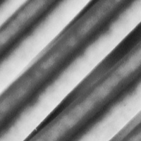
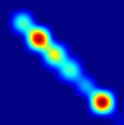
I
In this direction the pixel values do not change significantly.
v
P_{v}

Slide 28
What happens if
the diagonal of the co-occurrence matrix is low?
That means, that in the selected direction the pixel values do change significantly.

Slide 29
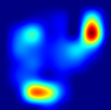
I
In this direction the pixel values do change significantly from low to high and from high to low.
v
P_{v}

Slide 30
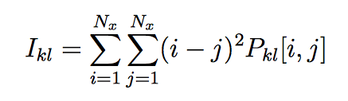

(i-j)²
Contrast
j
i
i
j

Slide 31
I
In this direction the pixel values do not change significantly.
v
(i-j)²
i
j
P_{v} (i - j)²
Contrast
= Σ
x
= low

Slide 32
I
In this direction the pixel values do change significantly from low to high and from high to low.
v
(i-j)²
i
j
P_{v} (i - j)²
Contrast
= Σ
x
= high

Slide 33
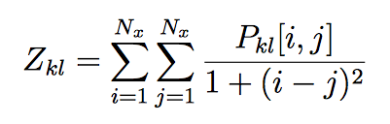
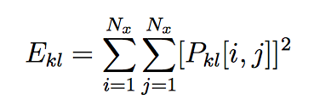
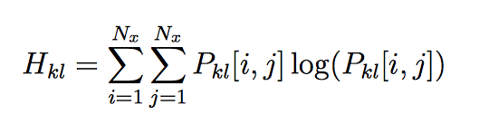
Features based on Co-occurrence Matrix
Contrast
Moment of
inverse difference
Energy
Entropy

