Slide 1
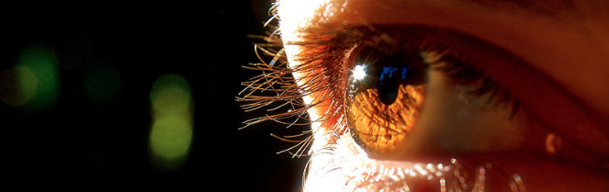
Reconocimiento de Patrones
Domingo Mery
Departmento de Ciencia de la Computación
Escuela de Ingeniería
Universidad Católica de Chile
Carácterísticas de Intensidad
[ Capítulo 2 ]

Slide 2
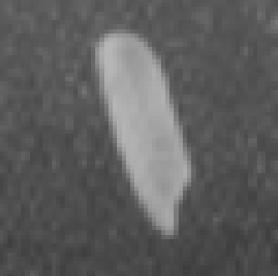
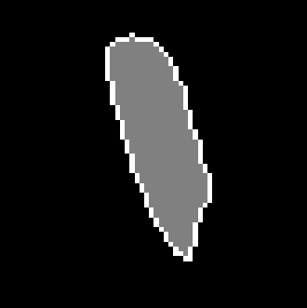
a) Grayscale image b) Segmentation c) 3D representation of a)
There are two categories of features: Geometric Features and
Intensity Features
Geometric Features give information about location, orientation, shape and size.
Intensity Features give information about how are the grayvalues.

Slide 3
Intensity Features

Slide 4
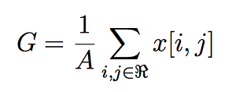
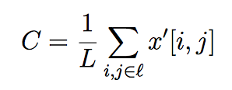
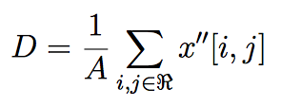
x
x
i
j
Average
Mean gradient
Mean 2nd gradient
Standard deviation, etc.

Slide 5
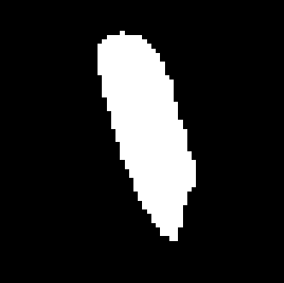

Contrast Features
x
e
x
i
j
e

Slide 6
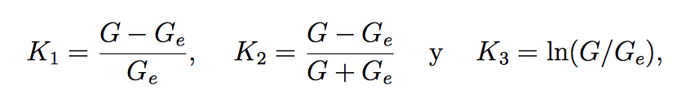
Contrast Features
x
e
x
i
j
Contrast
e
e
e

Slide 7
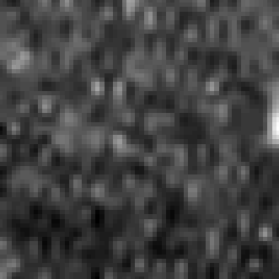


Contrast Features
I R Re
I = imread('onerice.bmp');
R = I>120;
J = imdilate(R,ones(11,11));
Re = and(not(R),J);
i = find(R==1);
ie = find(Re==1);
G = mean(I(i));
Ge = mean(I(ie));
K1 = abs(G-Ge)/Ge % 0.85 0.0051
K2 = abs(G-Ge)/(G+Ge) % 0.30 0.0025
K3 = log(G/Ge) % 0.62 0.0051

