Slide 1
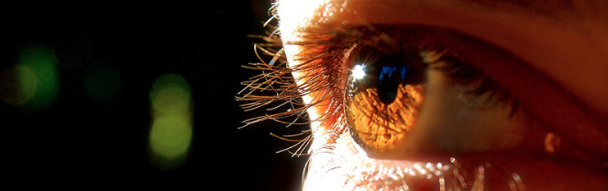
Visión por Computador
Domingo Mery
Departmento de Ciencia de la Computación
Escuela de Ingeniería
Universidad Católica de Chile
3D Transformations

Slide 2
[ 3D Transformation ]
M
M = [ X Y Z 1 ]^{T}
Z
Y
X

Slide 3
[ 3D Transformation ]
Z
Z'
M = [ X Y Z 1 ]^{T}
M
M’ = [ X’ Y’ Z’ 1 ]^{T}
Y'
Y
X'
X

Slide 4
[ 3D Transformation ]
Z'
M
ω_{Z}
Z
ω_{Y}
Y'
t
ω_{X}
Y
X'
X
t=(t_{X}, t_{Y}, t_{Z}): Translation
ω_{X}, ω_{Y}, ω_{Z}: Rotation

Slide 5
[ 3D Transformation ]
3D Translation:
Z'
M
Z
(X',Y',Z')
Y'
t
Y
X'
X

Slide 6
[ 3D Transformation ]
3D Rotation:
Z'
M
ω_{Y}
Z
ω_{Z}
Y'
t
ω_{X}
Y
X'
X

Slide 7

[ 3D Transformation ]
Axis Z Rotation:
Y'
Y
X
ω_{Z}
.
Z'
Z
X’

Slide 8

[ 3D Transformation ]
Axis Y Rotation:
X'
X
Z
ω_{Y}
.
Y'
Y
Z'

Slide 9

[ 3D Transformation ]
Axis X Rotation :
Z'
Z
Y
ω_{X}
.
X'
X
Y'

Slide 10
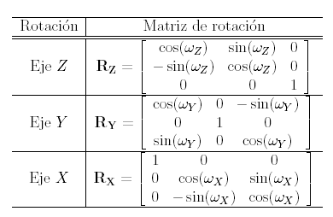
[ 3D Transformation ]
Y'
X'
Z'
Y
X
Z
X
Z
Y
ω_{Z}
ω_{Y}
ω_{X}
.
.
.
Z'
Z
X’
Y'
Y
Z'
X'
X
Y'

Slide 11
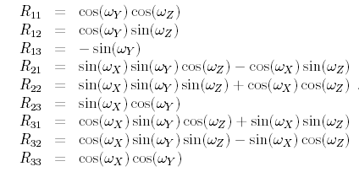

[ 3D Transformation ]

Slide 12
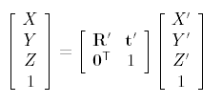
[ 3D Transformation ]

Slide 13
DEMO in MATLAB
CV02_3DPyramid.m

