Slide 1
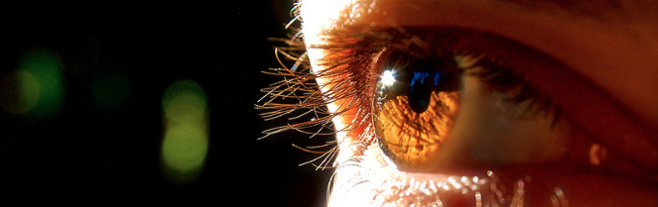
Visión por Computador
Domingo Mery
Departmento de Ciencia de la Computación
Escuela de Ingeniería
Universidad Católica de Chile
Transformation 3D➔2D

Slide 2
[ Perspective Projection ]
x
X
f
y
Z
m
Y
(x,y)
M
X
Z
C
(X,Y,Z)
x
Y
Z
Y
X
f
y
x
y

Slide 3
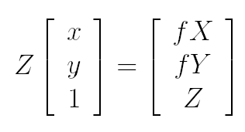
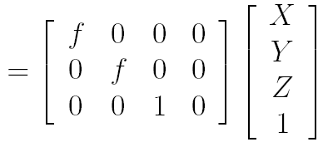

[ Perspective Projection ]
Z
Y
X
Z x = f X
f
y
x
Z y = f Y
m
is proportional to
P
*
M

Slide 4
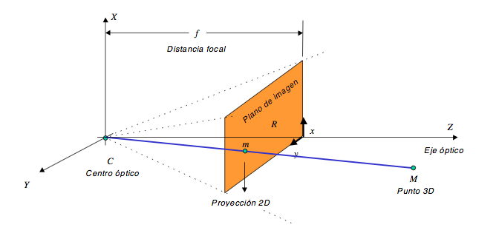
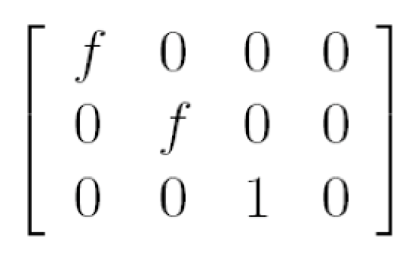
focal distance
Projection plane
optical axis
optical center
2D projection
3D point
Matrix P = ?

Slide 5
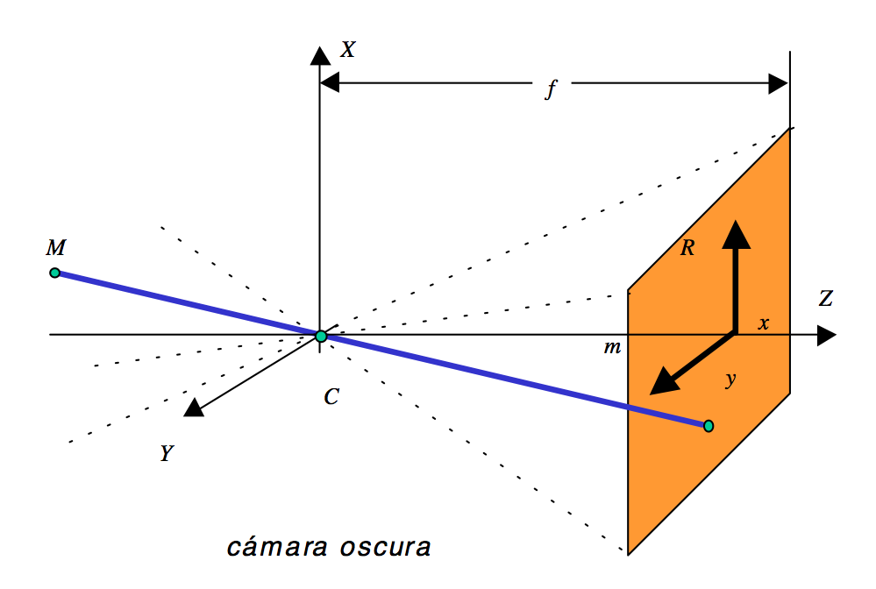
-
-
Matrix P = ?

Slide 6
[ Perspective Projection ]
Now, M is given in a new coordinate system: (X',Y',Z’)
x
X
f
y
m
Z'
M
(x,y)
Y'
(X',Y',Z')
Z
C
x
X'
Y
y
However, M was given in (X,Y,Z) coordinate system

Slide 7
[ 3D Transformation ]
3D Rotation:
Z'
M
ω_{Y}
Z
ω_{Z}
Y'
t
ω_{X}
Y
X'
X

Slide 8

[ 3D Transformation ]
Axis Z Rotation:
Y'
Y
X
ω_{Z}
.
Z'
Z
X’

Slide 9

[ 3D Transformation ]
Axis Y Rotation:
X'
X
Z
ω_{Y}
.
Y'
Y
Z'

Slide 10

[ 3D Transformation ]
Axis X Rotation :
Z'
Z
Y
ω_{X}
.
X'
X
Y'

Slide 11
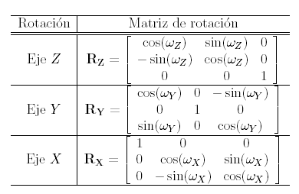
[ 3D Transformation ]
Y'
X'
Z'
Y
X
Z
X
Z
Y
ω_{Z}
ω_{Y}
ω_{X}
.
.
.
Z'
Z
X’
Y'
Y
Z'
X'
X
Y'

Slide 12
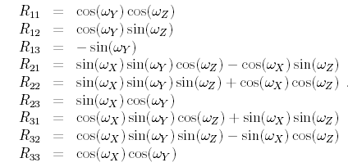

[ 3D Transformation ]

Slide 13
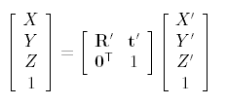
[ 3D Transformation ]

Slide 14
[ Perspective Projection ]
'
'

Slide 15
[ Perspective Projection ]
Now, m is given in a new coordinate system: (u,v)
x
X
f
v
y
m
Z'
M
Y'
(u,v)
(X',Y',Z')
Z
C
u
x
X'
Y
?
y

Slide 16
[ Perspective Projection ]
Now, m is given in a new coordinate system: (u,v)
x
X
f
v
y
m
Z'
M
Y'
(X',Y',Z')
Z
C
u
x
X'
Y
y

Slide 17
[ Perspective Projection ]
Now, m is given in a new coordinate system: (u,v)
f
v
m
Y
Z'
M
Y'
(u,v)
y
(X',Y',Z')
Z
C
u
X'
x
X

Slide 18
[ Perspective Projection ]
v
y
Between (x,y) and (u,v) there is no rotation.
u
x
Is this OK?
No, because in a camera system (x,y) is given in mm or inches and (u,v) in pixels.

Slide 19
[ Perspective Projection ]
v
y
Between (x,y) and (u,v) there is no rotation.
There is a scale factor in each direction.
u
x
Is this OK?
No, because sometimes the angle between u and v is not 90, it could be for example 89.99.

Slide 20
[ Perspective Projection ]
v
y
Between (x,y) and (u,v) there is no rotation.
There is a scale factor in each direction.
u
x
Is this OK?
No, because sometimes the angle between u and v is not 90, it could be for example 89.99.

Slide 21
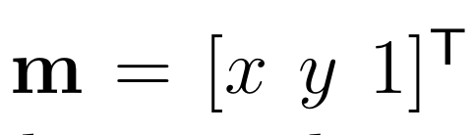
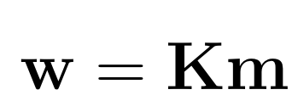
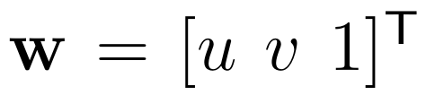
[ Perspective Projection ]
v
y
Between (x,y) and (u,v) there is no rotation.
There is a scale factor in each direction.
There is a skew factor.
u
x
Is this OK?
Yes!

Slide 22

[ Perspective Projection ]
Now, m is given in a new coordinate system: (u,v)
f
v
m
Y
Z'
M
Y'
(u,v)
y
(X',Y',Z')
Z
C
u
X'
x
X

Slide 23
[ Camera Model ]
Notes:
\lambda \begin{bmatrix}
u\\
v\\
1
\end{bmatrix}
=
\begin{bmatrix}
\alpha_x & s & u_0\\
0 & \alpha_s & v_0 \\
0 & 0 & 1
\end{bmatrix}
\begin{bmatrix}
f & 0 & 0 & 0\\
0 & f & 0 & 0 \\
0 & 0 & 0 & 1
\end{bmatrix}
\begin{bmatrix}
{\bf R}' & {\bf t}'\\
{\bf 0} & 1
\end{bmatrix}
\begin{bmatrix}
X'\\
Y'\\
Z'\\
1
\end{bmatrix}

Slide 24
[ Camera Model ]
Notes:
\lambda \begin{bmatrix}
u\\
v\\
1
\end{bmatrix}
=
\begin{bmatrix}
\alpha_x & s & u_0\\
0 & \alpha_s & v_0 \\
0 & 0 & 1
\end{bmatrix}
\begin{bmatrix}
f & 0 & 0 & 0\\
0 & f & 0 & 0 \\
0 & 0 & 0 & 1
\end{bmatrix}
\begin{bmatrix}
{\bf R}' & {\bf t}'\\
{\bf 0} & 1
\end{bmatrix}
\begin{bmatrix}
X'\\
Y'\\
Z'\\
1
\end{bmatrix}

Slide 25
[ Camera Model ]
11 DoF:
5 intrinsec parameters
6 extrinsec parameters
Notes:
\lambda \begin{bmatrix}
u\\
v\\
1
\end{bmatrix}
=
\begin{bmatrix}
\alpha_x & s & u_0\\
0 & \alpha_s & v_0 \\
0 & 0 & 1
\end{bmatrix}
\begin{bmatrix}
f & 0 & 0 & 0\\
0 & f & 0 & 0 \\
0 & 0 & 0 & 1
\end{bmatrix}
\begin{bmatrix}
{\bf R}' & {\bf t}'\\
{\bf 0} & 1
\end{bmatrix}
\begin{bmatrix}
X'\\
Y'\\
Z'\\
1
\end{bmatrix}

