Slide 1
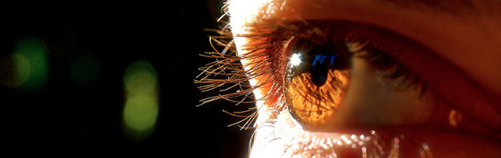
Visión por Computador
Domingo Mery
Departmento de Ciencia de la Computación
Escuela de Ingeniería
Universidad Católica de Chile
2D Transformations

Slide 2
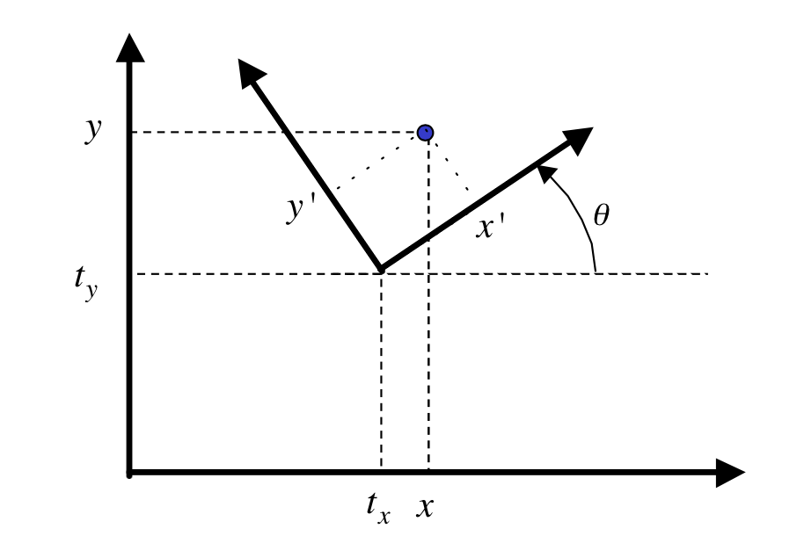
[ Euclidean 2D Transformation ]
Problem: Given (x',y') and (t_{x}, t_{y}, θ) find (x,y)
or: Given (x,y) and (t_{x}, t_{y}, θ) find (x',y')

Slide 3
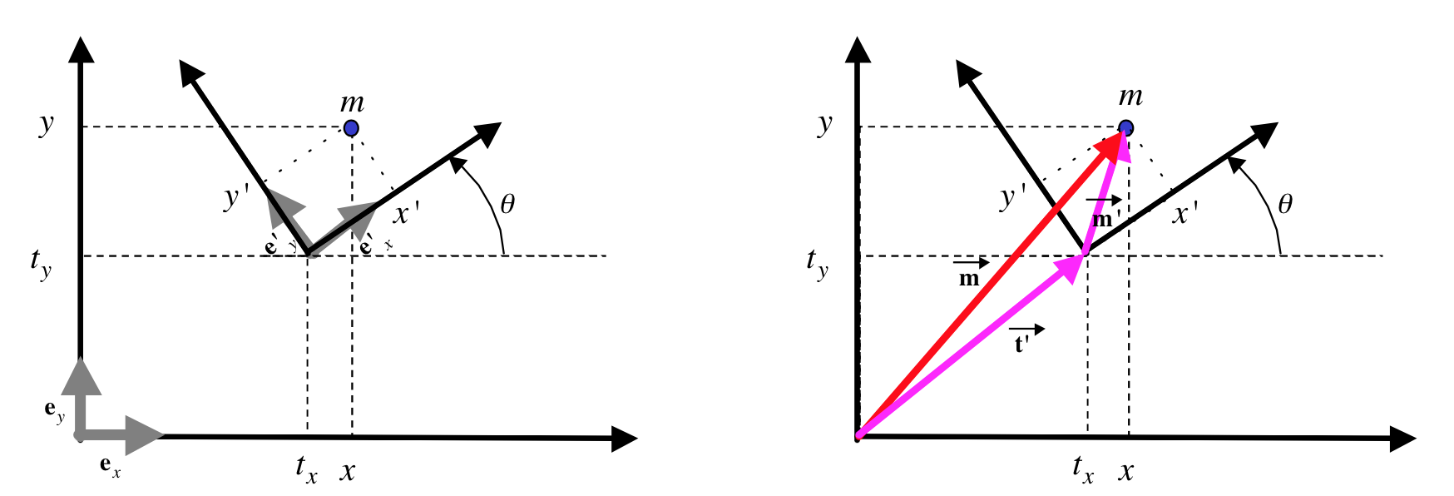
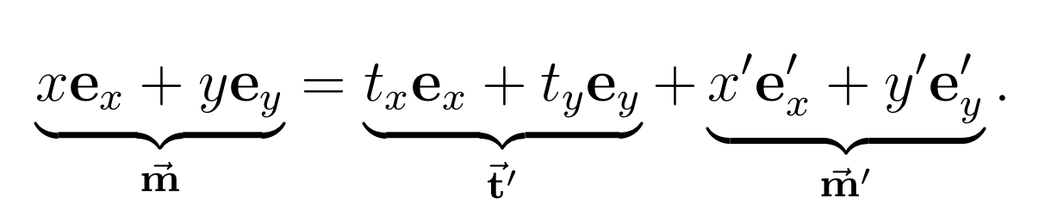
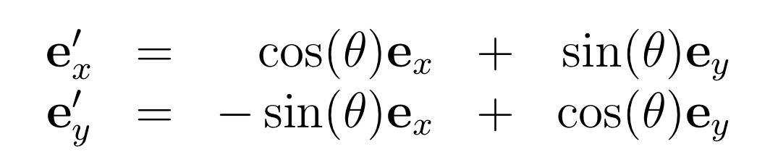
[ Euclidean 2D Transformation ]

Slide 4
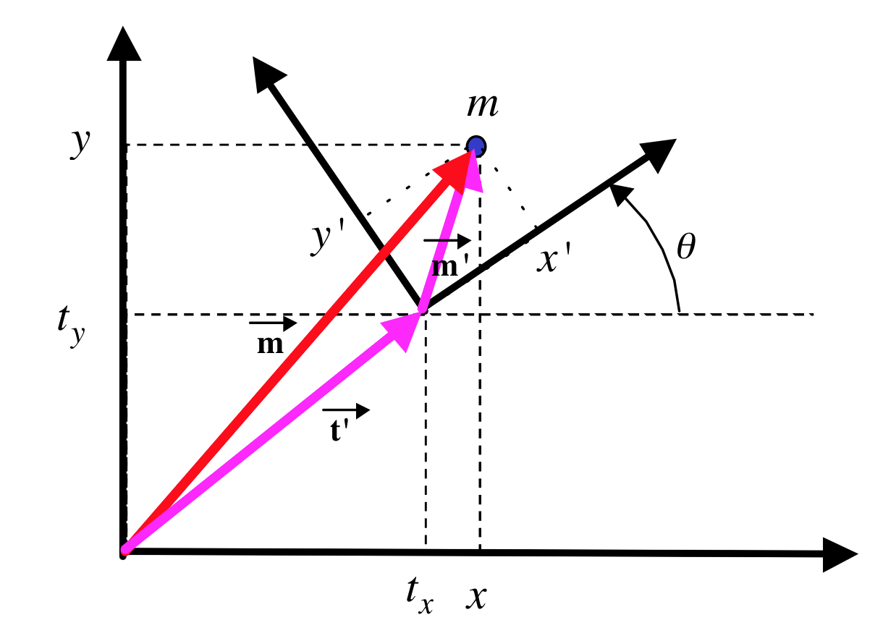
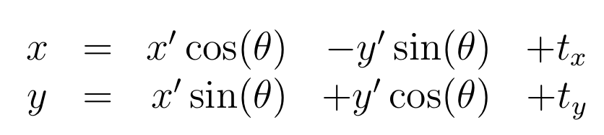
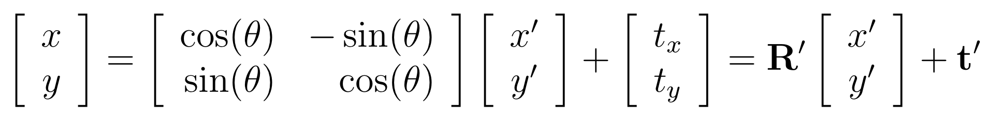
[ Euclidean 2D Transformation ]
e_{x} direction ➔
e_{y} direction ➔

Slide 5
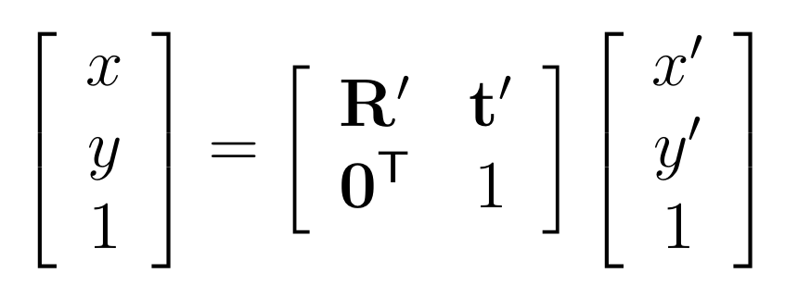
[ Euclidean 2D Transformation ]

Slide 6
[ Euclidean 2D Transformation ]
'
-1
'
'
Problem: Given (x',y') and (t_{x}, t_{y}, θ) find (x,y)
or: Given (x,y) and (t_{x}, t_{y}, θ) find (x',y')

Slide 7
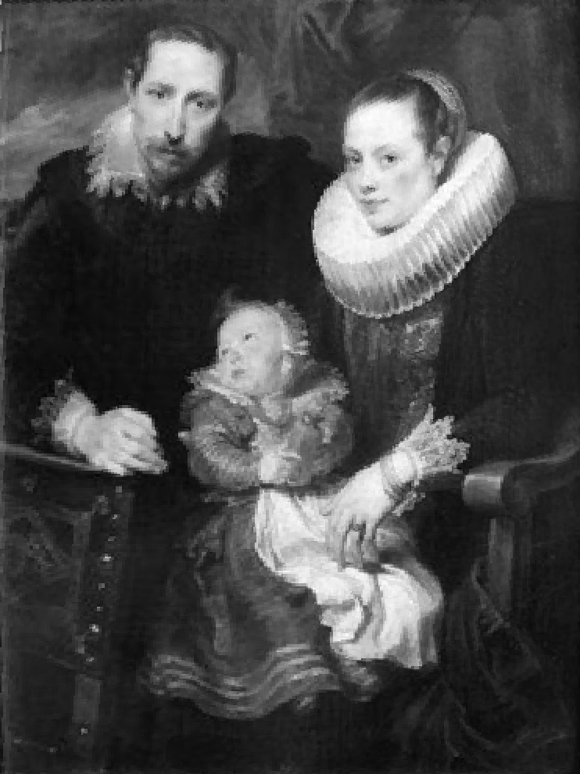
[ Euclidean 2D Transformation ]
y'
y
y'
θ
x'
t'
x'
x

Slide 8
[ Similarity 2D Transformation ]
y'
y
y'
θ
x'
t'
x'
x
s

Slide 9
[ 2D Transformations – H matrix ]

Slide 10
[ 2D Transformations – H matrix]
INVARIANTS
Length, Size | Shape, Angle | Parallels | Lines
Euclidean | Similarity | Affine | General
Notes:
Affine: In geometry, an affine transformation, affine map or an affinity (from the Latin, affinis, "connected with") is a function between affine spaces which preserves points, straight lines and planes. Also, sets of parallel lines remain parallel after an affine transformation. [wikipedia]
\begin{bmatrix}
\cos(\theta) & -\sin(\theta) & t_x\\
\sin(\theta) & \cos(\theta) & t_y\\
0 & 0 & 1
\end{bmatrix}
\begin{bmatrix}
s\cos(\theta) & -s\sin(\theta) & t_x\\
s\sin(\theta) & s\cos(\theta) & t_y\\
0 & 0 & 1
\end{bmatrix}
\begin{bmatrix}
a_{11} & a_{12} & a_{13}\\
a_{21} & a_{22} & a_{23}\\
0 & 0 & 1
\end{bmatrix}
\begin{bmatrix}
h_{11} & h_{12} & h_{13}\\
h_{21} & h_{22} & h_{23}\\
h_{31} & h_{32} & h_{33}
\end{bmatrix}

Slide 11
DEMO in MATLAB
Use Bmv_guihomography
Load image ‘painting.png’ from directory ‘images’

