Slide 1






SLIP
Shopping Lists In the App
Login:
Password:
Login
Register

Slide 2
SLIP
Username
Password
Real Name
City
Start using an app

Slide 3

Welcome SLIP, an app which will change your way of making shopping lists! The concept is very simple:
Once you run out of something, find a supermarket you normally go to;
Add a product you want to buy and it will be added to your shopping list;
You can add/change/remove items;
So next time you have to go to supermarket you have a shopping list in your app!
You can start here or by accessing menu on the top left

Slide 4

Your Shopping List
Map
About

Slide 5
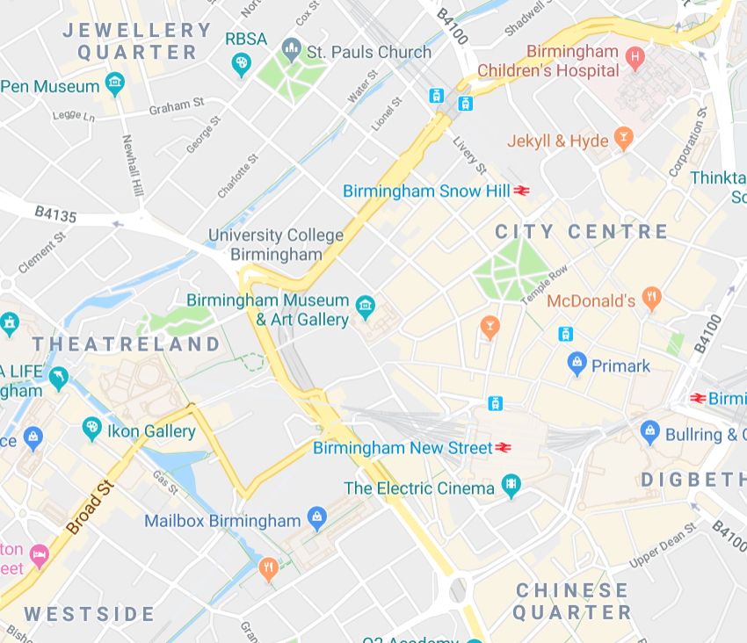

`
Select Shop

Slide 6
`
Select Shop
Tesco
Sainsbury’s
Corner Shops
Markets

Slide 7
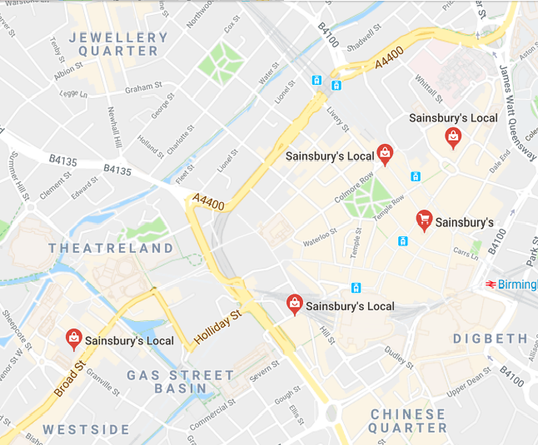
`
Sainsbury’s

Slide 8
`
Sainsbury’s
Tesco
Sainsbury’s
Corner Shops
Markets

Slide 9
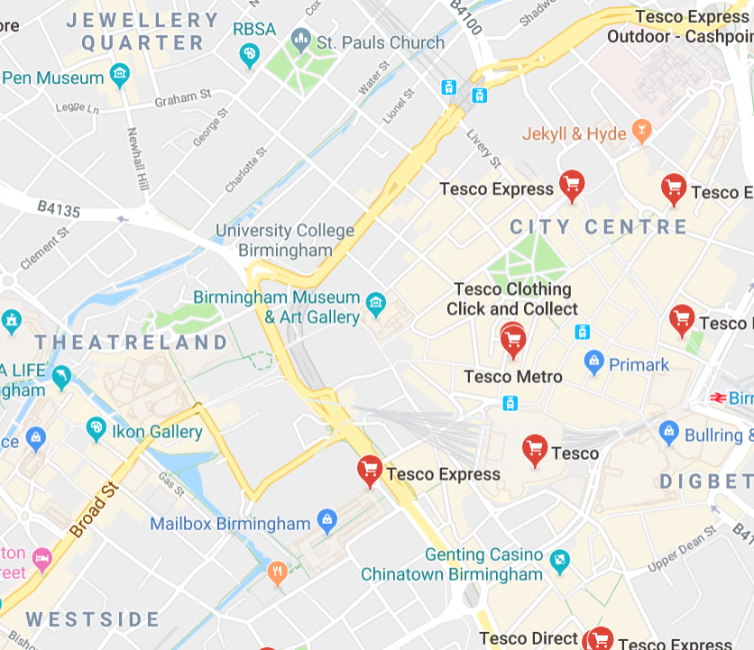
`
Tesco

Slide 10
`
Tesco
Tesco
Sainsbury’s
Corner Shops
Markets

Slide 11
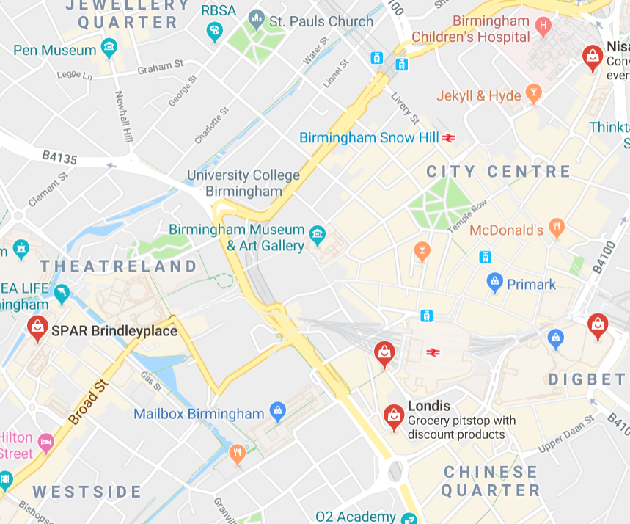
`
Corner Shops

Slide 12
`
Corner Shops
Tesco
Sainsbury’s
Corner Shops
Markets

Slide 13
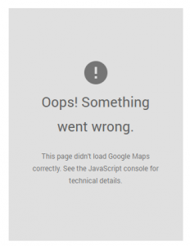
`
Markets

Slide 14
`
Market
Tesco
Sainsbury’s
Corner Shops
Markets

Slide 15


Your Shopping
You selected: Sainsbury’s Local at <Address>

Slide 16
Your Shopping
You selected: Tesco Express at <Address>

Slide 17
Your Shopping
You selected: <Corner Shop> at <Address>

Slide 18

Select a category:
B
Bakery
Biscuits
D
Dairy Products
Drinks
V
Vegetables
More is coming soon!

Slide 19

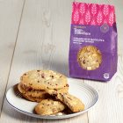

Biscuits
Oreo Original 154g
50p/unit
In stock
Galaxy Caramel Cookies
£1.50/unit
In stock
Sainsbury’s Belgian White & Raspberry Cookies Taste Difference x4
£1.60/unit
Out Of Stock
-
0
+
-
0
+
-
0
+

Slide 20
Biscuits
Oreo Original 154g
50p/unit
In stock
Galaxy Caramel Cookies
£1.50/unit
In stock
Sainsbury’s Belgian White & Raspberry Cookies Taste Difference x4
£1.60/unit
Out Of Stock
-
1
+
-
0
+
-
0
+
The item has been added to your list

Slide 21
Biscuits
Oreo Original 154g
50p/unit
In stock
Galaxy Caramel Cookies
£1.50/unit
In stock
Sainsbury’s Belgian White & Raspberry Cookies Taste Difference x4
£1.60/unit
Out Of Stock
-
2
+
-
0
+
-
0
+
The item has been added to your list

Slide 22


Biscuits
Oreo Original 154g
50p/unit
In stock
Galaxy Caramel Cookies
£1.50/unit
In stock
Sainsbury’s Belgian White & Raspberry Cookies Taste Difference x4
£1.60/unit
Out Of Stock
-
2
+
-
0
+
-
0
+
The item has been added to your list

Slide 23
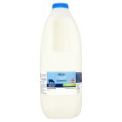


Dairy
Sainsbury’s British Whole Milk 2.27L (4 pint)
£1.15/unit
In stock
Neo Valley Organic Natural Yogurt
£1.65/unit
In stock
Sainsbury’s New York Cheesecake Dessert 550g
£3.00/unit
In stock
-
0
+
-
0
+
-
0
+

Slide 24


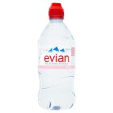
Drinks
Twinings Earl Grey x100 Tea Bags 250g
£5.00/unit
In stock
Red Bull
£1.00/unit
In stock
Evian Mineral Water
£1.00/unit
In stock
-
0
+
-
0
+
-
0
+

Slide 25
Drinks
Twinings Earl Grey x100 Tea Bags 250g
£5.00/unit
In stock
Red Bull
£1.00/unit
In stock
Evian Mineral Water
£1.00/unit
In stock
-
0
+
-
1
+
-
0
+
The item has been added to your list

Slide 26
Drinks
Twinings Earl Grey x100 Tea Bags 250g
£5.00/unit
In stock
Red Bull
£1.00/unit
In stock
Evian Mineral Water
£1.00/unit
In stock
-
0
+
-
1
+
-
0
+
The item has been added to your list

Slide 27
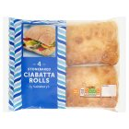
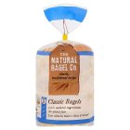
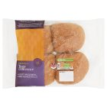
Bakery
Sainbury’s Stonebaked Ciabatta Rolls x4
£1.20/unit
In stock
Mr Bagels Plain Bagels x5
£1.05/unit
In stock
Sainsury’s Wholemeal Rolls,
Taste the Difference x4
£1.00/unit
In stock
-
0
+
-
0
+
-
0
+

Slide 28
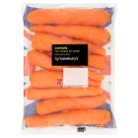
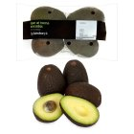
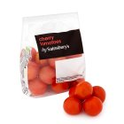
Vegetables
Sainsbury’s Carrots 1kg
70p/unit
In stock
Sainsbury’s Avocado, Ripen at Home x4
£1.85/unit
In stock
Sainsbury’s Cherry Tomatoes 335g
85p/unit
In stock
-
0
+
-
0
+
-
0
+

Slide 29
Vegetables
Sainsbury’s Carrots 1kg
70p/unit
In stock
Sainsbury’s Avocado, Ripen at Home x4
£1.85/unit
In stock
Sainsbury’s Cherry Tomatoes 335g
85p/unit
In stock
-
0
+
-
1
+
-
0
+
The item has been added to your list

Slide 30
Vegetables
Sainsbury’s Carrots 1kg
70p/unit
In stock
Sainsbury’s Avocado, Ripen at Home x4
£1.85/unit
In stock
Sainsbury’s Cherry Tomatoes 335g
85p/unit
In stock
-
0
+
-
2
+
-
0
+
The item has been added to your list

Slide 31
Vegetables
Sainsbury’s Carrots 1kg
70p/unit
In stock
Sainsbury’s Avocado, Ripen at Home x4
£1.85/unit
In stock
Sainsbury’s Cherry Tomatoes 335g
85p/unit
In stock
-
0
+
-
2
+
-
0
+
The item has been added to your list

Slide 32

Select a category:
F
Frozen Food
H
Health & Beauty
Household
More is coming soon!

Slide 33
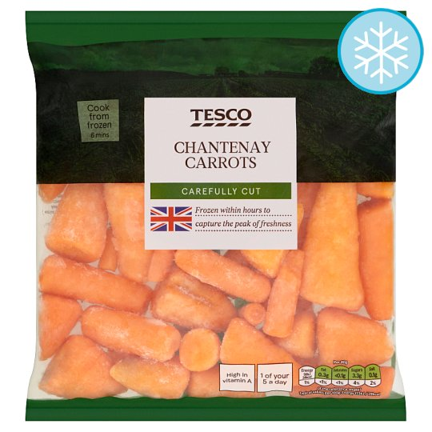
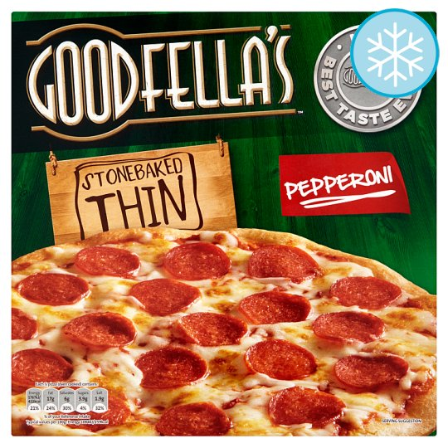

Frozen Food
Tesco Chantenay Carrots 600g
£1.00
In stock
Goodfella’s Stonebaked Thin Pepperoni Pizza 340g
£1.50
In stock
Ben And Jerry’s Chocolate Fudge Brownie Ice Cream 500ml
£4.50
In stock
-
0
+
-
0
+
-
0
+

Slide 34
Frozen Food
Tesco Chantenay Carrots 600g
£1.00
In stock
Goodfella’s Stonebaked Thin Pepperoni Pizza 340g
£1.50
In stock
Ben And Jerry’s Chocolate Fudge Brownie Ice Cream 500ml
£4.50
In stock
-
0
+
-
0
+
-
1
+
The item has been added to your list

Slide 35
Frozen Food
Tesco Chantenay Carrots 600g
£1.00
In stock
Goodfella’s Stonebaked Thin Pepperoni Pizza 340g
£1.50
In stock
Ben And Jerry’s Chocolate Fudge Brownie Ice Cream 500ml
£4.50
In stock
-
0
+
-
0
+
-
1
+
The item has been added to your list

Slide 36
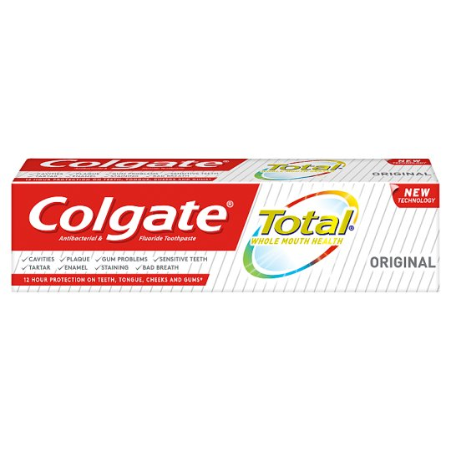
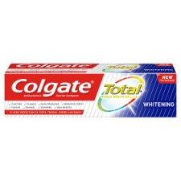
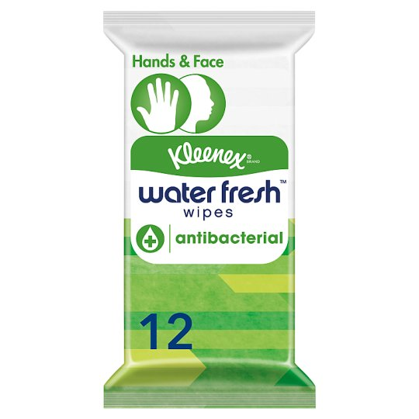
Health & Beauty
Colgate Total Original Care Toothpaste 125ml
£2.00
In stock
Colgate Total Whitening Toothpaste 125ml
£2.00
In stock
Kleenex 12 Water Fresh Antibacterial Wet Wipes
£1.00
In stock
-
0
+
-
0
+
-
0
+

Slide 37
Health & Beauty
Colgate Total Original Care Toothpaste 125ml
£2.00
In stock
Colgate Total Whitening Toothpaste 125ml
£2.00
In stock
Kleenex 12 Water Fresh Antibacterial Wet Wipes
£1.00
In stock
-
0
+
-
0
+
-
1
+
The item has been added to your list

Slide 38
Health & Beauty
Colgate Total Original Care Toothpaste 125ml
£2.00
In stock
Colgate Total Whitening Toothpaste 125ml
£2.00
In stock
Kleenex 12 Water Fresh Antibacterial Wet Wipes
£1.00
In stock
-
0
+
-
0
+
-
2
+
The item has been added to your list

Slide 39
Health & Beauty
Colgate Total Original Care Toothpaste 125ml
£2.00
In stock
Colgate Total Whitening Toothpaste 125ml
£2.00
In stock
Kleenex 12 Water Fresh Antibacterial Wet Wipes
£1.00
In stock
-
0
+
-
0
+
-
2
+
The item has been added to your list

Slide 40
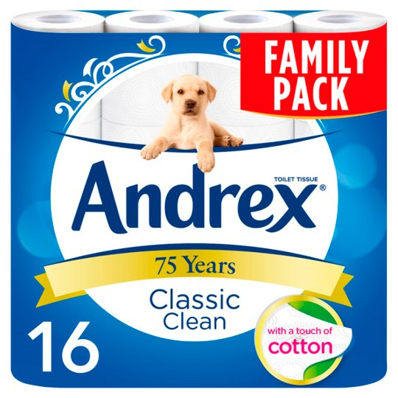
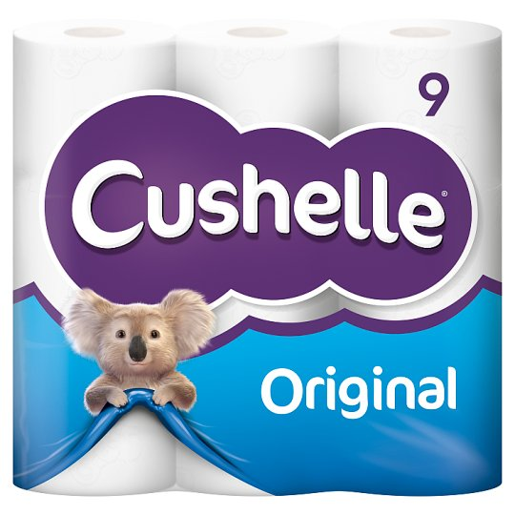
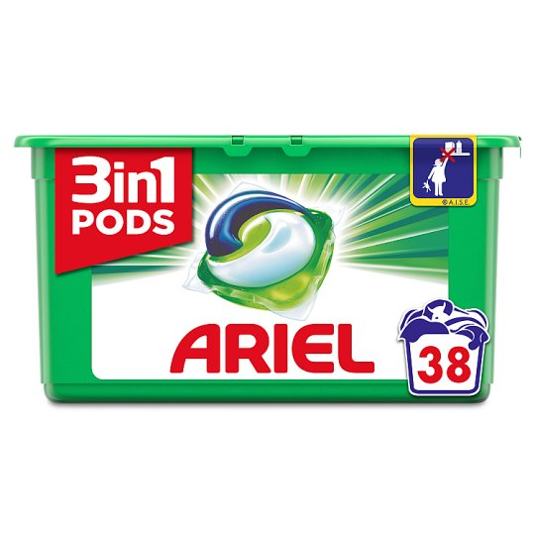
Household
Andrex Toilet Tissue 16 Roll White
£6.50
In stock
Cushelle Toilet Tissue 9 Roll White
£4.45
In stock
Ariel 3In1 Pods Washing Capsules 38 washes
£9.00
In stock
-
0
+
-
0
+
-
0
+

Slide 41

Select a category:
A
Alcohol
D
Deals
More is coming soon!

Slide 42

Alcohol
Budweiser Premium Lager 4x440ml can pack
£4.00
In stock
Carlsberg Export Premium Lager 4x330ml Bottle Pack
£4.25
Out Of Stock
Corona Extra Premium Lager Beer bottles 4x330ml
£4.75
In stock
-
0
+
-
0
+
-
0
+

Slide 43
Alcohol
Budweiser Premium Lager 4x440ml can pack
£4.00
In stock
Carlsberg Export Premium Lager 4x330ml Bottle Pack
£4.25
Out Of Stock
Corona Extra Premium Lager Beer bottles 4x330ml
£4.75
In stock
-
0
+
-
0
+
-
1
+
The item has been added to your list

Slide 44
Alcohol
Budweiser Premium Lager 4x440ml can pack
£4.00
In stock
Carlsberg Export Premium Lager 4x330ml Bottle Pack
£4.25
Out Of Stock
Corona Extra Premium Lager Beer bottles 4x330ml
£4.75
In stock
-
0
+
-
0
+
-
1
+
The item has been added to your list

Slide 45
Deals
Doritos Cool Original
£1.00
Out Of Stock
Doritos Tangy Cheese
£1.00
In stock
Estrella Flamed Grilled Steak
£1.00
In stock
-
0
+
-
0
+
-
0
+

Slide 46
Deals
Doritos Cool Original
£1.00
Out Of Stock
Doritos Tangy Cheese
£1.00
In stock
Estrella Flamed Grilled Steak
£1.00
In stock
-
0
+
-
1
+
-
0
+
The item has been added to your list

Slide 47
Deals
Doritos Cool Original
£1.00
Out Of Stock
Doritos Tangy Cheese
£1.00
In stock
Estrella Flamed Grilled Steak
£1.00
In stock
-
0
+
-
1
+
-
1
+
The item has been added to your list

Slide 48
Deals
Doritos Cool Original
£1.00
Out Of Stock
Doritos Tangy Cheese
£1.00
In stock
Estrella Flamed Grilled Steak
£1.00
In stock
-
0
+
-
1
+
-
1
+
The item has been added to your list

Slide 49
Deals
Doritos Cool Original
£1.00
Out Of Stock
Doritos Tangy Cheese
£1.00
In stock
Estrella Flamed Grilled Steak
£1.00
In stock
-
0
+
-
1
+
-
1
+
The item has been added to your list

Slide 50
Shopping List
Sainsbury’s
Sainsbury’s Local, <Address>
Tesco
Tesco Metro, New Street
Corner Shops
SPAR Brindleyplace, Brunswick Square

Slide 51

Shopping List
Sainsbury’s, Colmore Row
Sainsbury’s Avocado, Ripen at Home x4
Qty: 2 Aisle 2 Price: £3.70
Red Bull
Qty: 1 Aisle 4 Price: £1.00
Oreo Original 154g
Qty: 2 Aisle 7 Price: £0.50
Total: £5.70

Slide 52
Shopping List
Sainsbury’s, Colmore Row
Sainsbury’s Avocado, Ripen at Home x4
Would you like to delete this item?
Qty: 2 Aisle 2 Price: £3.70
Red Bull
Qty: 1 Aisle 4 Price: £1.00
Oreo Original 154g
Qty: 2 Aisle 7 Price: £0.50
Total: £5.70

Slide 53
Shopping List
Sainsbury’s, Colmore Row
Sainsbury’s Avocado, Ripen at Home x4
Qty: 2 Aisle 2 Price: £3.70
Oreo Original 154g
Qty: 2 Aisle 7 Price: £0.50
Total: £4.70
The item has been deleted from your list

