Slide 1

Concept Demo
Finn Habraken
Niray Mak
Dary van Sleeuwen
Nidhi Sharma
Edgaras Spiridonovas
Gijs Zwegers

Slide 2
Concept
People from different nationalities come together and get to know each other.
Create and join events with other neighbours
See neighbours in a radius nearby and which countries they belong to
Get some important details of cultural differences on people’s backgrounds at the events

Slide 3
Comparison with other apps
Nextdoor
Facebook
Whatsapp

Slide 4
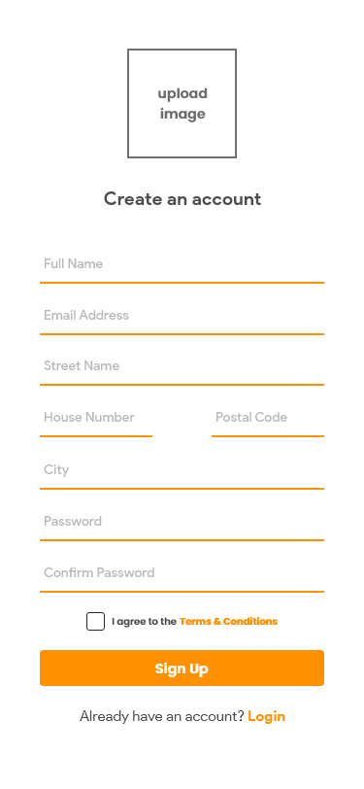
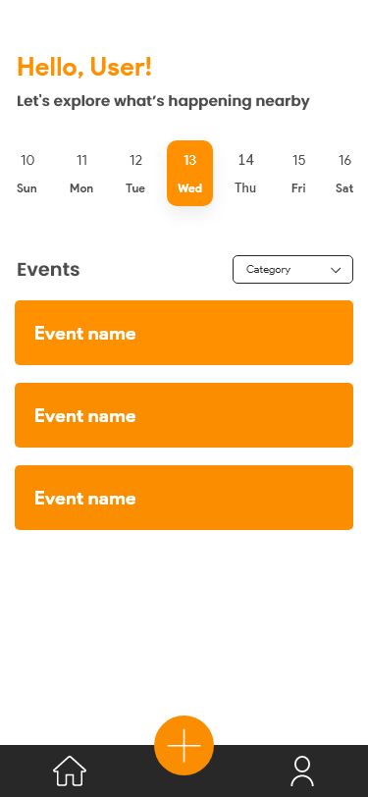
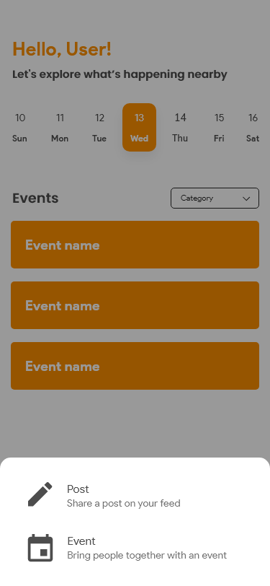
Visualisations

Slide 5
Next steps
Finalizing the design
Prototyping
Development

