Slide 1
ATMO 656A – HW3
Edgardo I. Sepulveda Araya

Slide 2
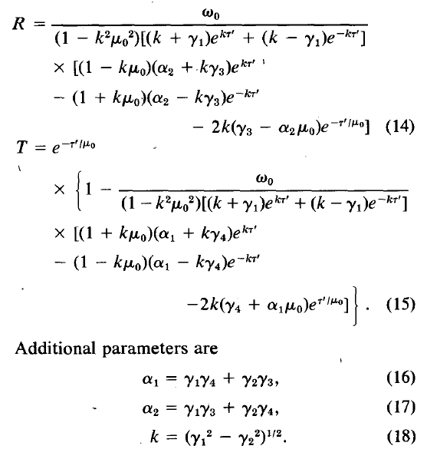
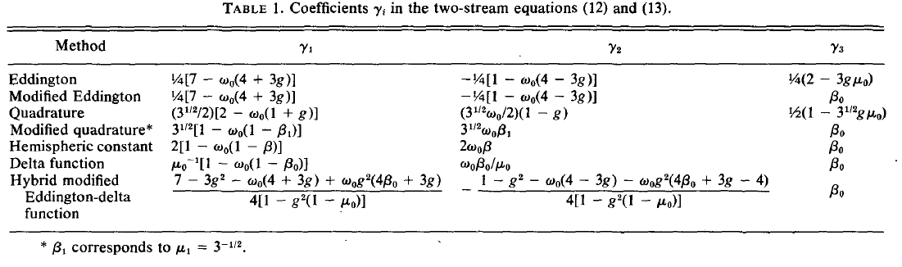

Meador & Weaver (1979)

Slide 3
Liou (1974)

Slide 4
g = 0.75

