Slide 1
ATMO 656A – HW6
Edgardo I. Sepulveda Araya

Slide 2
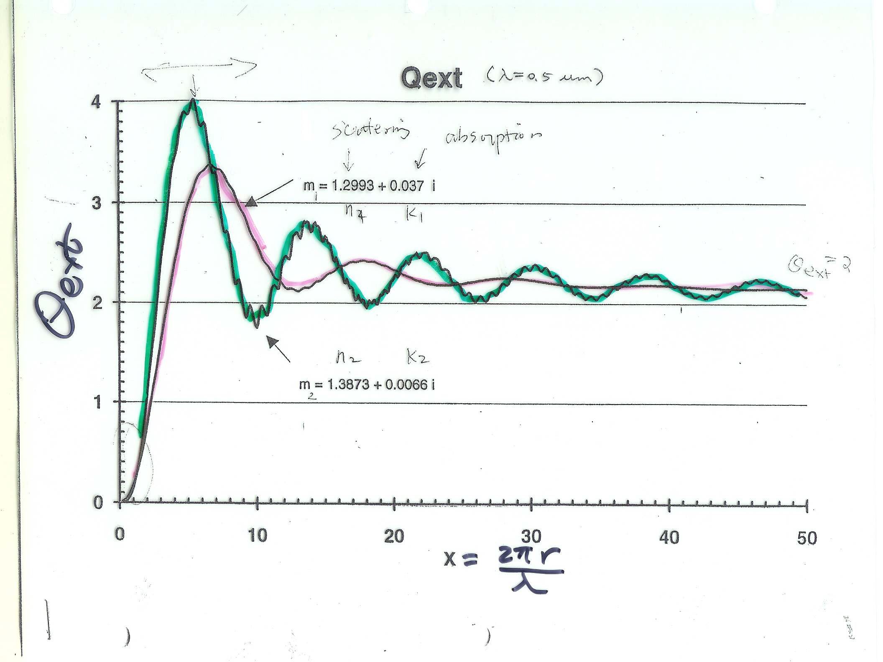
For $λ=0.55 μm$ (ALAM array in FORTRAN code) and r from 0.1 to 4 $μm$ (0.1 $μm$ step):

Slide 3
For $λ=0.55 μm$ (ALAM array in FORTRAN code) and r from 0.1 to 4 $μm$ (0.1 $μm$ step):

Slide 4
For $λ=0.55 μm$ and $r=2 μm$:

