Slide 1
ATMO 656A – HW1
Edgardo I. Sepulveda Araya

Slide 2
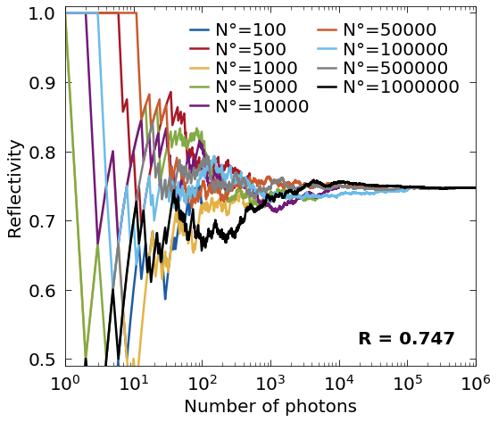
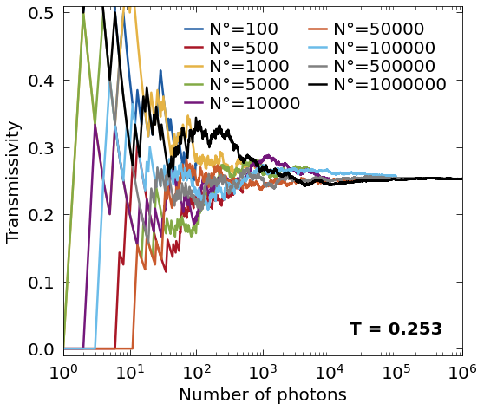
Question 1
g = 0.001
w₀ = 0.99999
µ₀ = -0.7
Tau = 4
Number of photons for convergence: ~50,000 (16.5 s)

Slide 3
Question 2
With:
Mean Transmissivity: 0.252
Sigma Transmissivity: 0.001
Mean Reflectance: 0.748
Sigma Reflectance: 0.001
g = 0.001
w₀ = 0.99999
µ₀ = -0.7
Tau = 4
10 iterations

Slide 4
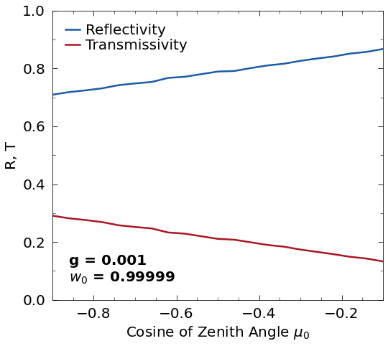
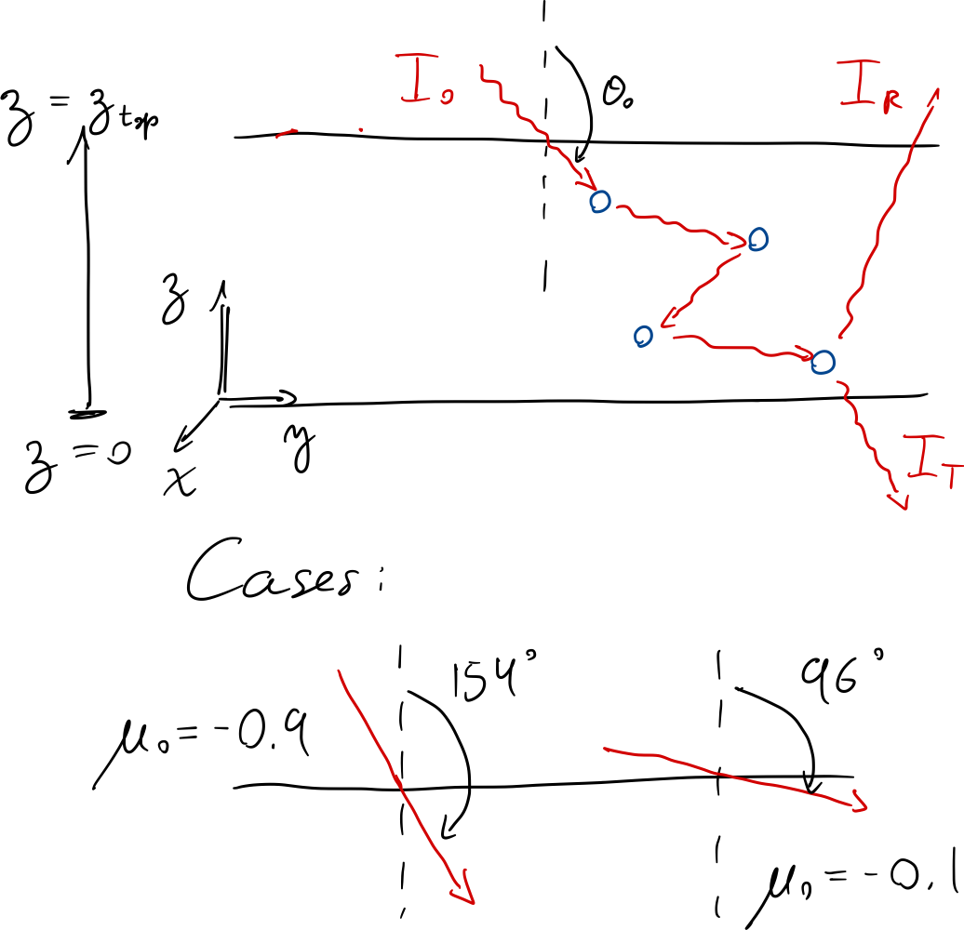

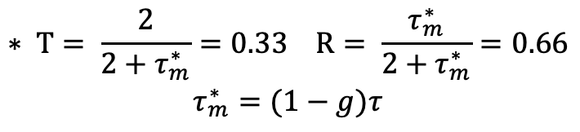

Question 3
Tau = 4
N photons = 50,000
$$\cos^{−1}\left(−0.9\right)=154°$$
$$\cos^{−1}\left(−0.1\right)=96°$$
$$∗ T= \frac{2}{2+τ_{m}^{∗}}=0.33 R= \frac{τ_{m}^{∗}}{2+τ_{m}^{∗}}=0.66$$
$τ_{m}^{∗}=(1−g)τ$

Slide 5
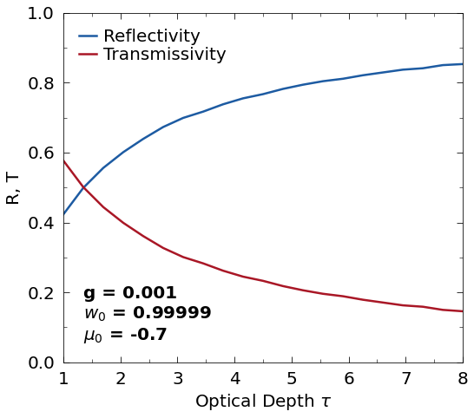
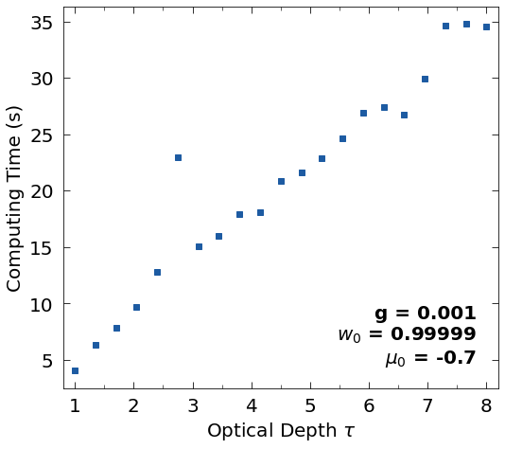
Question 4
N photons = 50,000
4.4 seconds per optical depth unit

Slide 6
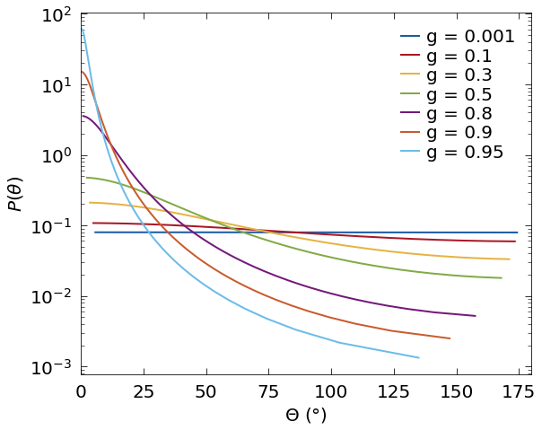
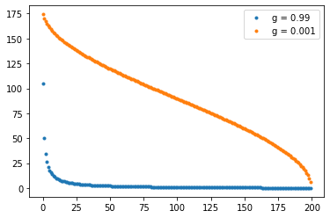

Annex
$$Θ$$

