Slide 1
ATMO 656A – HW4
Edgardo I. Sepulveda Araya

Slide 2
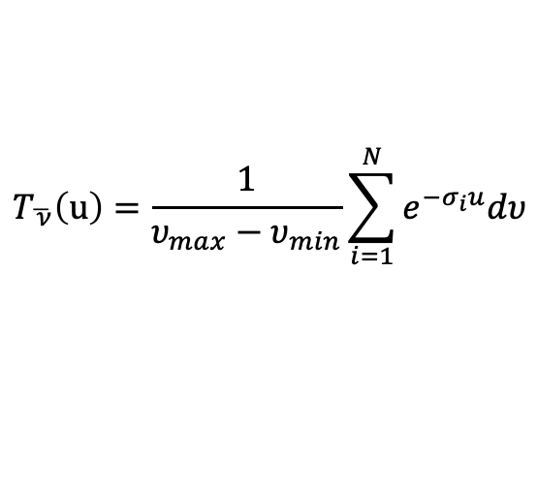
Number of water vapor molecules (absorbers) u at the path (molecules/cm²)
Average band Transmission by LBL method:
$$T_{\overline{ ν}}\left(u\right)=\frac{1}{υ_{max}−υ_{min}}\sum_{i=1}^{N}{e^{−σ_{i}u}dυ}$$

Slide 3
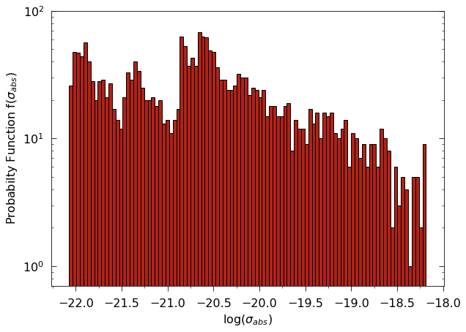
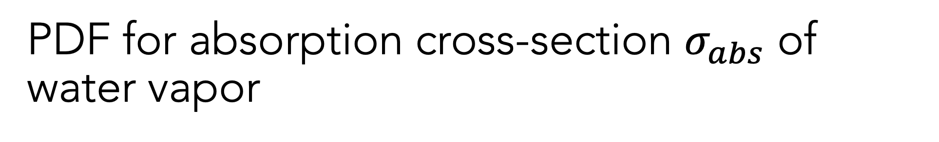
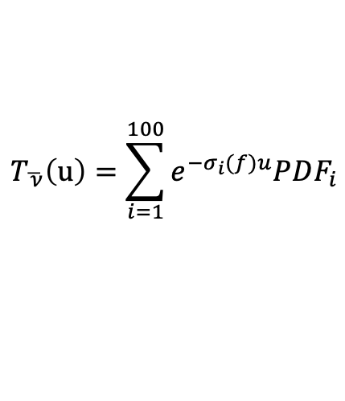
PDF for absorption cross-section $σ_{abs}$ of water vapor
Average band Transmission by Sort Distribution method:
$$T_{\overline{ ν}}\left(u\right)=\sum_{i=1}^{100}{e^{−σ_{i}(f)u}PDF_{i}}$$

Slide 4
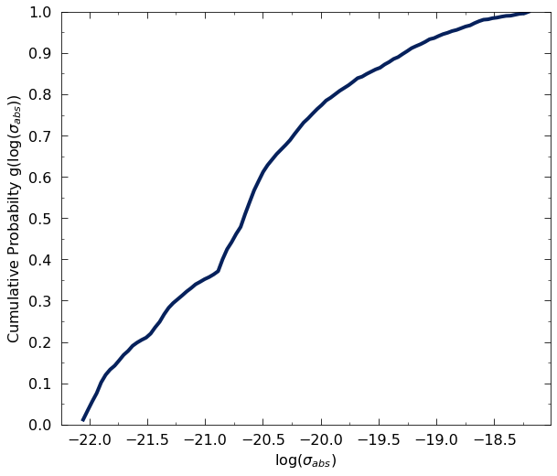
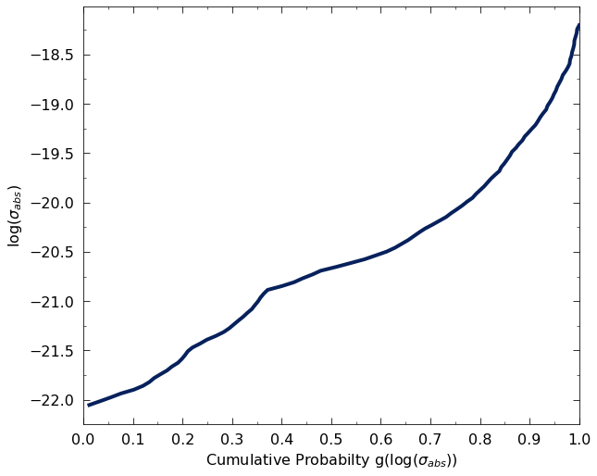
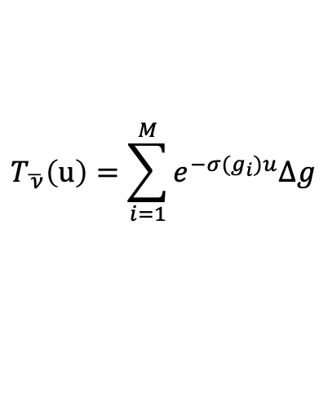
CFD and its inverse
Average band Transmission by Quadrature CFD method:
$$T_{\overline{ ν}}\left(u\right)=\sum_{i=1}^{M}{e^{−σ(g_{i})u}∆g}$$

Slide 5
