Slide 1
ATMO 656A – HW4v2 and HW5
Edgardo I. Sepulveda Araya

Slide 2
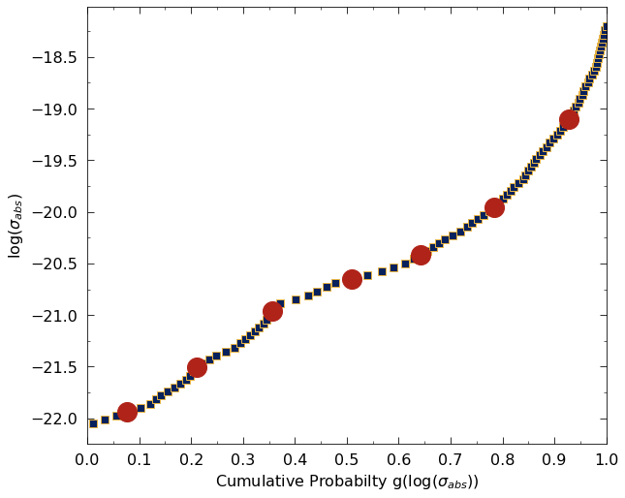
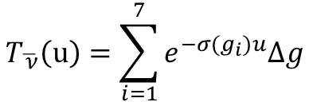
CDF (Quadrature) Method
Average band Transmission by Quadrature CFD method (7 points example):
$$T_{\overline{ ν}}\left(u\right)=\sum_{i=1}^{7}{e^{−σ(g_{i})u}∆g}$$

Slide 3
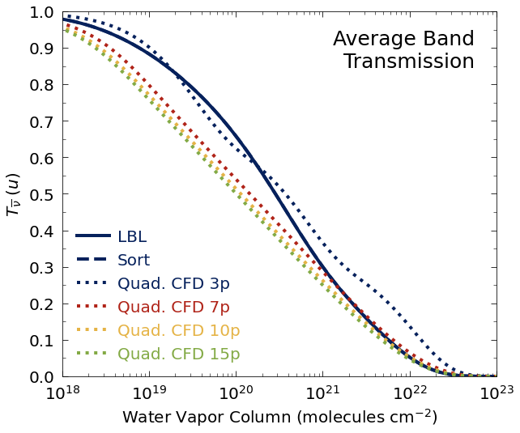
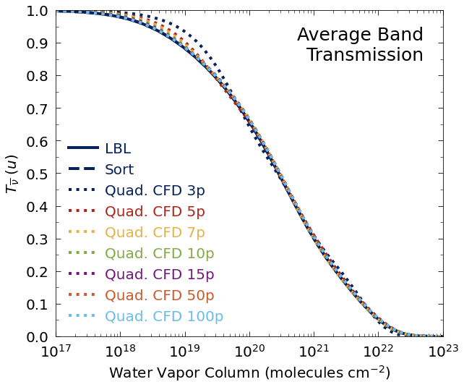
Old version
New version

Slide 4
Method | Relative Difference (r/ to LBL) (%)
Sort | 0.017
Quad 3p | 2.047
Quad 5p | 1.139
Quad 7p | 0.750
Quad 10p | 0.687
Quad 15p | 0.691
Quad 50p | 0.557
Quad 100p | 0.569

Slide 5
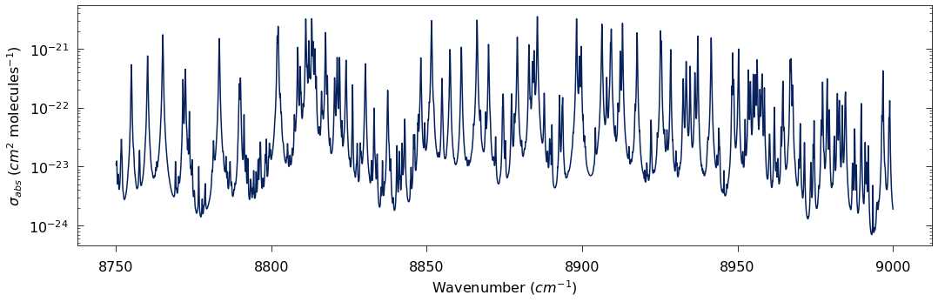
HW5

Slide 6
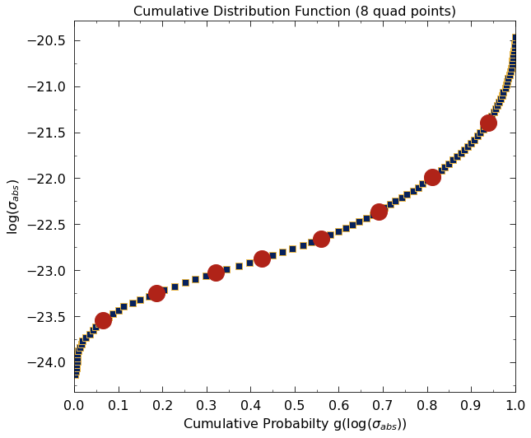
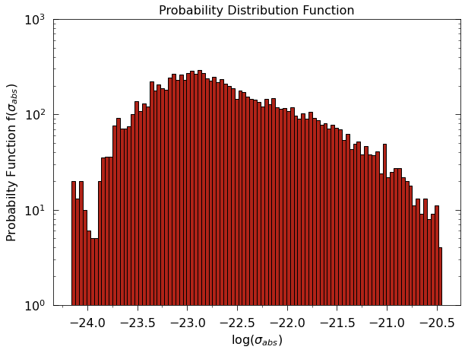

Slide 7
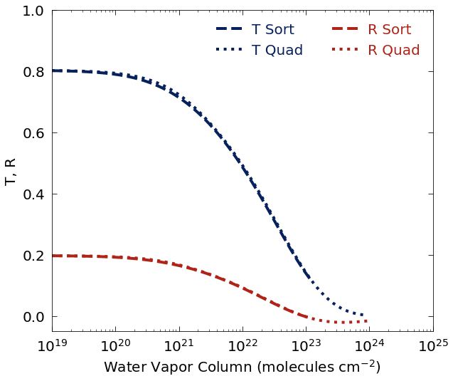
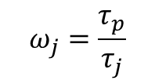






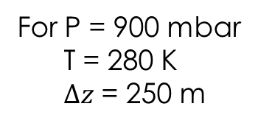
PDF and CDF with 2-stream model
$$τ_{j}=τ_{p}+τ_{vj}$$
$$τ_{p}=4$$
$$τ_{vj}=σ_{i}u_{j}$$
$σ_{i}$ from PDF (i = 1 to 100)
$σ_{i}$ from CDF (i = 1 to 8)
$$ω_{j}=\frac{τ_{p}}{τ_{j}}$$
For 10²³ molecules/cm²: T = 0.14
R = 0
For P = 900 mbar
T = 280 K
$Δz$ = 250 m
$$u=5.8×{10}^{23} molec cm^{−2}$$
T = 0
R = 0
*But $P_{sat}=13.3$ mbar
$$⇒u=6.4×{10}^{21} molec cm^{−2}$$

