Slide 1
ATMO 656A – HW4v2 and HW5
Edgardo I. Sepulveda Araya

Slide 2
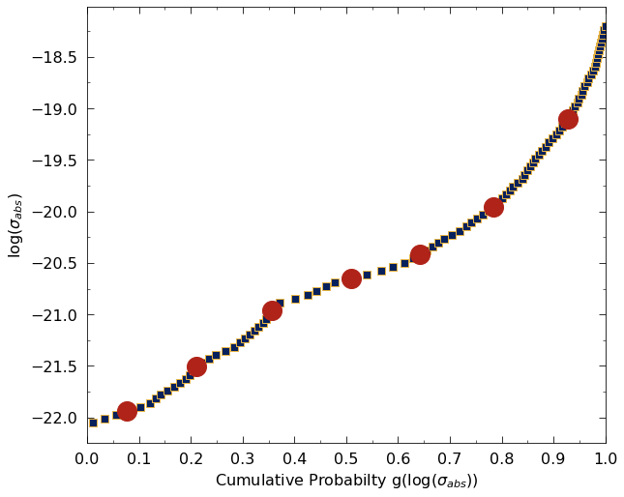
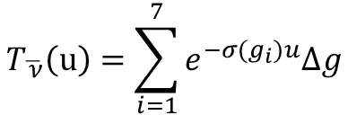
HW4v2 - CDF (Quadrature) Method
Average band Transmission by Quadrature CFD method (7 points example):
$$T_{\overline{ ν}}\left(u\right)=\sum_{i=1}^{7}{e^{−σ(g_{i})u}∆g}$$

Slide 3
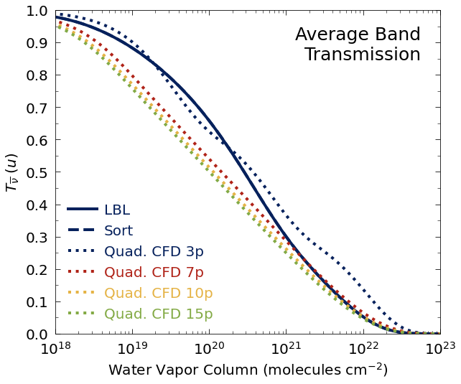
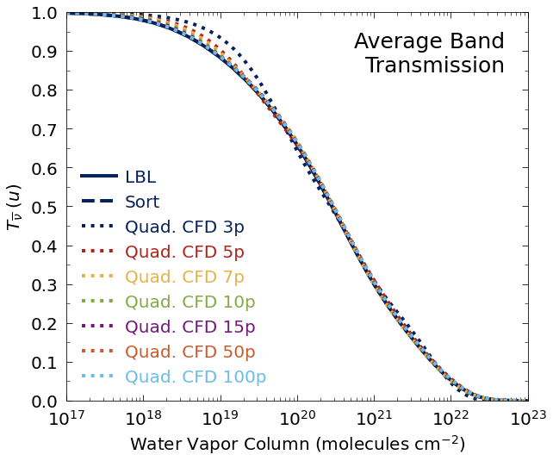
HW4v2
Old version
New version

Slide 4
HW4v2
Method | Relative Difference (r/ to LBL) (%)
Sort | 0.017
Quad 3p | 2.047
Quad 5p | 1.139
Quad 7p | 0.750
Quad 10p | 0.687
Quad 15p | 0.691
Quad 50p | 0.557
Quad 100p | 0.569

Slide 5
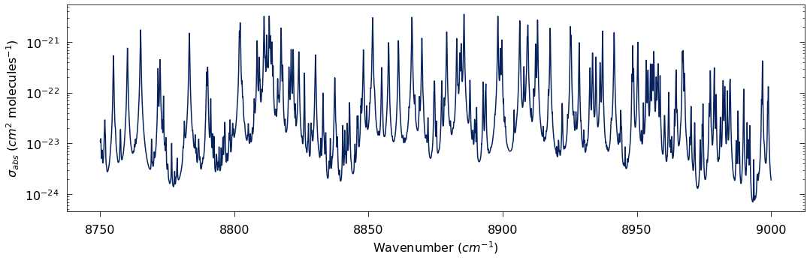
HW5

Slide 6
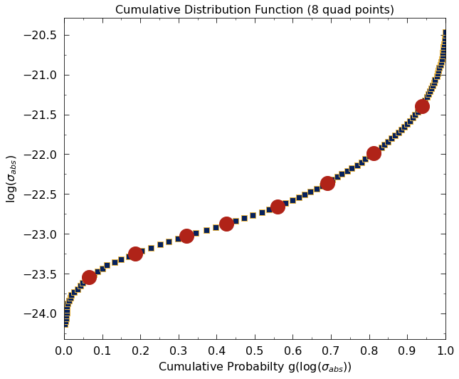
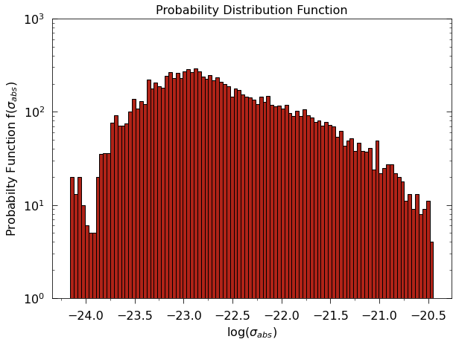
HW5

Slide 7
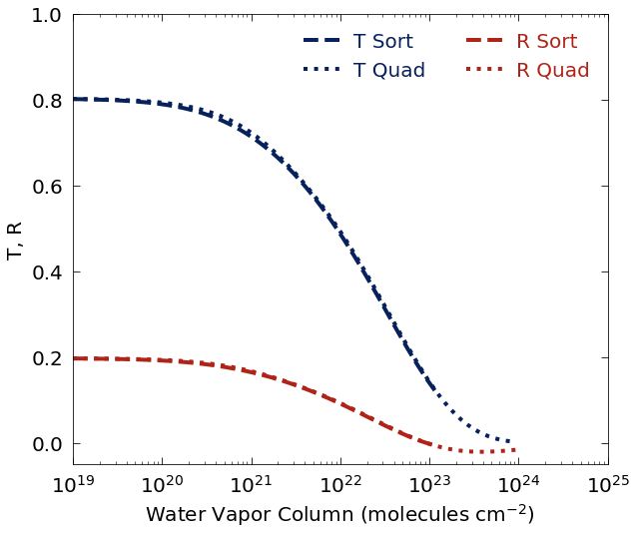



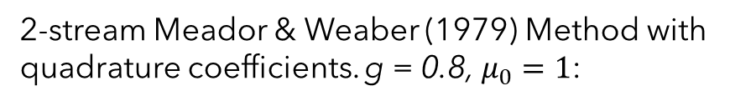




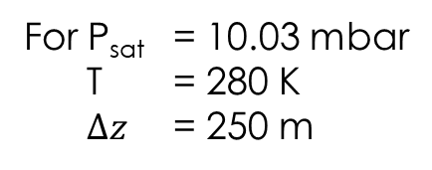
HW5 - PDF and CDF with 2-stream model
2-stream Meador & Weaber (1979) Method with quadrature coefficients. g = 0.8, $μ_{0}=1$:
$$τ_{j}=τ_{p}+τ_{vj}$$
$$τ_{p}=4$$
$$τ_{vj}=σ_{i}u_{j}$$
$σ_{i}$ from PDF (i = 1 to 100)
$σ_{i}$ from CDF (i = 1 to 8)
And $ω_{j}=\frac{τ_{p}}{τ_{j}}$
For 10²³ molecules/cm²: T = 0.14 and R = 0
For P_{sat} = 10.03 mbar
T = 280 K
$Δz$ = 250 m
$$u=6.48×{10}^{21} molec cm^{−2}$$
$⇒$ T = 0.54, R = 0.11

