Slide 1



Economic Activities – Portugal
Edgar Tomé
JUN, 10th | PARIS
DAFT MAY2022

Slide 2


Business case
Domain
Analyse of the evolution of the economy in factors of production activities, efficiency and return, internationalization of the economy, and they sub factors, for the industries along the years.
Problem
Compare the difference of production activities, efficiency and return for all industries, and verify witch is more important for the economy in Portugal, and how is the balance od export/import and is importance for the growth of economy.

Slide 3
Plan
Select a source that was able to provide information and reliable data, for the different factors of the economy in Portugal.
Retrieve the data to prepare a data set for future analyse of the business case.
Understanding of the data collected, data cleaning of missing values our not reelevate values, primary analyses using graphic visualizations, creations of database to able to combine various data sets to create new views for analyse.

Slide 4
About data
Data source is PORDATA, the Database of Contemporary Portugal, organized and developed by the Francisco Manuel dos Santos Foundation, was created in 2009.
The collection, compilation, systematization and dissemination of data on multiple areas of society, for Portugal and its municipalities, and for the European countries.
The reported statistics derive from official and certified sources, with data production skills in the respective areas.
Production Activities | Efficiency and Return | Internationalization
Export | Apparent labour productivity | Degree of exposure to international trade
Import | Investment rate | Export intensity
Production | Degree of production | Import penetration rate

Slide 5
Data cleaning, data preparation
The data cleaning and exploratory data analysis process, had two different process, because the excel files didn't had the data in the same formation.
The process was in a loop, in the the first cleaning , it was deleted rows and columns with not necessary information, defined the name of columns, uniformized the data types.
In the second iteration of cleaning after the data visualization was verified the necessity to remove more irrelevant information.
In the third iteration, after first creation of the database, realized that had to transpose the data frame to be stubble to the entity relationship model and to able to combine various data sets.
Notes:
Had different values, different types of values, missing values, different quantity of rows and columns.
One industries was removed, because it not existed in all data frames!!!

Slide 6
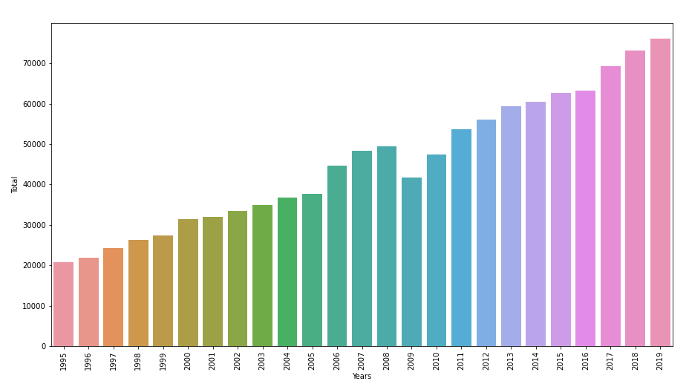
Exploratory Data Analyses
It was applied the function to obtain bars plot for the evolution true the years for production activities exports, because of the relevance of exporting as to the economy in Portugal.
Notes:
During the process of data cleaning, was performed at the same time data visualization, in python with the libraries matplotlib and seaborn.
To analyse if the data was clean, and the relations between the values were corrected, and if was need to removed outliers our columns and rows with no relevance to the study.
This process was performed to all files, extracted during the loop process in data cleaning, with same visualizations and plots for each file.

Slide 7
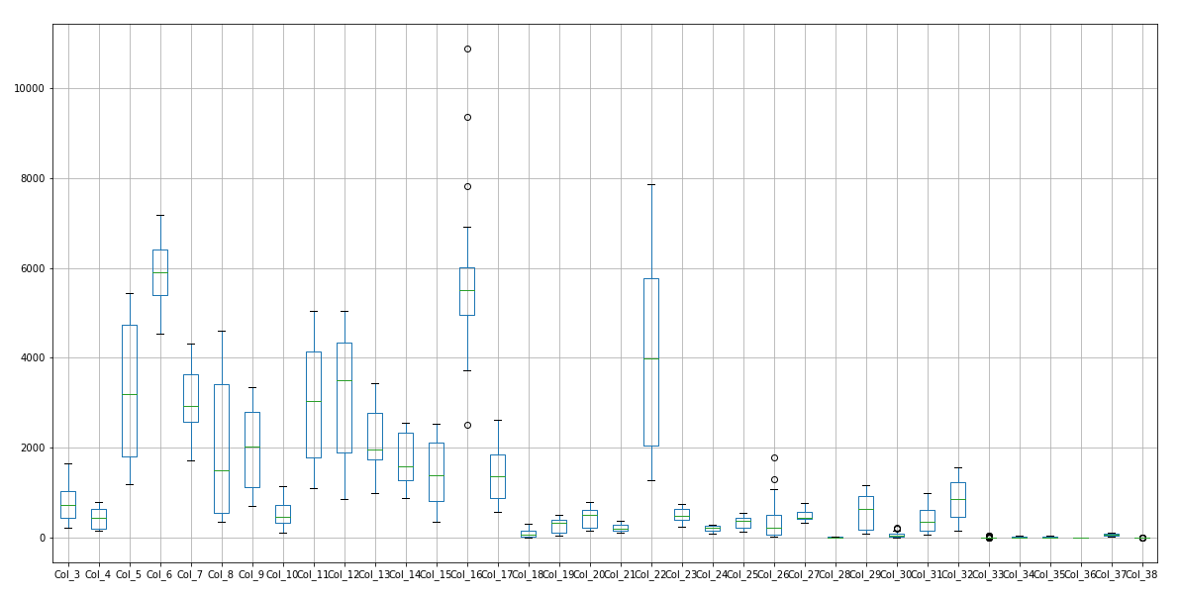
Exploratory Data Analyses
To verifier if existed outliers, was used a function of box plot, for visualization of the distribution of the values for all the industries.
Notes:
It was identified outliers in the industries Col_16 (Transport equipment), that was verified has a growth on that industry in the past years, doubling the value in five years.

Slide 8
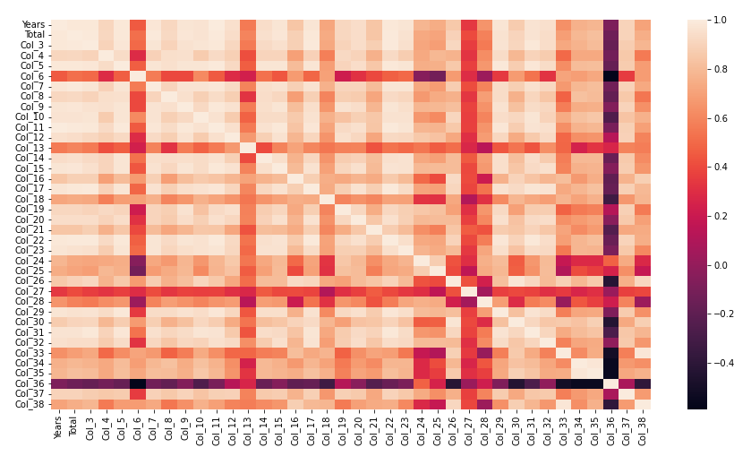
Exploratory Data Analyses
To be verified the relation between the industries in production activities exports, was applied the function correlation of numeric values and plotted using the function of heatmap.
Notes:
Verifying that the industries Col_23 (Accommodation and food services), have higher correlation to the industries Col_3 (Products of agriculture, forestry and fishing) and Col_5(Food products, beverages and tobacco products), the increased industries of tourism makes that the industries that provides food, beverage increases with the consumption of the tourists in the accommodations and in bars and restaurants.

Slide 9
Choose a data base
SQL – relation database | Non SQL – document oriented
The relational databases (SQL based), collects data in tables like csv files, each row in a table represents a record, production of queries that relates information in different tables. | The NoSQL databases there is no common structured schema for all records, most of the databases contain JSON records, and different records can include different fields.
In order to store the data collected in a database, that can produce queries and retrieve information with relations our not, is necessary to choose the database that is more suitable for the project
Notes:
SQL - It this structed database can be proceeded relations between rows, production of queries that relates information in different tables, but that have a relation key that are common in the tables for correlation. For that reason, before insertion of data, is need to produce the entity relationship model.
NON SQL - document-oriented the schema can vary between different documents and contain different fields, as the records are not depended it supports parallel computations. Columnar database, the data is store column by column, that makes column-based queries very efficient. Key-value database, is based on key only, requesting for a key and getting its value, not supporting queries across different record values.

Slide 10
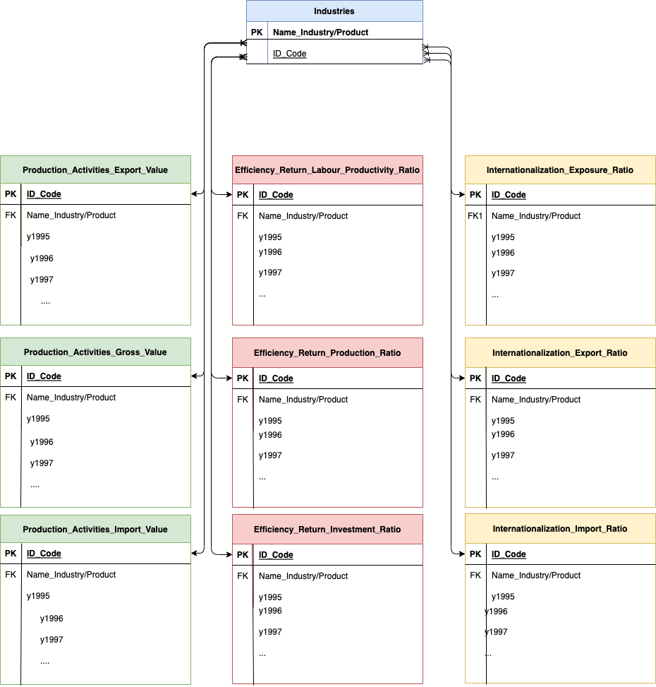
ERD
Considering the data collected and relations between industries that are of great value for analyses, it was chooses the relation data base in SQL.
For the use of relations database is necessary, before upload the data into SQL, create entity relationship model, with the different entities, and their relations, primary keys and foreign keys.

Slide 11
Database creation
For the project considering the data collected and relations between industries that are of great value for analyses, it was chosen the relation data base in SQL.
Create the database
Create tables with primary key and foreign key
Import the clean data from csv files to each table
Perform queries, to obtain relations between industries in the subjects
Notes:
Query 1 - Production value comparison for import and export for the year 2019, for the industry with more value of export and industries with more value of import ;
Query 2 - Production value comparison for import and export for the year 2019;
Query 3 - Internationalization ratio comparison for import and export for the year 2019;
Query 4 - Efficiency ratio comparison for investment and production for the year 2019;
Query 5 - Total of production export and production import for last 5 years all years;

Slide 12
Conclusions
The process of collection data, cleaning data, visualization data, creation of database and retrieving queries from all the data inputted:
It is the principal base for analysed the data of the study object, giving information, that have to be contextualized with reality and whit the requirements of the project.
This process is a loop, that for each iteration, some conclusions can be made and a new perspective can be observed.

Slide 13
Economic Activities - Portugal
Edgar Tomé
Questions?

