Slide 1
Verify Email Image
Unmarked: /docs/studio/assets/user/email-verification.jpg

Slide 2
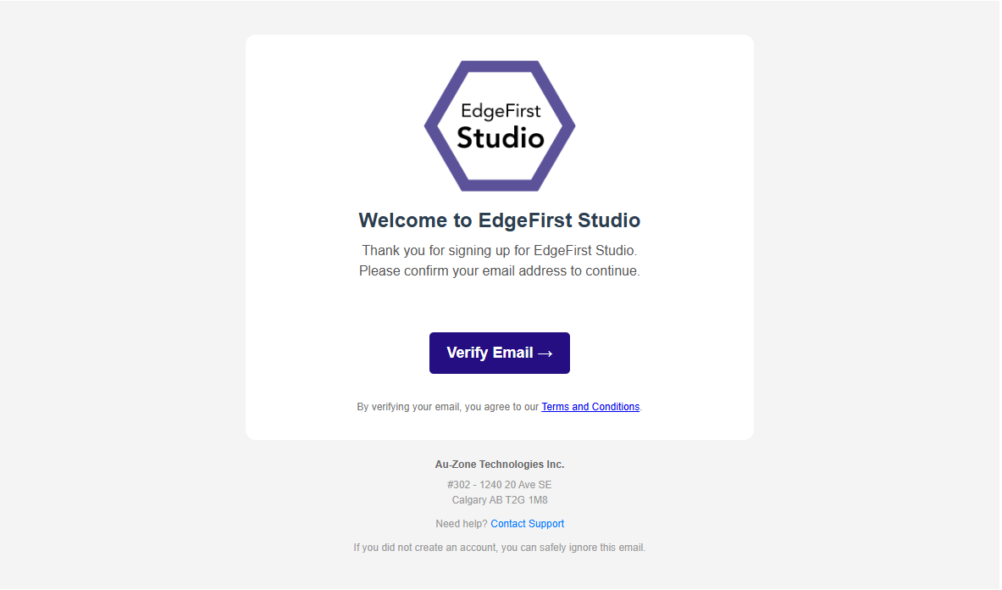

Slide 3
Login Page Image
Unmarked: /docs/studio/assets/user/login-page.jpg

Slide 4
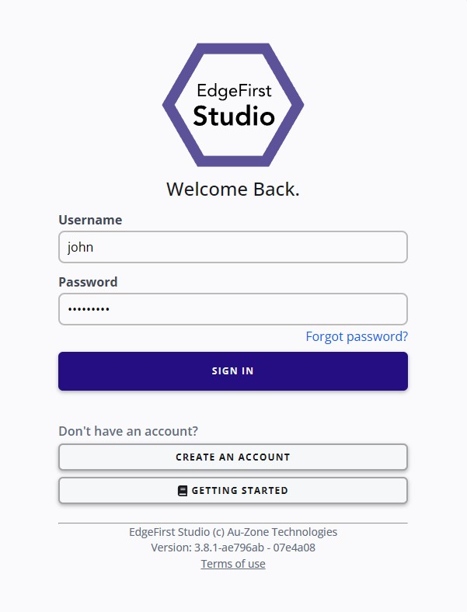
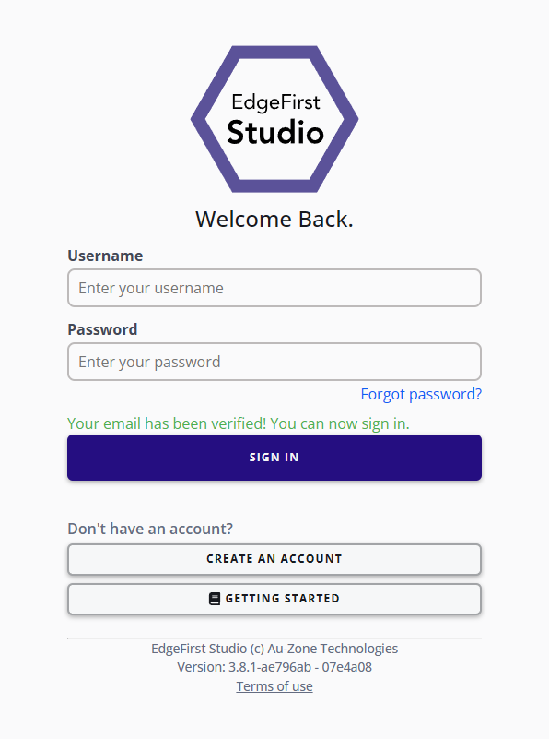

Slide 5
Home Page Image
Unmarked: /docs/studio/assets/user/home-page.png
1005 x 660 pixels
3 variants

Slide 6
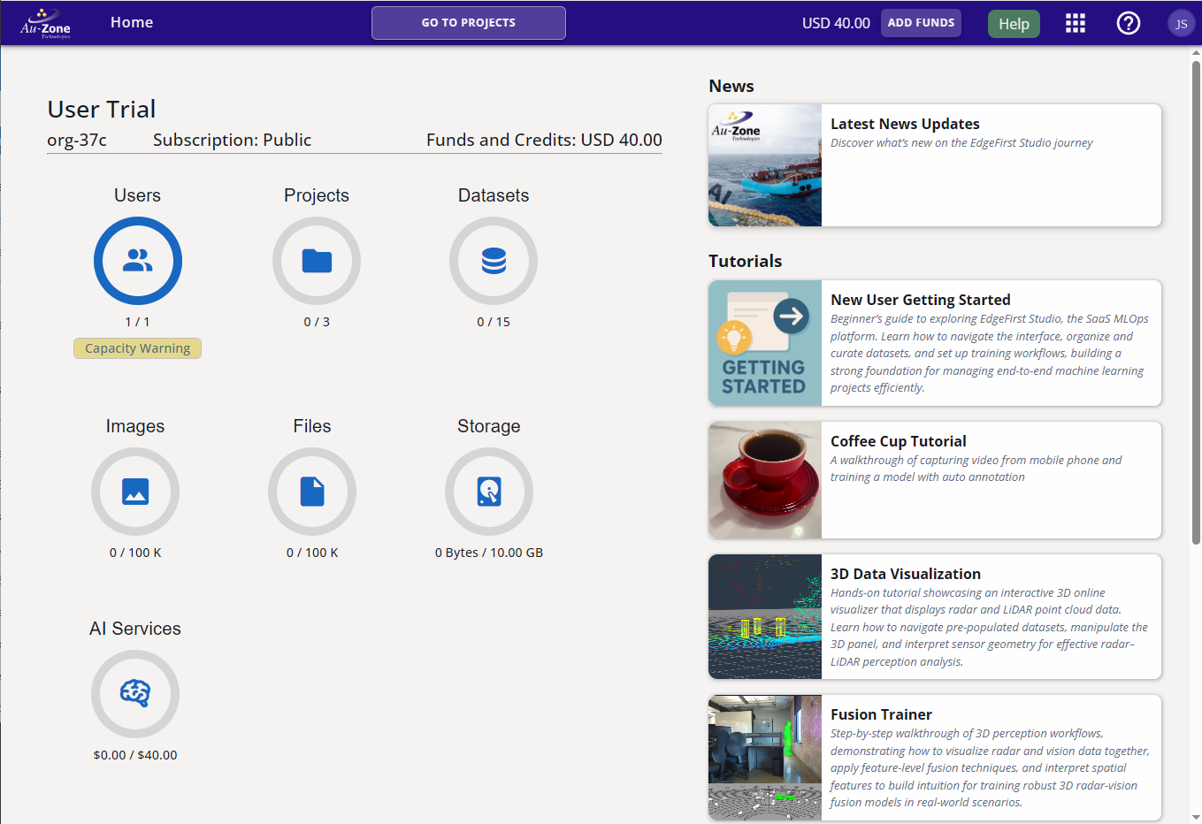
1
2
5
3
4
6
Notes:
Marked: /docs/studio/assets/user/home-page-breakdown.png

Slide 7
Notes:
Marked: /docs/studio/assets/user/home-page-goto-projects.png

Slide 8
1
2
3
4
5
6
7
8
Notes:
Marked: /docs/studio/assets/navigation/navigation-bar.png

Slide 9
Projects Page Image
Unmarked: None

Slide 10
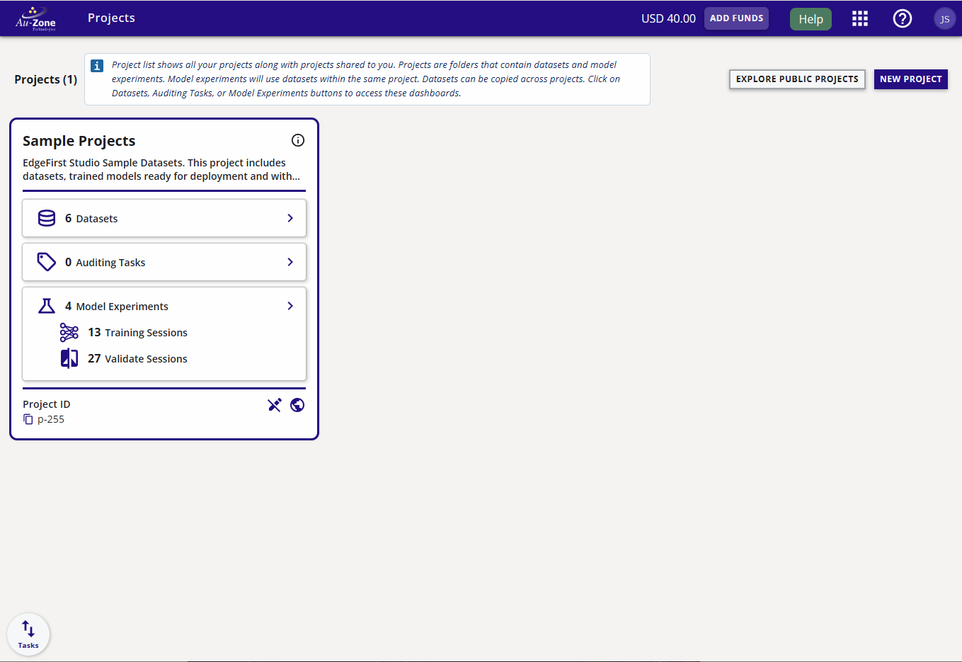
Notes:
Marked: /docs/studio/assets/projects/create-project.jpg

Slide 11
Create Project Image
Unmarked: None

Slide 12
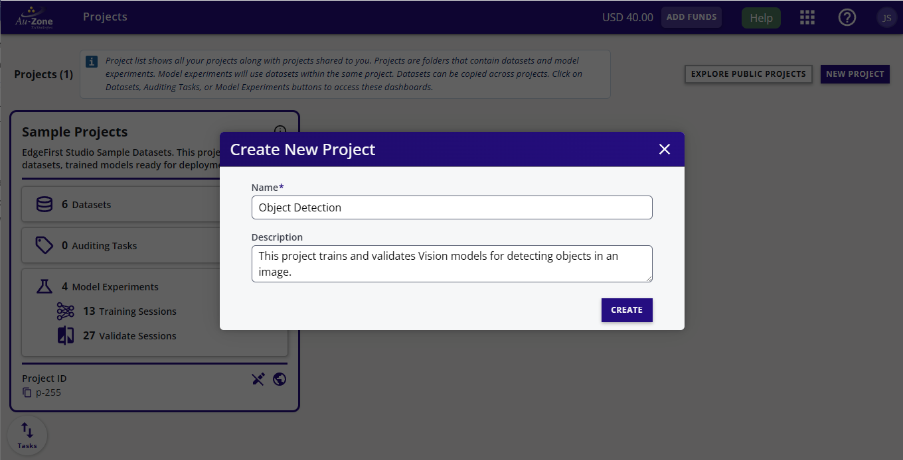
Notes:
Marked: /docs/studio/assets/projects/create-project-fields.jpg

Slide 13
Created Project Image
Unmarked: None

Slide 14
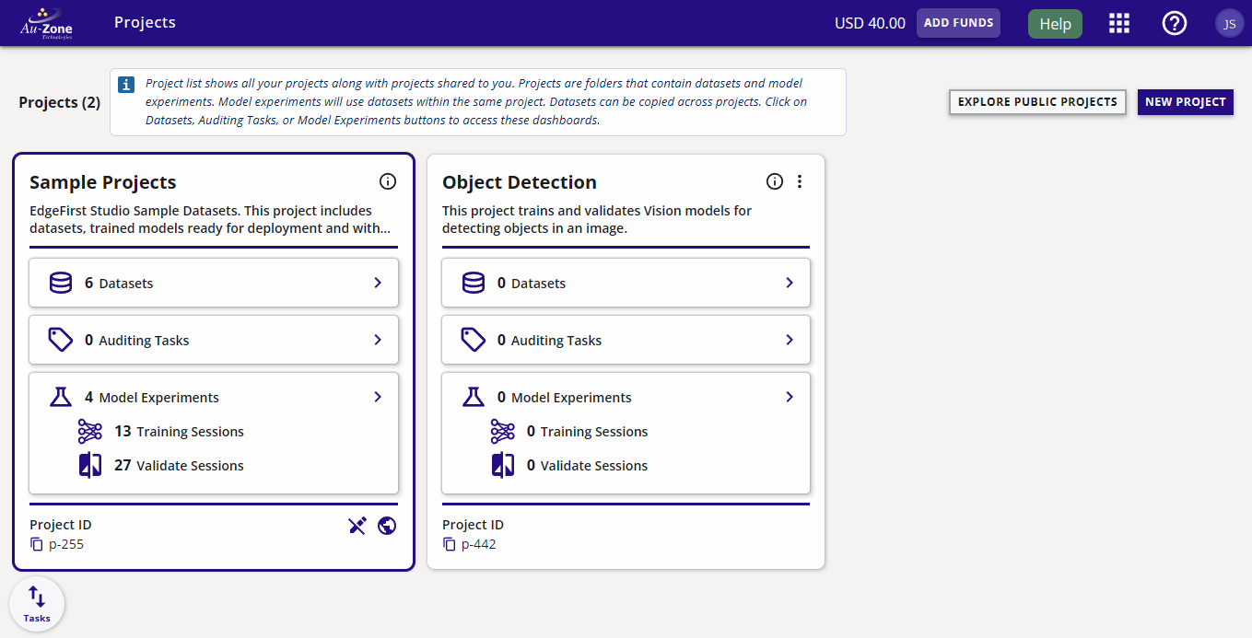
Notes:
Marked: /docs/studio/assets/projects/new-project.jpg

Slide 15
Notes:
Marked: /docs/studio/assets/projects/sample-datasets-button.jpg

Slide 16
Sample Project Datasets
Unmarked: None

Slide 17
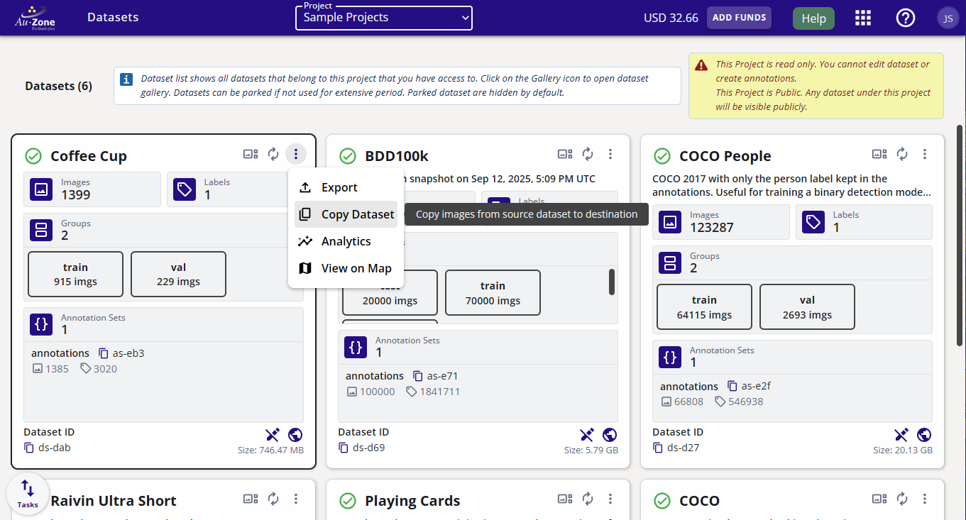
Notes:
Marked: /docs/datasets/assets/management/copy-dataset-option.jpg

Slide 18
Copy Datasets
Unmarked: None

Slide 19
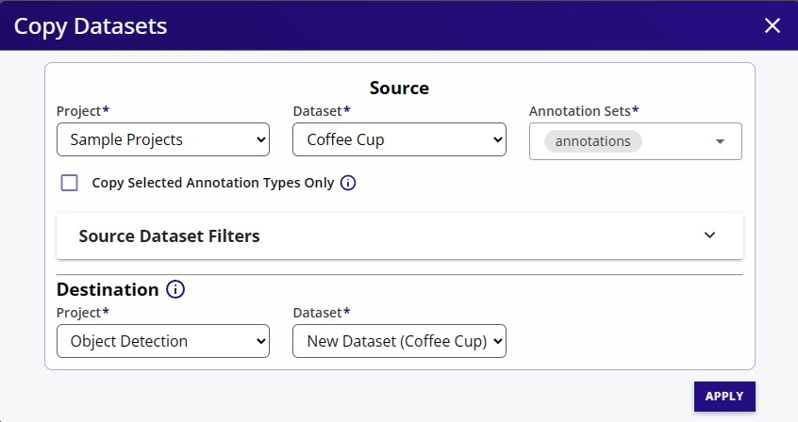

Slide 20
Dataset History
Unmarked: None

Slide 21
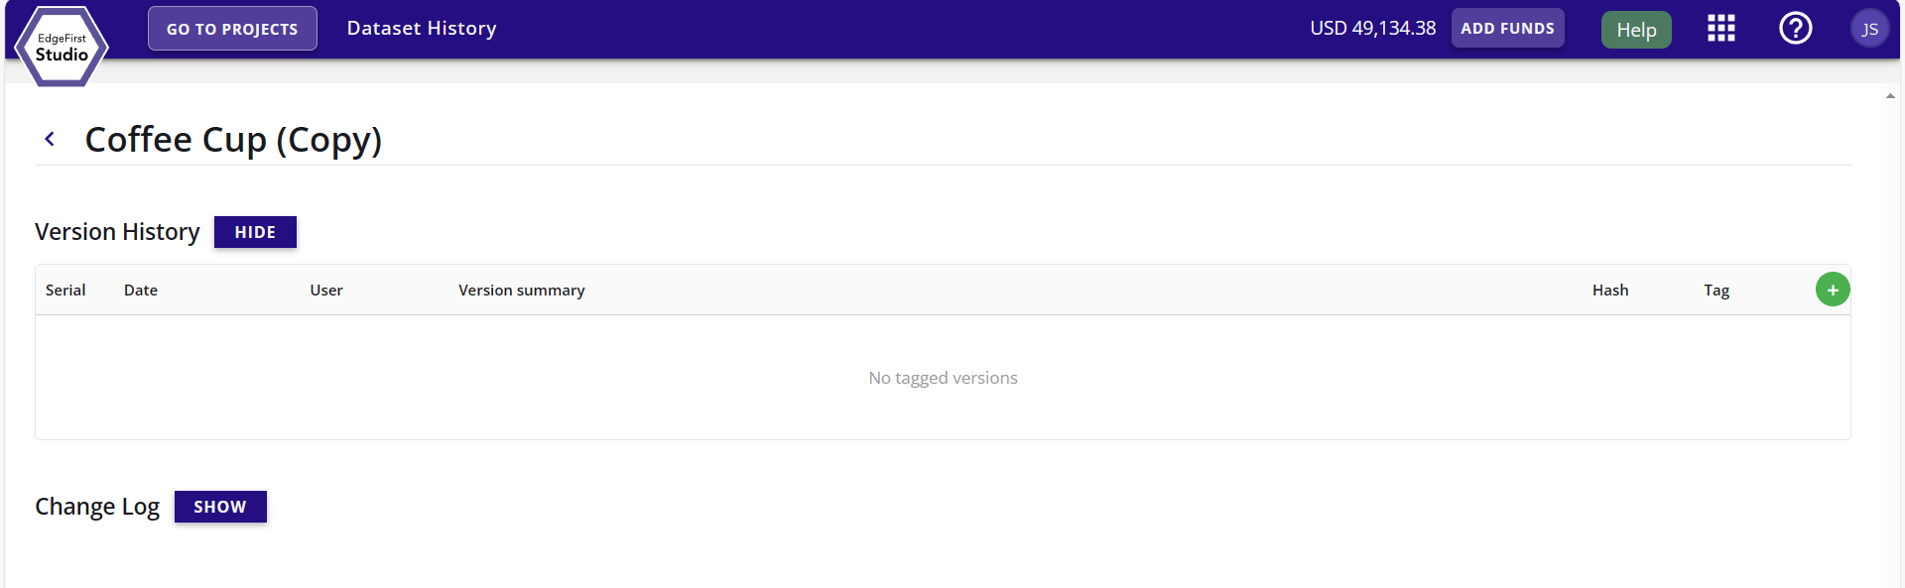

Slide 22
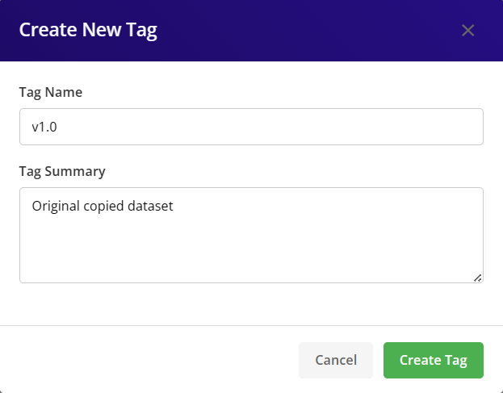

Slide 23
Dataset Gallery Sidebar
Not unmarked
212 x 464

Slide 24
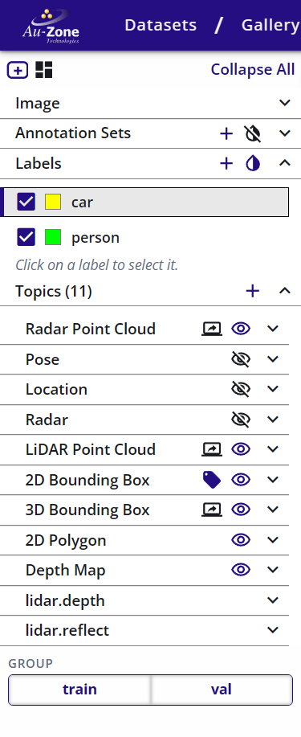
1
2
3
4
Notes:
Marked: /docs/3D/assets/3d_viewers.jpg

