Slide 1
Capacity Estimation of MIMO Systems via Support Vector Regression
Xiaolin Hu
Supervisor : Nicholas E.Buris
School of Communication and Information Engineering Shanghai University
1

Slide 2
Outline
Background and Motivation
System Model
Fundamentals of Support Vector Regression
Capacity Estimation of MIMO Systems
Effect of Interference Power
Effect of Propagation Model
Comparison of SVR and Gaussian Process Regression
Conclusions
2

Slide 3
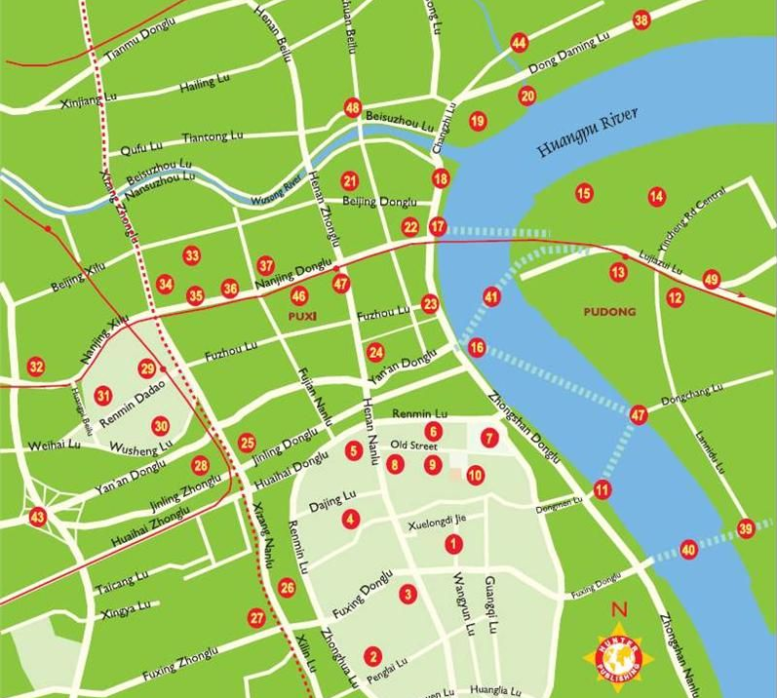
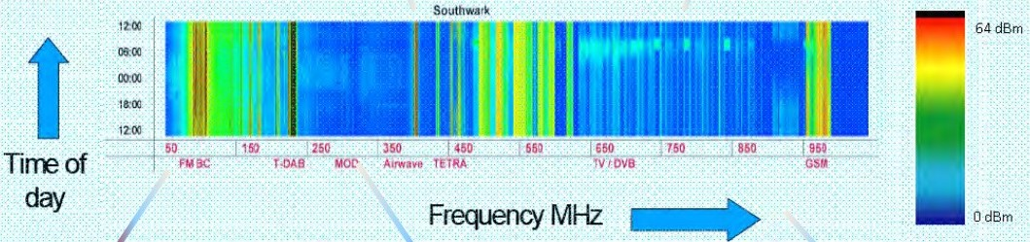
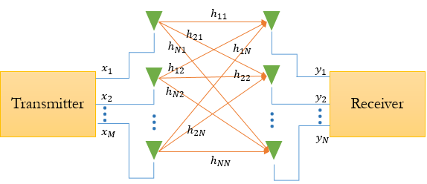

Background and Motivation
Capacity Estimation of MIMO Systems
Goal: Find capacity map $φ(x,f)$ across
MIMO Systems
Open-Loop
To estimate capacity more efficiently !
3

Slide 4
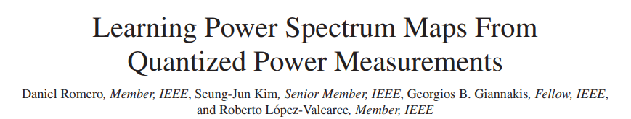
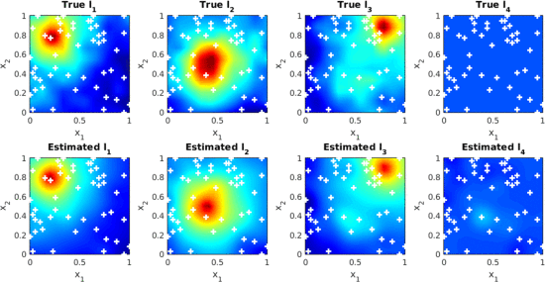
Background and Motivation
Existing work
MAY 15, 2017
4

Slide 5
System model
Transmitters
Predict Data here
MIMObit
Transmitters
Antenna pattern
Frequency
Signal or interference
total power
Interference
Signal
Receiver
Antenna pattern
Frequency
Propagation model
Sensors
Received Data used for training
5

Slide 6
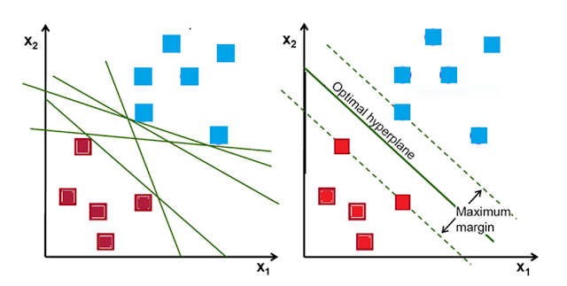
Fundamentals of Support Vector Regression
Support Vector Machine
6

Slide 7
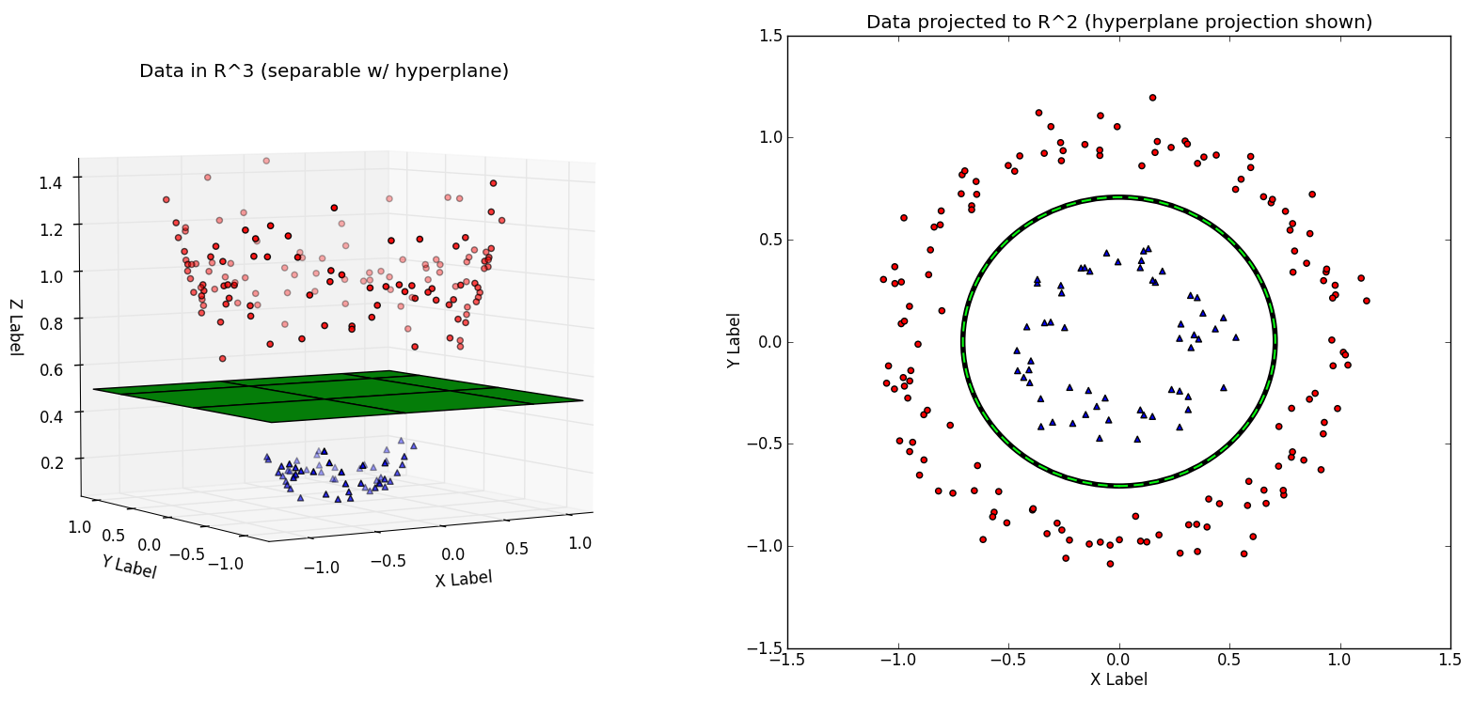
Fundamentals of Support Vector Regression
Support Vector Machine
Kernel Function
7

Slide 8
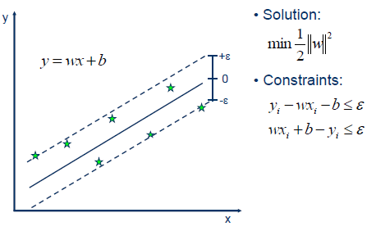
Fundamentals of Support Vector Regression
Support Vector Regression
8

Slide 9


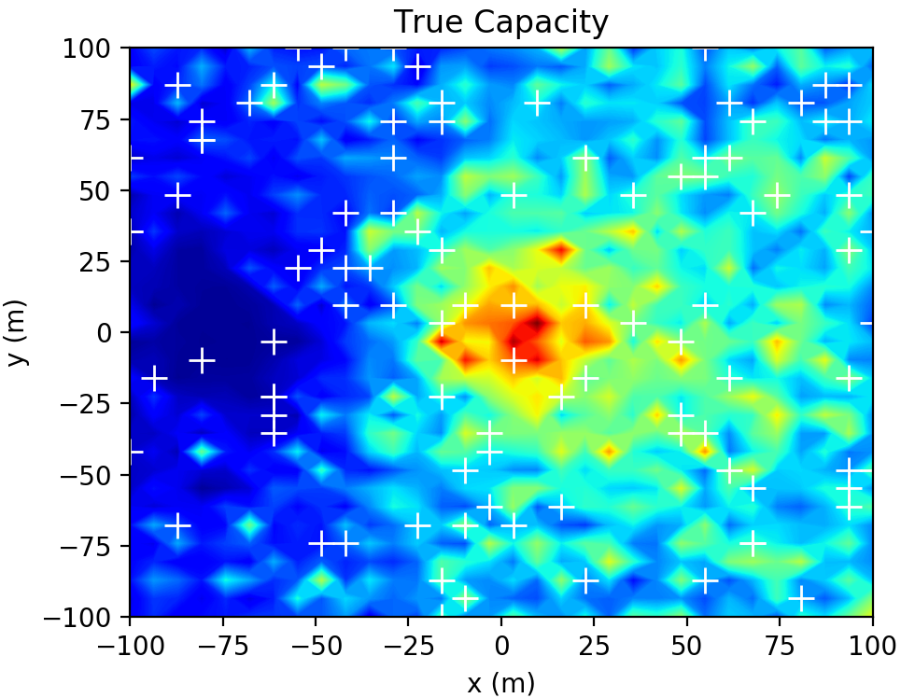
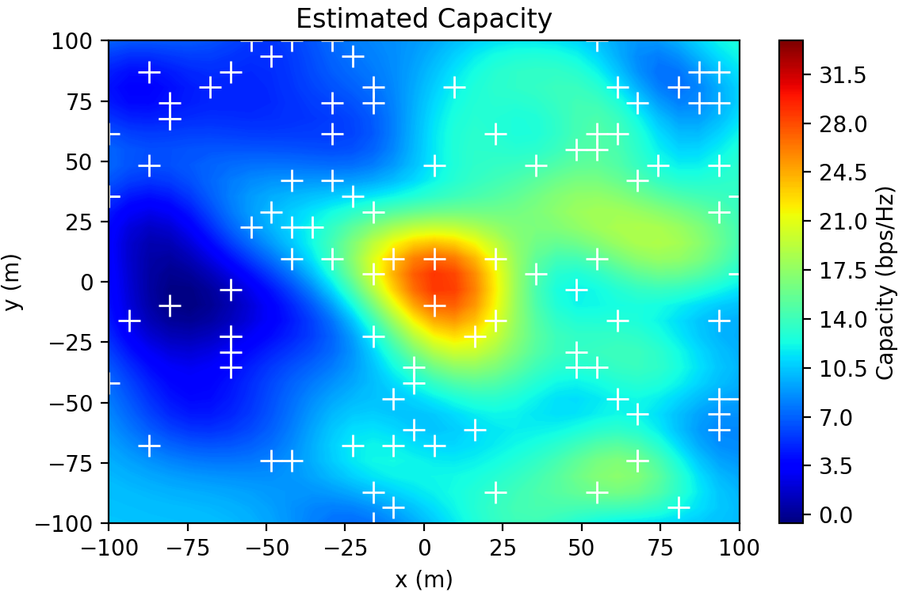

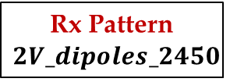
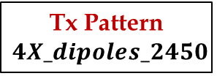

Capacity Estimation of MIMO Systems
$$4X_dipoles$$
$$2V_dipoles$$
True and SVR estimated capacity
Tx Pattern
$$4X_dipoles_2450$$
Rx Pattern
$$2V_dipoles_2450$$
Frequency
2450M
Interference / Singal
15dBm / 30dBm
Channel Model
TGn-B
9

Slide 10
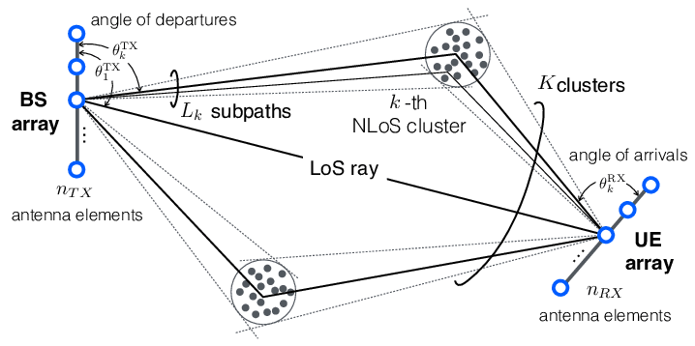
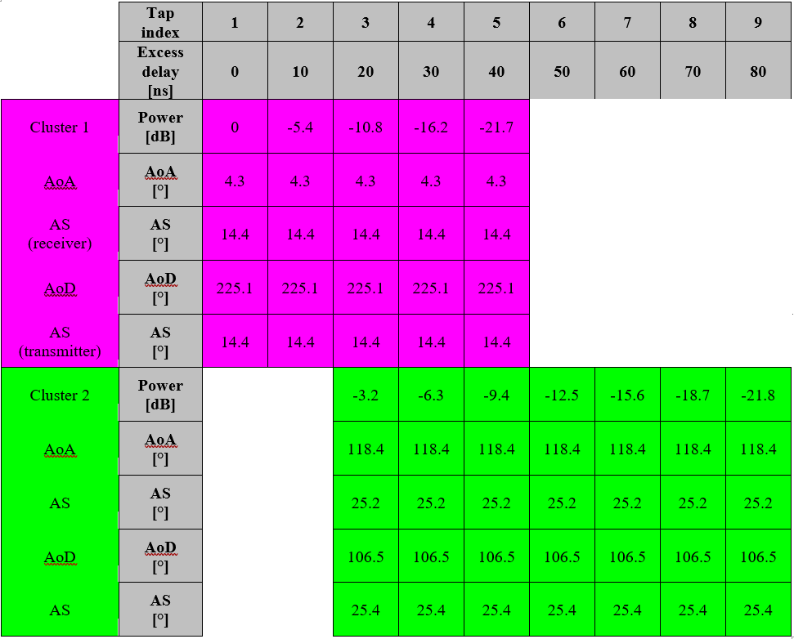
Estimation performance of SVR
IEEE TGn-B Channel Model
line-of-sight (LOS)
Direct path propagation
Flat-Earth:
two-ray model
10

Slide 11
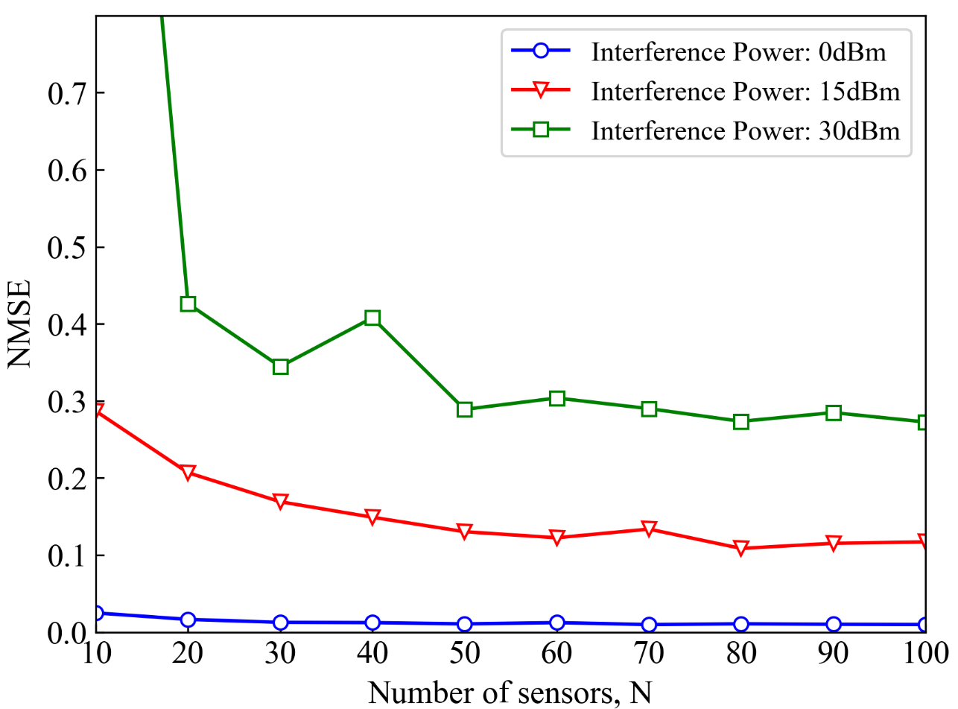
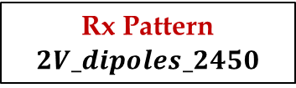
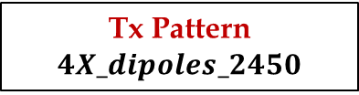
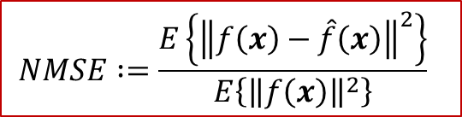
Estimation performance of SVR
Effect of Interference Power
$$NMSE∶=\frac{E\left\{{\left\|f\left(x\right)−\hat{f}\left(x\right)\right\|}^{2}\right\}}{E\left\{{\left\|f\left(x\right)\right\|}^{2}\right\}}$$
performance improves with number of sensors
lower interference, better performance
Tx Pattern
$$4X_dipoles_2450$$
Rx Pattern
$$2V_dipoles_2450$$
Frequency
2450M
Channel Model
TGn-B
11

Slide 12
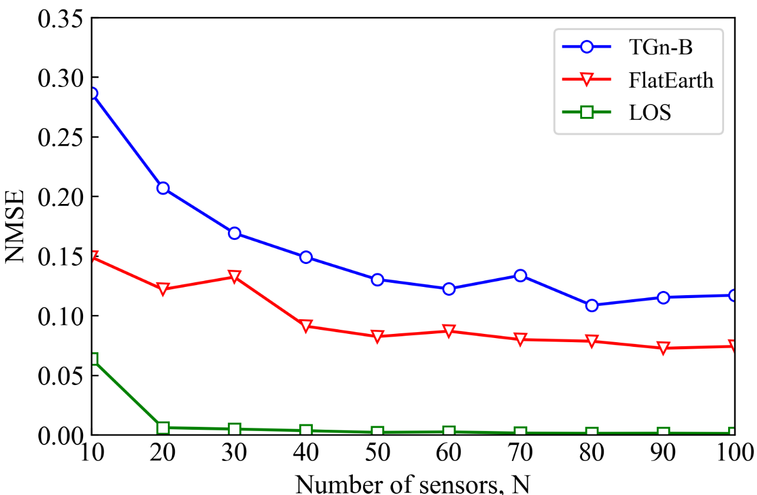
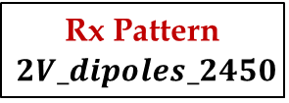

Estimation performance of SVR
Effect of Propagation Model
line-of-sight (LOS)
Direct path propagation
Flat-Earth:
two-ray model
TGn-B:
two random clusters of
plane waves
Tx Pattern
$$4X_dipoles_2450$$
Rx Pattern
$$2V_dipoles_2450$$
Frequency
2450M
Interference / Singal
15dBm / 30dBm
12

Slide 13
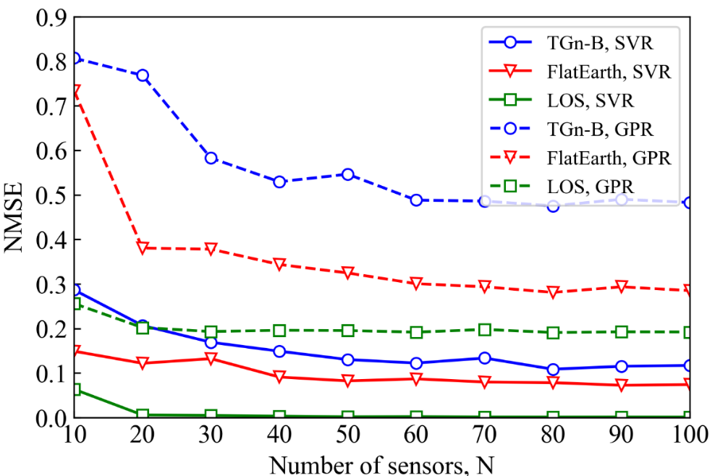
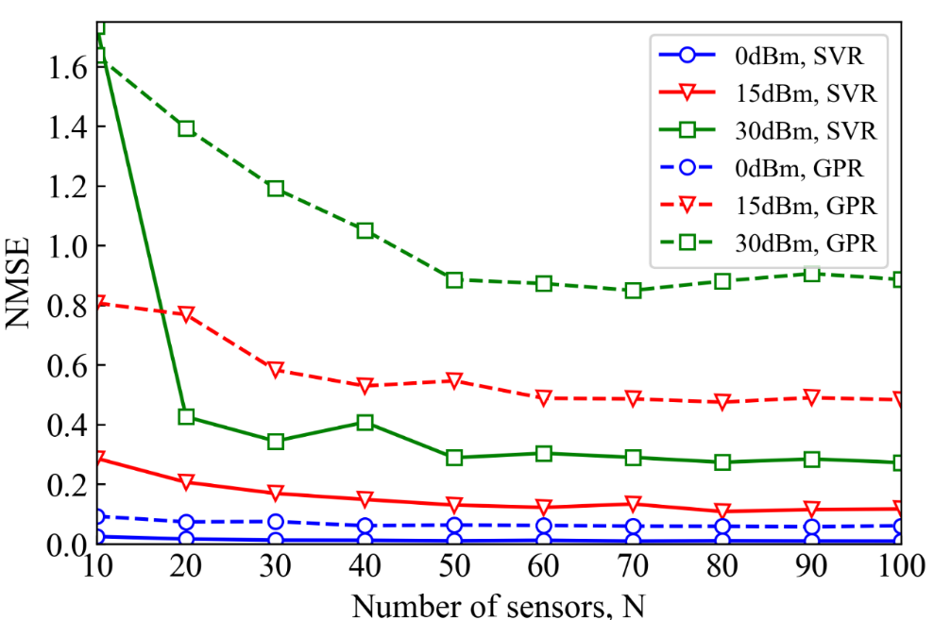
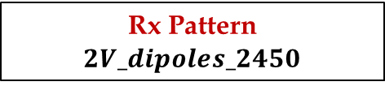
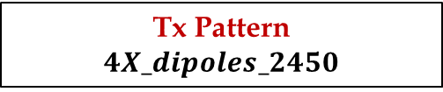
Comparison of SVR and GPR
Effect of Propagation Model
Effect of Interference Power
Interference Power : 15dBm
Channel Model:TGN-B
Tx Pattern
$$4X_dipoles_2450$$
Rx Pattern
$$2V_dipoles_2450$$
Frequency
2450M
13

Slide 14
Conclusions
The cartography of capacity for such a MIMO link is feasible even when using just 10% of data for training
The performances of the estimator are tested from different aspects
Performance improves with number of sensors
Lower interference, better performance
The SVR run better when the actual model is simple
14

Slide 15
THANK YOU !!!
DISCUSSION & FEEDBACK

Slide 16
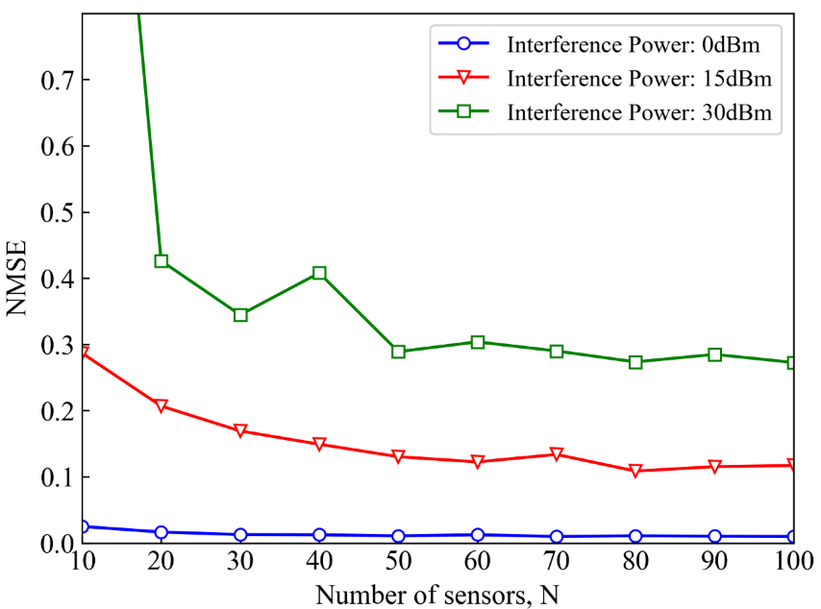
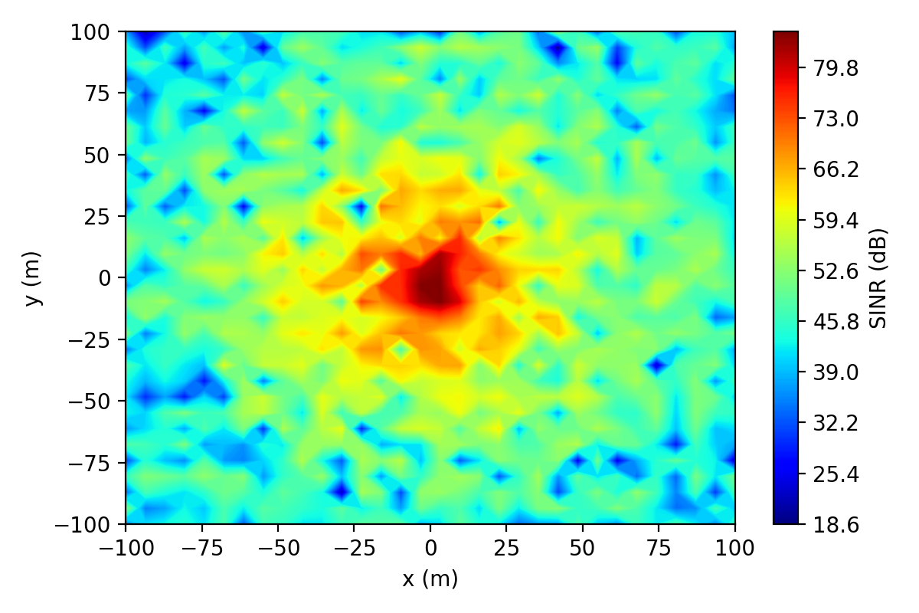
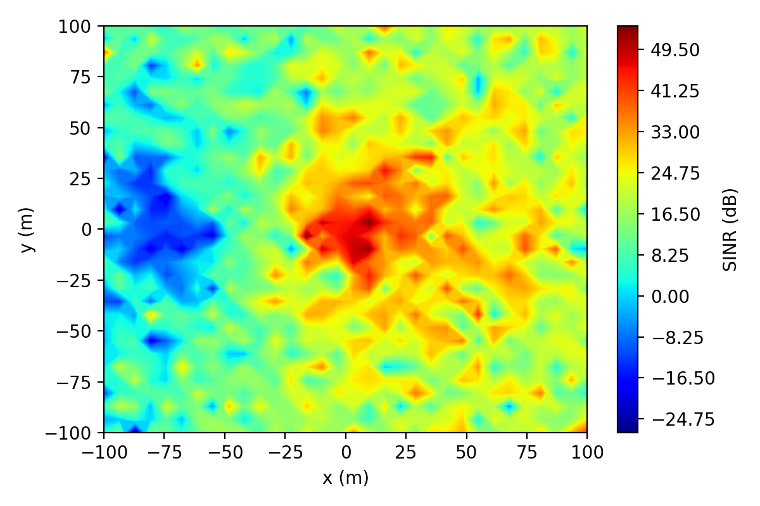
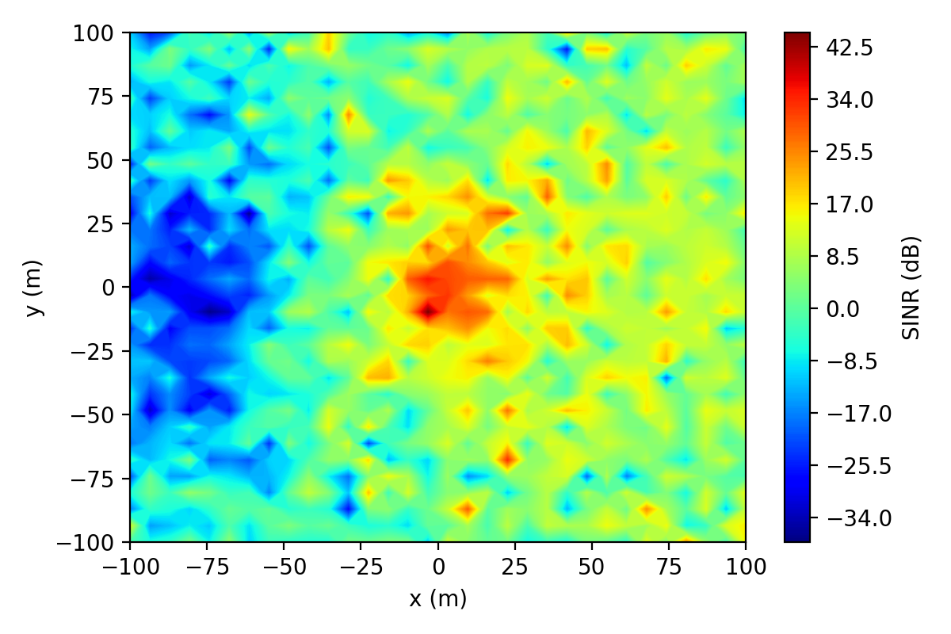
SINR for Different Interference Power
Interference Power : 0dBm
Interference Power : 15dBm
Interference Power : 30dBm

Slide 17
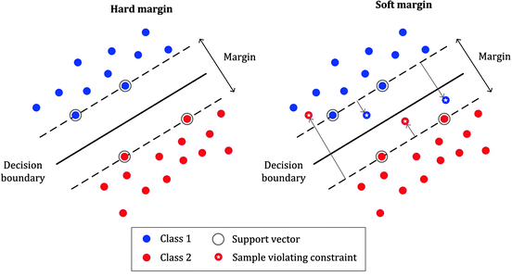
Fundamentals of Support Vector Regression
Support Vector Machine

Slide 18
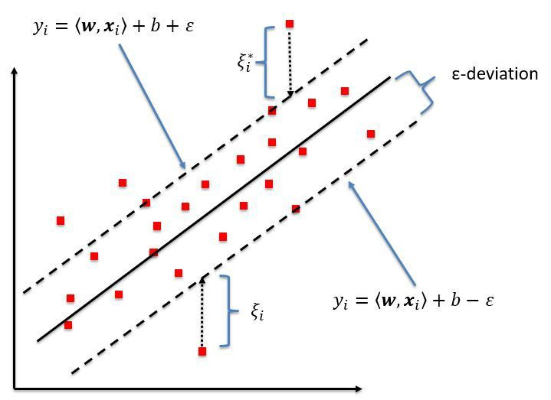

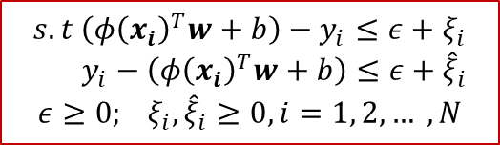
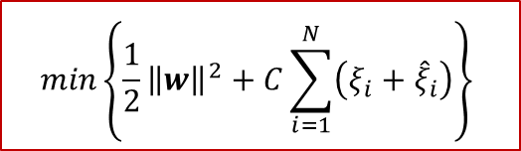
Fundamentals of Support Vector Regression
Support Vector Regression
$$f\left(x\right)={φ\left(x\right)}^{T}w+b$$
$$min\left\{\frac{1}{2}{\left\|w\right\|}^{2}+C\sum_{i=1}^{N}{\left({ξ_{i}+\hat{ξ}}_{i}\right)}\right\}$$
$$s.t \left({φ\left(x_{i}\right)}^{T}w+b\right)−y_{i}≤ε+ξ_{i}$$
$$y_{i}−\left({φ\left(x_{i}\right)}^{T}w+b\right)≤ε+{\hat{ξ}}_{i}$$
$$ε≥0; ξ_{i}, {\hat{ξ}}_{i}≥0, i=1, 2, … ,N$$
Smola, Alex J., and Bernhard Schölkopf. "A tutorial on support vector regression." Statistics and computing 14.3 (2004): 199-222.

Slide 19
Open Loop mismatched capacity
Open Loop:
The Tx does NOT know the channel. Therefore, the Tx creates as many orthogonal signals as there are transmitter chains and allocates the same power to each such signal. The SVR run better when the actual model is simple
Mismatched:
this pertains to the case where the source impedances driving the antenna system are in the mix for the input power. That is, the mismatches between these source impedances and the antenn

