Slide 1
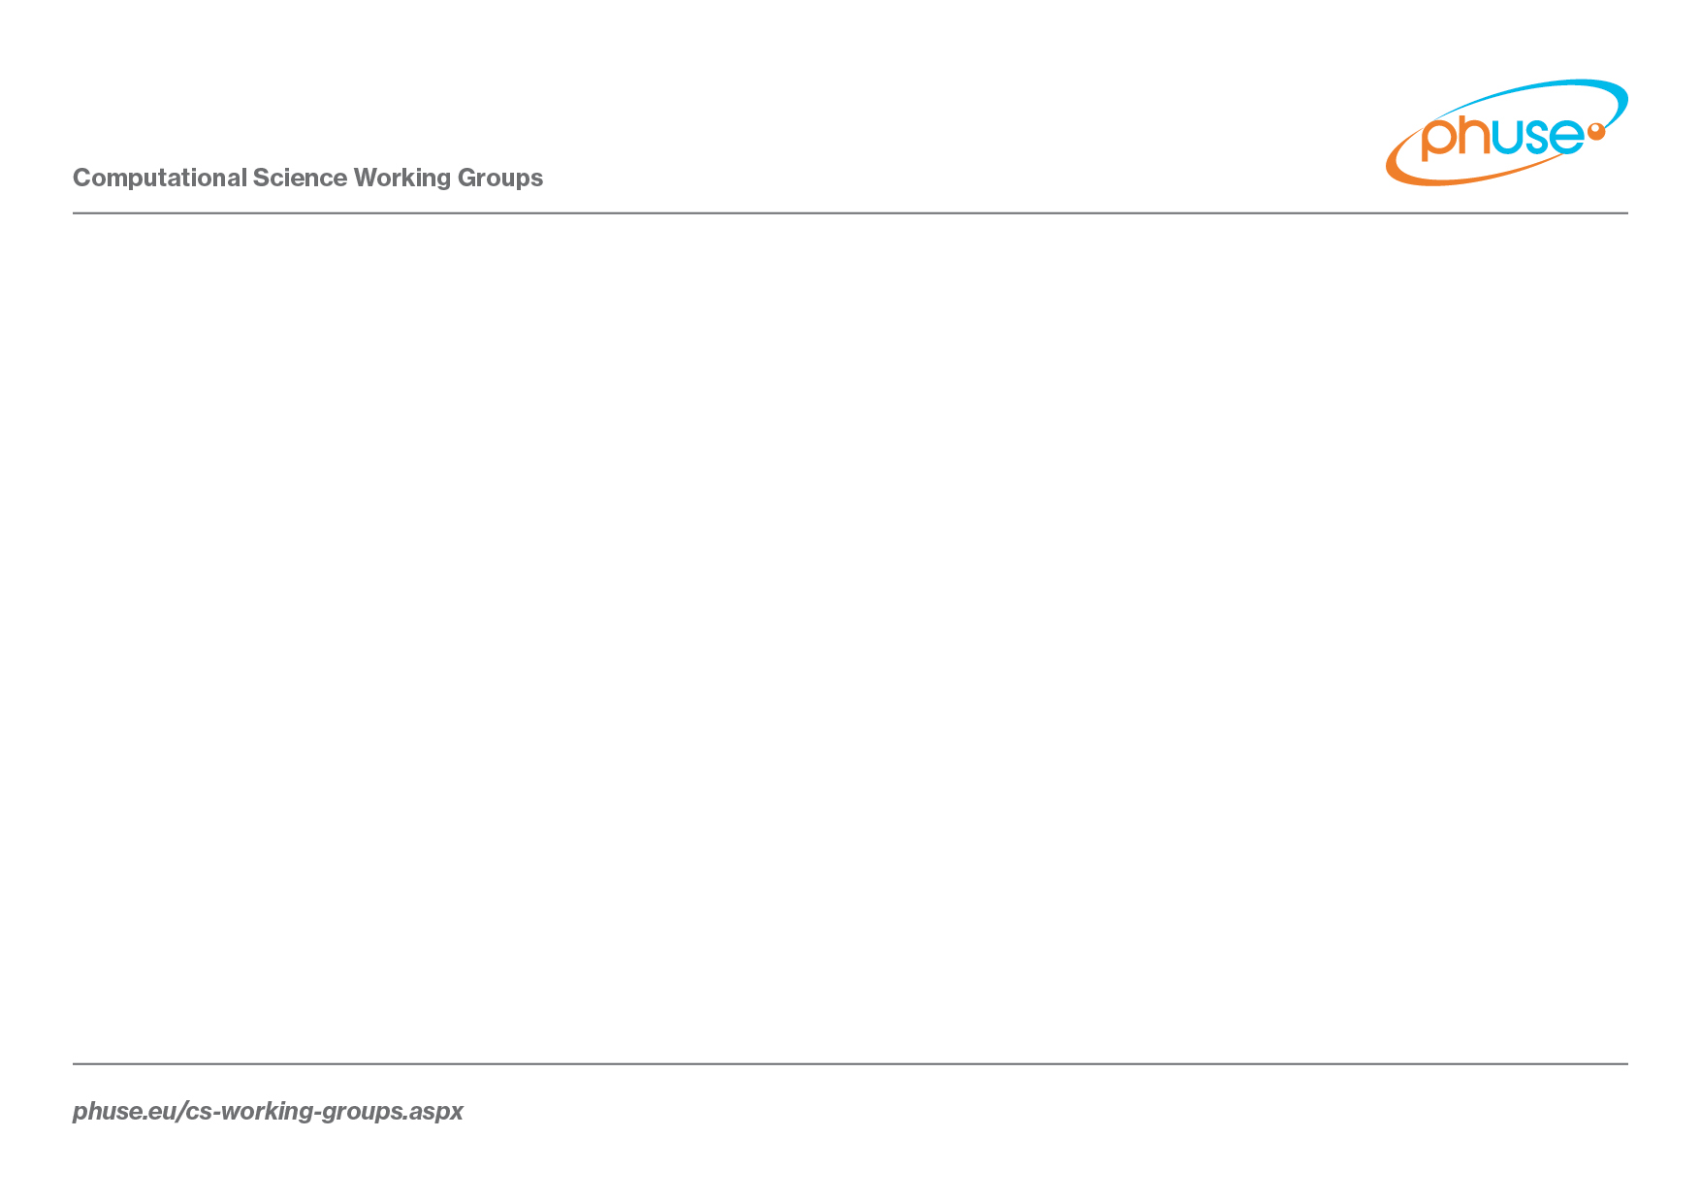
Standard Analyses and Code Sharing
Hanming Tu
26 April 2017

Slide 2




Vision: Fill the Gap on Analysis and Display Standards
Trial Design
Data Collection Systems
Observed Datasets
Analysis Datasets
Tables, Figures and Listings
Clinical Data
Flow
Industry
Standards
Alignment
No Standards Exist
PRM
CDASH
SDTM
ADaM
(Therapeutic Areas)
Notes:
A lot of progress has been made with respect to standardization – mostly in the collection and data space. There’s a gap with respect to analyses and displays. CFAST = Coalition for Accelerating Standards and Therapies

Slide 3

Vision: Script Repository (Shared Reusable Code Library)
FDA
Industry
Academia
Script Repository in Github
Test Data
SAS, R, Spotfire, Etc.
Code Test Environment
White Paper Scripts
Contributed Scripts
Notes:
Vision of the Script Repository – Reusable code library – Utilizing crowd-sourcing to maintain. All inclusive. Assumes SDTM/ADaM data structure. Currently SAS and R focus but not intended to be limited to those. Getting code associated with the white papers is a current focus. Adding some standard code that FDA medical reviewers use is also a focus. Can also be a place to share code for ADaM derivations.

Slide 4
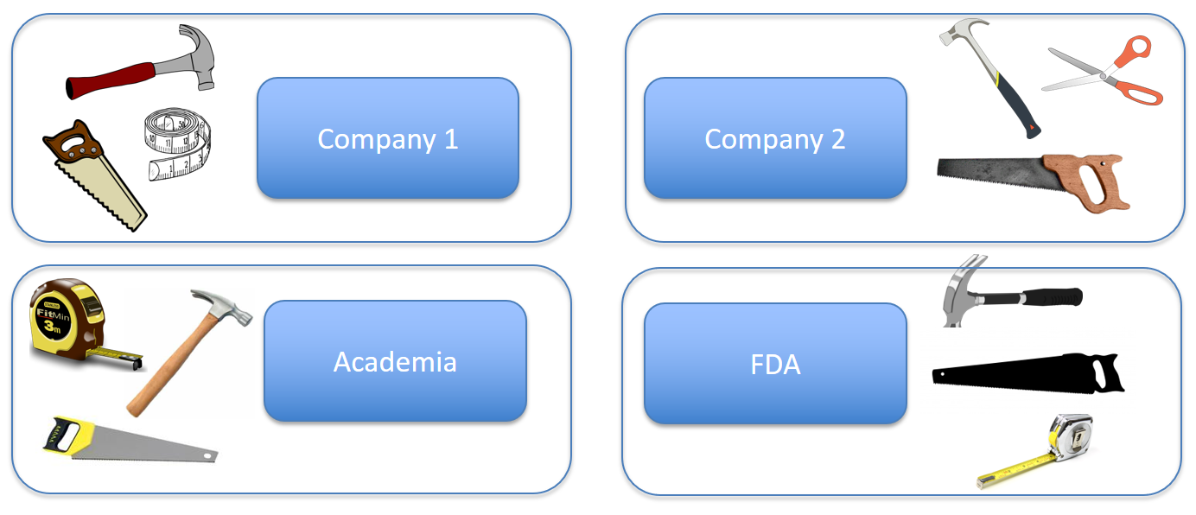
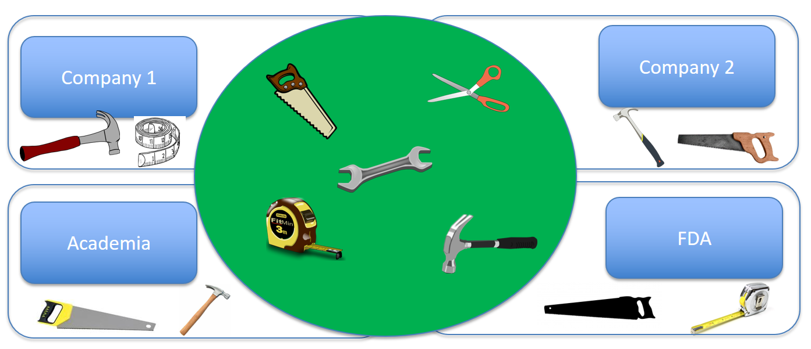
Vision – From Everyone Building Their Own Tools to Shared Tools
Text
Text
Text
Text
Shared tools
Text
Text
Text
Text
Text
Shared Value
Notes:
Another way to look at the vision for script/code-sharing

Slide 5


Focus Areas
Three Focus Areas, 6 active projects
Script Repository (4 projects)
Script Discovery and Acquisition (SDA, Rebeka Revis, Alfredo Rojas)
Repository Content and Delivery (RCD, Gustav Bernard, Andrew Miskell)
Repository Governance and Infrastructure (RGI, Mike Carniello, Hanming Tu)
Test Data Factory (TDF, Peter Schaefer)
Analyses and Display White Papers (ADW, Mary Nilsson)
Communication, Promotion, Education (CPE, Jared Slain and Wendy Dobson)

Slide 6


Accomplishments
6 Analysis and Display White Papers finalized
Script Repository has been created and scripts have been contributed and developed
NEW: Contributed scripts are starting to be used by others! The crowd-sourcing vision for scripts is showing signs of working!

Slide 7
CSS 2017
Github Workshop
Demo on creating and editing scripts in Github
Demo on SAS programs contributed by the FDA
Demo on a Spotfire interactive display package
Discussed communication/education
Discussed topics related to the repository
Discussed priority test data sets
Discussed the Script input format
Discussed the Script test environment (STE)
Discussed need for R expertise

Slide 8
CSS 2017
Discussed plans for new white papers, plans for updating a couple existing white papers
AE white paper follow-up topics
Hepatotoxicity, Treatment-emergent definitions, labs/vitals/ECGs
Joint meetings
Analysis and Display White Papers project team with
Best Practices for Data Collection Instructions project team
Data Visualizations project team
Feedback – project team members seemed to really like these joint meetings between project teams!

Slide 9
Working Group Next Steps
Continue work on white papers
4 additional white papers planned; 3 white papers to be updated
Continue work on the Script Repository
Increase usability, quality, and acceptability of the scripts
Develop scripts based the recommendations from white papers
Work through getting true “crowd-sourcing” to work
Continue work on Test Data Factory Project
Update CDISC pilot data
Provide additional test data for multiple purposes
Continue work on Communication/Promotion/Education
Communicate in multiple forums
Develop training material
Notes:
All of our project teams are looking for additional volunteers!

Slide 10
How to Participate
Sign up for the PhUSE working group mailings
From phusewiki.org, click “Join a Working Group Now”
Standard Scripts Groups
CSS-WG-Standard-Scripts (Entire Working Group)
CSS-WG-Standard-Scripts-WhitePapers (White Paper Project Team)
CSS-WG-Standard-Scripts-Platform (Script Repository)
CSS-WG-SS-WhitePaperReviewers (Notified when a white paper is ready for review)
See wiki pages for each of the projects (www.phusewiki.org)

Slide 11


Slide 12
Working Group Vision/Goals
Leverage crowd-sourcing to improve the content and implementation of analyses for medical research, leading to better data interpretations and increased efficiency in the clinical drug development and review processes.
Establish and maintain a publicly available repository for storing program code to be used as analytical tools for medical research.
Where gaps exist, develop recommendations for analyses and displays in areas that could benefit from crowd-sourcing.
Where gaps exist, develop code for recommended analyses and displays that could benefit from crowd-sourcing (to reside in the repository).

Slide 13

Projects at Glance
Test Data Factory (P09)
Governance and Infrastructure (P03)
GitHub
Test Data
Standard Analyses
(White Papers)
TFL’s
Content and Delivery (P02)
Scripts
White papers (P08)
Script Discovery and Acquisition (P01)
Communication, Promotion and Education (P07)
Circa 2016

Slide 14
Accomplishments: Repository
Script Repository
MIT license chosen
https://github.com/phuse-org/phuse-scripts/blob/master/LICENSE.md
Qualification guidelines developed
http://www.phusewiki.org/wiki/index.php?title=WG5_Project_02#Qualification_Process
User-friendly front end developed
https://github.com/phuse-org/phuse-scripts/wiki/Simple-Index
Repository has been updated to have a place to store scripts developed by other groups

Slide 15
Accomplishments: Scripts Contributed
Scripts contributed by other groups
FDA: https://github.com/phuse-org/phuse-scripts/wiki/JumpStart-Scripts
Non-clinical: https://github.com/phuse-org/phuse-scripts/tree/master/contributed/Nonclinical
Data Handle: https://github.com/phuse-org/phuse-scripts/tree/master/lang/SAS/datahandle
Spotfire Templates: https://github.com/phuse-org/phuse-scripts/tree/master/contributed/Spotfire

Slide 16
Accomplishments: Scripts Developed
Scripts developed by volunteers
6 Scriptathons (plus additional work by project members) resulting in several scripts at various stages
Focused on creating scripts associated with the displays in the white papers, starting with ADaM data
The specifications for the scripts include assumptions and required ADaM variables
Starting with CDISC pilot data
Scripts developed based on white paper
Central Tendency package Qualification Completed: 6 Recommended displays in CT White Paper

Slide 17
Accomplishments: White papers
6 Analysis/Display White Papers Finalized
Vital Signs, ECGs, Labs - Central Tendency (2013)
Non-Compartmental Pharmacokinetics (2014)
Demographics, Disposition, Medications (2014)
Vital Signs, ECGs, Labs – Outliers and Shifts (2015)
Thorough QT/QTc Studies (2016)
Adverse Events (2017)
How to find final white papers: Go to www.phuse.eu, Click on Working Groups, Click on CS Deliverables Catalog
Notes:
Vital Signs, ECGs, Labs - Central Tendency Finalized in October 2013, Lead – Mary Nilsson
Non-Compartmental Pharmacokinetics Finalized in March 2014, Lead - Francois Vandenhende
Demographics, Disposition, and Medications Finalized October 2014, Lead – Simin Baygani
Vital Signs, ECGs, Labs – Outliers and Shifts Finalized in September 2015, Lead – Wei Wang
QT/QTc Studies Finalized in March 2016, Lead – Christos Stylianou
Adverse Events Finalized February 2017, Lead – Mary Nilsson, Nhi Beasley, Sheryl Treichel

Slide 18
White Papers Project
Analysis and Display White Papers (ADW)
Project Description:
Develop white papers that provide recommended Tables, Figures, and Listings for clinical trial study reports and submission documents.
Project Leads: Mary Nilsson

Slide 19
White Papers Project: Next Steps
Analysis and Display White Papers (ADW)
Project Next Steps:
AE White Paper follow-up tasks
Gender- and Pediatric-specific MedDRA lists
Process for Grouping MedDRA terms
Work on 4 new white papers
Hepatotoxicity
Questionnaire data
Treatment-emergent definitions
Adverse events of special interest
Work on version 2 of a couple white papers
Demographics/Dispostion/Medications
Labs/Vitals/ECGs

Slide 20
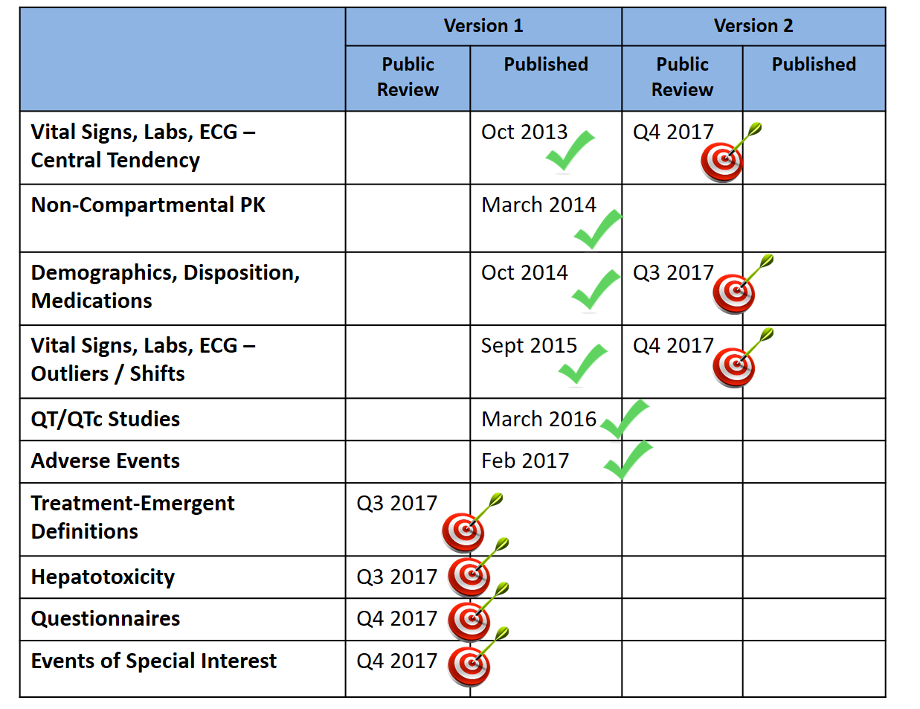
White Papers Project: Timeline
Notes:
Open to additional ideas. Some ideas that have been brought up:
1. TOSNP and Narratives
2. Combining Studies for Integrated Analyses - Points to Consider
3. Qualitative ECGs
4. Analysis of genomic and biomarkers
5. Statistical methods for safety (individual study and integrated, include Bayesian methods)
6. Writing statistical results for safety (individual study and integrated)
7. Process for determining Adverse Drug Reactions
8. Defining the safety population (not necessarily a separate white paper, but include somewhere)
9. Analysis and display of adjudicated data

Slide 21
Communication Project
Communication, Promotion, Education (CPE)
Project Description:
Develop white papers that provide recommended Tables, Figures, and Listings for clinical trial study reports and submission documents.
Project Leads: Jared Slain and Wendy Dobson

Slide 22
Communication Project: Next Steps
Communication, Promotion, Education (CPE)
Project Next Steps
Develop library of materials that have been presented
Create a list of upcoming events and abstract deadlines
Conferences – presentations, posters, roundtables
Work with White Papers project to enhance White Paper visibility
Educational series on analytical and statistical methods from the white papers
Brainstorming ideas now
Webinars?
Onboarding training videos?
Tutorial or Workshop at conferences?
Networking with “Educating for the Future” project team

Slide 23
Repository Projects: SDA
Script Discovery and Acquisition (SDA)
Project Description:
Discover, acquire and review scripts to be stored in the repository with adequate metadata to describe the scripts
Project Leads: Rebeka Revis, Alfredo Rojas
Project Next Steps:
Continue reviewing SAS scripts contributed by the FDA
Creating script metadata files for individual script in JumpStart
Capturing the codes behind Interactive display of the data in Spotfire or R Shiny

Slide 24
Repository Projects: RCD
Repository Content and Delivery (RCD)
Project Description:
Develop and enhance scripts under a defined qualification process to ensure the usability and quality of the standard scripts
Project Leads: Gustav Bernard, Andrew Miskell
Project Next Steps:
Packaging CT scripts including linking to whitepaper, spec and qualification docs
Finishing the shift outlier package including spec and metadata
Creating a R group to develop R scripts for CT package

Slide 25
Repository Projects: RGI
Repository Governance and Infrastructure (RGI)
Project Description:
Establish the basic structure and management of the repository.
Define and enforce existence of required metadata for scripts
Manage users and projects in the repository
Project Leads: Mike Carniello, Hanming Tu
Project Next Steps:
Create a test environment (R and SAS)
Expand the YML metadata usage
Continue maintaining and administering the repository
Crowd-source a shared interactive tool for safety data

Slide 26
Repository Projects: TDF
Test Data Factory (TDF)
Project Description:
Provide test data formatted in SDTM and ADaM that support a more systematic and comprehensive testing of these concepts and scripts.
Project Leads: Peter Schaefer
Project Next Steps:
Determine test dataset requirements
Implement scripts that create ‘simulated’ SDTM and/or ADaM test data sets
Publicize the test data sets

Slide 27
Working Group Needs
More project team members
Increased participation in white paper reviews – Help recruit!
Use/reference recommendations in existing final white papers!
Forward to any existing standards groups
Link to white papers from Statistical Analysis Plans
Participate in re-usable code development
Write, Test, Qualify, Review, Improve
Keep eyes open for existing scripts that need a public home
Advertise! Advertise! Advertise!

Slide 28
Important Links
Working Group:
Main Page: http://www.phusewiki.org/wiki/index.php?title=Standard_Scripts
Projects:
P01 - SDA: Script discovery and acquisition (Rebeka M Revis; Alfredo Rojas)
P02 - RCD: Repository content and delivery (Gustav Bernard; Andrew Miskell; FDA Liaison: Mat Soukup)
P03 - RGI: Repository governance and infrastructure: (Mike Carniello and Hanming Tu)
P07 - CPE: Communication, Promotion and Education (Jared Slain and Wendy Dobson)
P08 - ADW: Analysis and Display White papers (Mary Nilsson)
P09 - TDF: Test Data Factory (Peter Schaefer)
Repository:
Github: https://github.com/phuse-org/phuse-scripts
Publications:
Analyses and Displays of Central Tendency 10Oct2013
Analyses and Displays of PK 25Mar2014
Analyses and Displays of Demographics, Disposition, and Medications 07Oct2014
Analyses and Displays of Outliers/Shifts from Normal to Abnormal 10Sep2015
Analyses and Displays Associated with ThoroughQT/QTc Studies 11Mar2016
Analyses and Displays Associated with Adverse Events 03Feb2017
Index Pages:
Simple Index: https://github.com/phuse-org/phuse-scripts/wiki/Simple-Index.
Standard Index: https://github.com/phuse-org/phuse-scripts/wiki/Standard-Script-Index
Mirrored Index: http://www.phusewiki.org/wiki/index.php?title=Standard_Script_Index
FDA JumpStart: https://github.com/phuse-org/phuse-scripts/wiki/JumpStart-Scripts

