Slide 1
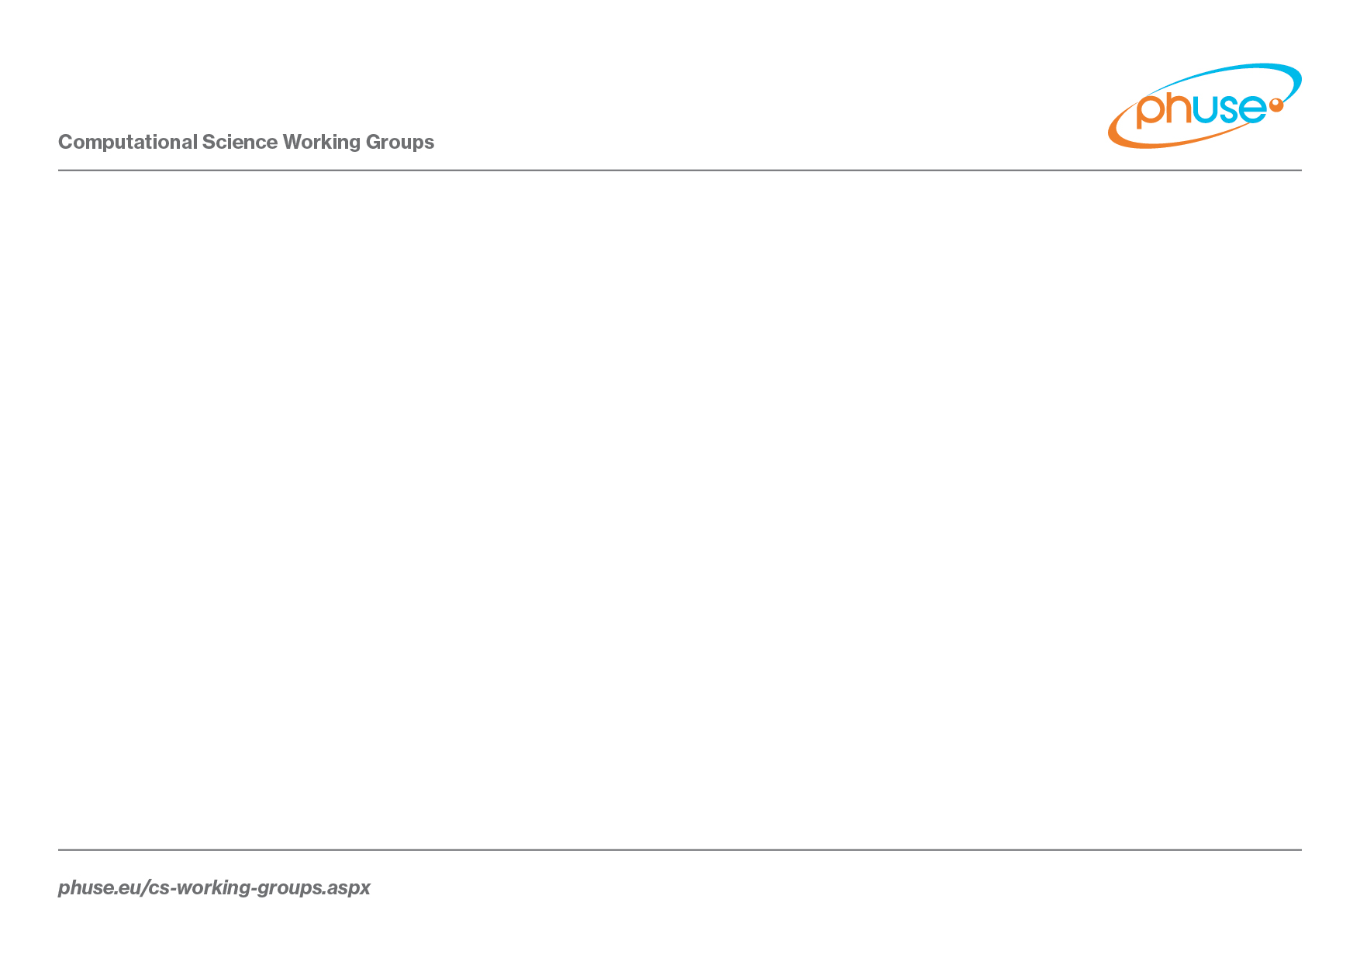
An Update on the PhUSE Standard Analyses and Code Sharing Working Group
ASA Webinar
Hanming Tu and Mary Nilsson
02 May 2017

Slide 2
PhUSE
PhUSE stands for Pharmaceutical User Software Exchange and is an independent, not-for-profit organization run by volunteers. Since its inception (2004), PhUSE has expanded from its roots as a conference for European Statistical Programmers, to a global membership organization and platform for the discussion of topics encompassing the work of Data Managers, Biostatisticians, Statistical Programmers and eClinical IT professionals.
Hosts events
Annual conferences: EU since 2004; US starts 2018
Computational Science Symposiums: US since 2012; EU since 2016
Single Data Events: 4+ in US, 1+ in other regions per year
Maintains a website: http://phuse.eu
Publishes “PhUSE News”

Slide 3
Computational Science Collaboration
Mission:
To provide an open, transparent, and collaborative forum in a non-competitive environment in which Academia, Regulators, Industry, and Technology providers can address computational science needs in support of product development and regulatory review, ultimately bringing safe and effective products to those who need them
Collaboration with PhUSE started in 2012

Slide 4
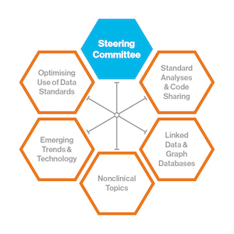
Notes:
Example deliverables from CS Working Groups:
Study Data Reviewer’s Guide and Analysis Data Reviewer’s Guide (referenced in the FDA Study Data Technical Conformance Guide)
SEND Implementation Guide
Traceability Best Practices

Slide 5
Working Group Information
Key site to know about: www.phuse.eu
Working Groups Button: Overview of active projects, new project ideas, call for volunteers, finalized work packages, draft work packages available for public review and comment
Conferences and Events Button: Slides from conferences, information on upcoming conferences
Wiki Button: Working group and project team updates, minutes, etc.

Slide 7
Standard Analyses and Code Sharing Working Group Vision/Goals
Leverage crowd-sourcing to improve the content and implementation of analyses for medical research, leading to better data interpretations and increased efficiency in the clinical drug development and review processes.
Establish and maintain a publicly available repository for storing program code to be used as analytical tools for medical research.
Where gaps exist, develop recommendations for analyses and displays in areas that could benefit from crowd-sourcing.
Where gaps exist, develop code for recommended analyses and displays that could benefit from crowd-sourcing (to reside in the repository).

Slide 8




Vision: Fill the Gap on Analysis and Display Standards
Trial Design
Data Collection Systems
Observed Datasets
Analysis Datasets
Tables, Figures and Listings
Clinical Data
Flow
Industry
Standards
Alignment
No Standards Exist
PRM
CDASH
SDTM
ADaM
(Therapeutic Areas)
Notes:
A lot of progress has been made with respect to standardization – mostly in the collection and data space. There’s a gap with respect to analyses and displays. CFAST = Coalition for Accelerating Standards and Therapies

Slide 9

Vision: Script Repository (Shared Reusable Code Library)
Regulatory Agencies
Industry
Academia
Script Repository in Github
Test Data
SAS, R, Spotfire, Etc.
Code Test Environment
White Paper Scripts
Contributed Scripts
Notes:
Vision of the Script Repository – Reusable code library – Utilizing crowd-sourcing to maintain. All inclusive. Assumes SDTM/ADaM data structure. Currently SAS and R focus but not intended to be limited to those. Getting code associated with the white papers is a current focus. Adding some standard code that FDA medical reviewers use is also a focus. Can also be a place to share code for ADaM derivations.

Slide 10
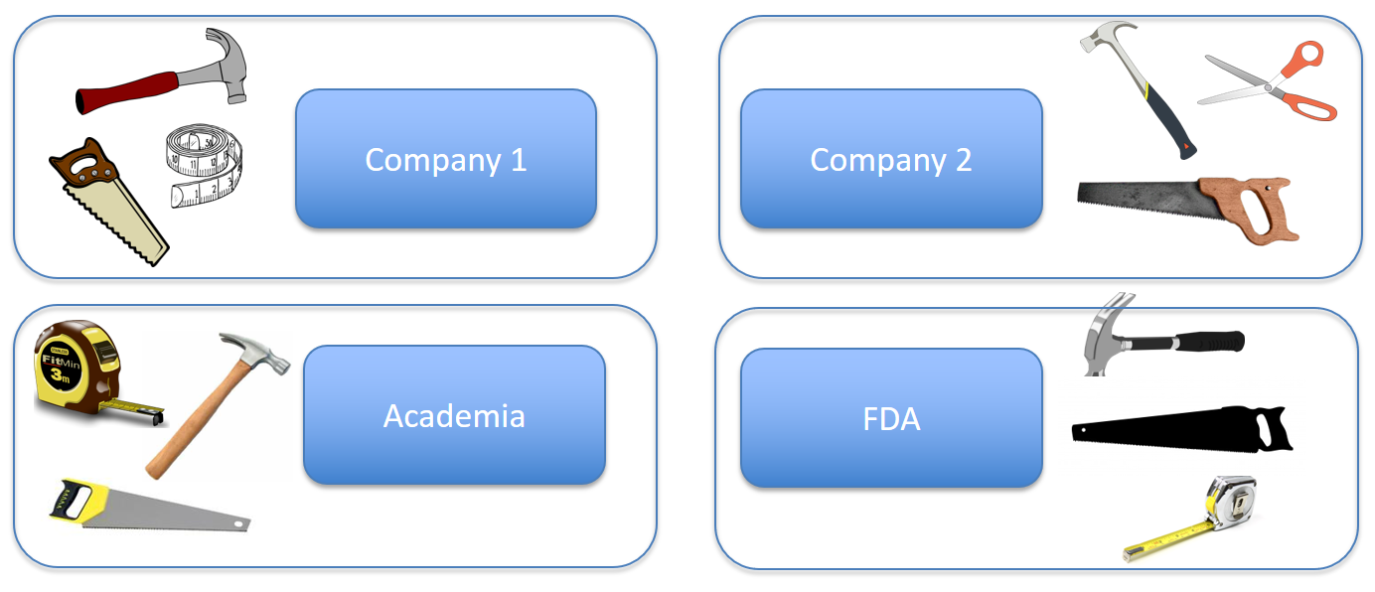
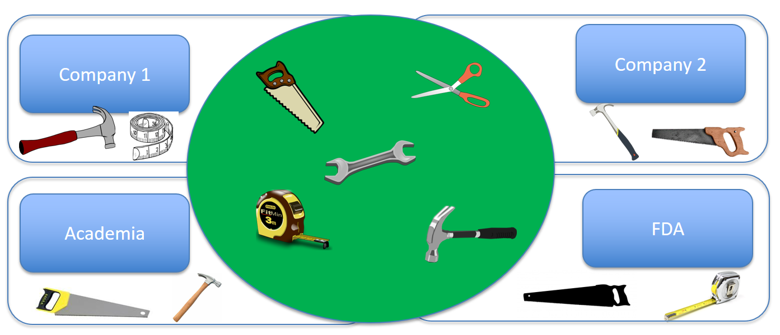
Vision – From Everyone Building Their Own Tools to Shared Tools
Text
Text
Text
Text
Shared tools
Text
Text
Text
Text
Text
Shared Value
Notes:
Another way to look at the vision for shared scripts/code

Slide 11


Focus Areas
Three Focus Areas, 6 active projects
Script Repository (4 projects)
Script Discovery and Acquisition (SDA, Rebeka Revis, Alfredo Rojas)
Repository Content and Delivery (RCD, Gustav Bernard, Andrew Miskell)
Repository Governance and Infrastructure (RGI, Mike Carniello, Hanming Tu)
Test Data Factory (TDF, Peter Schaefer)
Analyses and Display White Papers (ADW, Mary Nilsson)
Communication, Promotion, Education (CPE, Jared Slain and Wendy Dobson)

Slide 12
Standard Analyses and Code Sharing Working Group Vision/Goals
Why?
Better safety signal detection
Improve expertise in safety analytics
Ensure medical reviewers receive clinically relevant and meaningful analyses of patient safety for benefit-risk assessment
Assist in establishing analytical and statistical methods to reduce bias
Improved quality and efficiency
Reduce variability in analytical approaches
Have example code to facilitate implementation
Leverage crowd-sourcing in tool creation and maintenance
Notes:
Excerpts from the purpose section of AE white paper: Ensuring that reviewers receive clinically relevant and meaningful analyses of patient safety for benefit-risk assessment; improve expertise in safety analytics across the multiple disciplines involved with planning, interpreting, and reporting safety analyses; Statisticians can and should assist cross-disciplinary teams to understand and reduce bias in analysis planning and reporting; The potential for biased comparisons is especially a concern when multiple studies are combined (eg, via poor pooling practices for integrated summaries).

Slide 13
Accomplishments: White Papers
6 Analysis/Display White Papers finalized
Vital Signs, ECGs, Labs - Central Tendency
October 2013, Lead – Mary Nilsson
Non-Compartmental Pharmacokinetics
March 2014, Lead - Francois Vandenhende
Demographics, Disposition, and Medications
October 2014, Lead – Simin Baygani
Vital Signs, ECGs, Labs – Outliers and Shifts
September 2015, Lead – Wei Wang
QT Studies
March 2016, Lead – Christos Stylianou
Adverse Events
February 2017, Lead – Mary Nilsson, Nhi Beasley, Sheryl Treichel
How to find final white papers: Go to www.phuse.eu, Click on Working Groups, Click on CS Deliverables Catalog
Notes:
CS = Computational Science

Slide 14
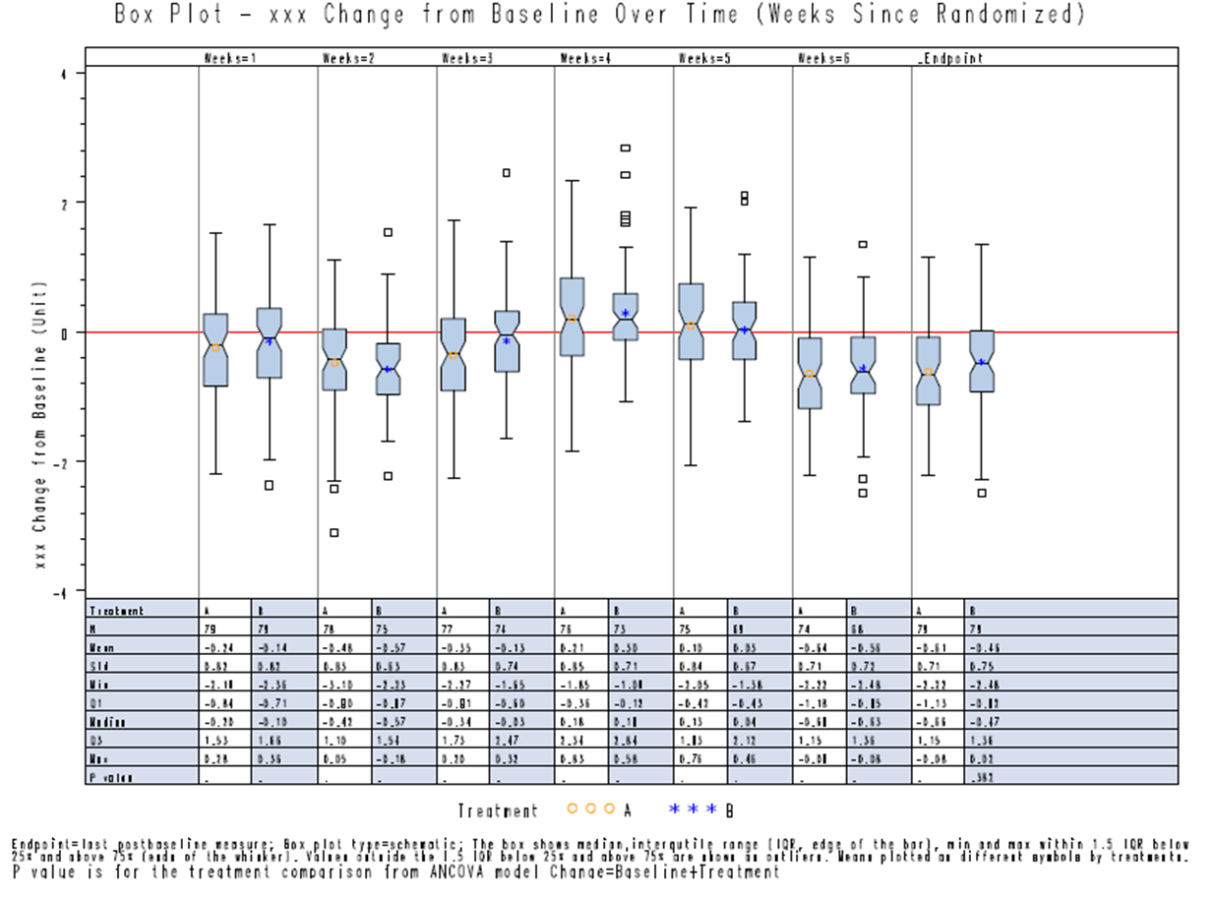
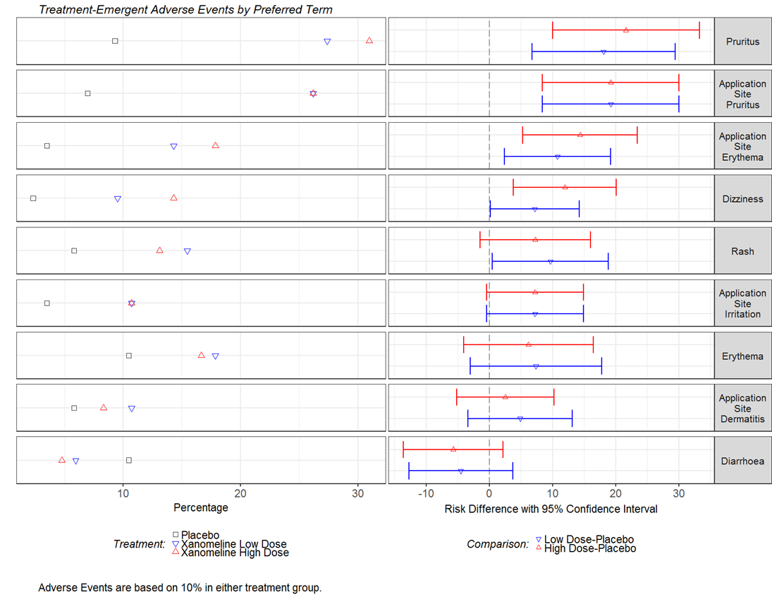
White Papers: Topics Covered
Recommended analyses/displays for individual studies and integrated summaries (data common across TAs)
Example SAP language
Indicates which displays are most suited for interactive tools
Discusses analytical and statistical topics/methods
P-values and CIs in safety
Events occurring after study drug stops
Alternative methods when percentages are biased
Notes:
TA = Therapeutic Area; SAP = Statistical Analysis Plan; CI = Confidence Interval
Excerpt from the AE white paper: Some researchers have the perception that it is standard practice to include TEAEs that occur up to a predefined period of time after study drug is stopped (eg, within 2 weeks of last dose of drug, within 30 days of last dose of drug, or within a certain number of half-lives after the last dose). If a sponsor or review division has a business rule, it would need to be applied with caution, as the rule may not be appropriate in all cases.

Slide 15



Crowd-Sourcing Model – White Papers
White Papers
Notes:
To date, we have seen good industry and FDA participation. FDA participation has been improving over time. Hoping to get more PMDA and EU regulatory participation. Broader cross-functional representation would be helpful too.

Slide 16
Accomplishments: Repository
Script Repository
MIT license chosen
https://github.com/phuse-org/phuse-scripts/blob/master/LICENSE.md
Qualification guidelines developed
http://www.phusewiki.org/wiki/index.php?title=WG5_Project_02#Qualification_Process
User-friendly front end developed
https://github.com/phuse-org/phuse-scripts/wiki/Simple-Index
Repository has been updated to have a place to store scripts developed by other groups

Slide 17
Crowd-Sourcing Model - Repository
Script Repository in Github – Creation and Governance Structure

Slide 18
Accomplishments: Scripts Contributed
Scripts contributed by other groups
FDA: https://github.com/phuse-org/phuse-scripts/wiki/JumpStart-Scripts
Non-clinical: https://github.com/phuse-org/phuse-scripts/tree/master/contributed/Nonclinical
Data Handle: https://github.com/phuse-org/phuse-scripts/tree/master/lang/SAS/datahandle
Spotfire Templates: https://github.com/phuse-org/phuse-scripts/tree/master/contributed/Spotfire

Slide 19
Accomplishments: Scripts Developed
Scripts developed by volunteers
6 Scriptathons (plus additional work by project members) resulting in several scripts at various stages
Focused on creating scripts associated with the displays in the white papers, starting with ADaM data
The specifications for the scripts include assumptions and required ADaM variables
Starting with CDISC pilot data
Scripts developed based on white paper
Central Tendency package Qualification Completed: 6 Recommended displays in CT White Paper

Slide 20
Crowd-Sourcing Model – Repository Content
Script Repository in Github
Notes:
Accomplishment – People have contributed to the Repository, but only a few have used content from the repository. It’s exciting though that a few have started to use content! More contributors/users would be helpful.

Slide 21
Crowd-Sourcing Model - Vision
Script Repository in Github
Notes:
Vision – More contributors and more users of the content.

Slide 22
Crowd-Sourcing Model - Vision
Script Repository in Github
Notes:
Vision – Something is contributed, someone improves it and re-contributes, etc.

Slide 23
Crowd-Sourcing Model - Vision
Script Repository in Github
Notes:
Vision – Someone contributes, a group improves it and re-contributes

Slide 24

Working Group Next Steps
Next Steps by Project Team
Analysis and Display White Papers (ADW) - Mary
Communication, Promotion, Education (CPE) - Mary
Script Discovery an Acquisition (SDA) – Hanming
Repository Content and Delivery (RCD) – Hanming
Repository Governance and Infrastructure (RGI) – Hanming
Test Data Factory (TDF) - Hanming
Notes:
Analyses and Display White Papers (ADW, Mary Nilsson)
Communication, Promotion, Education (CPE, Jared Slain and Wendy Dobson)
Script Discovery and Acquisition (SDA, Rebeka Revis, Alfredo Rojas)
Repository Content and Delivery (RCD, Gustav Bernard, Andrew Miskell)
Repository Governance and Infrastructure (RGI, Mike Carniello, Hanming Tu)
Test Data Factory (TDF, Peter Schaefer)

Slide 25
White Papers
Analysis and Display White Papers (ADW)
Project Description:
Provide recommended Tables, Figures, and Listings for clinical trial study reports and submission documents for measurements that are common across clinical trials and across therapeutic areas.
Project Lead: Mary Nilsson
Project Next Steps:
Work on AE white paper follow-ups (consolidated terms, gender-/pediatric-specific lists)
Work on 4 new white papers
Work on updating 3 white papers

Slide 26


Analysis and Display White Papers Project Team
 | Version 1 |  | Version 2
 | Public Review | Published | Public Review | Published
Vital Signs, Labs, ECG – Central Tendency |  | Oct 2013 | Q4 2017
Non-Compartmental PK |  | March 2014
Demographics, Disposition, Medications |  | Oct 2014 | Q3 2017
Vital Signs, Labs, ECG – Outliers / Shifts |  | Sept 2015 | Q4 2017
QT/QTc Studies |  | March 2016
Adverse Events |  | Feb 2017
Treatment-Emergent Definitions | Q3 2017
Hepatotoxicity | Q3 2017
Questionnaires | Q4 2017
Events of Special Interest | Q4 2017
Notes:
Open to additional ideas. Some ideas that have been brought up:
1. TOSNP and Narratives
2. Combining Studies for Integrated Analyses - Points to Consider
3. Qualitative ECGs
4. Analysis of genomic and biomarkers
5. Statistical methods for safety (individual study and integrated, include Bayesian methods)
6. Writing statistical results for safety (individual study and integrated)
7. Process for determining Adverse Drug Reactions
8. Defining the safety population (not necessarily a separate white paper, but include somewhere)
9. Analysis and display of adjudicated data

Slide 27
Communication, Promotion, Education
Communication, Promotion, Education (CPE)
Project Description:
Conceptualize Efficient Ways to Communicate Working Group Progress and Results
Project Leads: Jared Slain, Wendy Dobson
Project Next Steps:
Keep project page on PhUSE Wiki updated
Find people already going to events to present/promote working group (Help if you can!)
Create an educational series on analytical and statistical methods from the white papers
Notes:
Education Series: Brainstorming ideas now – Webinars? Onboarding training videos? Tutorials and workshops at conferences? Networking with the “Educating for the Future” project team.

Slide 28
Repository Projects
Script Discovery and Acquisition (SDA)
Project Description:
Discover, acquire and review scripts to be stored in the repository with adequate metadata to describe the scripts
Project Leads: Rebeka Revis, Alfredo Rojas
Project Next Steps:
Review selected scripts contributed by the FDA
Create script metadata files
Capture the codes behind Interactive display of the data in Spotfire or R Shiny

Slide 29
Repository Projects
Repository Content and Delivery (RCD)
Project Description:
Develop and enhance scripts under a defined qualification process to ensure the usability and quality of the standard scripts
Project Leads: Gustav Bernard, Andrew Miskell
Project Next Steps:
Package CT scripts including linking to whitepaper, spec and qualification docs
Finish the shift outlier package including spec and metadata
Create a R group to develop R scripts for CT package

Slide 30
Repository Projects
Repository Governance and Infrastructure (RGI)
Project Description:
Establish the basic structure and management of the repository.
Define and enforce existence of required metadata for scripts
Manage users and projects in the repository
Project Leads: Mike Carniello, Hanming Tu
Project Next Steps:
Create a test environment (R and SAS)
Expand the YML metadata usage
Continue maintaining and administering the repository
Crowd-source a shared interactive tool for safety data

Slide 31
Repository Projects
Test Data Factory (TDF)
Project Description:
Provide test data formatted in SDTM and ADaM that support a more systematic and comprehensive testing of these concepts and scripts.
Project Leads: Peter Schaefer
Project Next Steps:
Determine test dataset requirements
Implement scripts that create ‘simulated’ SDTM and/or ADaM test data sets
Publicize the test data sets

Slide 32
Working Group Needs
More project team members
Increased participation in white paper reviews – Help recruit!
Use/reference recommendations in existing final white papers!
Forward to any existing standards groups
Link to white papers from Statistical Analysis Plans
Participate in re-usable code development
Write, Test, Qualify, Review, Improve
Keep eyes open for existing scripts that need a public home
Advertise! Advertise! Advertise!

Slide 33
How to Participate
Sign up for the PhUSE working group mailings
From phusewiki.org, click “Join a Working Group Now”
Standard Scripts Groups
CSS-WG-Standard-Scripts (Entire Working Group)
CSS-WG-Standard-Scripts-WhitePapers (White Paper Project Team)
CSS-WG-Standard-Scripts-Platform (Script Repository)
CSS-WG-SS-WhitePaperReviewers (Notified when a white paper is ready for review)
See wiki pages for each of the projects (www.phusewiki.org)

Slide 34
Potential Opportunities for Collaboration
Establish liaisons between PhUSE and ASA efforts
The Standard Analyses and Code Sharing Working Group is particularly suited for a collaboration with the ASA
PhUSE already has an official collaboration with CDISC (Memorandum of Understanding)
Help each other with communication
Co-sponsor educational forums
Notes:
SSPA=Section for Programmers and Analysts

Slide 35
Important Links
Working Group:
Main Page: http://www.phusewiki.org/wiki/index.php?title=Standard_Scripts
Projects:
P01 - SDA: Script discovery and acquisition (Rebeka M Revis; Alfredo Rojas)
P02 - RCD: Repository content and delivery (Gustav Bernard; Andrew Miskell; FDA Liaison: Mat Soukup)
P03 - RGI: Repository governance and infrastructure: (Mike Carniello and Hanming Tu)
P07 - CPE: Communication, Promotion and Education (Jared Slain and Wendy Dobson)
P08 - ADW: Analysis and Display White papers (Mary Nilsson)
P09 - TDF: Test Data Factory (Peter Schaefer)
Repository:
Github: https://github.com/phuse-org/phuse-scripts
Publications:
Analyses and Displays of Central Tendency 10Oct2013
Analyses and Displays of PK 25Mar2014
Analyses and Displays of Demographics, Disposition, and Medications 07Oct2014
Analyses and Displays of Outliers/Shifts from Normal to Abnormal 10Sep2015
Analyses and Displays Associated with ThoroughQT/QTc Studies 11Mar2016
Analyses and Displays Associated with Adverse Events 03Feb2017
Index Pages:
Simple Index: https://github.com/phuse-org/phuse-scripts/wiki/Simple-Index.
Standard Index: https://github.com/phuse-org/phuse-scripts/wiki/Standard-Script-Index
Mirrored Index: http://www.phusewiki.org/wiki/index.php?title=Standard_Script_Index
FDA JumpStart: https://github.com/phuse-org/phuse-scripts/wiki/JumpStart-Scripts

Slide 36


