Slide 1
Classification of Malaria Cell Images
BBM469 Data Intensive Applications Laboratory
Data Science Capstone Project
21626934 Edib Hamza Arslan
Notes:
1

Slide 2
Problem
1

Slide 3
Malaria is a transmittable disease caused by the parasites which belong to the Plasmodium family. Malaria disease can be spread by the bite of the female mosquito. Every year around 228 million people are affected by malaria around the globe. The number of deaths due to malaria disease is almost
4,05,000. The number of children who died because of malaria disease is 67% (2,72,000) around the globe. The Africa region is inflicted by high malaria cases and high death rates. The increase in the percentage of these deaths is due to the failure to detect the disease early. The traditional mechanism to
detect the malaria disease is to visually examine the bloodsmears for identifying red blood cells affected by malaria-parasites under the microscope and the appearance of an experienced technician. This method is inefficient due to the absence of lab equipment, and the diagnosis is very dependent
on the seniority or experience of a person. To overcome the problems in the traditional malaria detecting system, I create a deep learning model detect malaria parasites to improve diagnostic accuracy. For this implementation, I referred to the NIH dataset, which consists of 27,558 images that belong to two classes.[1]
I try to classified the images (parasitized and uninfected), the problem type is supervised machine learning problem.

Slide 4
Data Understanding
1

Slide 5
After the download the data there are 2 folders which are parasitized and uninfected folders. They have same number of images.
The images are rgb image.

Slide 6
Data Preparation
1

Slide 7
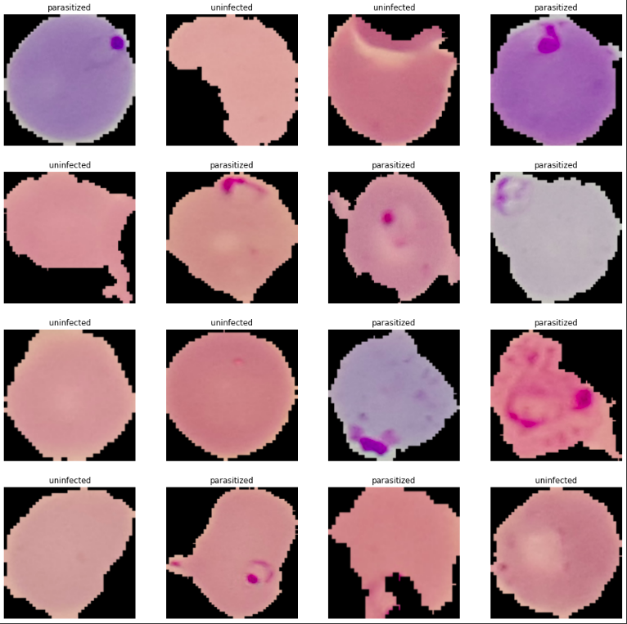
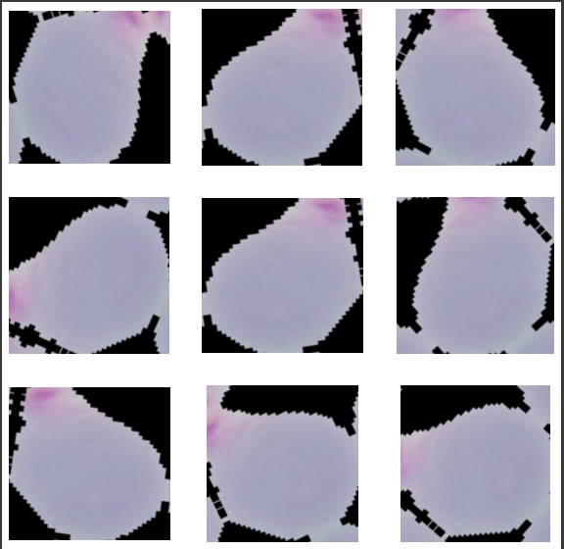

Slide 8
Batch size 32
Input image size (224, 224)
Shuffled
Random fliped, weighted, heighted and rotated

Slide 9
Modeling
<number>

Slide 10
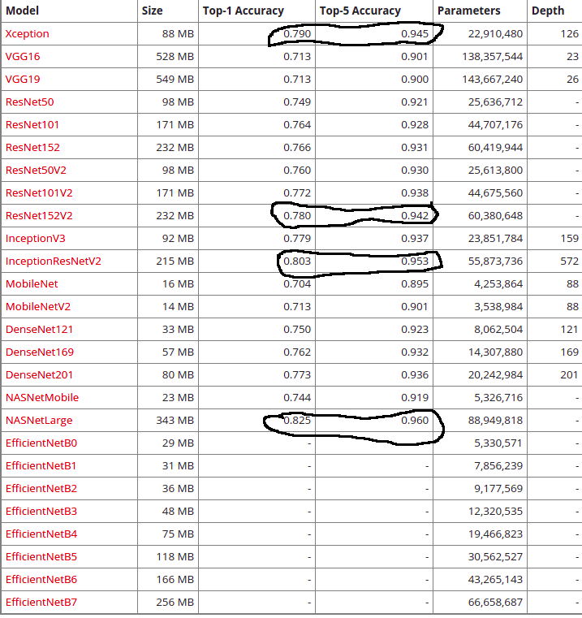
The pre-trained model’s from keras applications site. I choose top 3 model from here depend on accuracy results. I didn’t choose Nasnet Large, because the input size’s for big images such as (331, 331, 3) .
The chosen models are
Xception
ResNet152V2
InceptionResNetV2

Slide 11
Transfer learning
Fine tuning
Transfer learning is the reuse of a pre-trained model on a new problem. It's currently very popular in deep learning because it can train deep neural networks with comparatively little data.
Fine-tuning, in general, means making small adjustments to a process to achieve the desired output or performance. Fine-tuning deep learning involves using weights of a previous deep learning algorithm for programming another similar deep learning process.

Slide 12
Evaluation
11

Slide 13
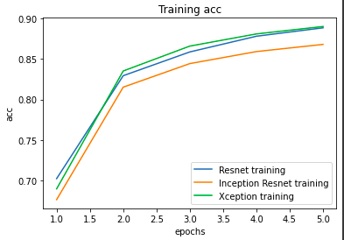
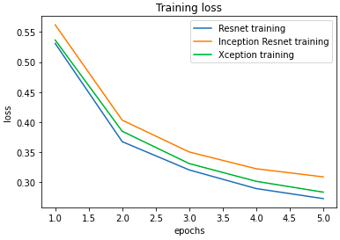
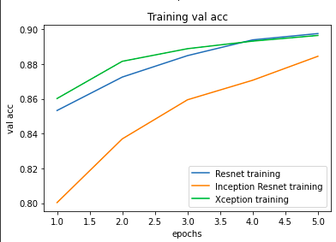
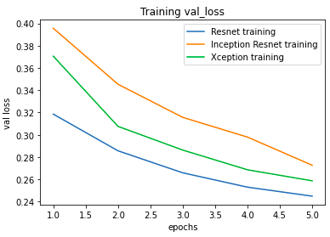
Transfer learning training and validation accuracy and loss results

Slide 14
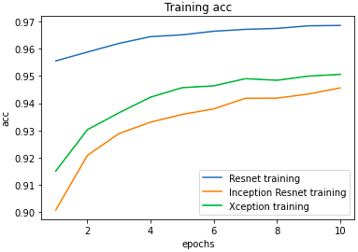
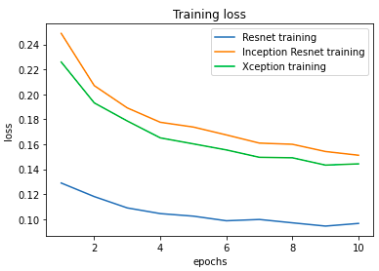
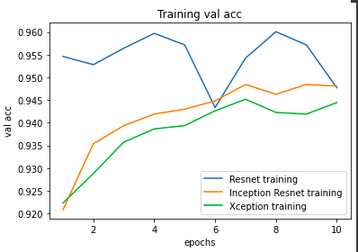
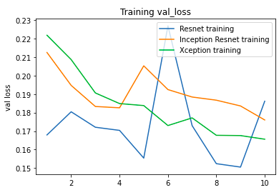
Fine tuning training and validation accuracy and loss results

Slide 15
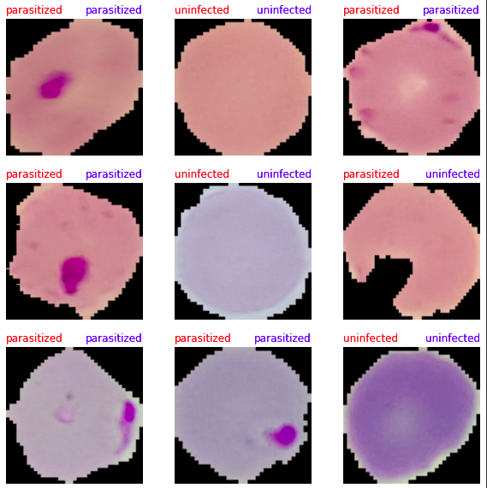
The visualization of prediction results with resnet152V2 model The red text is showing true label and the blue text is showing predicted label.

Slide 16
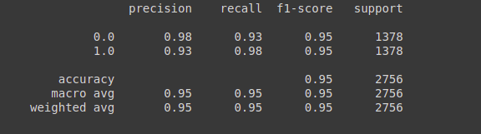
Classification Report

Slide 17
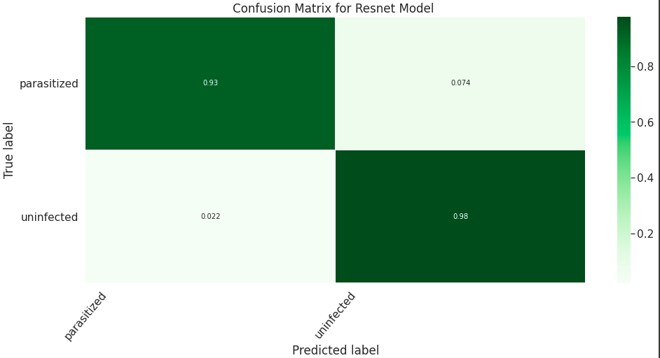

Slide 18
Model | Batch Size | Dropout Rate | Epoch | Learning rate | Accuracy
Resnet 152V2 | 32 | 0.2 | 10 | 0.00001 | %95
InceptionResNetV2 | 32 | 0.2 | 10 | 0.00001 | %94
Xception | 32 | 0.2 | 10 | 0.00001 | %93

Slide 19
References
https://www.researchgate.net/publication/349105266_Classification_of_Malaria_Cell_Images_with_Deep_Learning_Architectures
https://towardsdatascience.com/cnn-transfer-learning-fine-tuning-9f3e7c5806b2
https://towardsdatascience.com/deep-learning-using-transfer-learning-python-code-for-resnet50-8acdfb3a2d38
https://machinelearningmastery.com/how-to-use-transfer-learning-when-developing-convolutional-neural-network-models/
https://neptune.ai/blog/transfer-learning-guide-examples-for-images-and-text-in-keras
https://cs231n.github.io/transfer-learning/
https://www.tensorflow.org/tutorials/images/transfer_learning
https://keras.io/api/applications/
https://keras.io/api/applications/xception/
https://keras.io/api/applications/inceptionresnetv2/
https://keras.io/api/applications/resnet/#resnet152v2-function
https://www.kaggle.com/iarunava/cell-images-for-detecting-malaria
<number>

