Slide 1
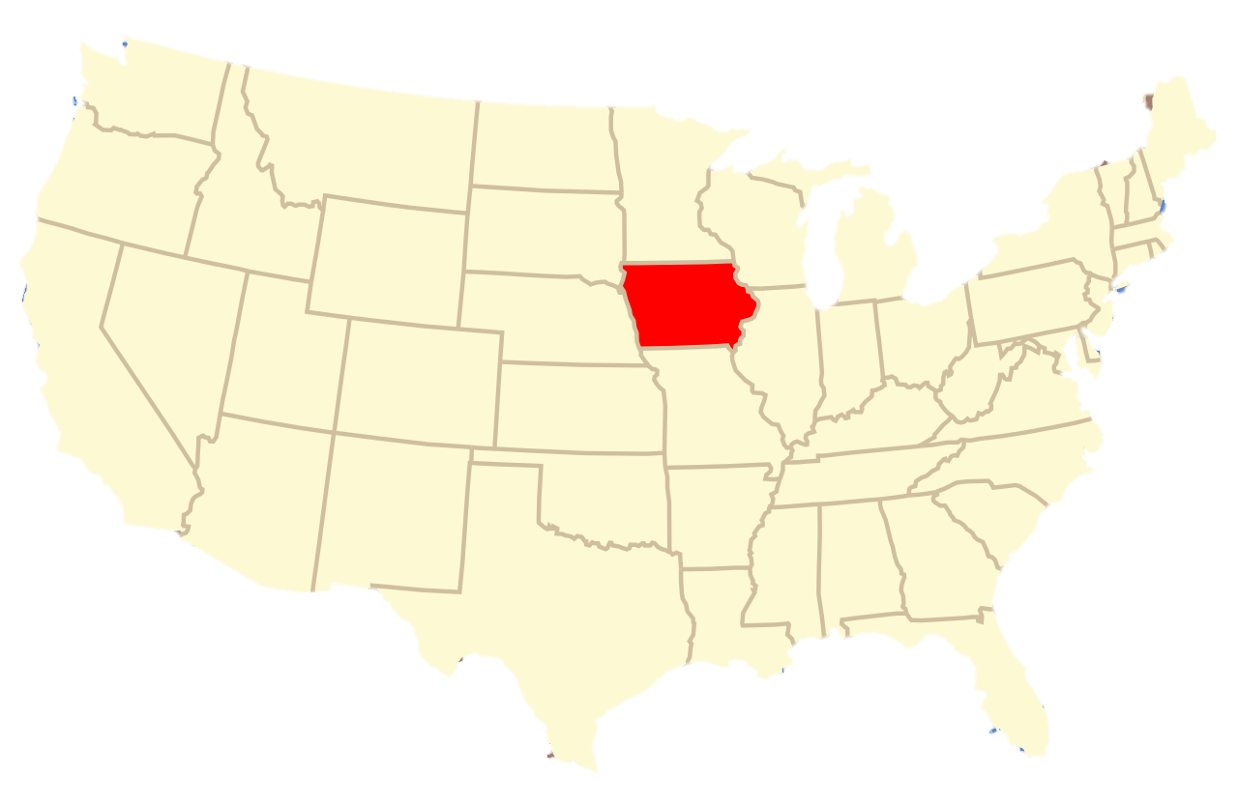

Did you get a fair price?

