Slide 1
AuthFlow AI Prior authorization, orchestrated.
UiPath AgentHack. Build the AI agents of tomorrow.

Slide 2

[Your team name]​ AuthFlow AI​
Jane Doe
Jane Doe
Jane Doe
Jane Doe
Job title @Company jane.doe@uipath.com
Job title @Company jane.doe@uipath.com
Job title @Company jane.doe@uipath.com
Job title @Company jane.doe@uipath.com

Slide 3
Problem statement and proposed solution
Problem
Solution
Prior authorization is slow, manual paperwork that delays patient care for days.
The hard part is not writing a letter — it is knowing what a specific payer requires and whether the chart actually meets it.
Decisions must stay with clinicians, and every step must be auditable.
AuthFlow AI is a governed, long-running workflow — not a document generator. UiPath Maestro orchestrates RPA, AI agents, APIs, and clinicians end to end.
A LangChain CriteriaMatch agent maps chart evidence to payer criteria; a BPMN gateway routes each case to auto-submit, a staff task, or a clinician.
Missing documentation suspends the process and resumes when supplied — agents accelerate the work, clinicians keep the decisions.

Slide 4
Benefits and technologies used
Details
Benefits, impact and outcomes
End-user​ | Clinics & provider prior-auth teams​
User department​ | Utilization management / authorization staff​
Industries​ | Healthcare payers & providers (cardiovascular, rheumatology)​
UiPath products used​ | Maestro BPMN, Agent Builder, API Workflows, Document Understanding, RPA​
Other - integrations / APIs / technologies used​ | LangChain (CriteriaMatch), OpenAI, Qdrant RAG, Supabase; built with Claude Code via UiPath CLI​
80%+ of clean requests resolved in minutes instead of days; staff stop chasing scattered systems.
Every AI decision is explainable and logged for audit; clinicians stay accountable. One pipeline generalizes across specialties and payers with no code change.

Slide 5
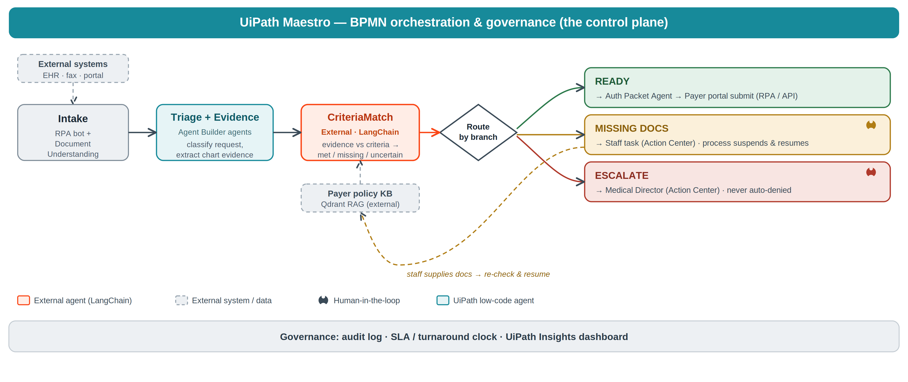
Solution architecture

Slide 6
Three cases, three BPMN branches
1. Clean approval (READY)
All payer criteria documented. The packet is generated and submitted automatically.
2. Missing documentation (SUSPEND / RESUME) — the centerpiece
The conservative-therapy evidence is ambiguous. The process pauses, opens a staff task, and resumes when the documentation is supplied.
3. Guideline-discordant (ESCALATE)
Routed to a medical director — never auto-denied. A clinician makes the call.

Slide 7
AuthFlow AI — agents accelerate the work; clinicians keep the decisions.

