Slide 1
rho=6000
k=70
Cp=550
Fo=0.2
6000 time steps
6 data files
Tests can overwrite: 4,5
Diverging parameters:
-Ea=4000, A0=1e6, dH=300000
-Ea=4000, A0=1e8, dH=300000

Slide 2
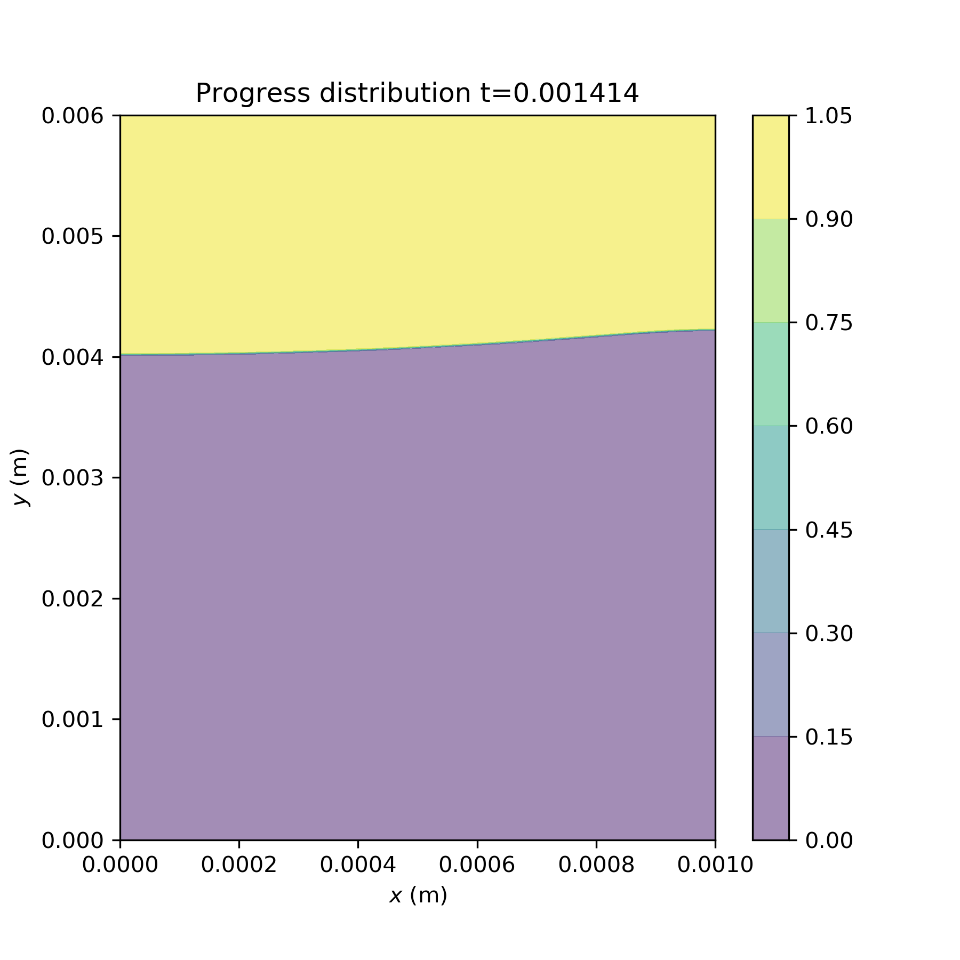
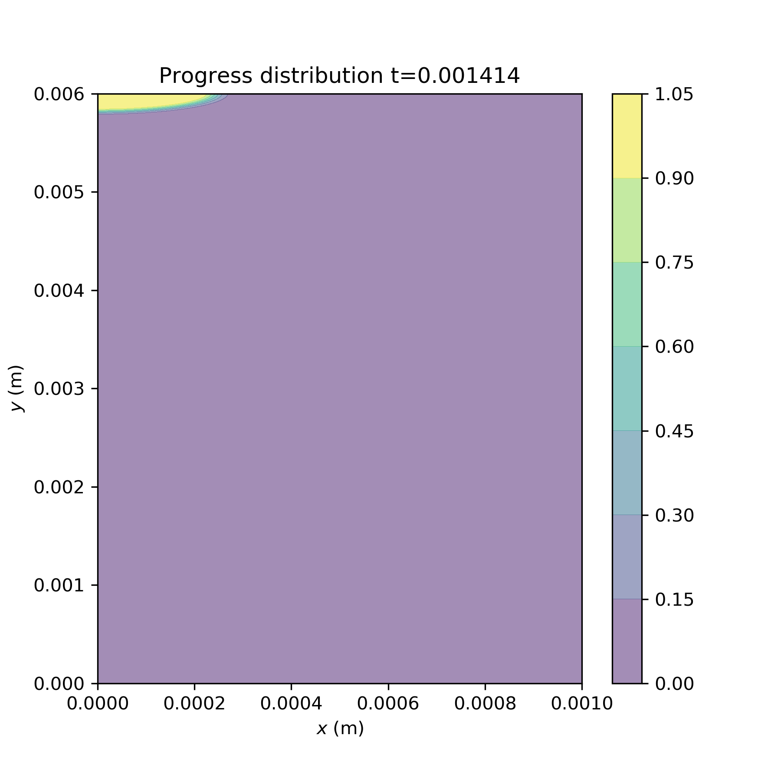
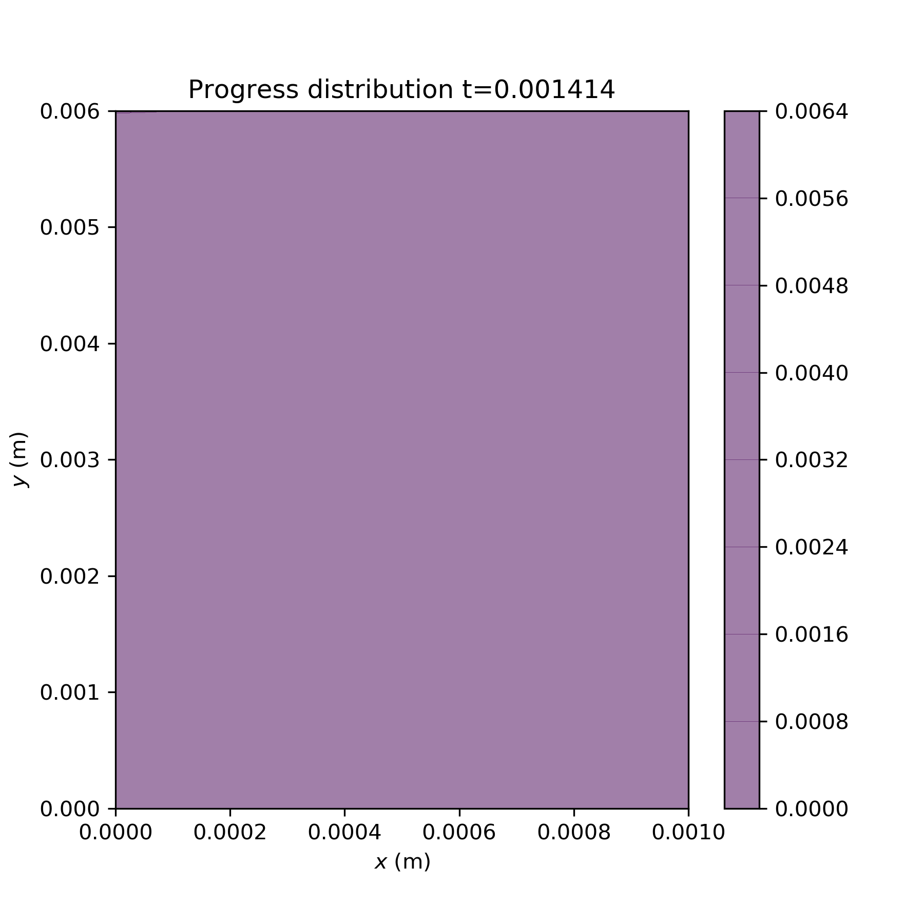
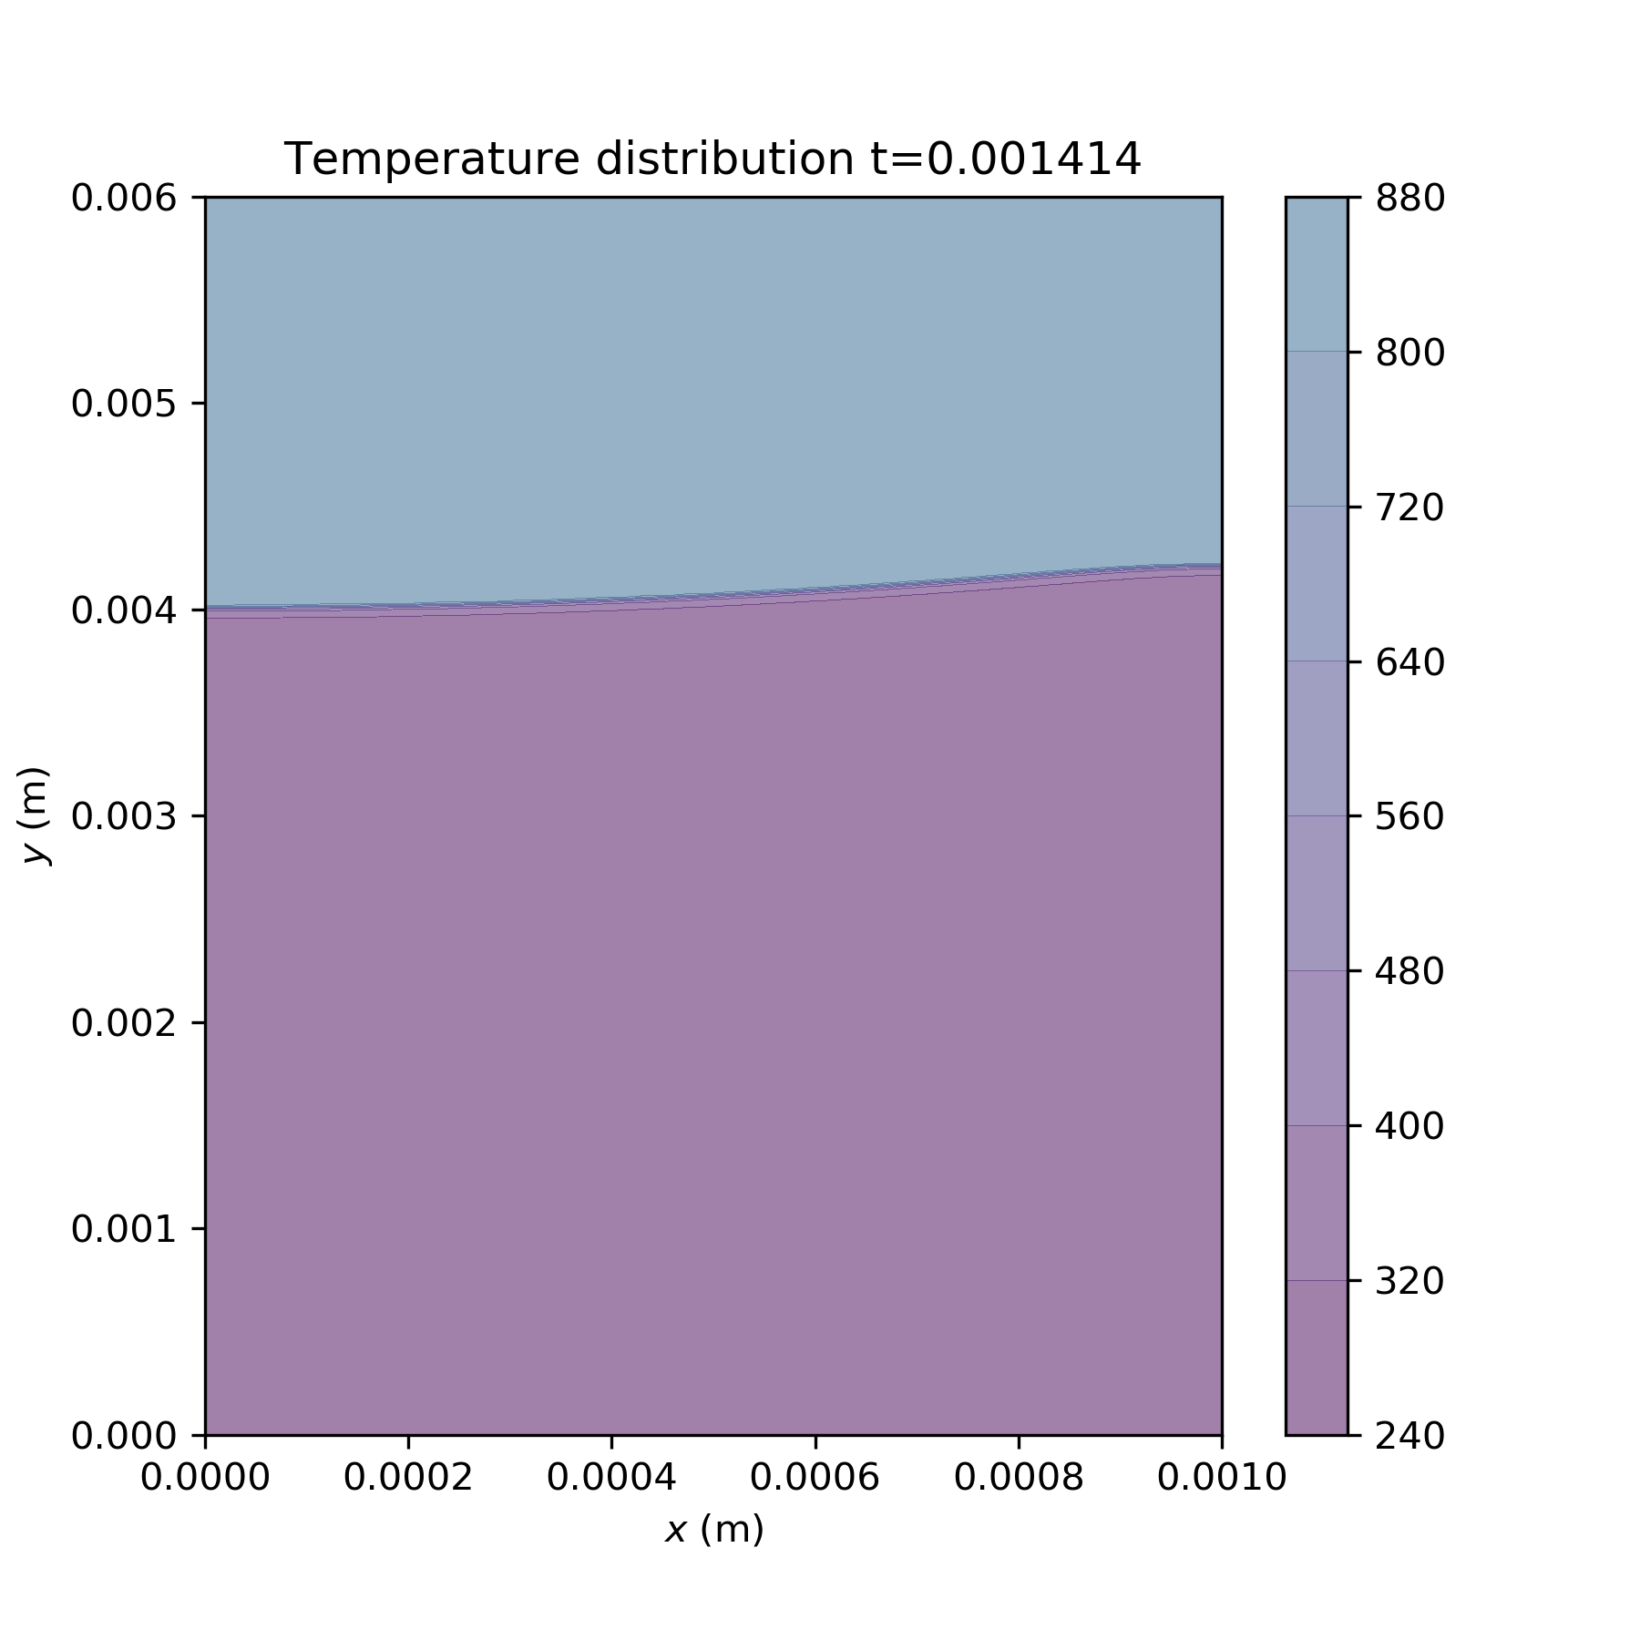
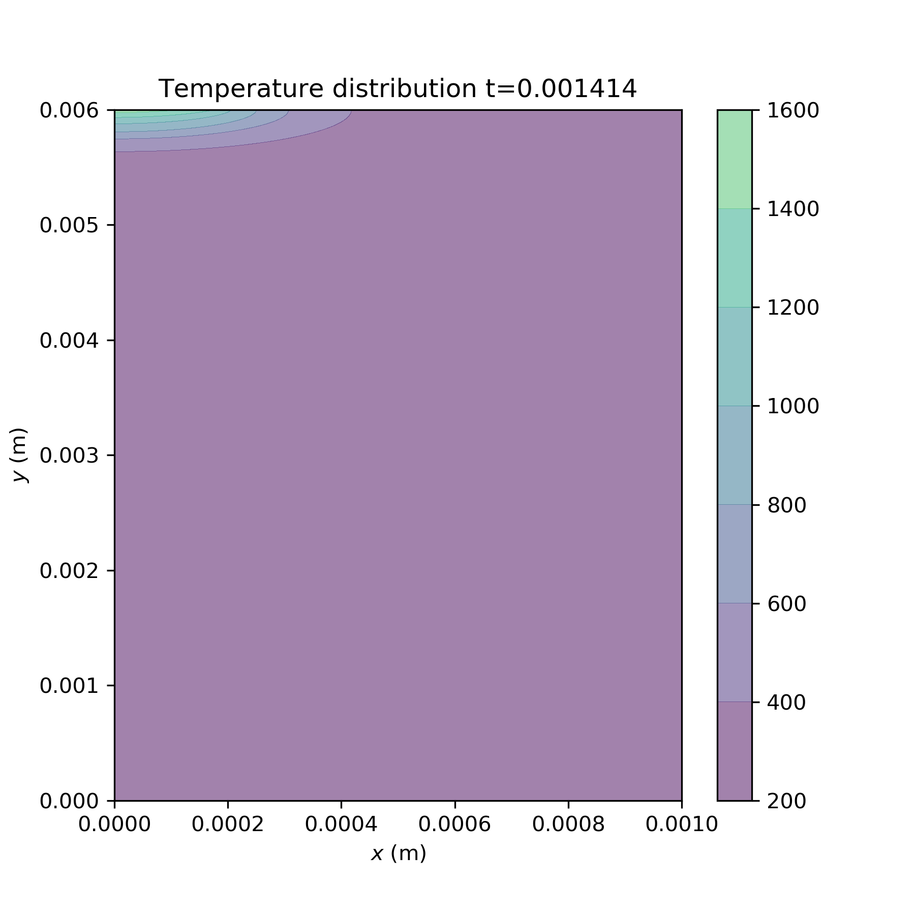
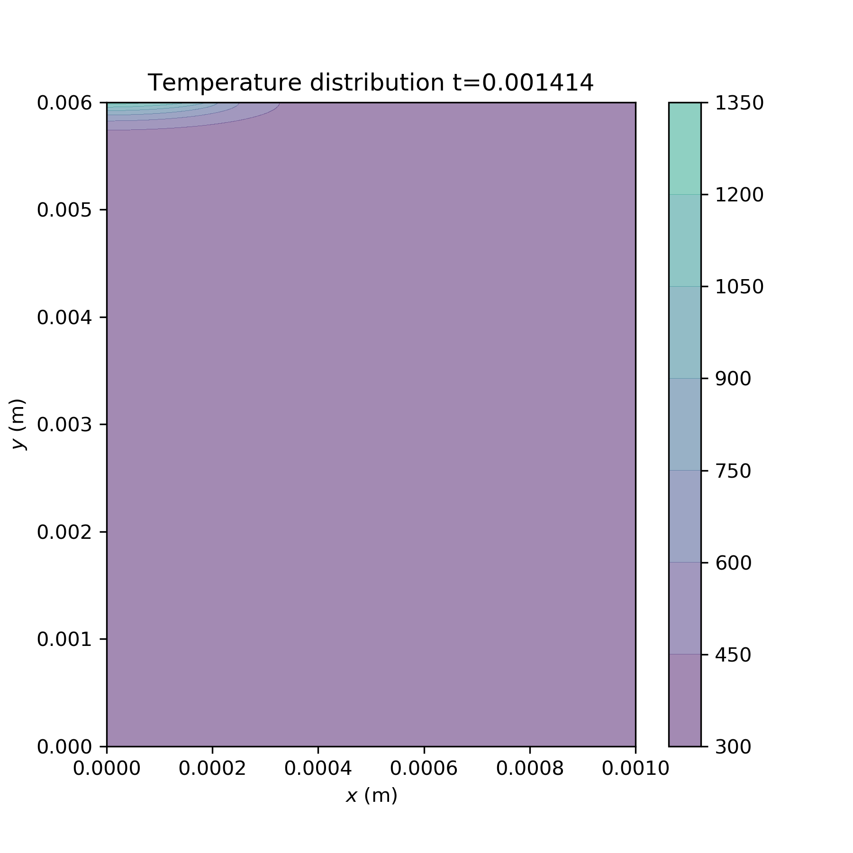
Ea investigations
(1)
Ea=40000
A0=1e8
dH=300000
(8)
Ea=70000
(9)
Ea=170000
Notes:
Ea

Slide 3
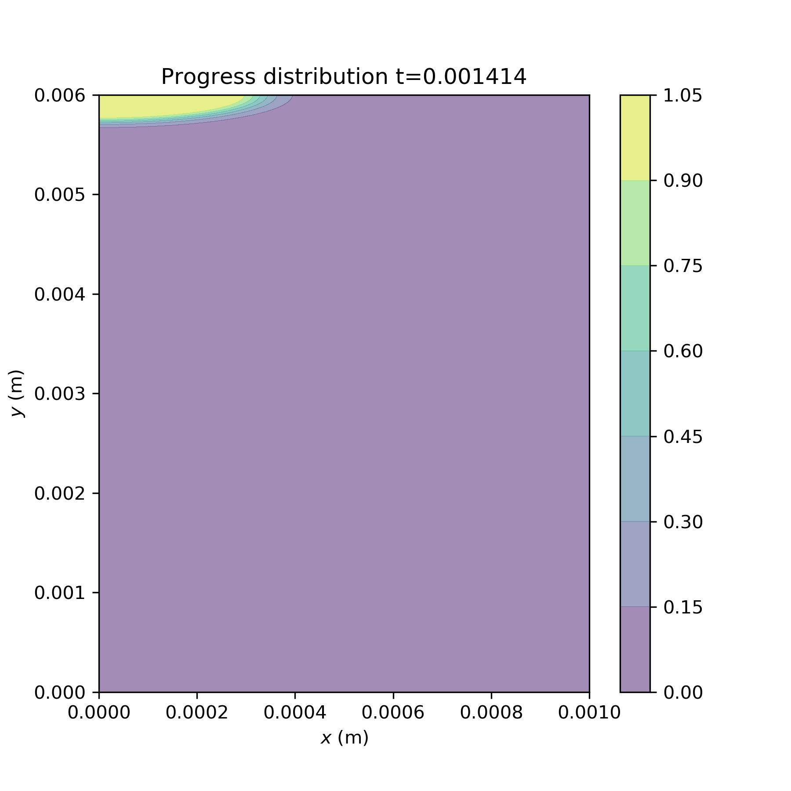
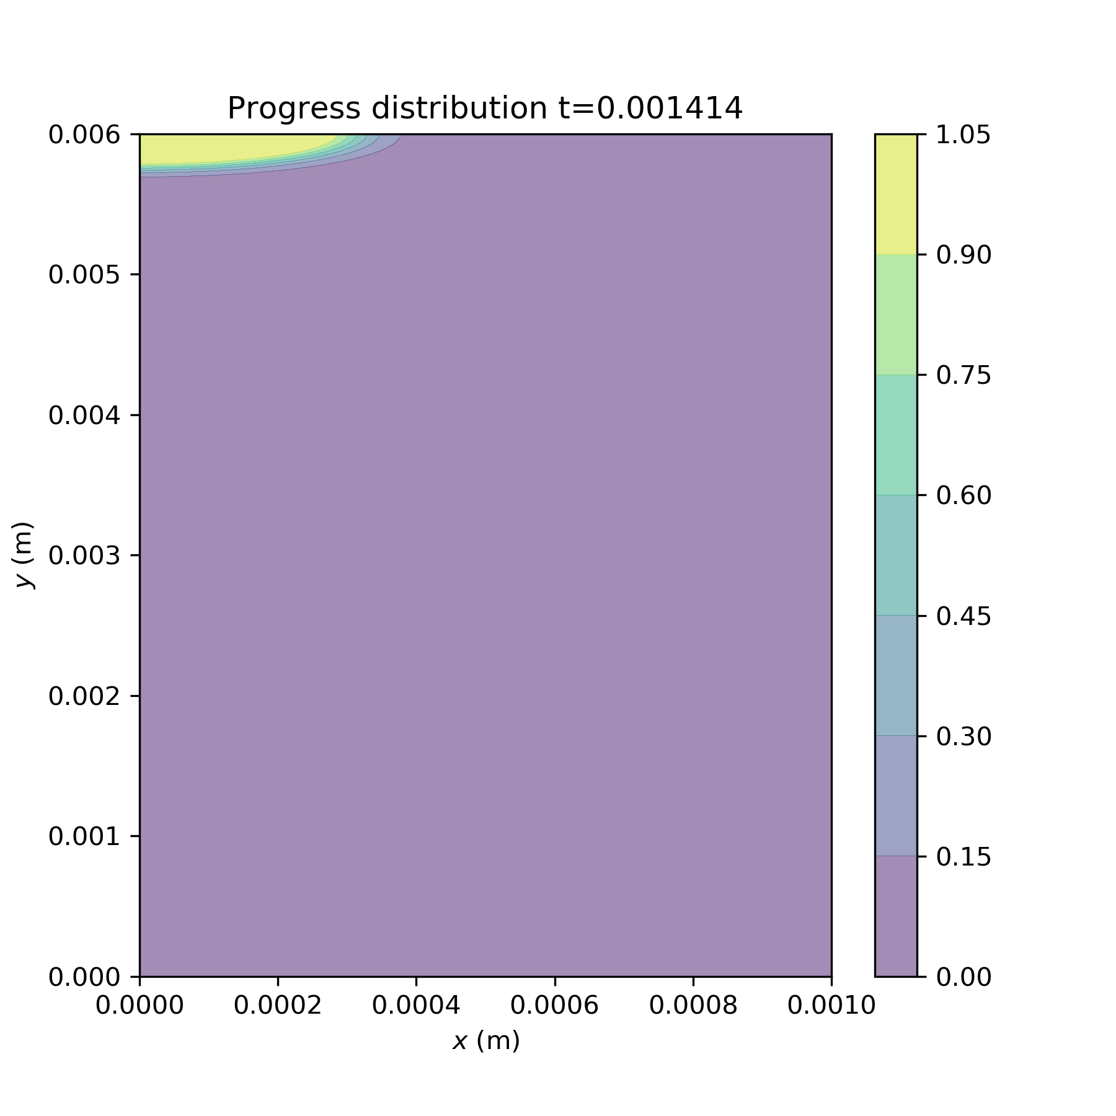
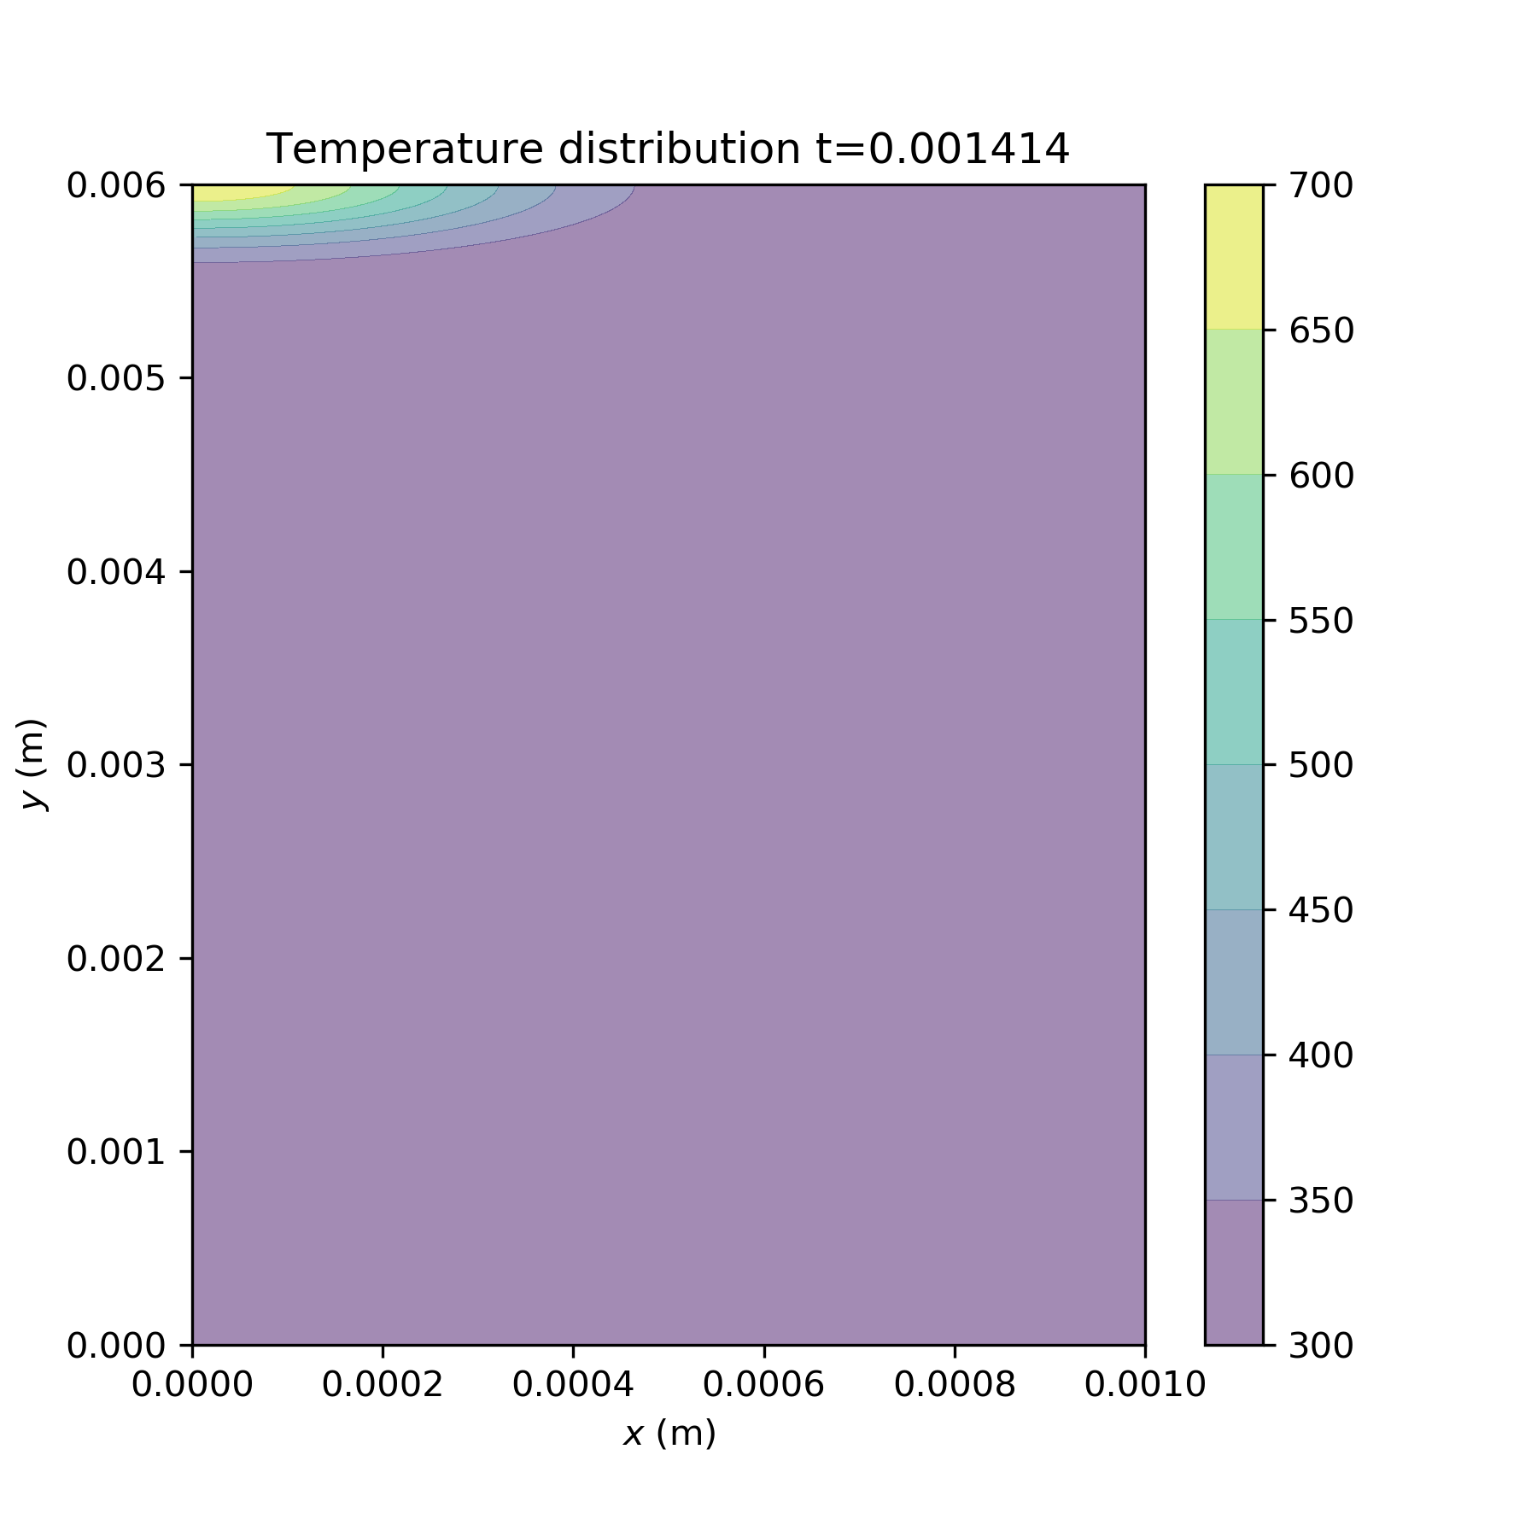
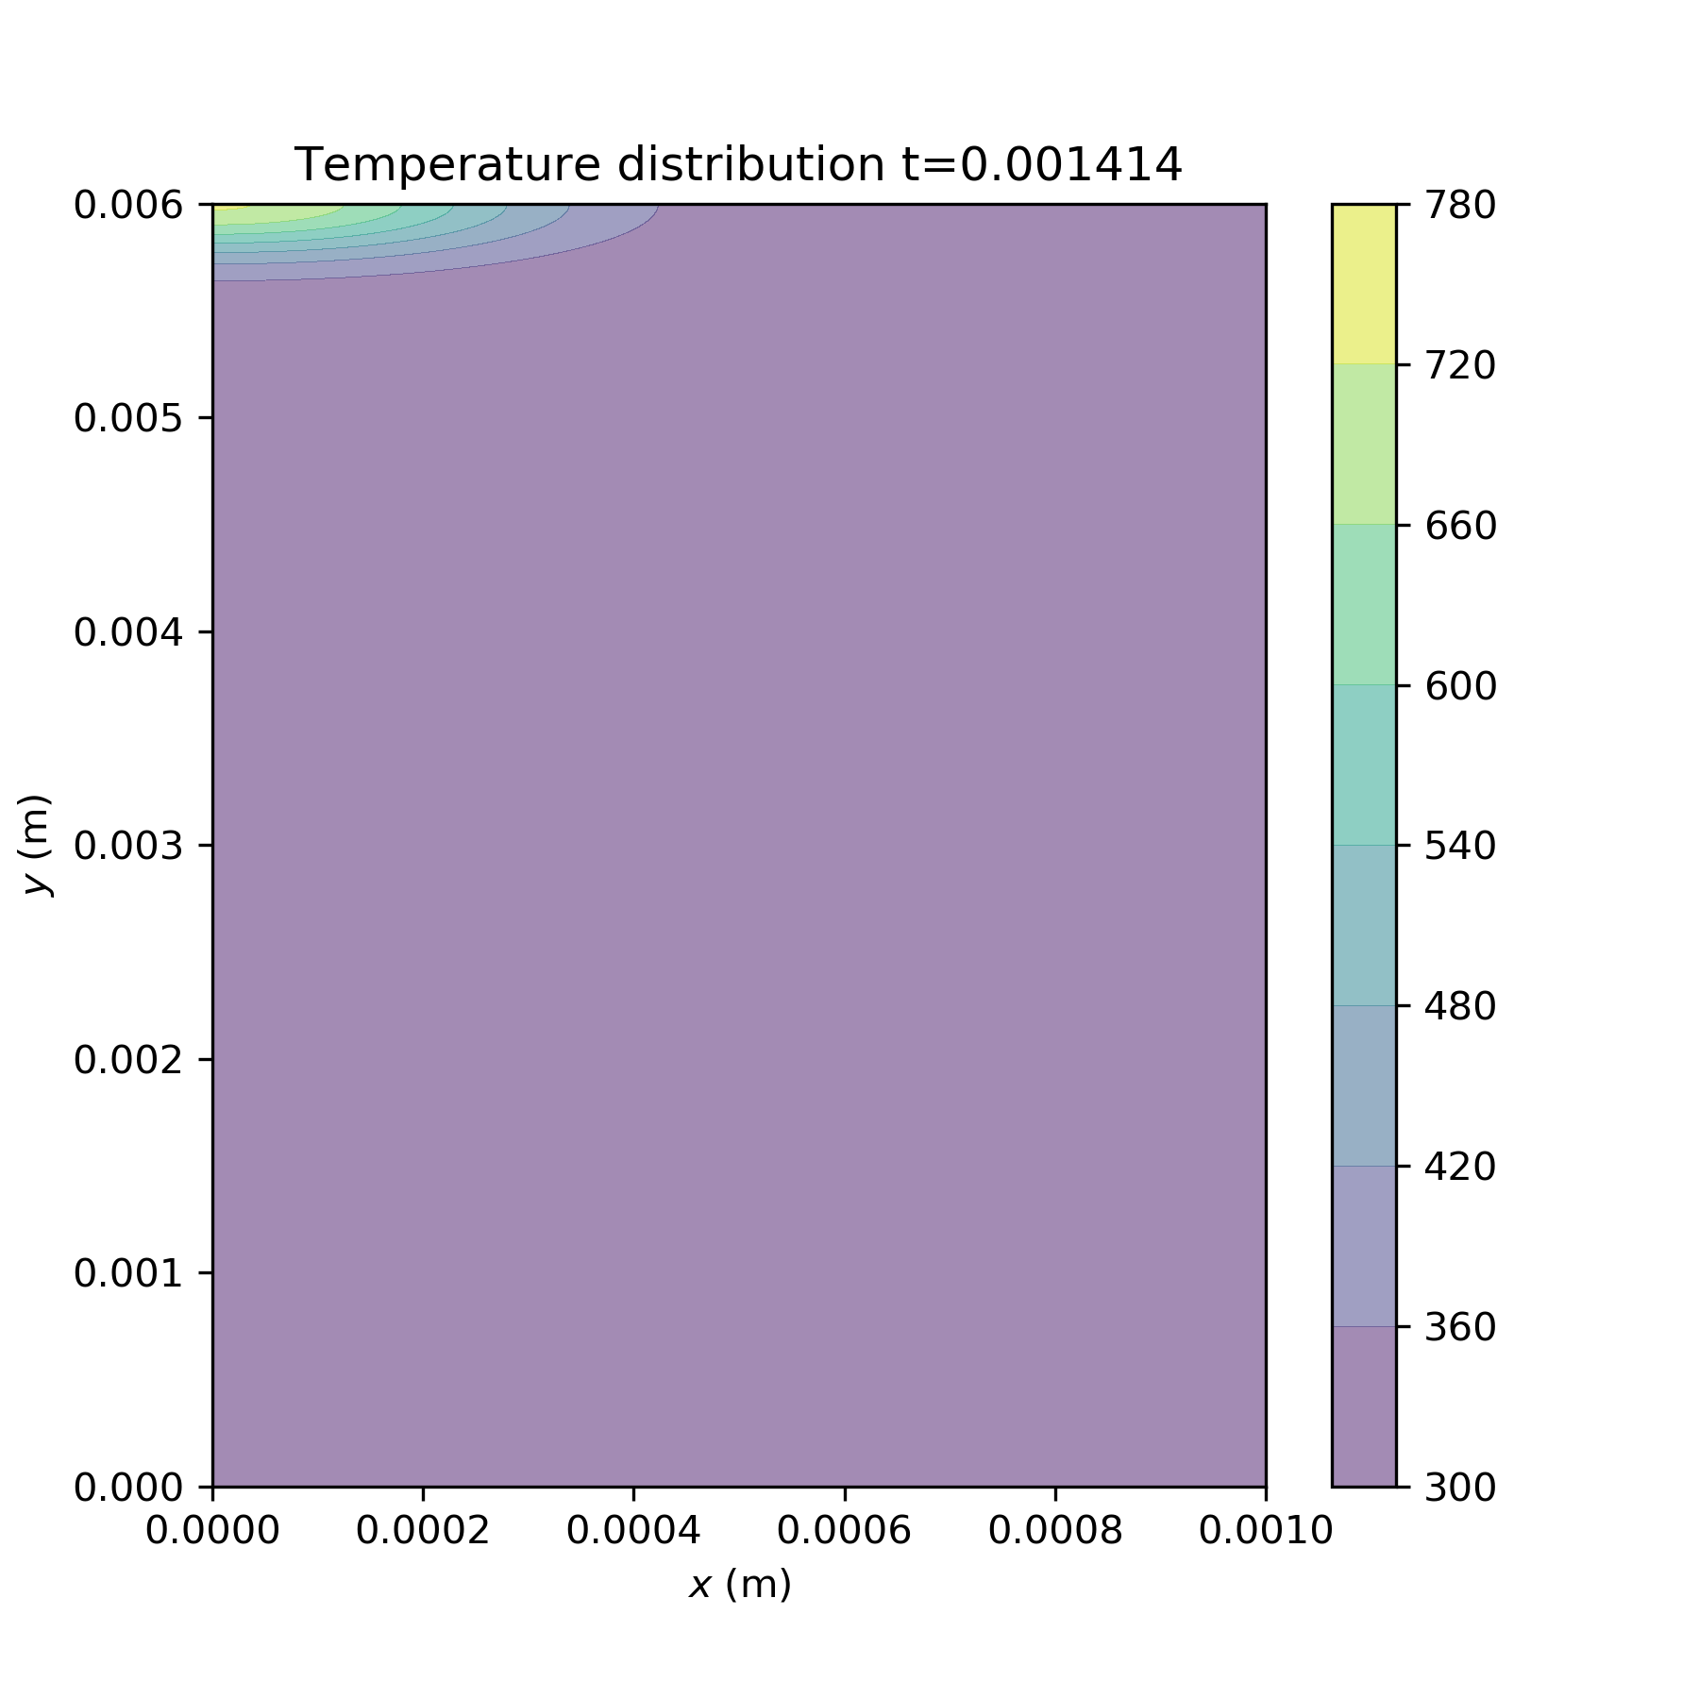
dH investigations
(1)
Ea=40000
A0=1e8
dH=300000
(2)
dH=30000
(3)
dH=1200
Notes:
dH

Slide 4
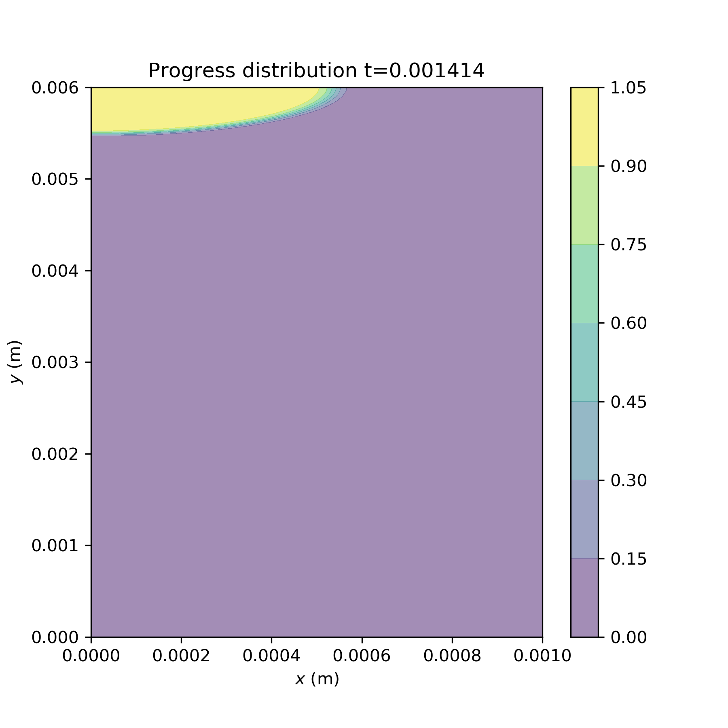
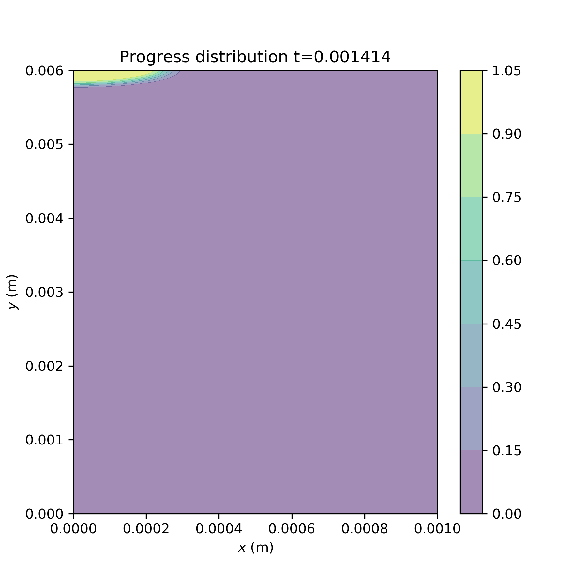
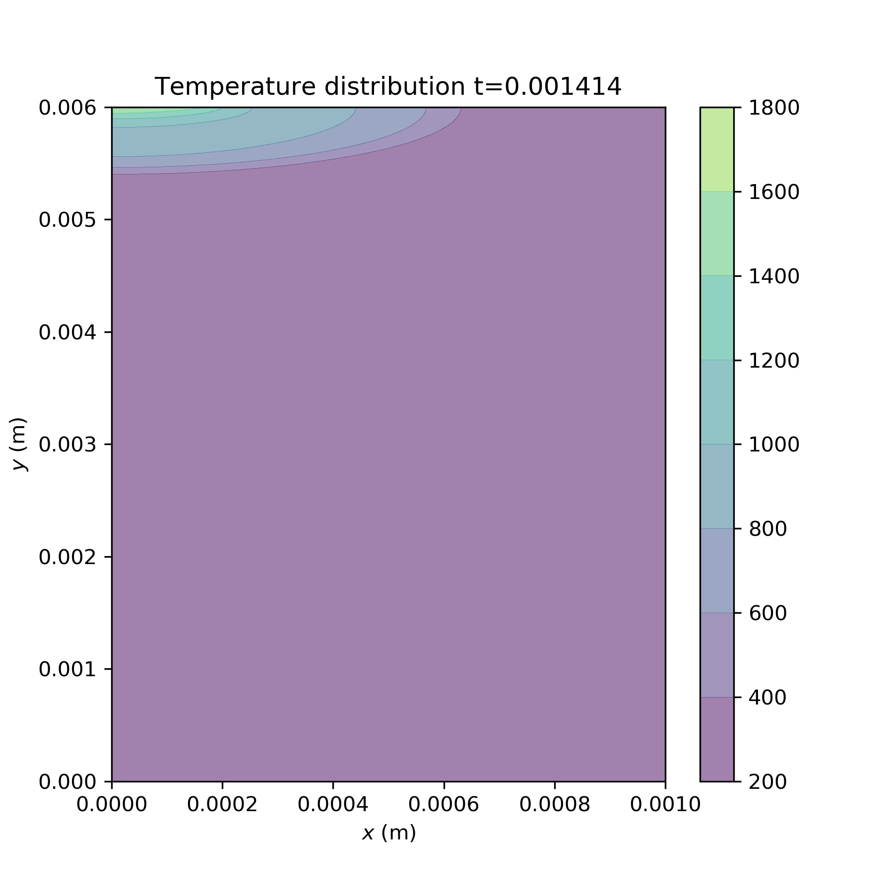

A0 investigations
(1)
Ea=40000
A0=1e8
dH=300000
(7)
A0=1e7
(6)
A0=1e6
Notes:
A0

Slide 5
rho=f(eta)
k= f(eta)
Cp= f(eta)
Fo=0.2
6000 time steps
6 data files
Tests can overwrite: 4,5
Diverging parameters:
-Ea=4000, A0=1e6, dH=300000
-Ea=4000, A0=1e8, dH=300000

