Slide 1
rho=6000
k=70
Cp=550
Flux=400 MW/m2
T_ign=1200 K
Fo=0.2
6000 time steps
6 data files
Parameters tested:
-Arrhenius parameters
-Enthalpy of combustion
Tests can overwrite: 4,5
Diverging parameters:
-Ea=4000, A0=1e6, dH=300000
-Ea=4000, A0=1e8, dH=300000

Slide 2
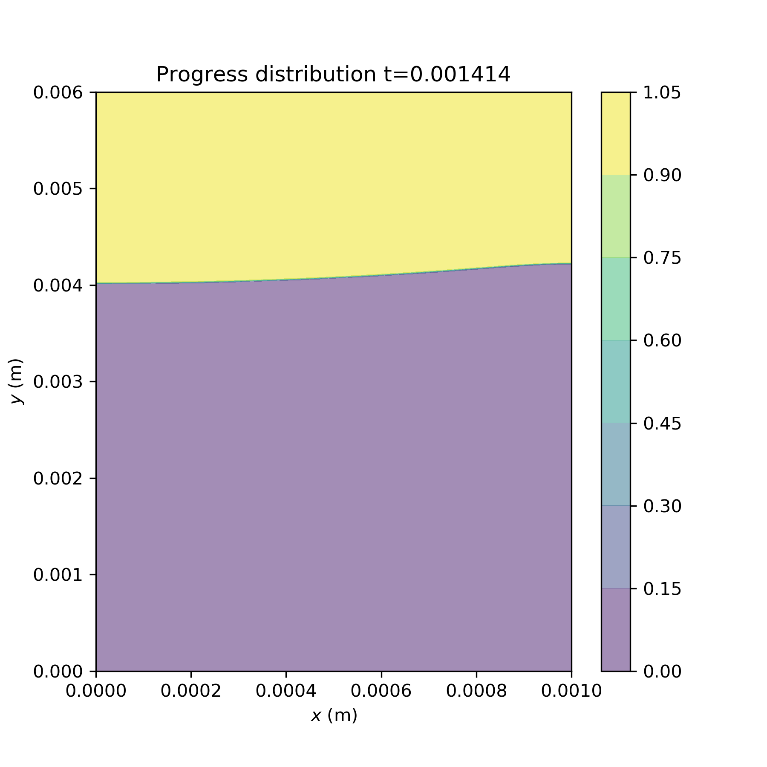
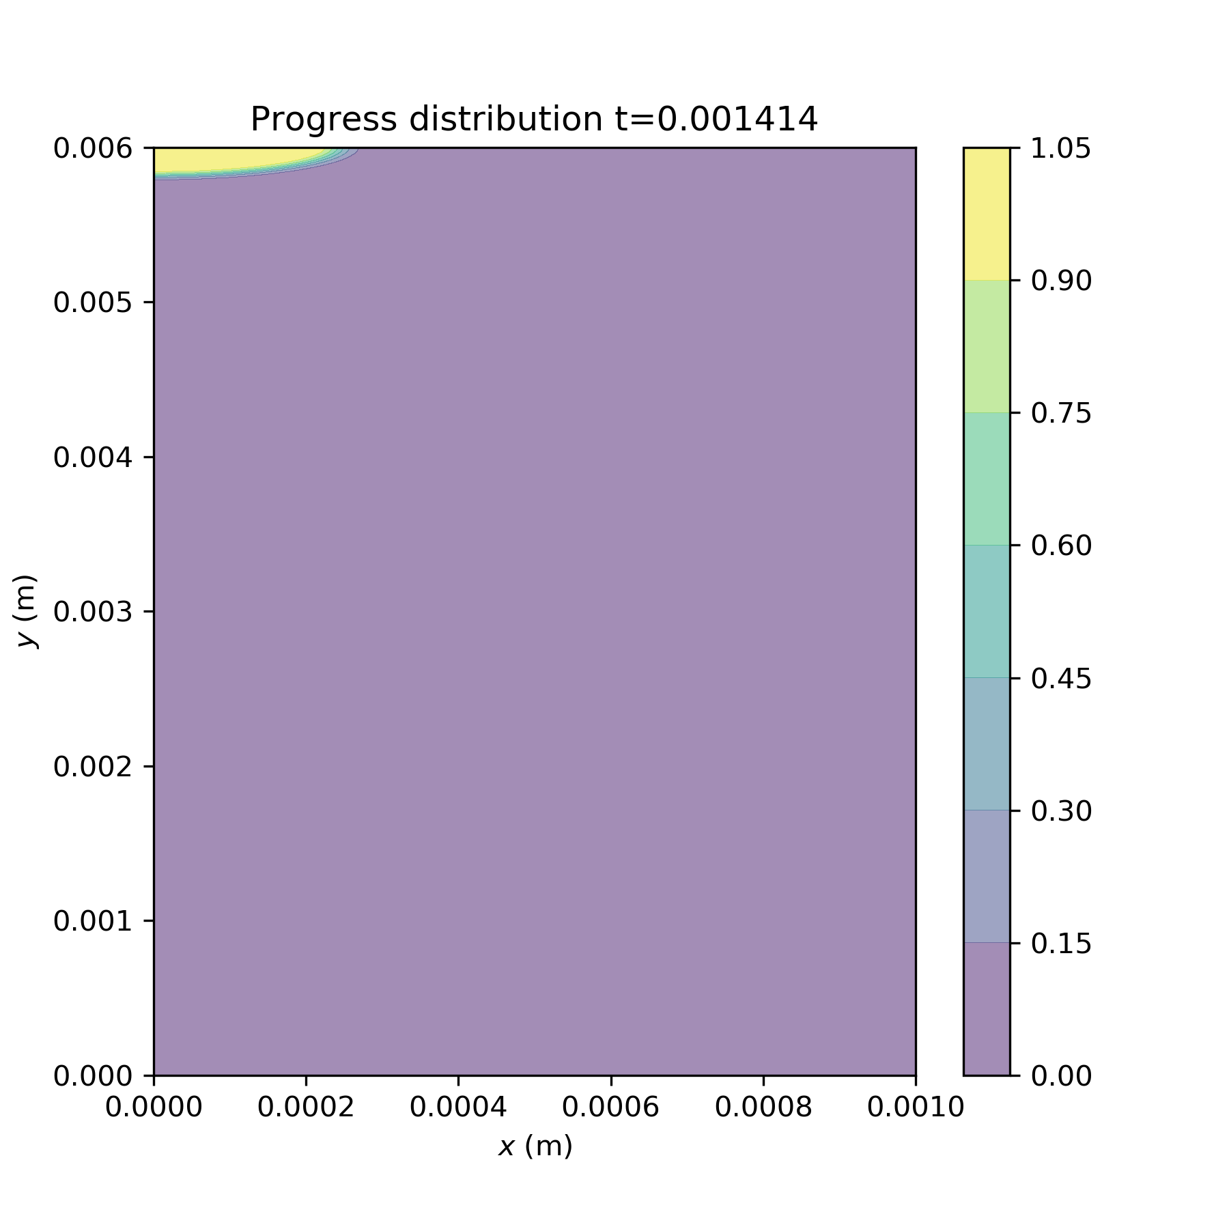
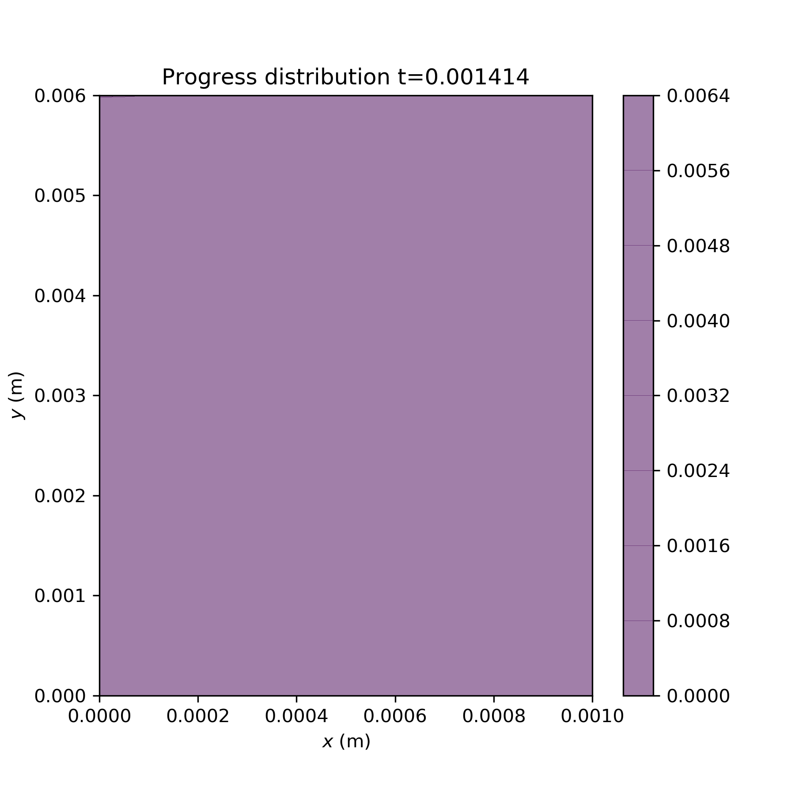
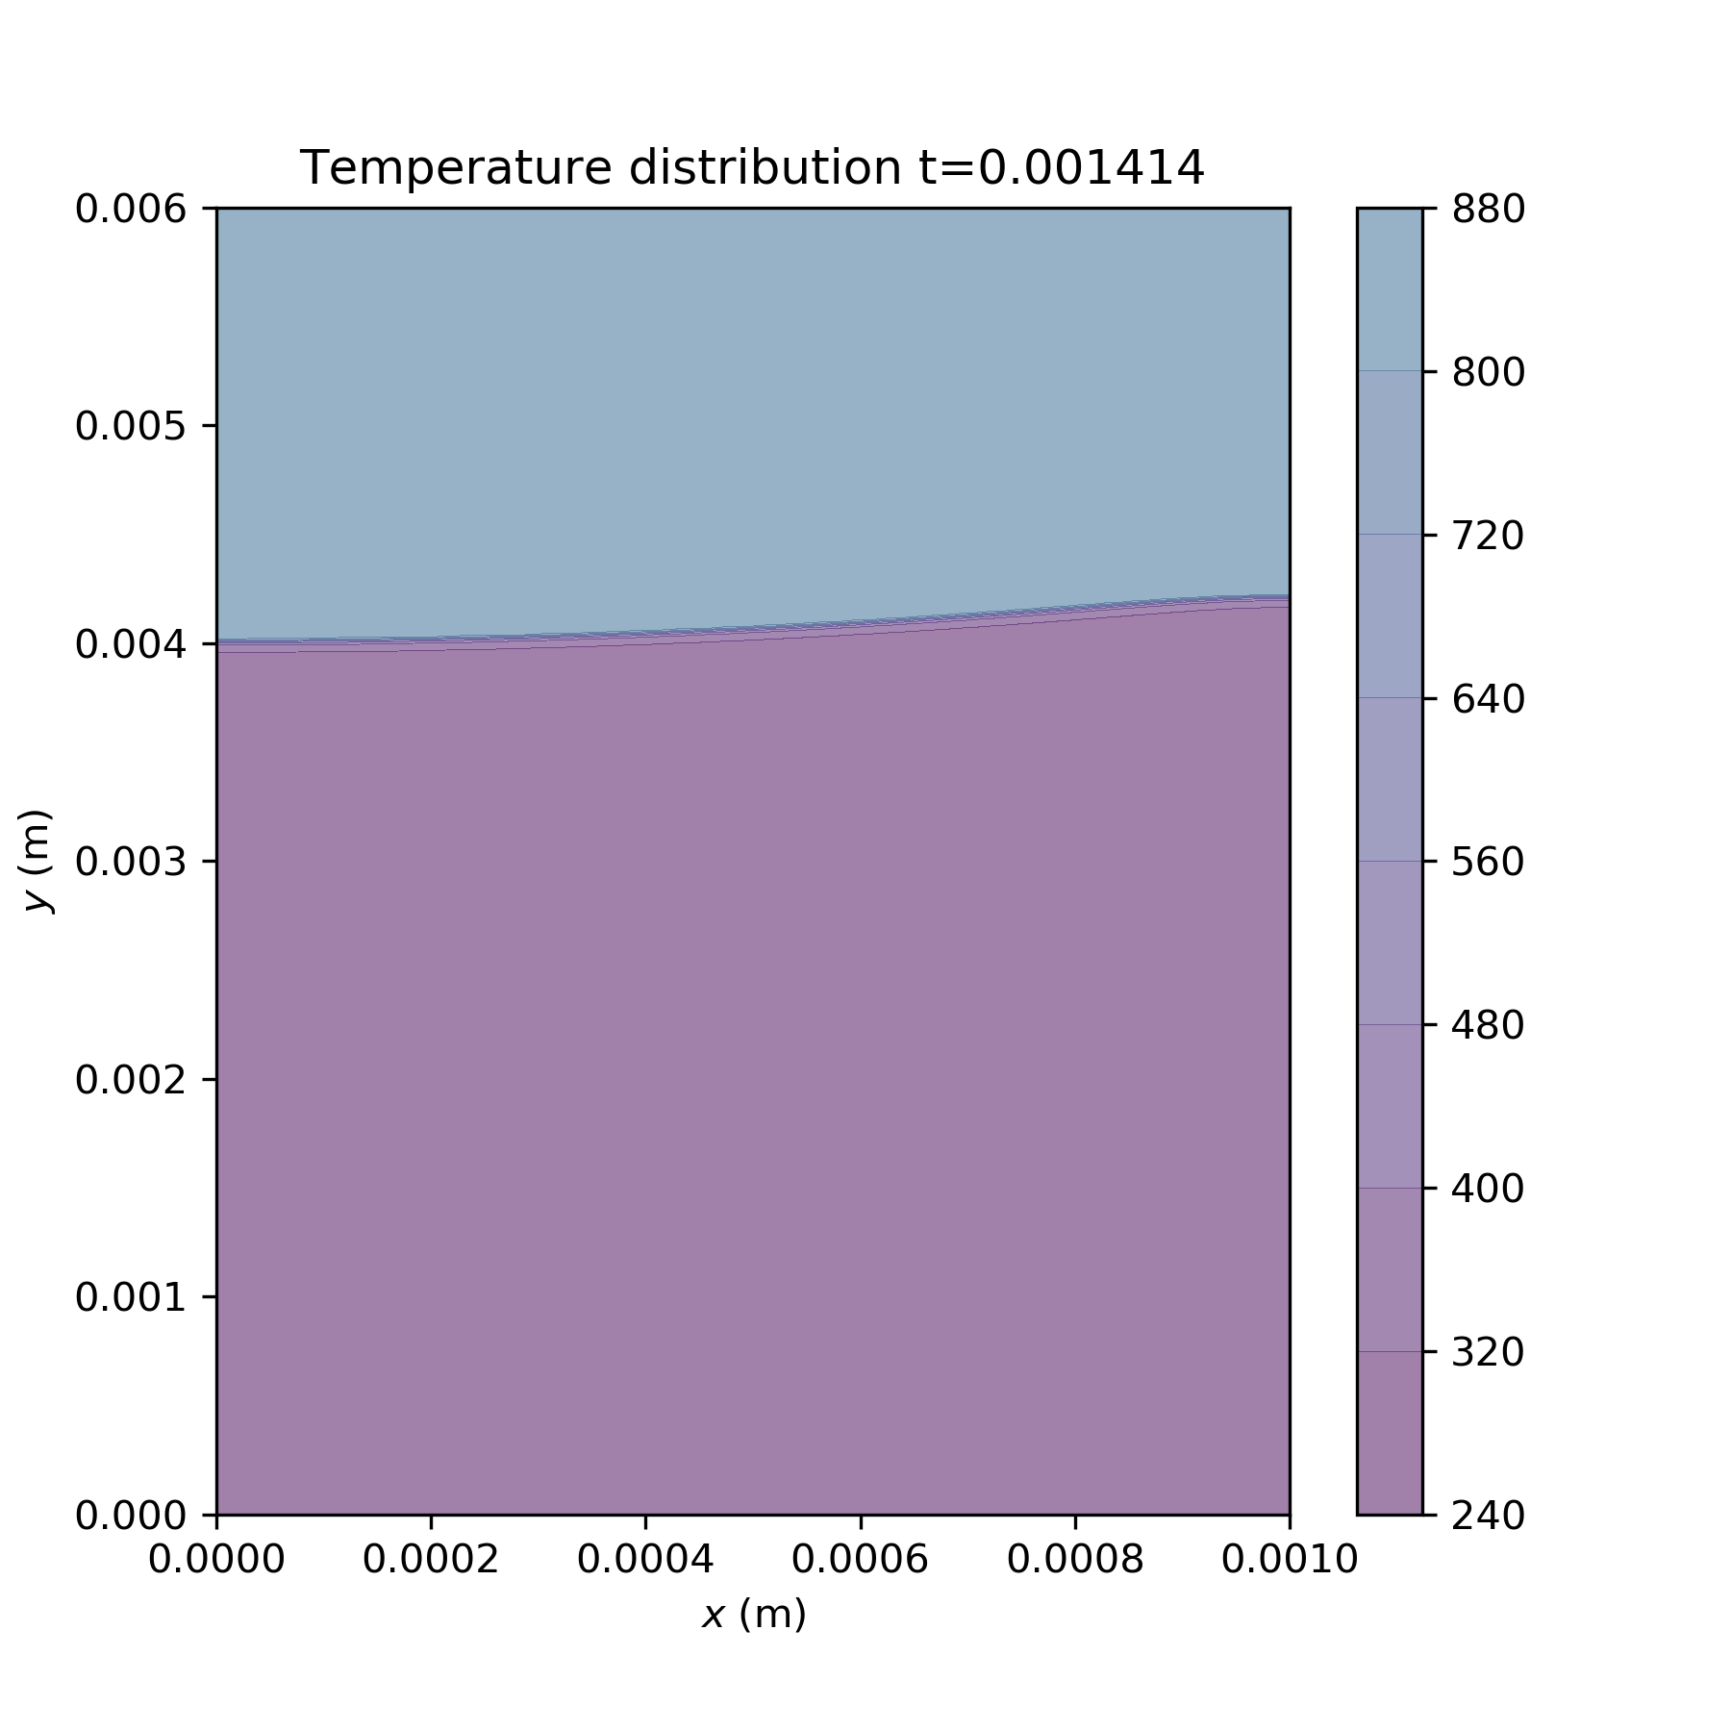
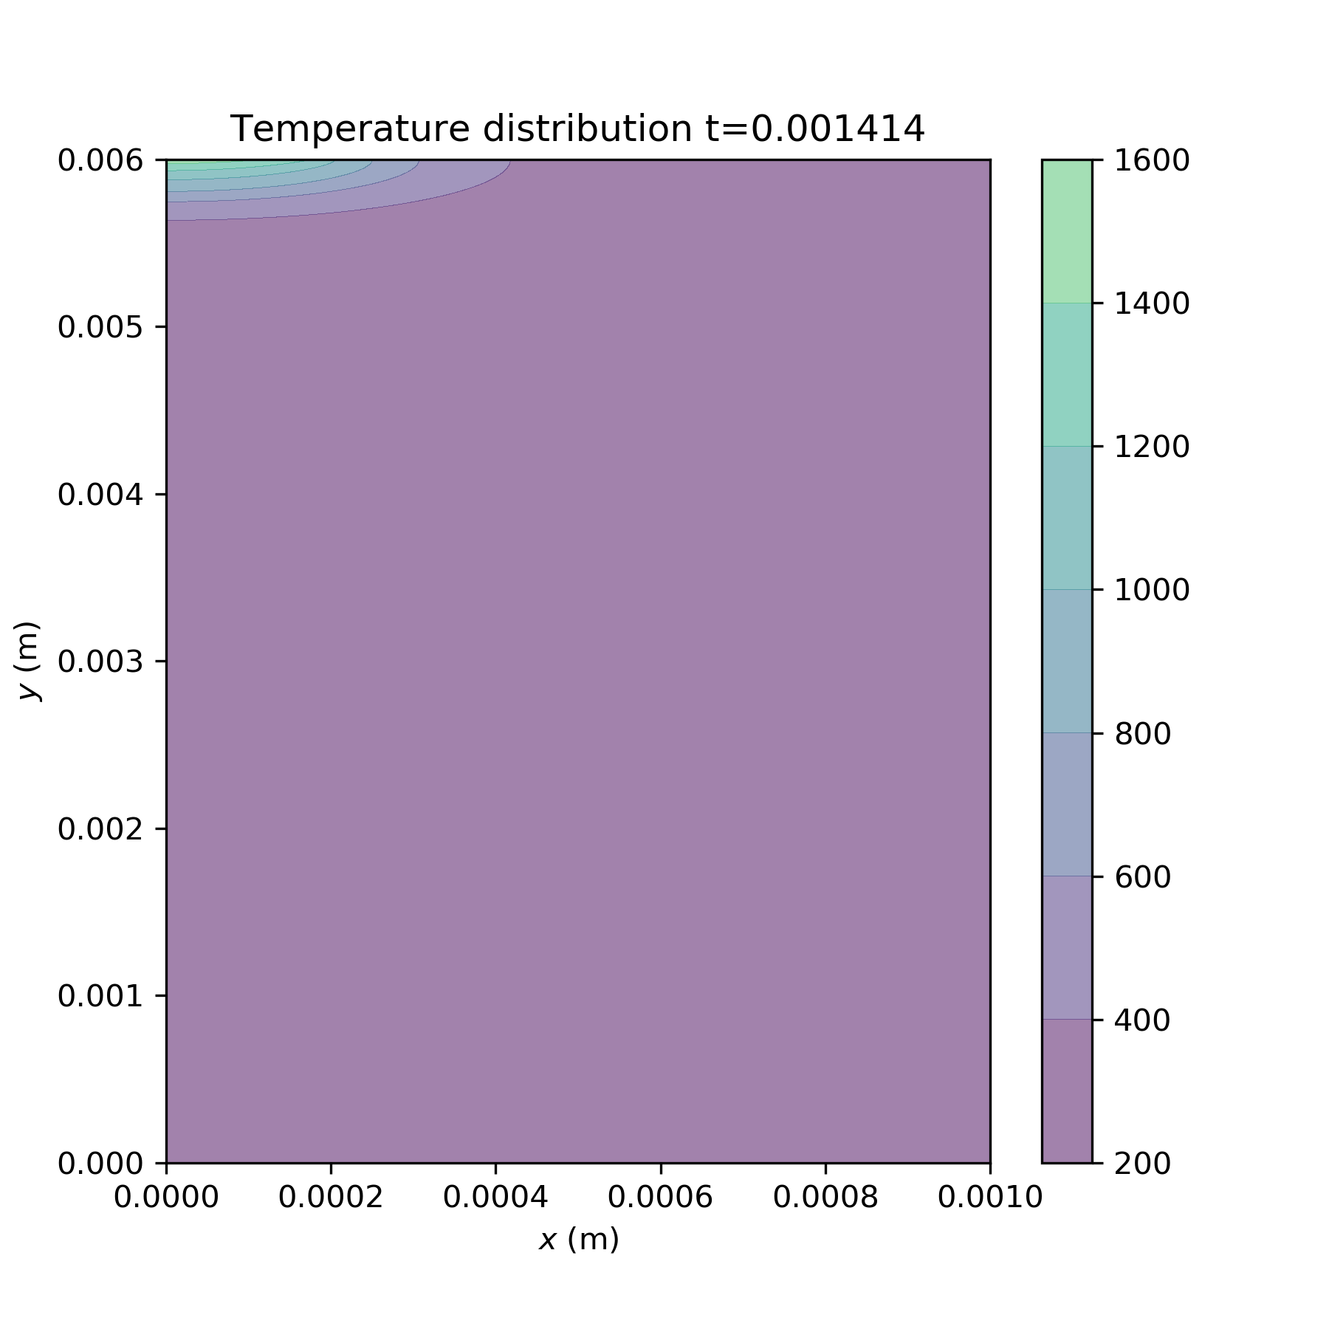
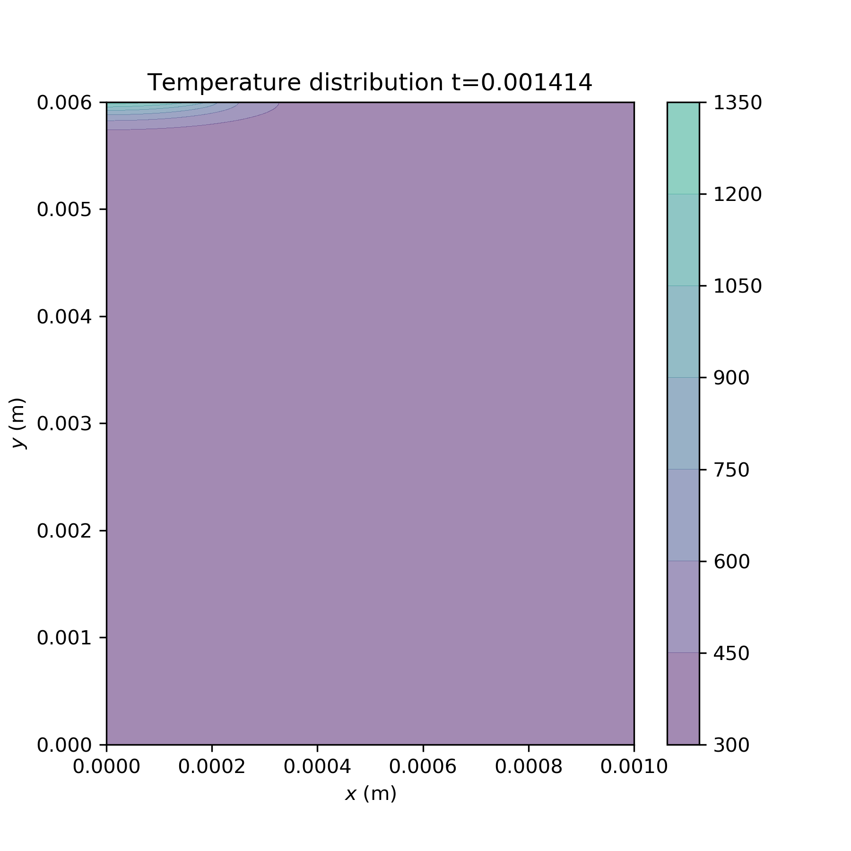
Ea investigations
(1)
Ea=40000
A0=1e8
dH=300000
(8)
Ea=70000
(9)
Ea=170000
Notes:
Ea

Slide 3
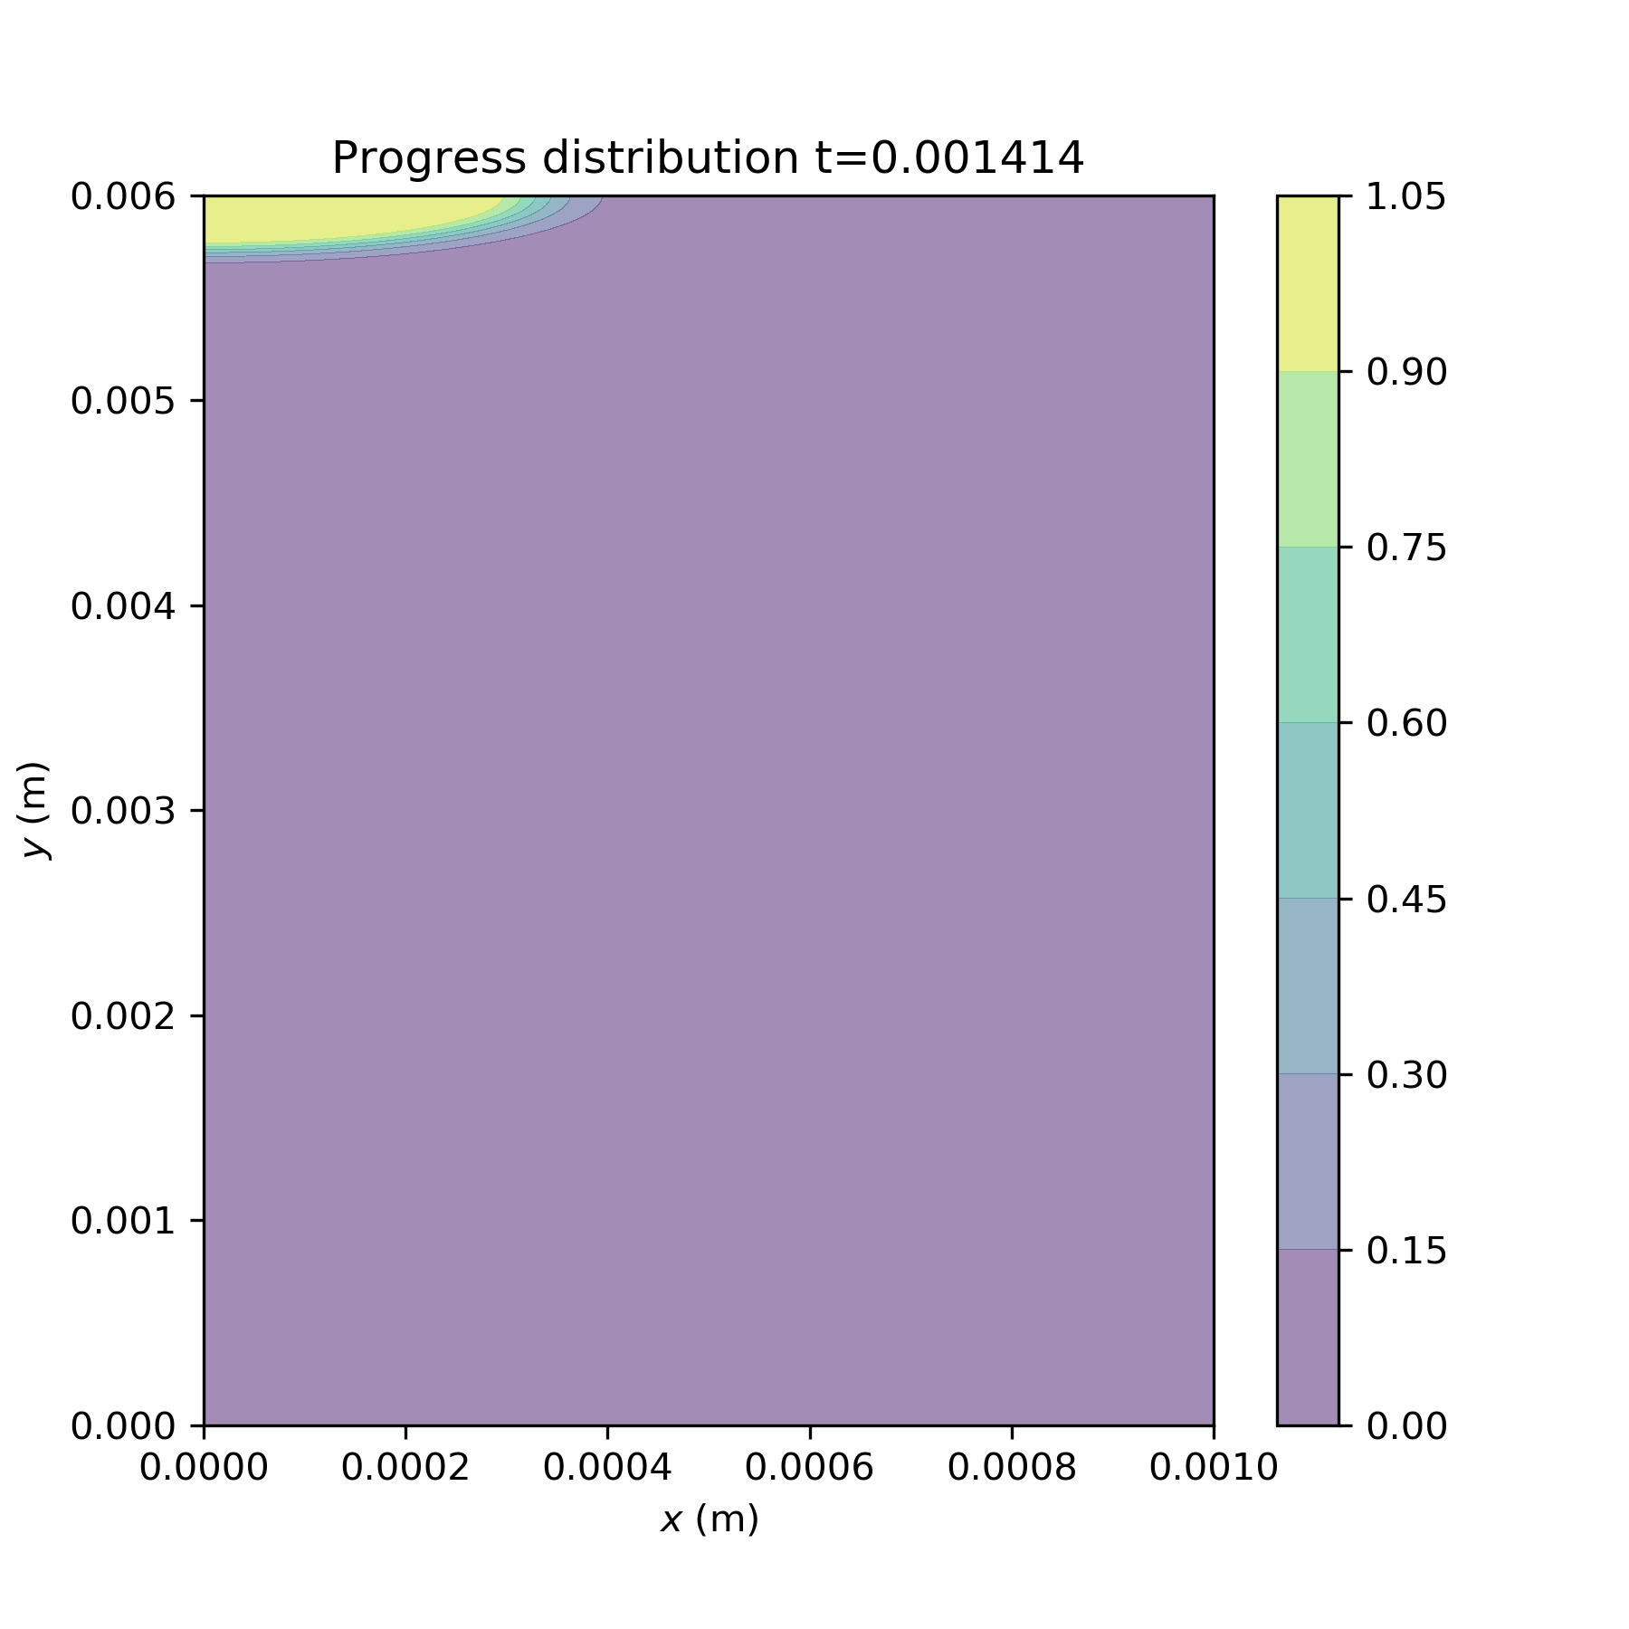
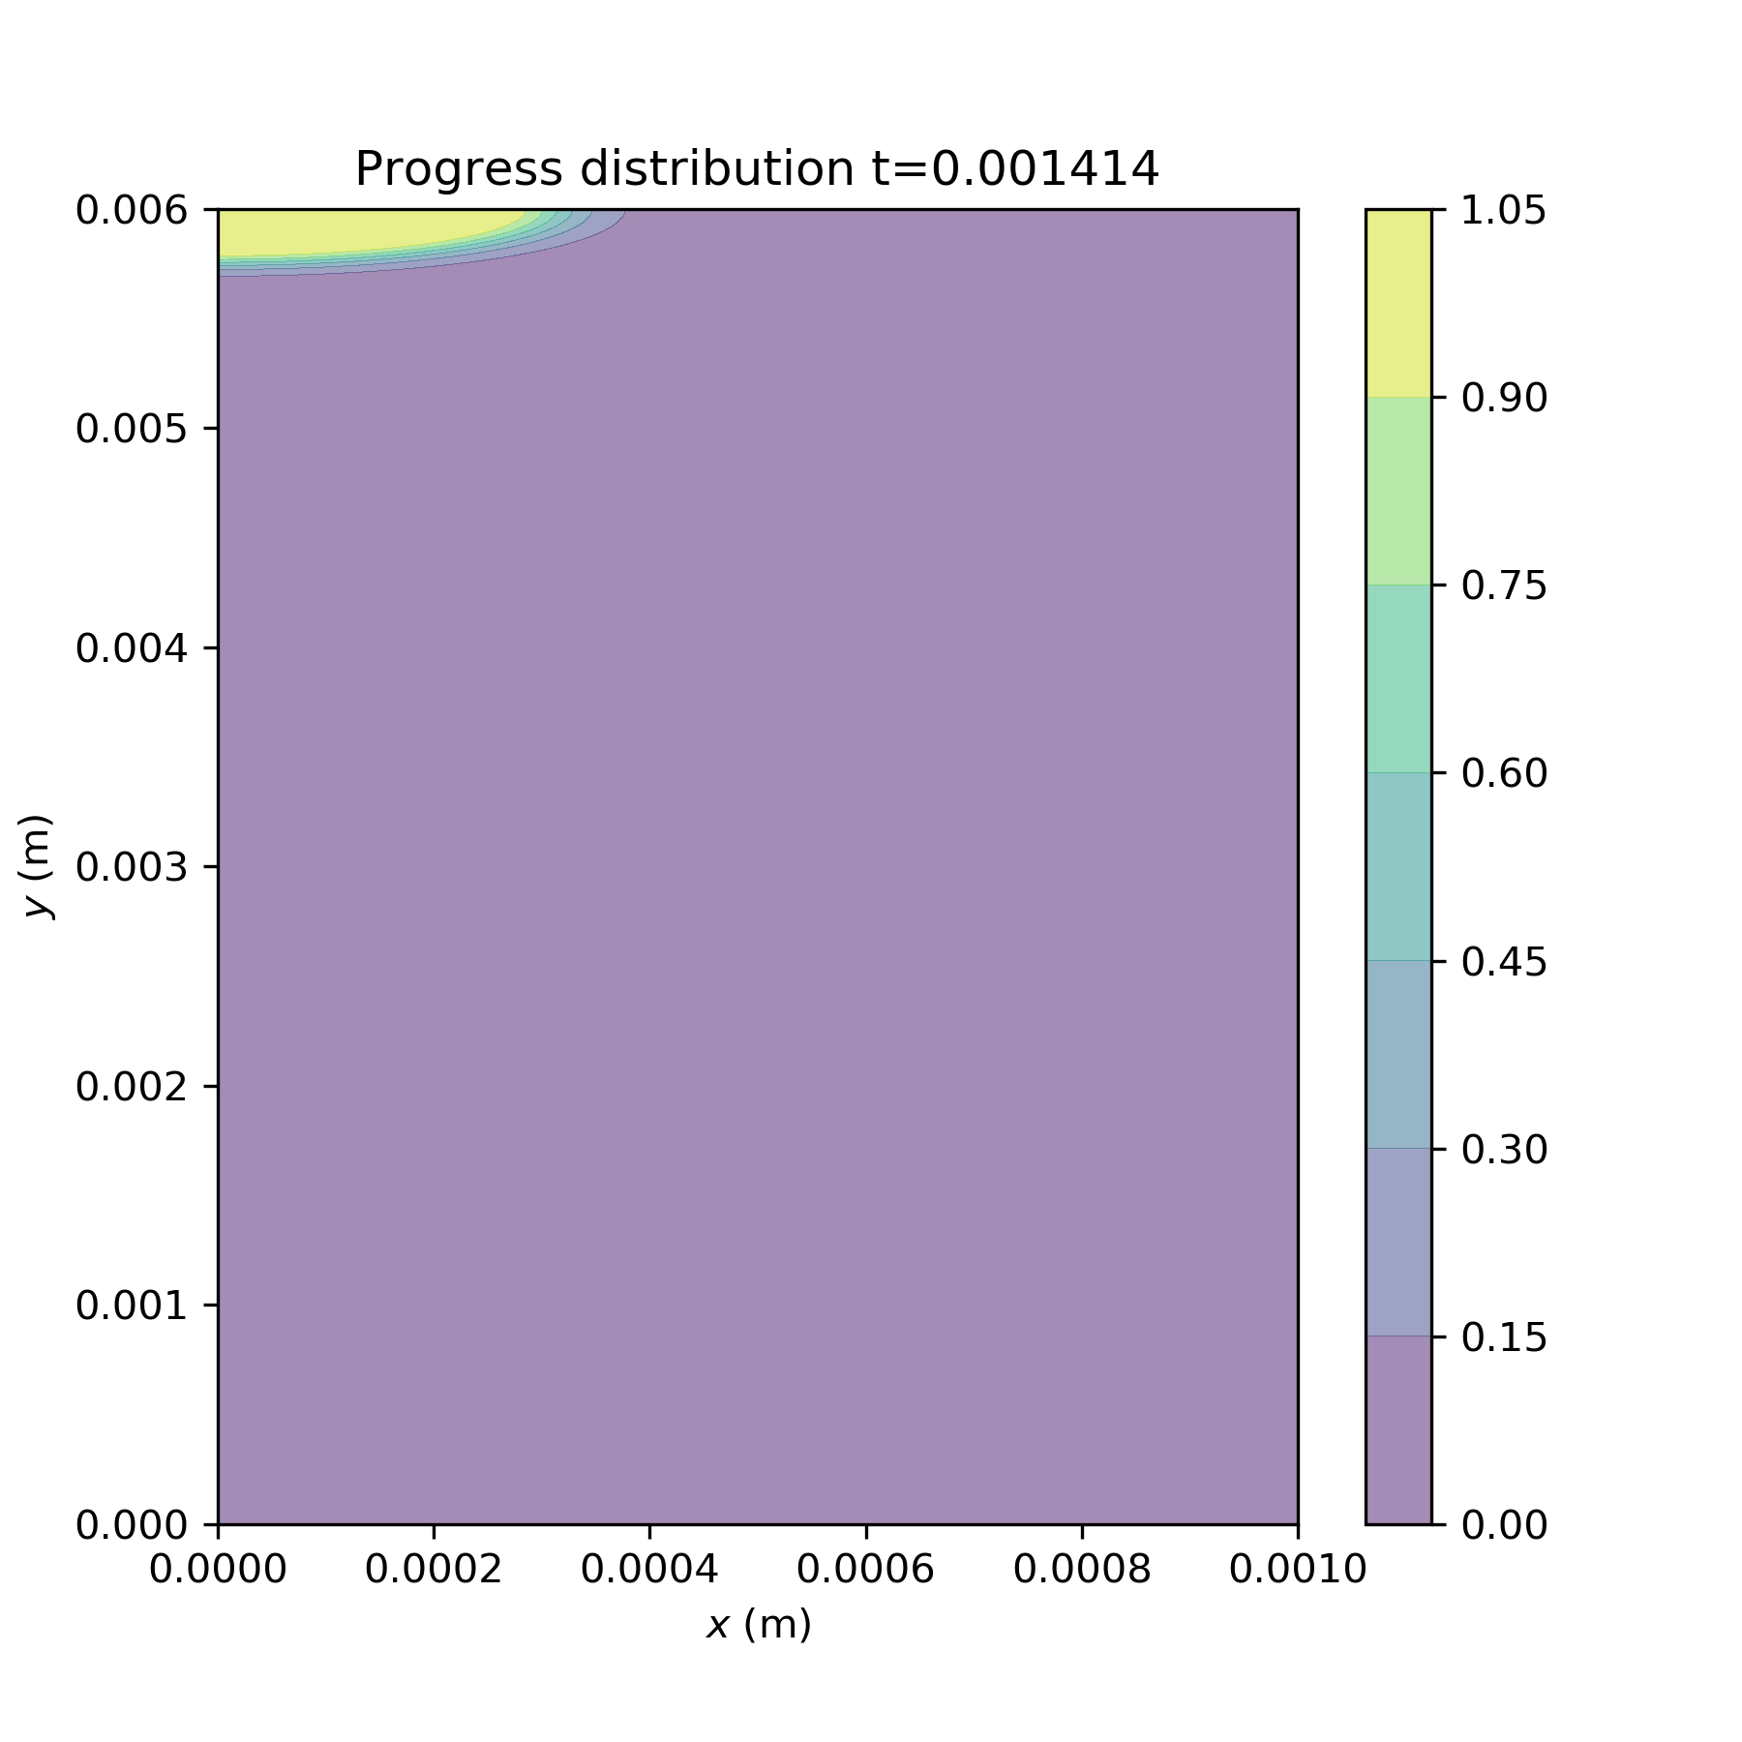
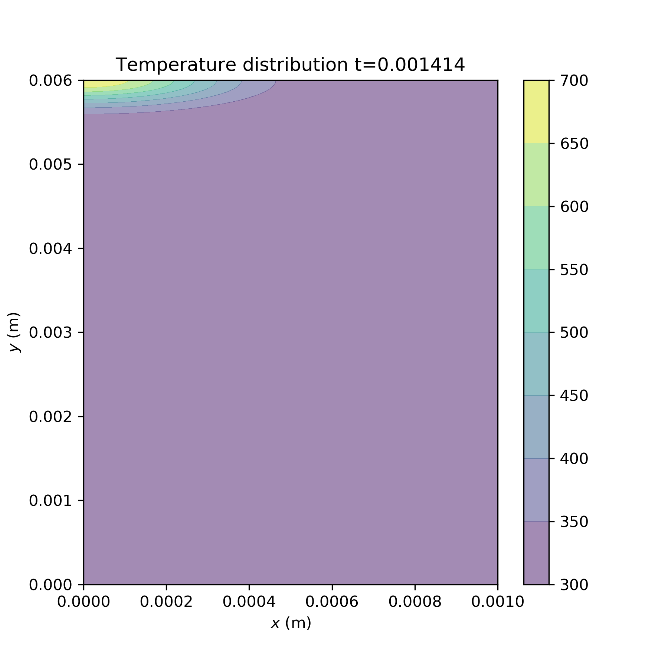
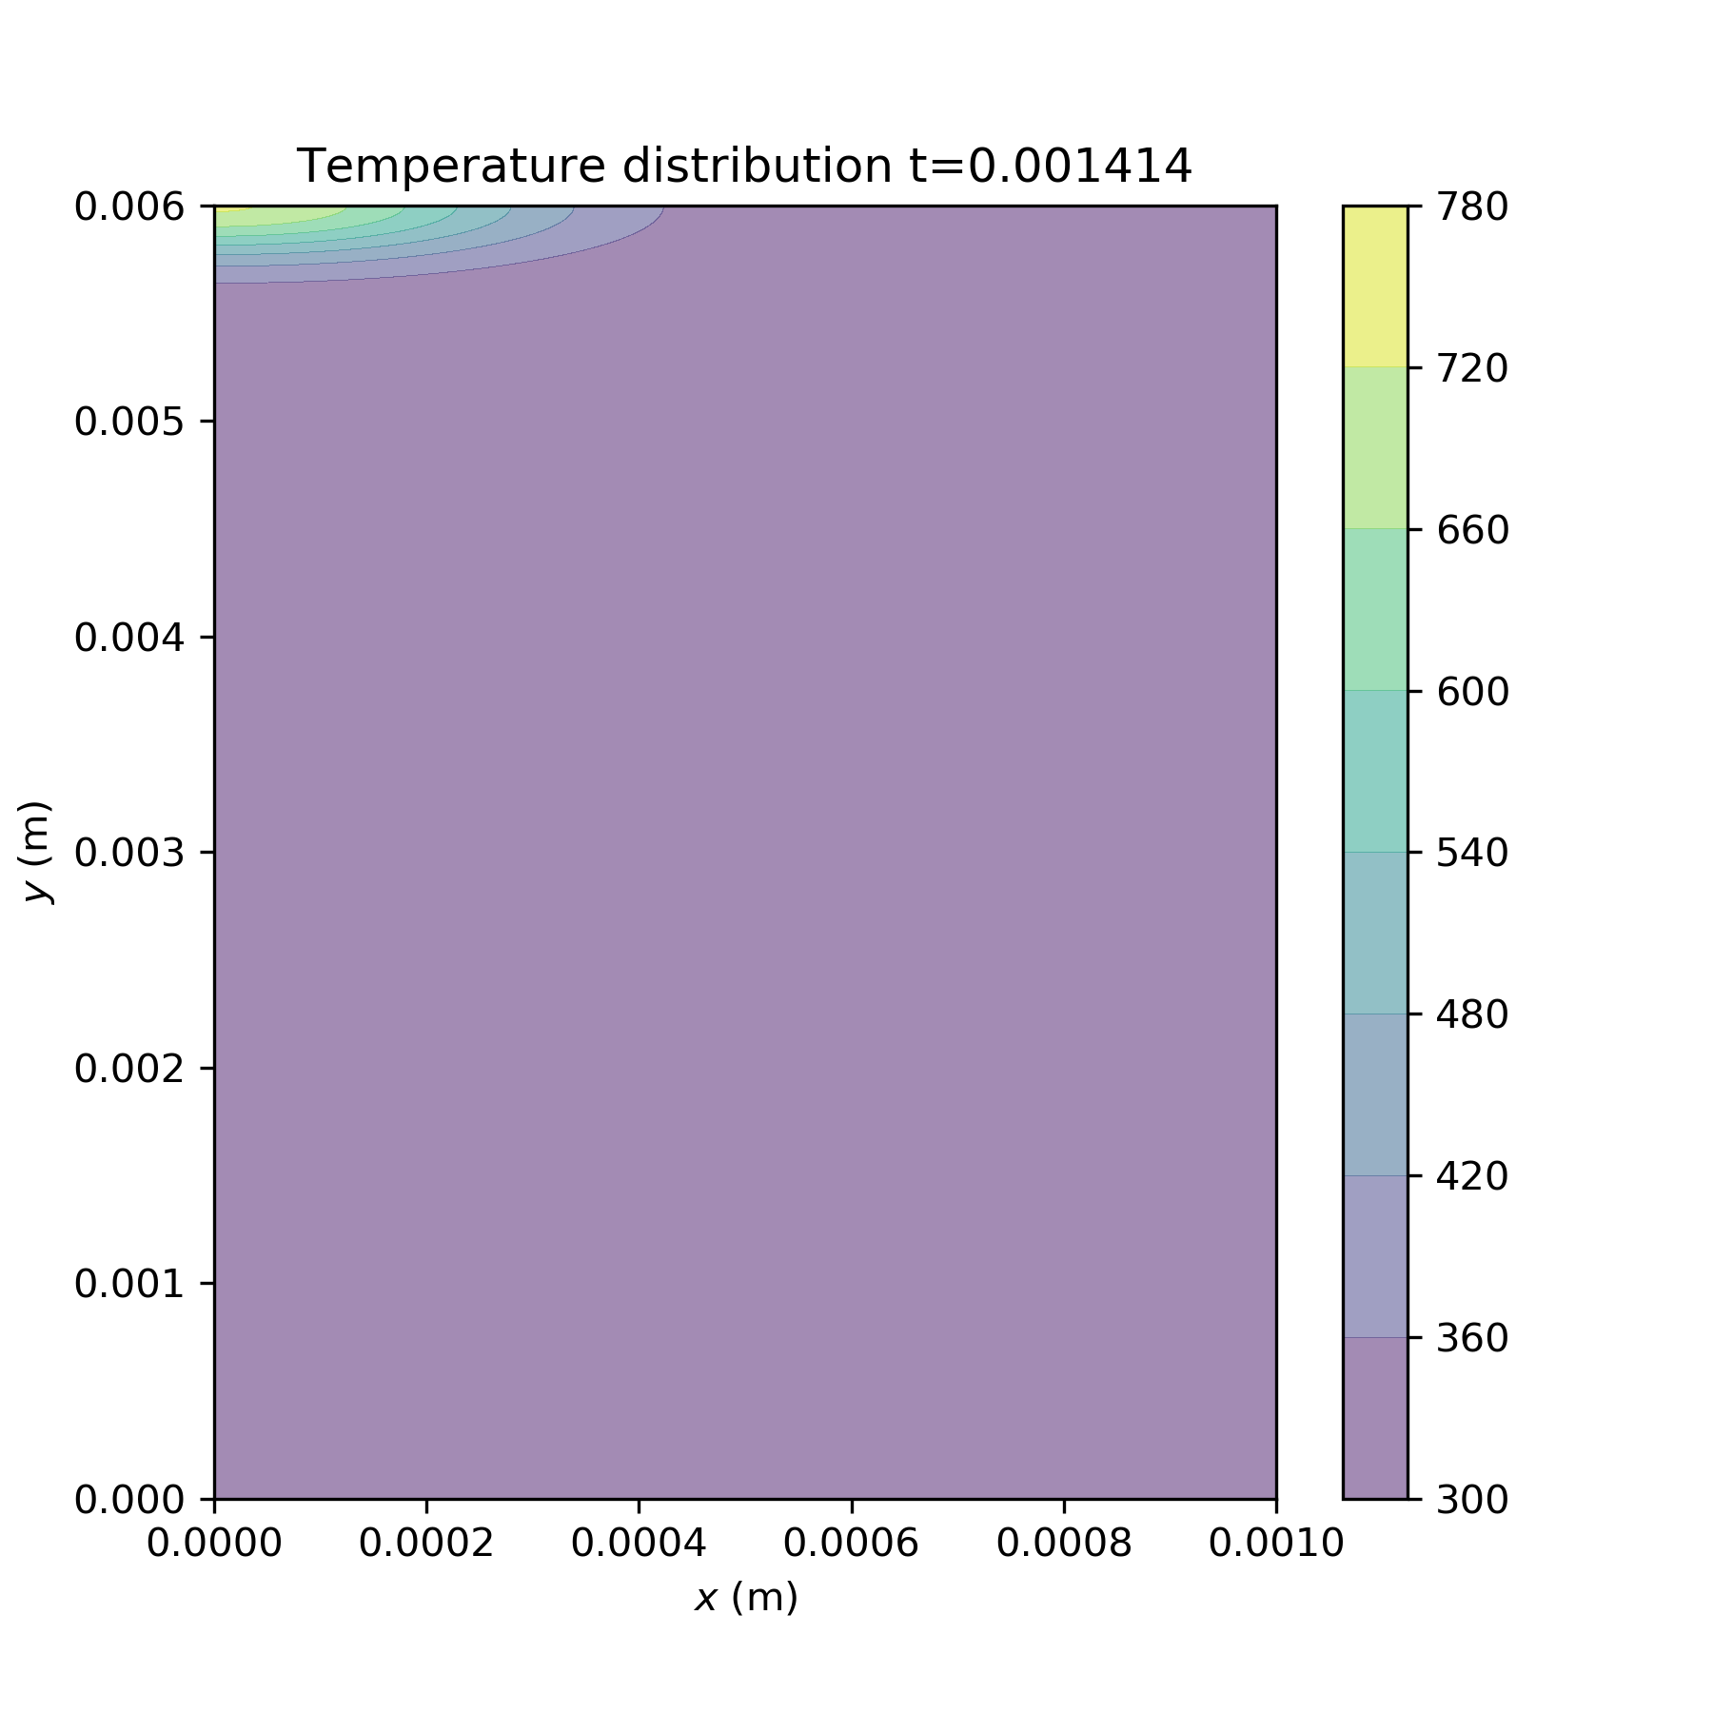
dH investigations
(1)
Ea=40000
A0=1e8
dH=300000
(2)
dH=30000
(3)
dH=1200
Notes:
dH

Slide 4
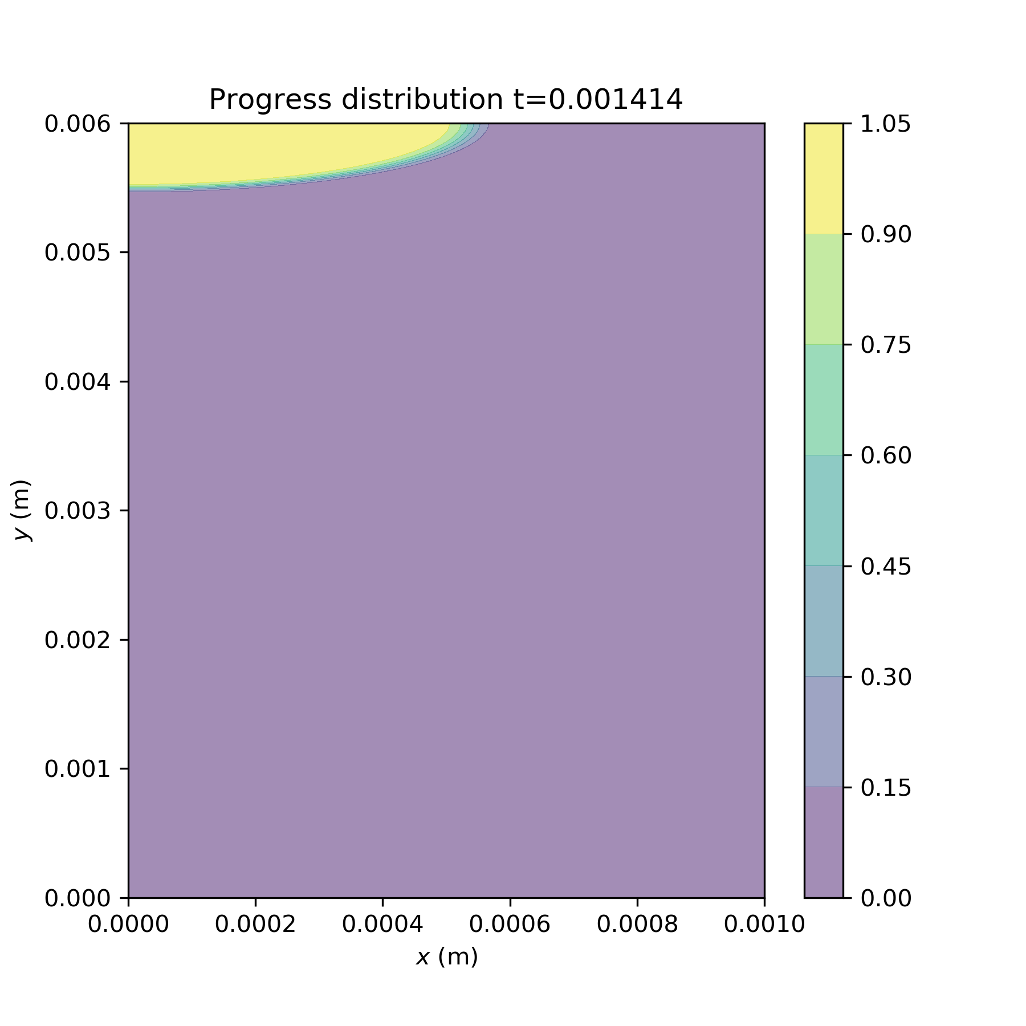
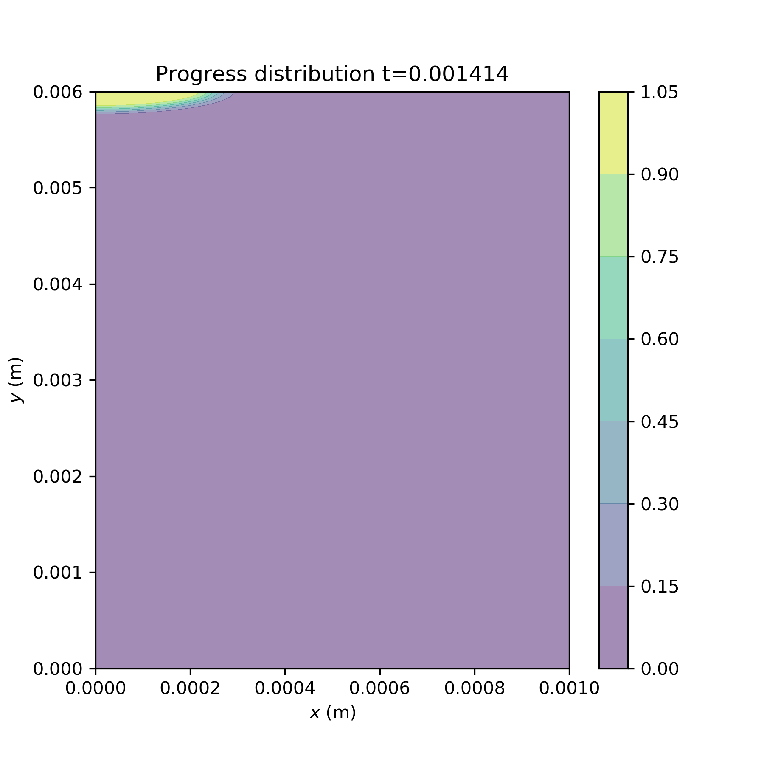
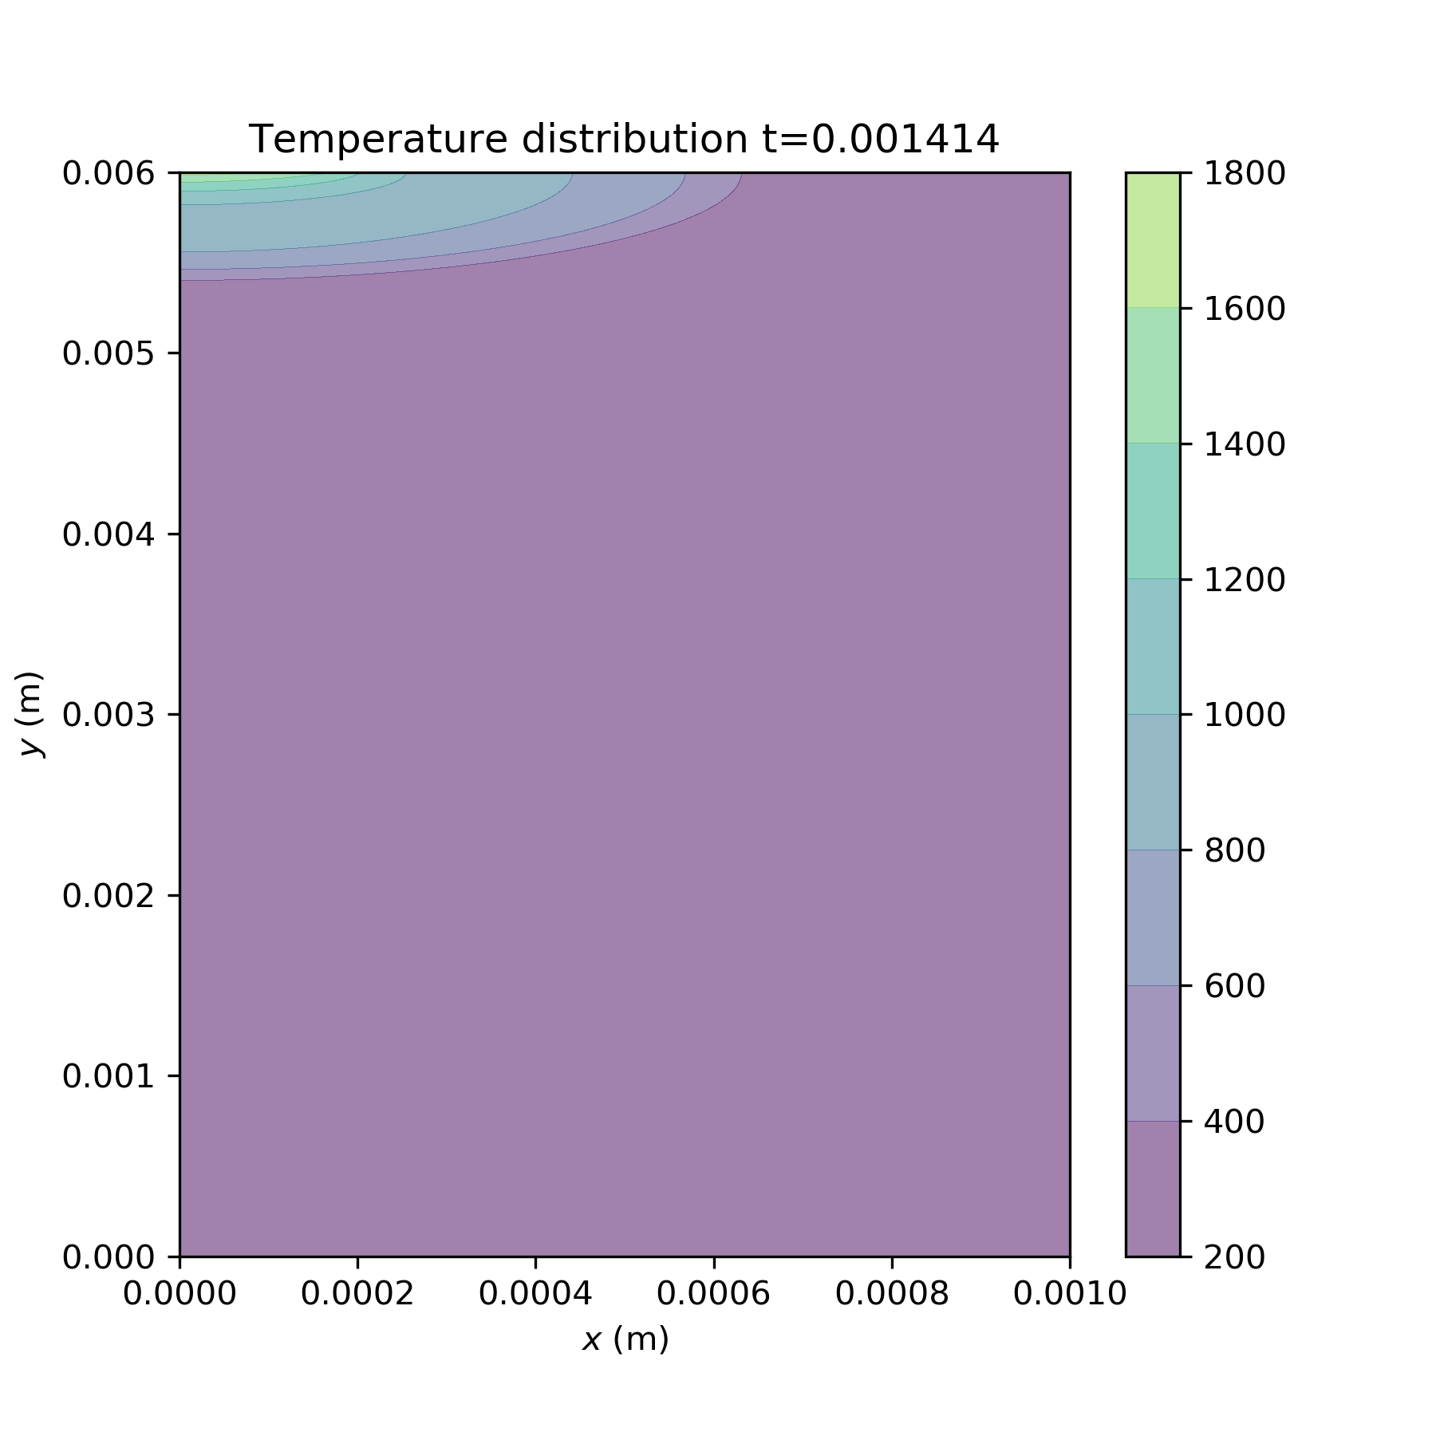

A0 investigations
(1)
Ea=40000
A0=1e8
dH=300000
(7)
A0=1e7
(6)
A0=1e6
Notes:
A0

Slide 5


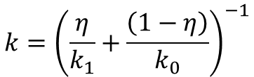
$$rho=ηrho_{1}+\left(1−η\right)rho_{0}$$
Fo=0.2
6000 time steps
6 data files
rho=f(eta)
k= f(eta)
Cp= f(eta)
$$k={\left(\frac{η}{k_{1}}+\frac{\left(1−η\right)}{k_{0}}\right)}^{−1}$$
$$C_{p}=ηC_{p1}+\left(1−η\right)C_{p0}$$
Parameters tested:
-Flux BC
-Arrhenius parameters
-Enthalpy of combustion
-Ignition temperature (flux BC removed)
Tests can overwrite: n/a
Diverging parameters:
-
Notes:
Reset folder numbering

Slide 6
Flux BC investigations
A0=4.89e6, dH=63 kJ/cm^3, T_ign=1200 K,
Flux (MW/m^2) | Ea (kJ/mol) | Ignition delay (ms) | Flame front speed (m/s) | OOM Temperature (K)
200 | 48 | 0.15 | 9.2 | 20000
400 | 48
200 | 70 | 0.54 | 7.0 | 20000
400 | 70
Flux-1
Flux-2
Notes:
Flux

Slide 7
Ignition temperature investigations
A0=4.89e6, dH=63 kJ/cm^3, Flux=400 MW/m^2
Ignition temperature (K) | Ea (kJ/mol) | Ignition delay (ms) | Flame front speed (m/s) | OOM Temperature (K)
1200 | 48 | 0.049 | 8.7 | n/a
1200 | 70 | 0.17 | 6.9 | n/a
1200 | 78 | 0.22 | 0 | n/a
1000 | 70 | 0.15 | 0 | 500
900 | 70 | 0.13 | 0 | 460
800 | 48 | 0.045 | n/a | n/a
800 | 70 | 0.096 | 0 | 400
Tign-1
Tign-2
Tign-3
Tign-6
Tign-5
Tign-7
Tign-4
Notes:
Flux

Slide 8
Enthalpy of Combustion investigations
A0=4.89e6, Ea=48 kJ/mol, Flux=200 MW/m^2, T_ign=1200 K
Enthalpy of Combustion (various) |  | Ignition delay (ms) | Flame front speed (m/s) | OOM Temperature (K)
63 MJ/m^3 |  | 0.4 | 1.7 | 2500
4.07 MJ/kg |  | 0.22 | 5.2 | 9000
dH-1
dH-2
Notes:
Flux

