Slide 1
rho=6000
k=70
Cp=550
Fo=0.2
6000 time steps
6 data files

Slide 2
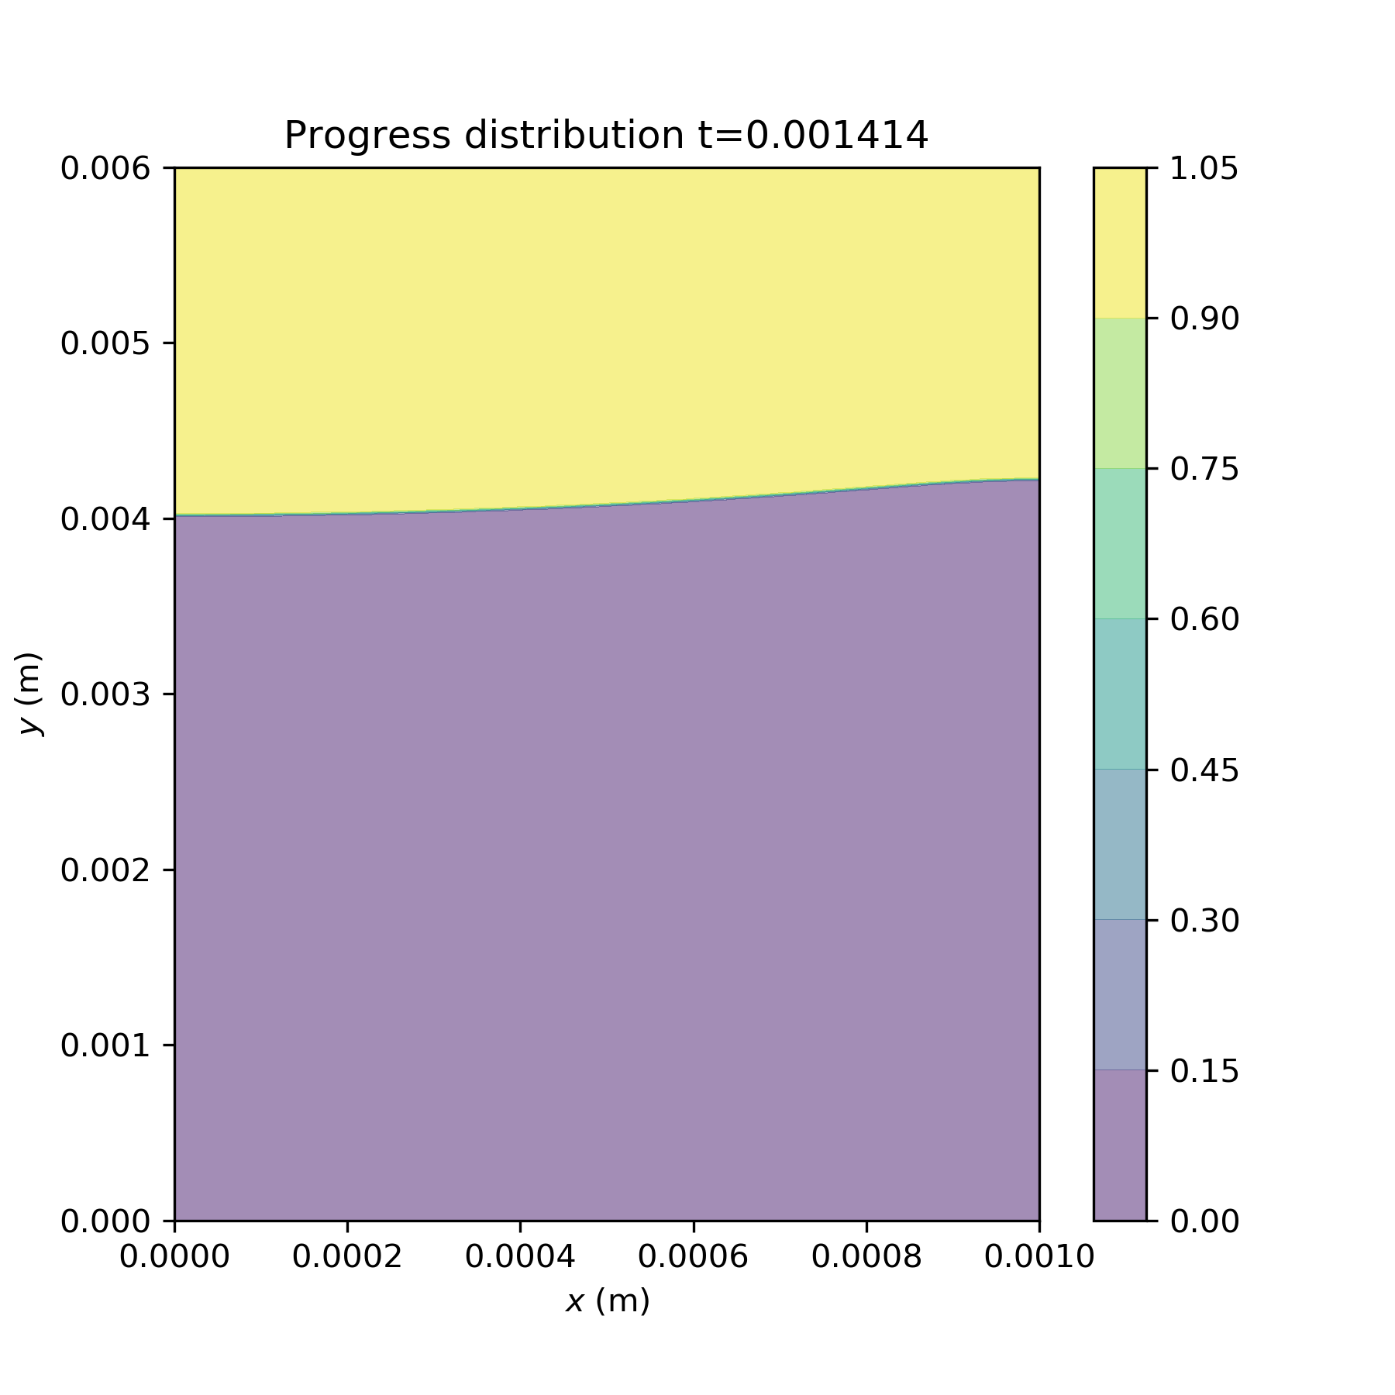
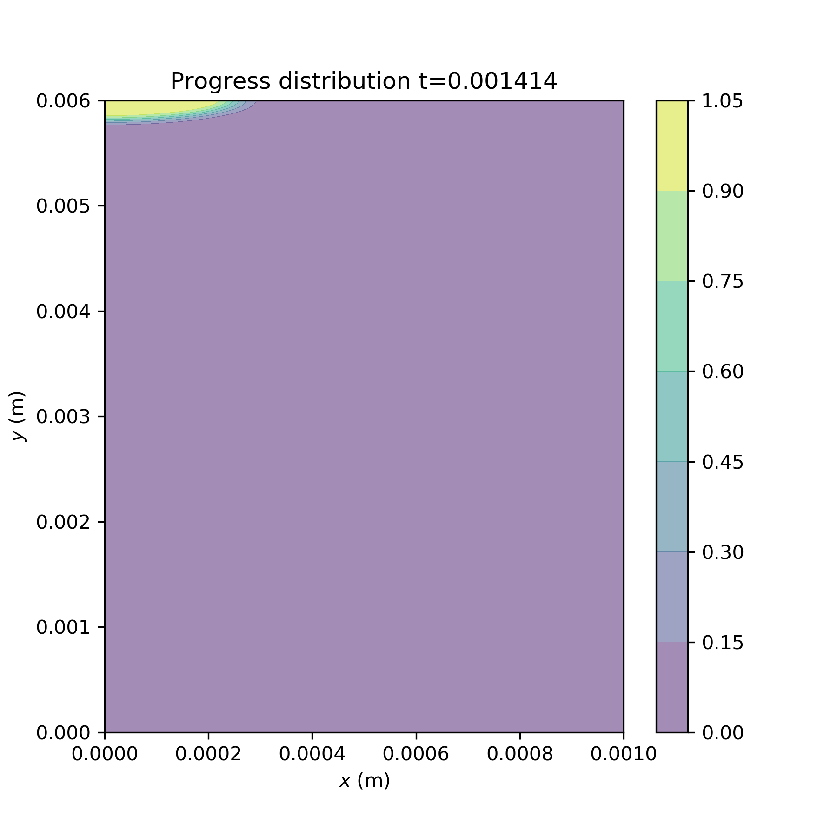
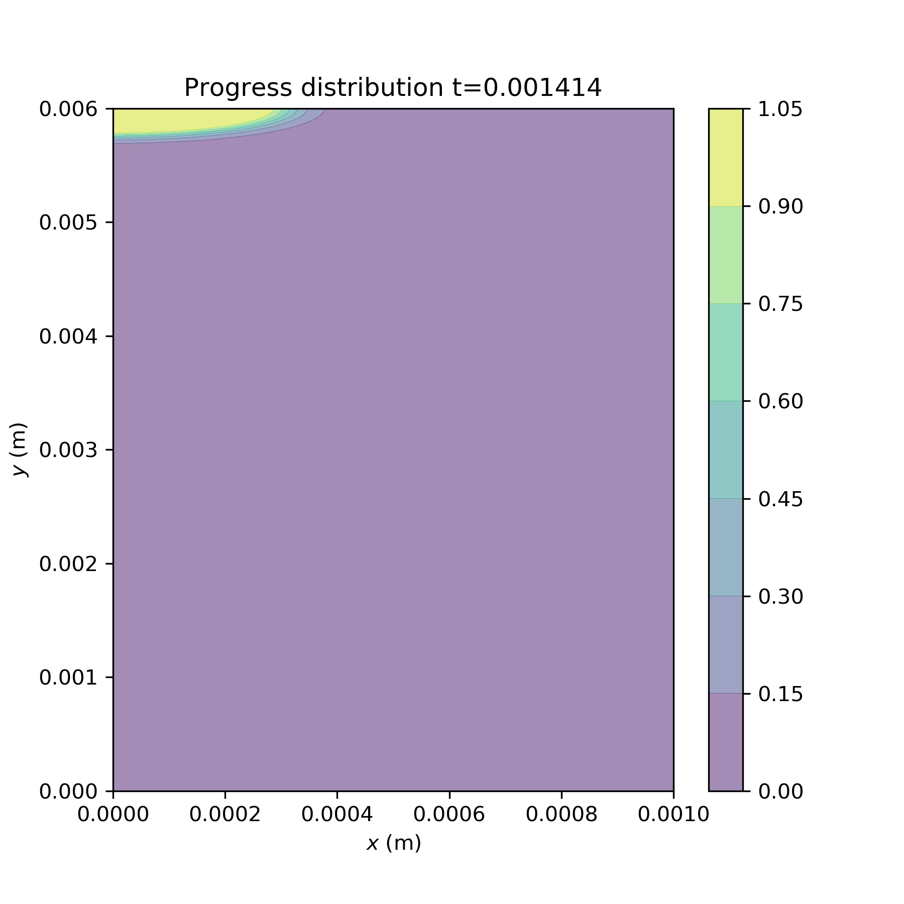
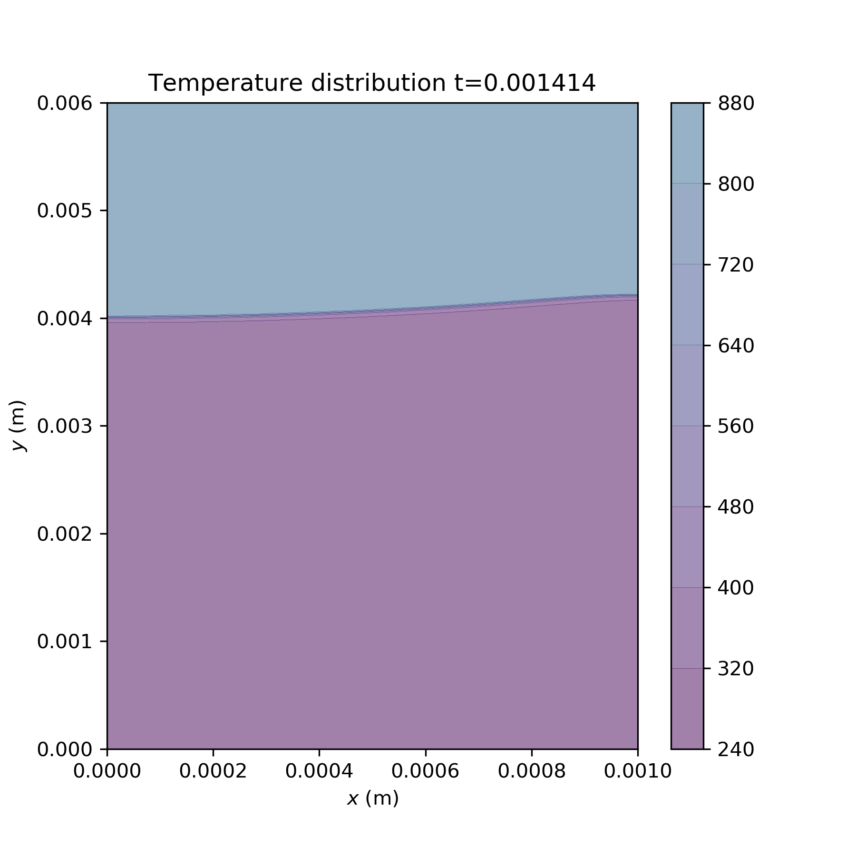
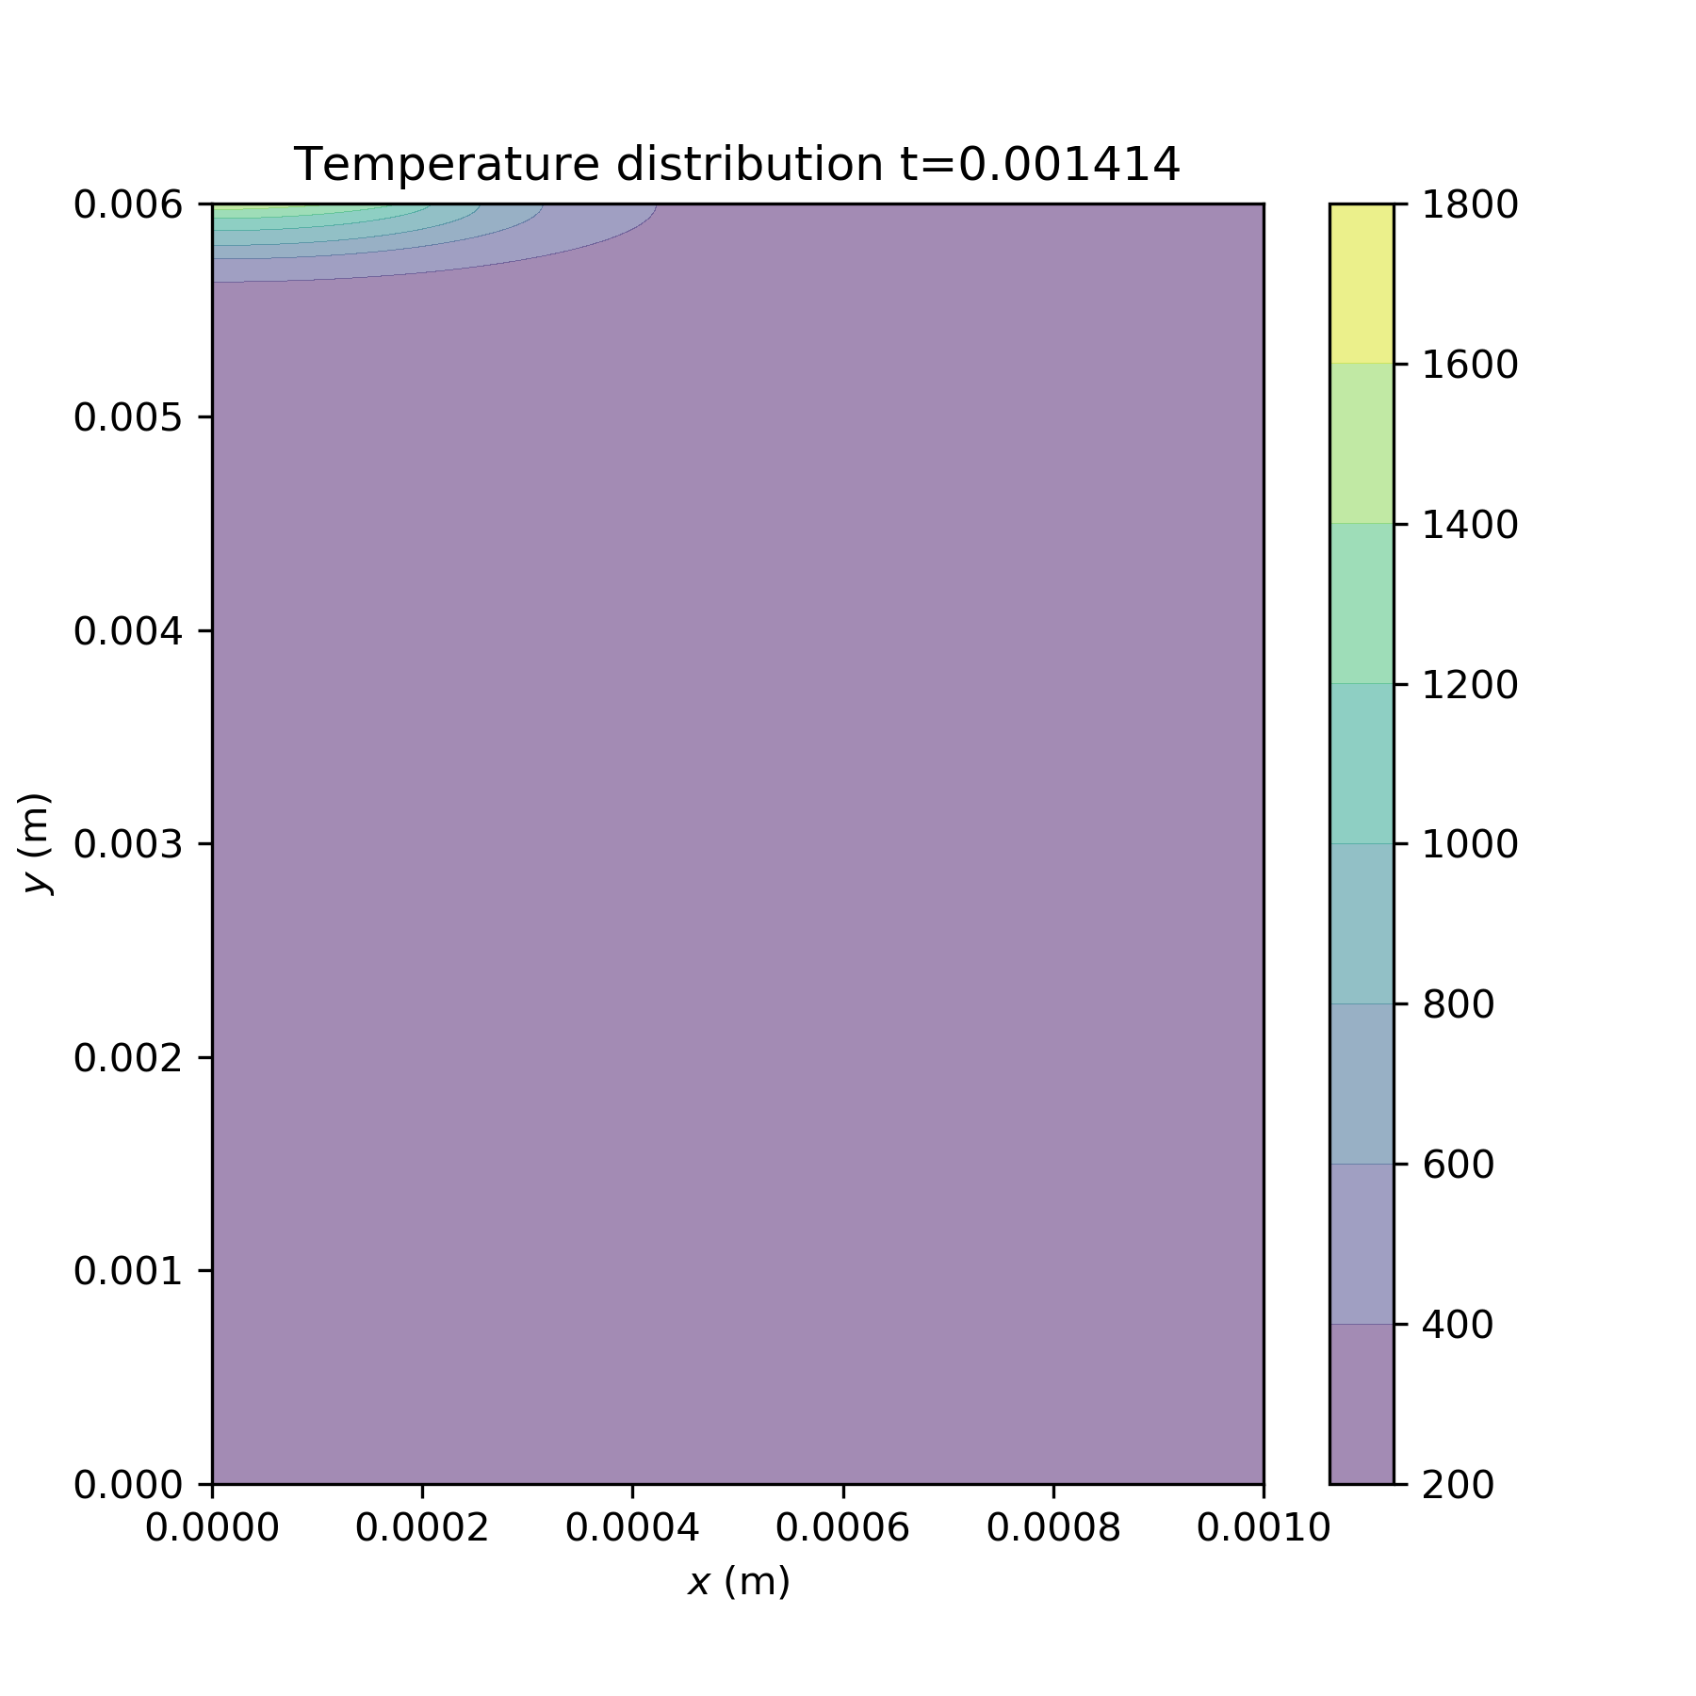

dH investigations
Ea=40000
A0=1e8
dH=300000
A0=1e6
dH=300000
A0=1e6
dH=30000
A0=1e8
dH=1200
Ea=4000
A0=1e6
dH=1200

Slide 3
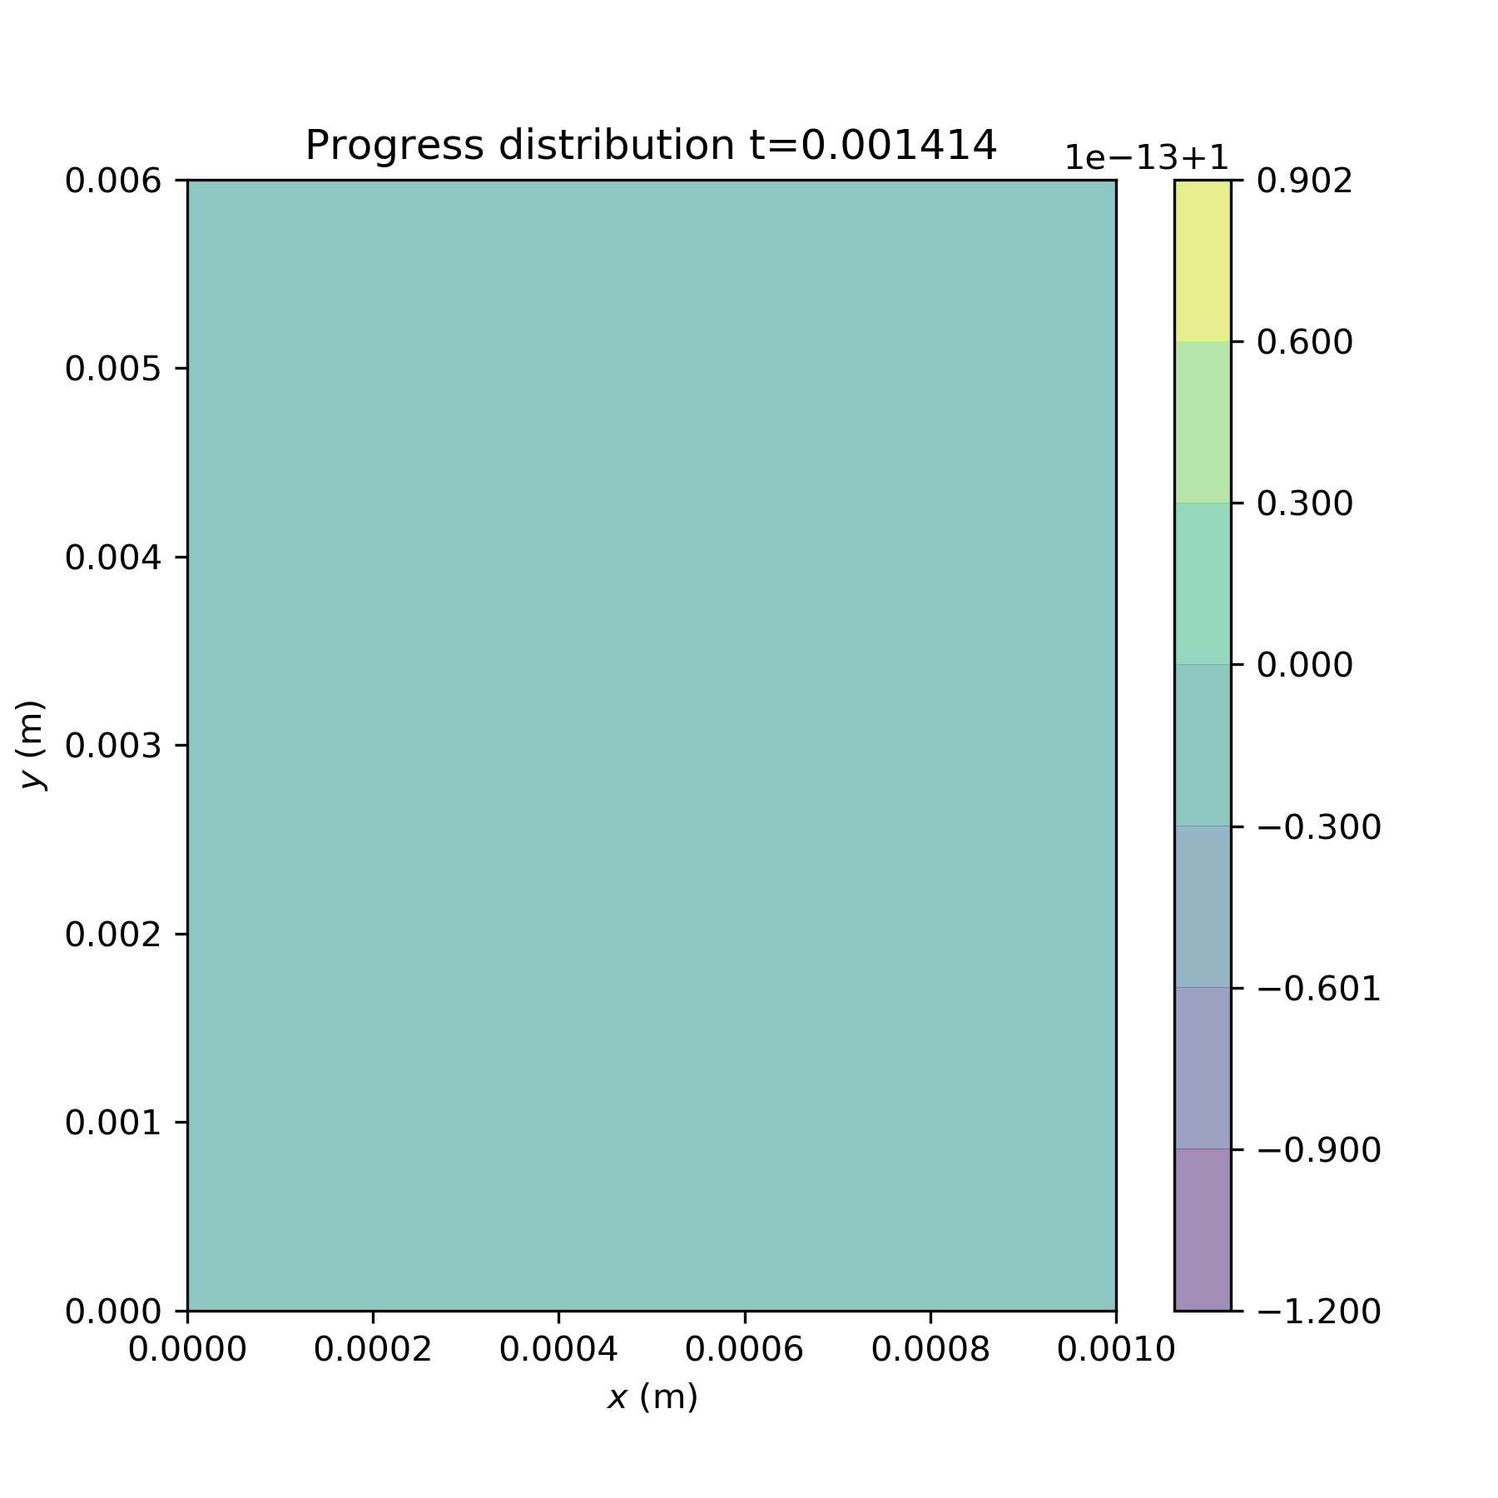

Ea investigations
Ea=4000
A0=1e6
dH=1200
A0=1e6
dH=300000
A0=1e6
dH=1200
A0=1e8
dH=1200
Ea=40000
A0=1e8
dH=300000

Slide 4
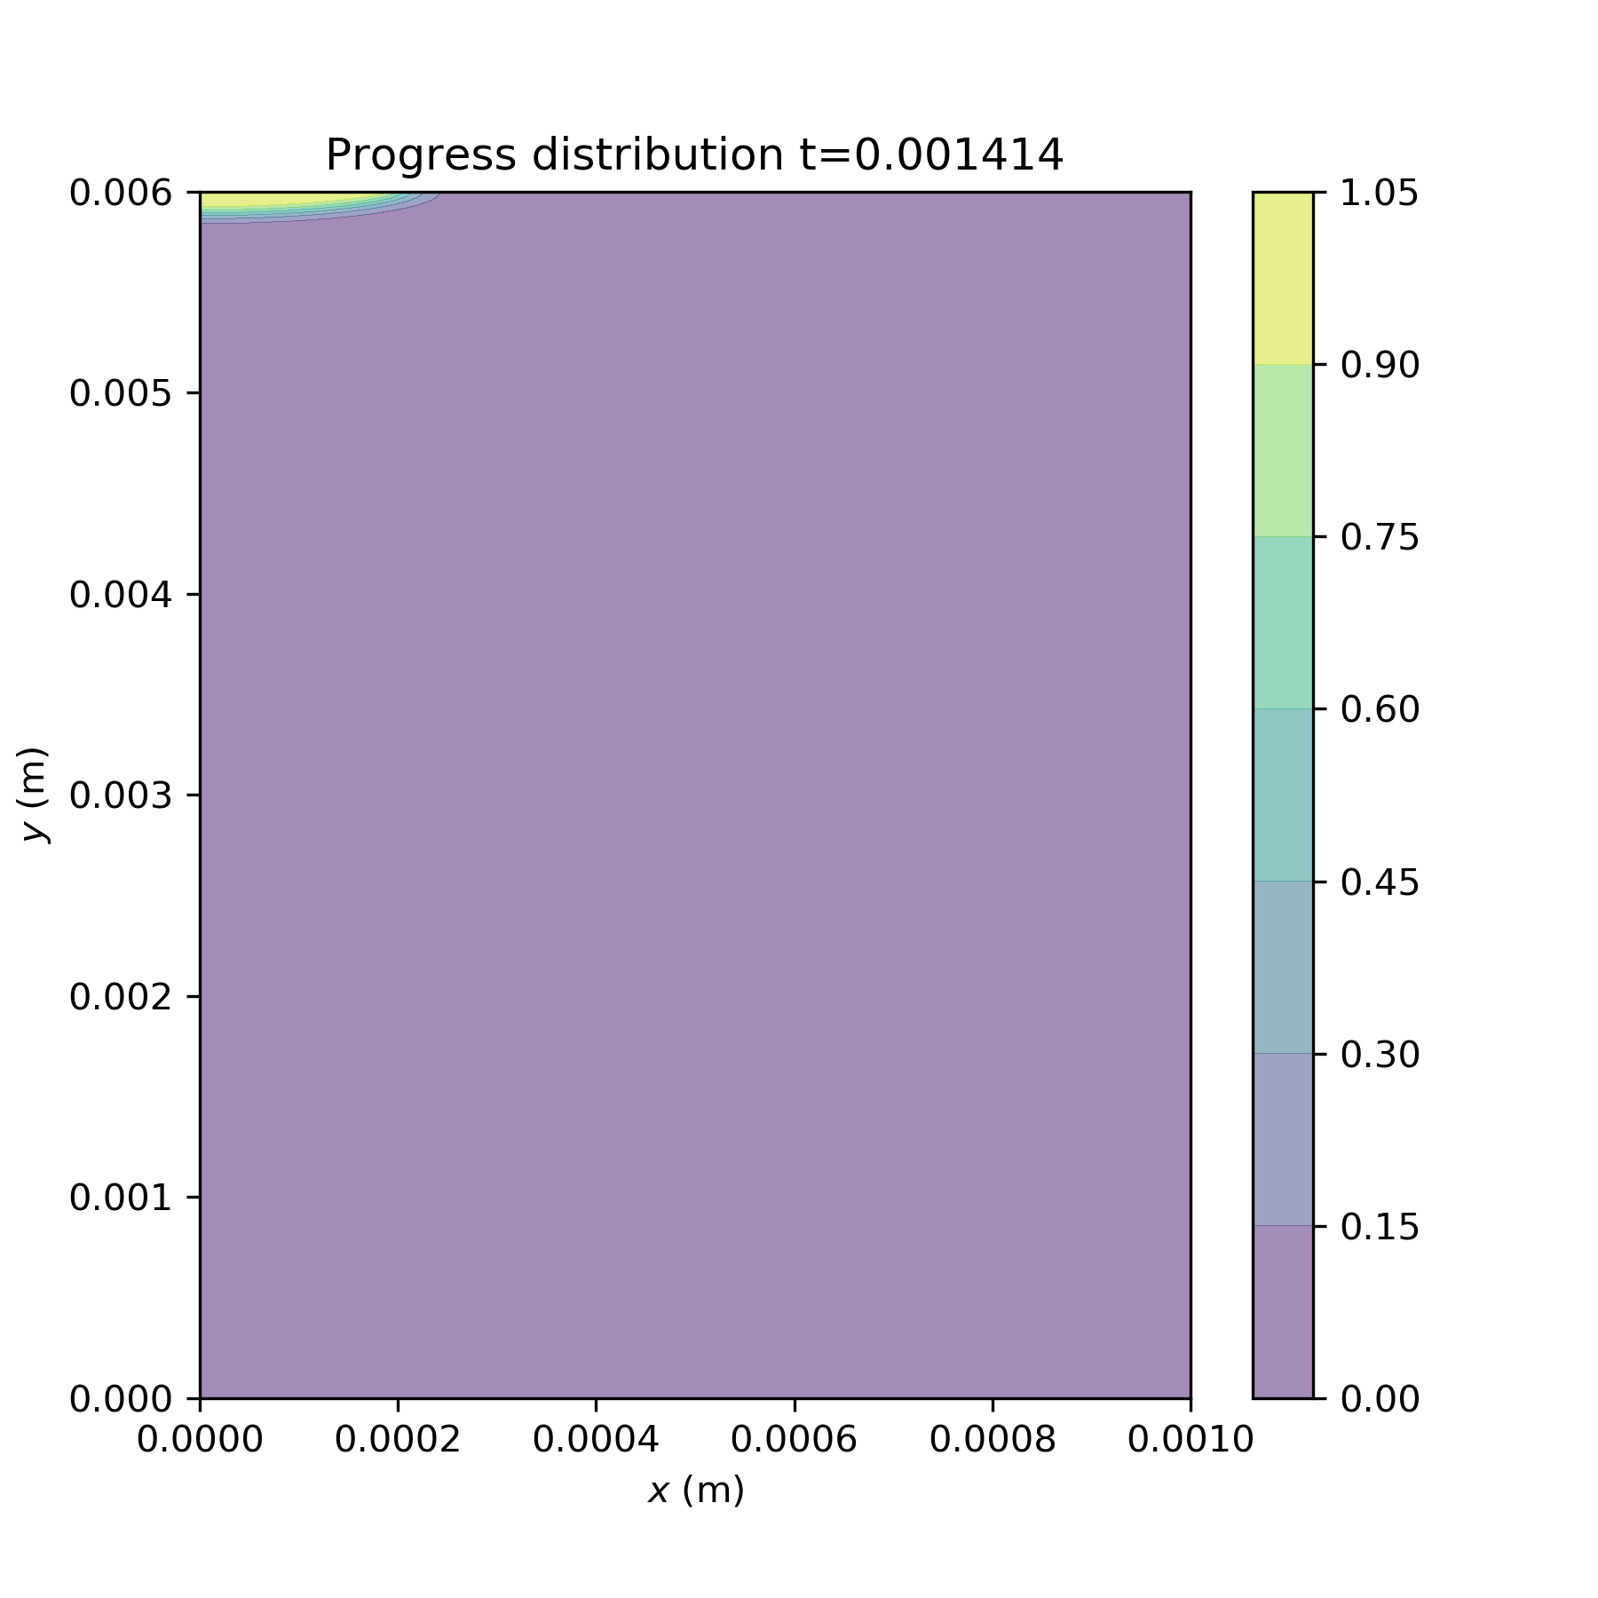

A0 investigations
Ea=40000
A0=1e6
dH=1200
A0=1e6
dH=300000
A0=1e6
dH=1200
A0=1e8
dH=1200
Ea=40000
A0=1e8
dH=300000

