Slide 1

Students & Companies R&DD Project
Software Engineering 2 – Matteo Camilli
A presentation by:
Dimić Nikola
Tatalović Veljko
Žiga Edin
17th of January 2025 – Politecnico di Milano

Slide 2
Outline
RASD
Goals and Boundaries
Meaningful Use Case
Requirements and Assumptions
Alloy model
DD
Components and Interfaces
Architectural styles, meaningful interactions
Implementation, Integration and Testing

Slide 3

Requirements Analysis Specification Document (RASD)

Slide 4

Goals
Companies create internship advertisement.
Students find appropriate internship and initiate contact with the selected company.
Students become interns in the companies in order to gain experience in the desired area of industry.
The platform provides a transparent and fair selection process where companies can evaluate and select suitable candidates.
The platform offers a recommendation system that matches students to internships based on their CVs, skills, and preferences, as well as company requirements.
The platform allows universities to monitor internships to ensure alignment with academic standards.
The platform collects feedback from both students and companies to improve the platform’s functionality.
Ensure a safe and supportive environment by providing students with mechanisms to file complaints and enabling universities to resolve them.

Slide 5
Highlighted Phenomena
Унесите овдје које ове феномене хоћете да ставите, шта мислите да је битно

Slide 6
[UC6] Create and Publish Internship Advertisement
Actors: Company Users
Preconditions: The company user has successfully logged into the platform and is viewing the landing page. The company user has been externally verified by an admin. The company user has not reached the maximum number of advertisements.
Success Guarantee (Postconditions): The company user successfully published an Internship Advertisement.
Main Success Scenario (or Basic Flow):
1. The company user presses the large ’+’ button for creating a new advertisement.
2. The platform redirects the user to the advertisement creation page.
3. The company user enters the mandatory information required for advertisement creation.
4. The company user presses the ’Publish button’.
5. The company user is redirected to the landing page and informed that the advertisement has been published. The company user can see his newly published advertisement.

Slide 7
[UC6] Extensions (or Alternative Flows):
*a. At any point, the user disconnects or the system fails:
1. The user reconnects to the platform.
1a. The platform fails to recover, or the user is unable to reconnect.
2. The user is automatically logged back in.
3. The user continues from the last saved checkpoint.
3a. The company user enters invalid information in the advertisement:
1. The platform informs the company user that the change is not possible.
2. The user corrects their action and proceeds with advertisement creation.
2a.; 5a. The platform is unable to redirect the user.
4a. The advertisement is unable to be published due to server error.

Slide 8
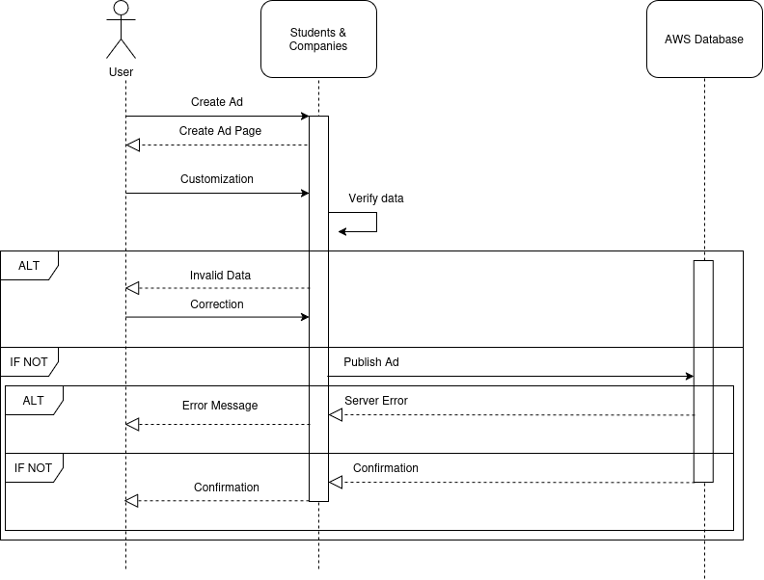
[UC6] Use Case Diagram

Slide 9
Requirements
39 Functional Requirements in the following categories:
Registration of Students [3]
Registration of Companies [6]
Registration of Universities [3]
Profile Management [7]
Internship Advertisement Creation and Management [6]
Internship Search, Application, and Management of Applications [9]
Internship Monitoring, Complaint Management & Feedback System [5]

Slide 10
Highlighted Functional Requirements
[FR1] The system shall allow new student users to register on the platform using their respective institutional accounts.
[FR16] The system shall allow each field to be configured as public or private, provided that data is present in the respective field.
[FR18] The system shall allow all users to provide public hyperlinks to other platforms which the system shall display in a format that clearly indicates the platform to which the hyperlink leads to.
[FR26] The system shall analyze the profile of the student user upon lo- gin and recommend 3 internship advertisements based on matching qualifications and background, and display these recommendations prominently to the student user.

Slide 11
Highlighted Non-Functional Requirements
[NFR-P2] The system shall return internship search results within 2 seconds, assuming up to 500 results.
[NFR-P3] The system shall process and post a new internship advertisement within 15 seconds.
[NFR-P4] The system shall support at least 30,000 concurrent users actively interacting with the platform.
[NFR-P6] The system shall maintain a response time under 5 seconds at all times.

Slide 12
Domain Assumptions
User must have a reliable internet connection.
All users provide accurate information when creating profiles.
Universities actively engage with the platform for monitoring and complaint resolution.
Companies provide accurate information about an internship.
The system will be available ensuring uninterrupted access to users.
Submitted complaints are genuine and not misused to create unnecessary conflicts.
Companies respond to applications promptly.
Students complete selection process steps within deadlines.

Slide 13
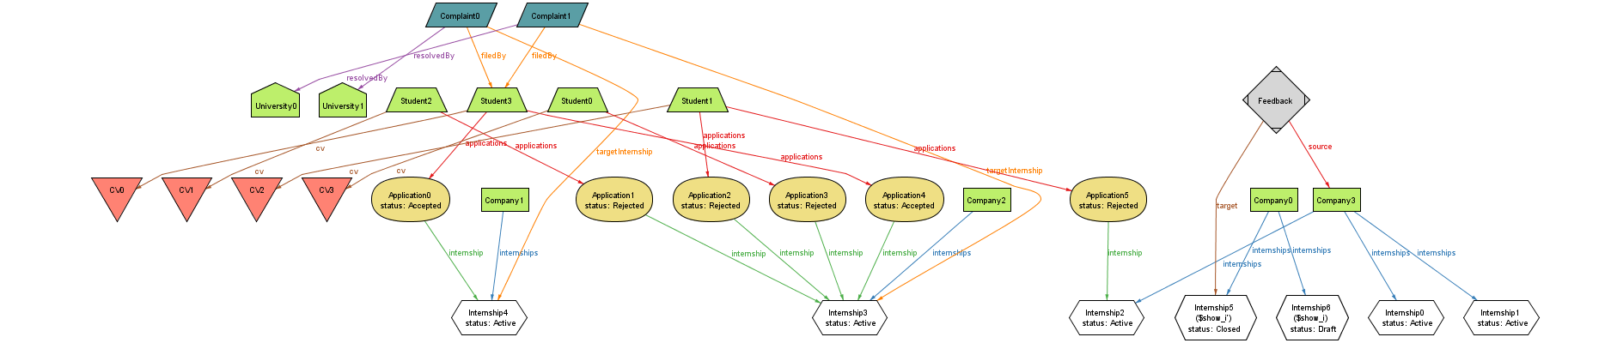
Alloy model

Slide 14

Design Document (DD)

Slide 15
Components Listed
ApplicationManager: Processes student internship applications, including stage transitions, rejections, acceptances, and internship initialization.
AuthenticationManager: Handles user authentication and routes authentication requests to institutional authenticators.
ComplaintManager: Processes the submission of complaints during active internships.
FeedbackManager: Processes feedback for users involved in internships.
InternshipManager: Manages internships and the associated users. Handles user state transitions during internships and initiates feedback requests.
RecommendationManager: Provides recommendations to students based on user data.
Presentation Layer and Database Layer components:
Database: Stores platform data (Layer 3).
Institutional Authenticator: An external service whose API enables institutional login for users.
S&C Web App Instance: An instance of the web application (Layer 1).

Slide 16
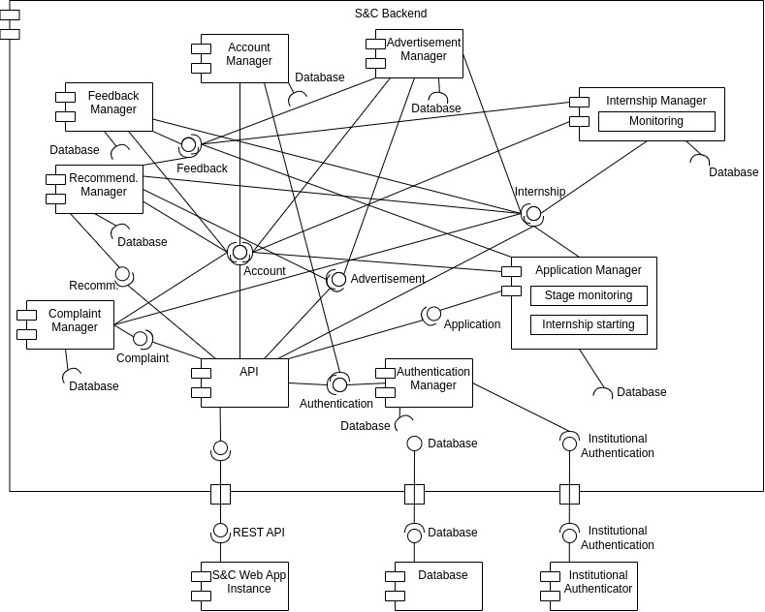
Component View Diagram

Slide 17
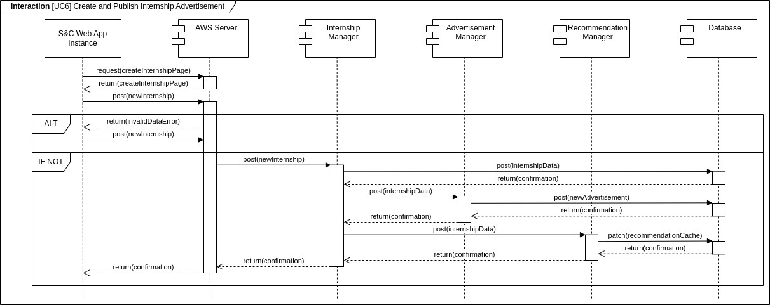
[UC6] Runtime View Diagram

Slide 18

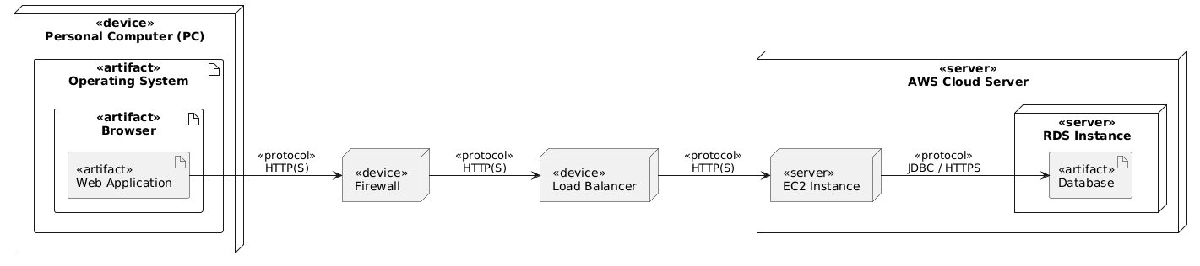
Architectural Styles and Patters
All implemented using Amazon Web Services (AWS)
Three tier Architecture
Model View Controller Pattern
Façade Pattern

Slide 19
Implementation, Integration and Testing
Унесите овдје шта вам је битно

Slide 20

Thank you! Questions?

