Slide 1
Identifying Low-Risk Aircraft for New Aviation Division Launch
Edinah Ogoti
25/7/2025

Slide 2
Executive Summary: Our Mission to De-Risk Aviation Entry
01
02
03
The Opportunity
The Challenge
Our Solution
Company is expanding into aviation (commercial & private enterprises).
Lack of internal expertise on aircraft risks, potential for significant financial/safety liabilities.
Data-driven analysis of historical aviation incident data to identify lowest-risk aircraft types.
Key Outcome
Actionable recommendations for initial aircraft purchases to ensure a safe and financially sound launch.

Slide 3
Understanding the Business Need: Mitigating Risk in Aviation
01
02
03
Diversification Goal: Company's strategic imperative to diversify portfolio by entering the aviation sector.
Core Problem: ”We don't know anything about the potential risks of aircraft."
Project Objective: Determine which aircraft are the lowest risk for the company's initial endeavor.
Key Stakeholder Need: Provide actionable insights for the Head of the New Aviation Division to decide on aircraft purchases.
Risk Categories Addressed from the analysis
Accident Frequency
Aircraft Damage Severity (Financial Risk)
Human Impact (Safety & Liability Risk)
Operational Vulnerabilities (Contextual Risk)

Slide 4
Data-Driven Approach: Leveraging Historical Incident Data
Data Source: National Transportation Safety Board (NTSB) Aviation Accident & Incident Data (Aviation_Data.csv).
Dataset Size: 24434 by 31 incidents analyzed.
Key Columns Used for Risk Assessment:
Aircraft Identification- Make, Model
Severity Factors- Aircraft_damage, Injury_Severity
Human Impact- Total_Fatal_Injuries, Total_Serious_Injuries, Total_Minor_Injuries
Incident Counting- Event_Id, Accident_Number
Operational Context - Purpose_of_flight, Weather_Condition, Broad_phase_of_flight
Methodology Overview
Data Cleaning & Preprocessing (e.g., filtering for "Airplane", handling missing values).
Quantification of Risk factors (Incident Counts, Damage Scores, Injury Rates).

Slide 5
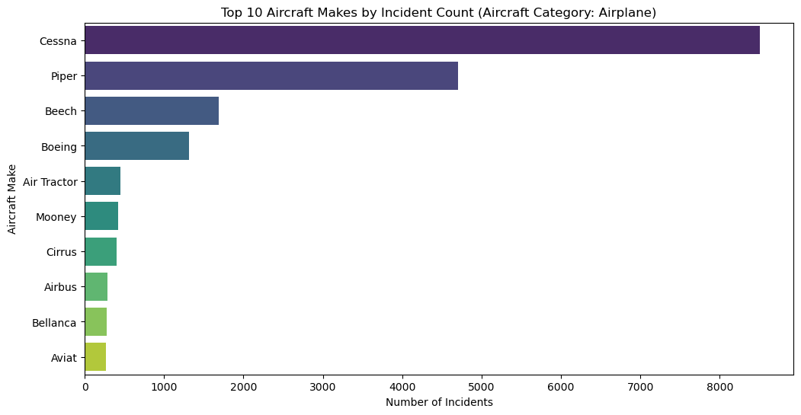
Key Findings: Which Aircraft Are Involved Most, and How Severely?
Insight: "Cessna and Piper, while highly prevalent, represent the largest volume of historical incidents. This is a baseline for exposure risk."

Slide 6
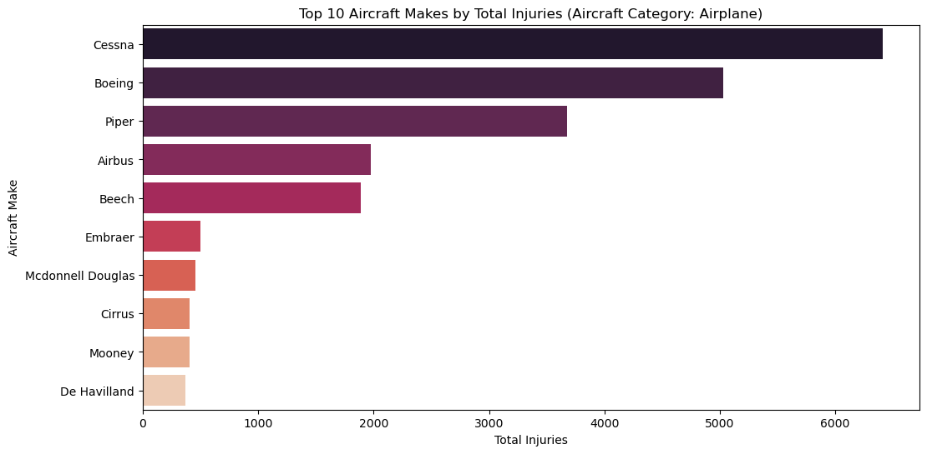
Key Findings: Human Impact & Operational Context
Insight: "Models with lower proportions of fatal incidents offer a superior safety profile, minimizing human tragedy and potential legal liabilities."

Slide 7
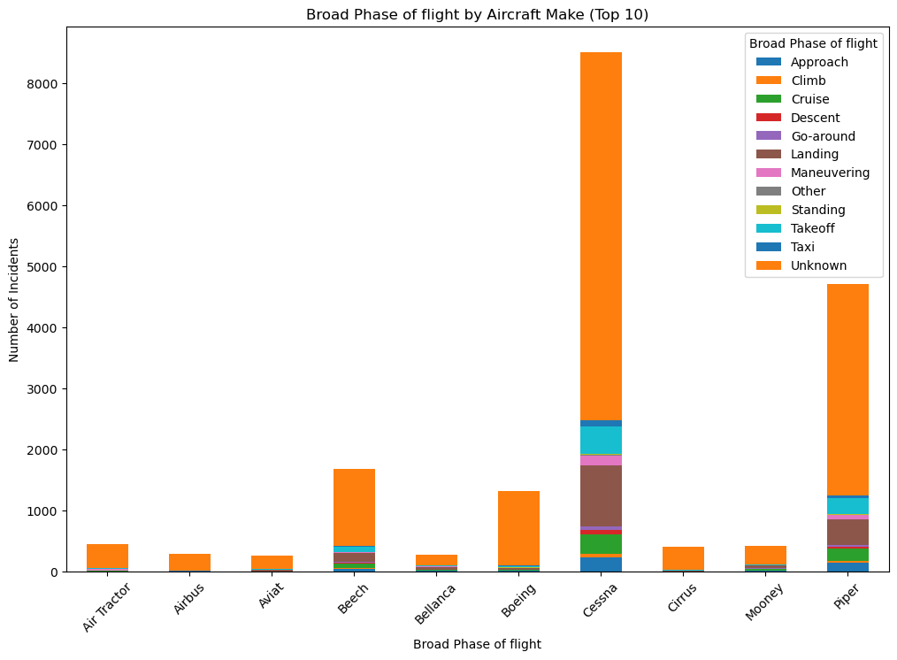
Broad Phase of Flight Distribution in Incidents (Top 10 Makes)
Insight: "Landing and Takeoff consistently represent the highest risk phases across most aircraft types, underscoring the need for rigorous operational protocols regardless of aircraft choice."

Slide 8
Low-Risk Aircraft Selection: Actionable Recommendations
Recommendation 1
Aircraft Make: Airbus, Bellanca and Maule
Rationale: Lowest Combined Risk Score, balanced performance across frequency, damage, and human impact.
Specific Insight: "This model offers the best balance of low incident frequency and minimal severe outcomes, ideal for initial entry."
Recommendation 2
Aircraft make: Cirrus, Mooney and De havillard]
Rationale: Strong safety record (low fatality rate), good for passenger-focused operations.
Specific Insight: "While incident count might be slightly higher, its superior human safety record makes it compelling for charter operations."
Recommendation 3: Aircraft make: Piper, Boeing
Rationale: Moderate risk, but high prevalence might mean better parts availability or some other factor not in the data.
Specific Insight: "A more common aircraft type, offering a manageable risk profile for training or varied use."
Key Takeaway: Our analysis supports a strategic focus on these aircraft types to minimize initial operational and financial risks.

Slide 9
Beyond the Data: Next Steps for the Aviation Division
For Immediate Action:
Prioritize further due diligence (maintenance costs, operational efficiency, pilot training requirements, market availability) on the recommended low-risk aircraft models.
Begin developing detailed operational manuals and training programs with a focus on high-risk flight phases (Takeoff, Landing).

Slide 10
Thanks!
Do you have any questions?
Edinah ogoti
https://www.linkedin.com/in/edinah-ogoti-4ba36394/

