Slide 1
Introduction to Shiny
EdinbR Workshop
17 June 2015

Slide 2
Workshop Aim
Create a simple Shiny app
Taken from Mango's Shiny training course

Slide 3
Workshop structure
1 hour
Some speaking
Some demos
Get involved – your turn!

Slide 4
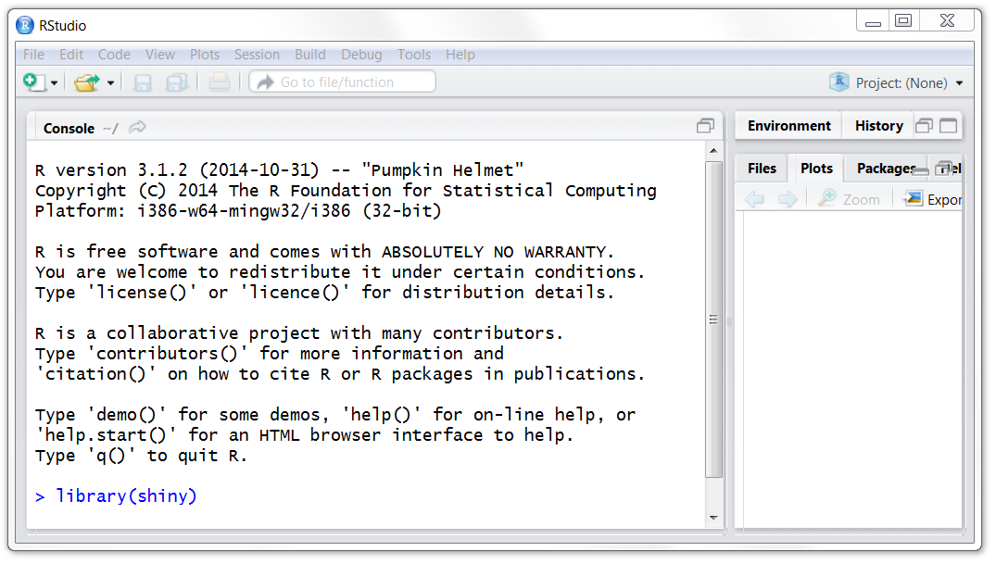
Workshop resources
R-3.1.2
RStudio
shiny

Slide 5
Outline
What is Shiny?
Defining the User Interface
Defining Outputs
Display Text
Display Plots

Slide 6
What is Shiny?
R package for interactive web browser pages
Deploy on a server to release as a web app
Gives the power of R in a convenient user interface
Can be written entirely in R
Created by Joe Cheng of RStudio

Slide 7
A Basic Shiny App
A basic app requires:
A "User Interface" script defining controls and outputs
A "Server" script defining analysis to perform
Runs using the runApp function

Slide 8
Print Text!
Collect text from the user
Print it in the browser!

Slide 9
The User Interface Script
Defines the components of the user interface
Page titles
Input options
Outputs
Defines what the user will see and interact with

Slide 10
The User Interface Script
library(shiny)
shinyUI(fluidPage(
# Define the header for the page
titlePanel("An Exciting Shiny App to Print Text!"),
# Set up the page to have a sidebar
sidebarLayout(
# Define the contents of the sidebar
sidebarPanel(
textInput(inputId = "userText",
label = "Enter text here:")
),
# Define the contents of the main panel
mainPanel(textOutput(outputId = "printedText"))
)
)
)

Slide 11
The User Interface Script
Creates the UI
shinyUI(fluidPage(
titlePanel("An Exciting Shiny App to Print Text!"),
sidebarLayout(
sidebarPanel(
textInput(inputId = "userText",
label = "Enter text here:")
),
mainPanel(textOutput(outputId = "printedText"))
)
)
)

Slide 12
The User Interface Script
Manages rescaling of the UI Components
shinyUI(fluidPage(
titlePanel("An Exciting Shiny App to Print Text!"),
sidebarLayout(
sidebarPanel(
textInput(inputId = "userText",
label = "Enter text here:")
),
mainPanel(textOutput(outputId = "printedText"))
)
)
)

Slide 13
The User Interface Script
UI title
shinyUI(fluidPage(
titlePanel("An Exciting Shiny App to Print Text!"),
sidebarLayout(
sidebarPanel(
textInput(inputId = "userText",
label = "Enter text here:")
),
mainPanel(textOutput(outputId = "printedText"))
)
)
)

Slide 14
The User Interface Script
shinyUI(fluidPage(
titlePanel("An Exciting Shiny App to Print Text!"),
sidebarLayout(
sidebarPanel(
textInput(inputId = "userText",
label = "Enter text here:")
),
mainPanel(textOutput(outputId = "printedText"))
)
)
)
Side-by-side components

Slide 15
The User Interface Script
shinyUI(fluidPage(
titlePanel("An Exciting Shiny App to Print Text!"),
sidebarLayout(
sidebarPanel(
textInput(inputId = "userText",
label = "Enter text here:")
),
mainPanel(textOutput(outputId = "printedText"))
)
)
)
Defines sidebar

Slide 16
The User Interface Script
shinyUI(fluidPage(
titlePanel("An Exciting Shiny App to Print Text!"),
sidebarLayout(
sidebarPanel(
textInput(inputId = "userText",
label = "Enter text here:")
),
mainPanel(textOutput(outputId = "printedText"))
)
)
)
Sidebar component

Slide 17
The User Interface Script
shinyUI(fluidPage(
titlePanel("An Exciting Shiny App to Print Text!"),
sidebarLayout(
sidebarPanel(
textInput(inputId = "userText",
label = "Enter text here:")
),
mainPanel(textOutput(outputId = "printedText"))
)
)
)
A comma separating arguments to sidebarLayout

Slide 18
The User Interface Script
shinyUI(fluidPage(
titlePanel("An Exciting Shiny App to Print Text!"),
sidebarLayout(
sidebarPanel(
textInput(inputId = "userText",
label = "Enter text here:")
),
mainPanel(textOutput(outputId = "printedText"))
)
)
)
Defines main panel

Slide 19
The User Interface Script
shinyUI(fluidPage(
titlePanel("An Exciting Shiny App to Print Text!"),
sidebarLayout(
sidebarPanel(
textInput(inputId = "userText",
label = "Enter text here:")
),
mainPanel(textOutput(outputId = "printedText"))
)
)
)
Main panel contents

Slide 20
The Server Script
Contains the instruction to build the app
Call to shinyServer
Only argument is a function with parameters
input
output
Defines the analysis performed by the R session

Slide 21
The Server Script
library(shiny)
shinyServer(function(input, output) {
# single line of text printed
output$printedText <- renderText(expr = {
paste("You entered the text:",
input$userText)
}
)
}
)

Slide 22
The Server Script
Instruct R session to process user inputs
shinyServer(function(input, output) {
output$printedText <- renderText(expr = {
paste("You entered the text:",
input$userText)
}
)
}
)

Slide 23
The Server Script
Function to defining processes
shinyServer(function(input, output) {
output$printedText <- renderText(expr = {
paste("You entered the text:",
input$userText)
}
)
}
)

Slide 24
The Server Script
Update output with reactive elements
shinyServer(function(input, output) {
output$printedText <- renderText(expr = {
paste("You entered the text:",
input$userText)
}
)
}
)

Slide 25
The Server Script
Reactive elements defined
by an expression
shinyServer(function(input, output) {
output$printedText <- renderText(expr = {
paste("You entered the text:",
input$userText)
}
)
}
)

Slide 26
The Server Script
shinyServer(function(input, output) {
output$printedText <- renderText(expr = {
paste("You entered the text:",
input$userText)
}
)
}
)
Expression uses
input

Slide 27
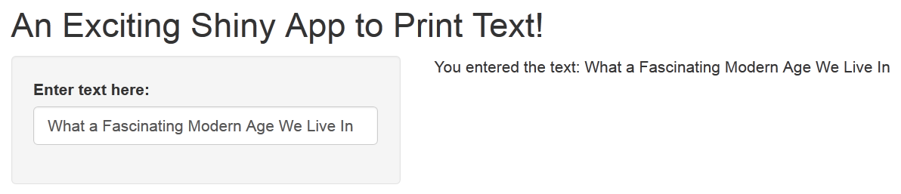
Print Text!

Slide 28
Print Text! UI Variables
shinyUI(fluidPage(
titlePanel("An Exciting Shiny App to Print Text!"),
sidebarLayout(
sidebarPanel(
textInput(inputId = "userText",
label = "Enter text here:")
),
mainPanel(
textOutput(outputId = "printedText")
)
)
)
)

Slide 29
Print Text! Server Variables
shinyServer(function(input, output) {
output$printedText <- renderText(expr = {
paste("You entered the text:",
input$userText))
}
)
}
)

Slide 30
Print Text! UI Variables
shinyUI(fluidPage(
titlePanel("An Exciting Shiny App to Print Text!"),
sidebarLayout(
sidebarPanel(
textInput(inputId = "userText",
label = "Enter text here:")
),
mainPanel(
textOutput(outputId = "printedText")
)
)
)
)

Slide 31
UI Sidebar Panel
Define the contents of the sidebar using the sidebarPanel function
Accepts *Input functions that specify the app inputs

Slide 32
UI Input Controls
Input | Description
textInput | Text string input
numericInput | Numeric value input
selectInput | Select single or multiple values from drop-down list
sliderInput | Numeric range “slider” input
radioButtons | Set of radio button inputs
dateInput | Date input
fileInput | File upload control

Slide 33
UI Main Panel
Define the contents of the main panel using the function mainPanel function
Can contain outputs using the *Output functions

Slide 34
Output Controls
Input | Description
textOutput | Text string output
verbatimTextOutput | Text sting with HTML escapes
imageOutput plotOutput | Render an image or plot
tableOutput | Create a static table
dataTableOutput | Create a JavaScript interactive table
htmlOutput uiOutput | Render an HTML object

Slide 35
Exercise 1
Build a simple Shiny application that takes a date string input (e.g. “17-06-2015”) and returns the following text:
What day of the week is it (e.g. “Wednesday”)
What month it is (e.g. “December”)
What year it is

Slide 36
input: a date (e.g. “17-06-2015”) (see ?dateInput)
output: day of week, month, year (see ?format)
ui.R server.R
shinyUI(fluidPage(
sidebarLayout(
sidebarPanel(
textInput(inputId = "userText",
label = "Enter text here:")
),
mainPanel(
textOutput(outputId =
"printedText"))
)
)
)
shinyServer(function(input, output) {
output$printedText <-
renderText(expr = {
paste("You entered the text:",
input$userText)
}
)
}
)

Slide 37
Exercise 1 - UI
library(shiny)
shinyUI(fluidPage(
# Define the header for the page
titlePanel("Exercise 1"),
# Set up the page to have a sidebar
sidebarLayout(
# Define the contents of the sidebar
sidebarPanel(
dateInput(inputId = "dateInput", label = "Select date")
),
# Define the contents of the main panel
mainPanel(
textOutput(outputId = "dateOutput")
)
)
)
)

Slide 38
Exercise 1 - Server
library(shiny)
shinyServer(function(input, output){
output$dateOutput <- renderText(expr = {
format(x = input$dateInput,
format = "A %A in %B. The year is %Y")
}
)
}
)

Slide 39
Rendering Outputs
So far we have just output text
shiny also allows us to output graphics, data and images
We have to render the output from the UI using corresponding functions in the Server script

Slide 40
Rendering Outputs
Output Type | server.R Function | ui.R Function
Text | renderPrint | textOutput
Data | renderDataTable | dataTableOutput
Plot | renderPlot | plotOutput

Slide 41
Plot Data!
Select a column from a dataset from a drop down menu
Plot a histogram of the data!

Slide 42
Plot Data! UI
sidebarLayout(
sidebarPanel(
helpText("Choose a variable;
that data will be displayed
as a histogram"),
selectInput(inputId = "variable",
label = "Select column:",
choices = colnames(mtcars))
),
mainPanel(
plotOutput("histogram")
)
)

Slide 43
Plot Data! Server
output$histogram <- renderPlot(expr = {
hist(x = mtcars[, input$variable],
main = paste("Histogram of",
input$variable),
xlab = input$variable)
}
)

Slide 44
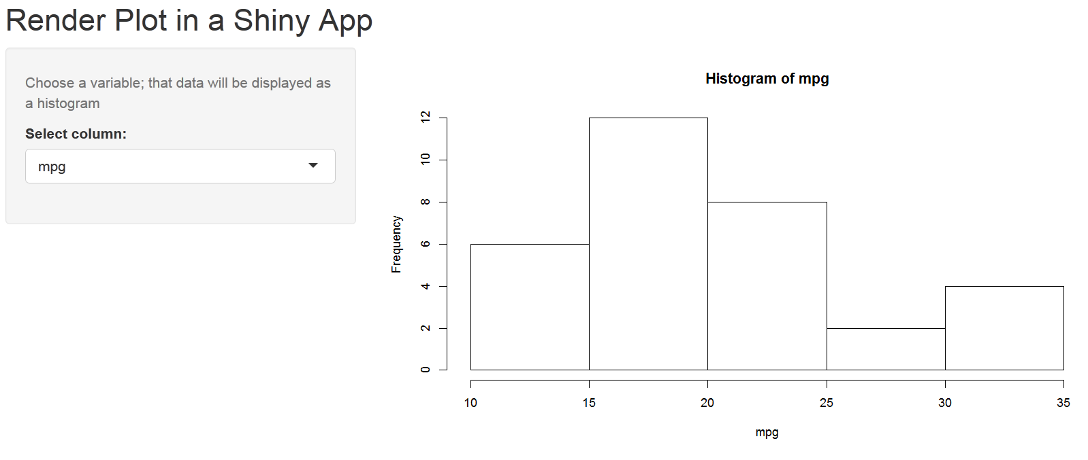
Plot Data!

Slide 45
Exercise 2
Create a Shiny application that takes:
a numeric value between 20 and 400
a colour
a main title
Use these inputs to create an output histogram of random data from the normal distribution where n is the numeric input

Slide 46
input: number, colour, title
output: histogram of rnorm(n = number)
ui.R server.R
shinyUI(fluidPage(
sidebarLayout(
sidebarPanel(
textInput(inputId = "userText",
label = "Enter text here:")
),
mainPanel(
textOutput(outputId =
"printedText"))
)
)
)
shinyServer(function(input, output) {
output$printedText <-
renderText(expr = {
paste("You entered the text:",
input$userText)
}
)
}
)

Slide 47
Exercise 2 - UI
library(shiny)
shinyUI(fluidPage(
titlePanel("Render Plot in a Shiny App"),
sidebarLayout(
sidebarPanel(
sliderInput(inputId = "numberInput",
label = "Select size of data:",
min = 20, max = 400, value = 100, step = 20),
selectInput(inputId = "colInput",
label = "Select a colour",
choices = c("red", "yellow", "blue", "green"))
),
mainPanel(
plotOutput("histogram")
)
)
)
)

Slide 48
Exercise 2 - Server
library(shiny)
shinyServer(function(input, output) {
output$histogram <- renderPlot(expr = {
vals <- rnorm(input$numberInput)
hist(x = vals,
col = input$colInput)
}
)
}
)

Slide 49
Shiny Themes
Update app from the bootstrap theme
library(shinythemes)
shinyUI(fluidPage(
theme = shinytheme("cerulean"),
...
)
)

Slide 50
What Next?
EARL Conference, London
14 – 16 September 2015
Introduction to R, London
29 – 30 September 2015
Advanced R, London,
7 – 8 October 2015
Introduction to R and Bioconductor, London,
19 – 21 October 2015

Slide 51
Getting Started with Shiny
1 day Training Course
Changes to layouts
Include CSS to style the page
Including tabbed pages
Share your app
Incorporate shiny with rmarkdown
Send an email to sales@mango-solutions.com to register for notification of new course dates

Slide 52

Tower Hotel
2 day conference
1 day of workshops prior to conference
Capacity for 400+
Conference evening event in Tower Bridge

Slide 53
Alex Bellos (author of Alex's Adventures in Numberland)
Joe Cheng (creator of shiny)
Dirk Eddelbuettel (author of Rcpp)
Hannah Fry (Lecturer in Mathematics at the Centre for Advanced Spatial Analysis)
Speak to the Mango team to know more or visit the webpage
http://www.earl-conference.com/

Slide 54
EARL Workshops
10.00 – 13.00
Integrating R and Python (Chris Musselle)
Current Best Practices in Formal Package Development (Aimee Gott, Gregoire Gauriot)
14.00 – 17.00
Introduction to Rcpp (Dirk Eddelbuettel)
Interactive reporting with R Markdown and Shiny (Joe Cheng)

Slide 55


Follow Mango!
@mangothecat
@earlconf
MangoTheCat

