Slide 1
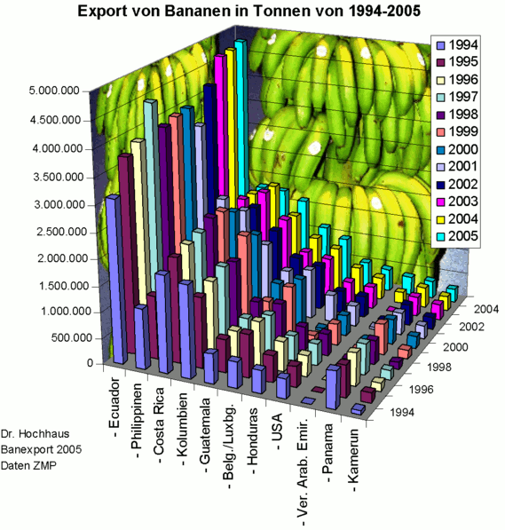
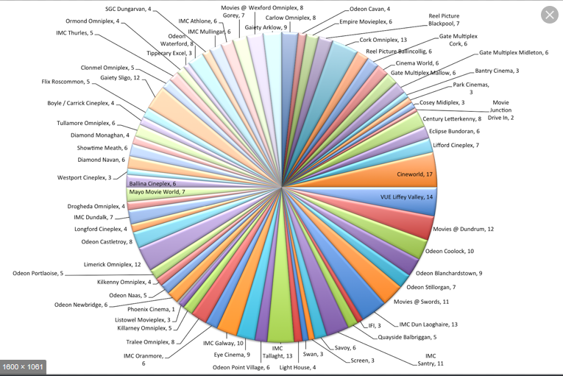
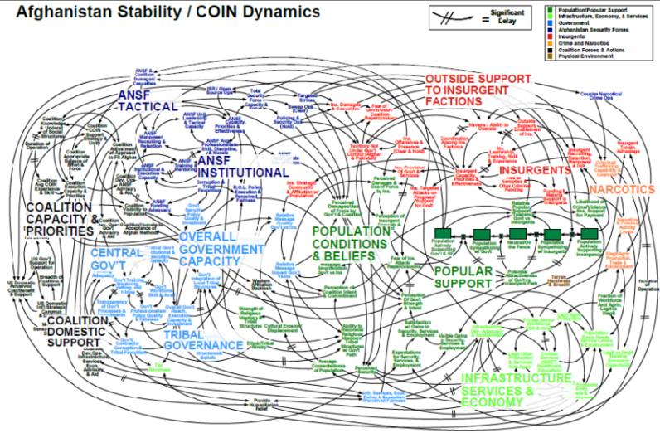
Visualising complex outputs with Shiny
When to use an interactive user interface, rather than a single graph

Slide 2
Link to code and data
https://github.com/GordonBryden/louvain_analysis
Original Input-Output matrices available:
https://www2.gov.scot/Topics/Statistics/Browse/Economy/input-output

Slide 3



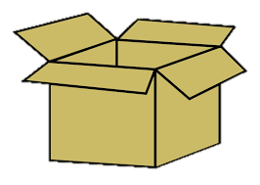
Generating metrics from Louvain
The implementation of Louvain we had available assigned each sector to a cluster – but did not give us any usable metrics
Do the sectors in a cluster really fit together? Why?
You should be able to justify your models decisions
Solution – re-implement the scoring algorithm in R
How do we go from an equation in an academic paper, to a function in R?

Slide 4

Decompress the equation into meaning
Sum of weights of
links between node
and cluster
Sum of weights of
links between cluster
and rest of graph
Sum of weights of
links between node
and rest of graph
Sum of weights of
links inside cluster
Sum of weights of
links in graph

Slide 5
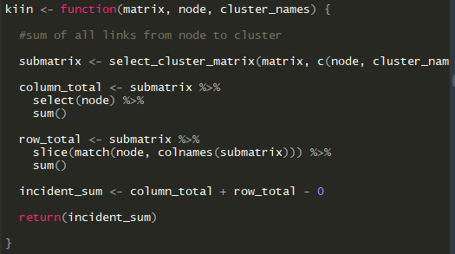
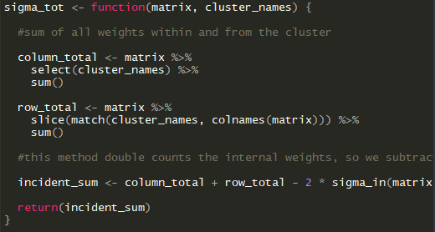
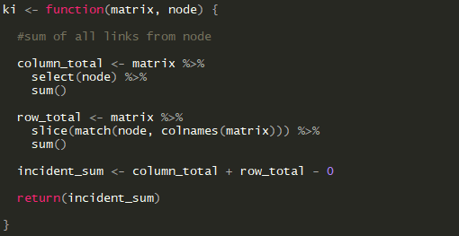
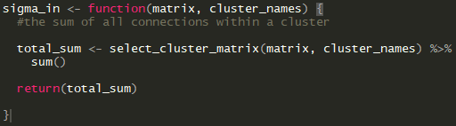
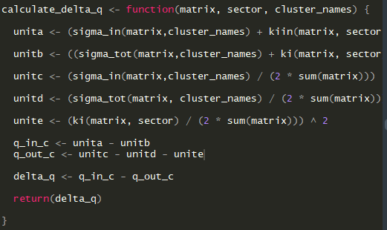
Break down the equation into functions

Slide 6
Use consistent arguments to aid re-use
Caution – really slow code
I don’t have access to the normal suite of matrix libraries
Have to make my own cobbled together versions
sigma_in (re-used here for convenience)
takes the same arguments are its parent function,
and in the same order
I wrote select_cluster_matrix for a previous
clustering algorithm that didn’t pan out
It’s proven to be incredibly useful
Write re-usable functions!
No cute names!
I might need to re-visit this after six months
don’t make it hard on yourself

Slide 7
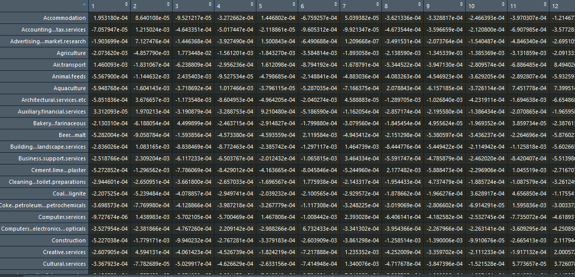
Put it into action
Now we have our own scoring algorithms
Build a loop (sorry) and:
Go through each sector (assuming sector has been removed from it’s cluster):
For each cluster, calculate the change in Delta Q if the sector were added to it’s cluster
Result:
A large matrix that has all our answers in,
If we can find them
Not pictured – 17 more matrices for all data
From 1998 to 2016

Slide 8
What questions do we want to answer?
Are there any other clusters that a sector could belong to?
Are there any other sectors that a cluster could take in?
Are there any bad fits?
How does a cluster fit together?
What would it look like if I moved a sector to a different cluster?
What would it look like on last years data?
How stable is this cluster across time?

Slide 9
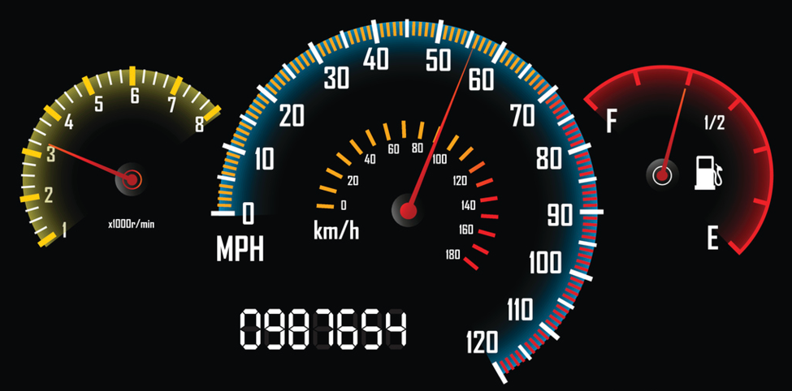

Building a tool to help the experts probe the data
The people with the best expertise on your data can come from extremely varied backgrounds – try and open the data up to them
Even if you are the expert, having key visualisations at a glance is extremely powerful for insight
It’s just a much more pleasant environment

Slide 10
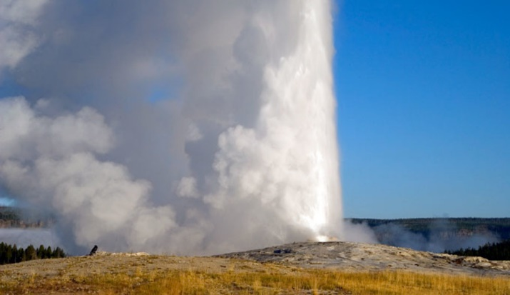
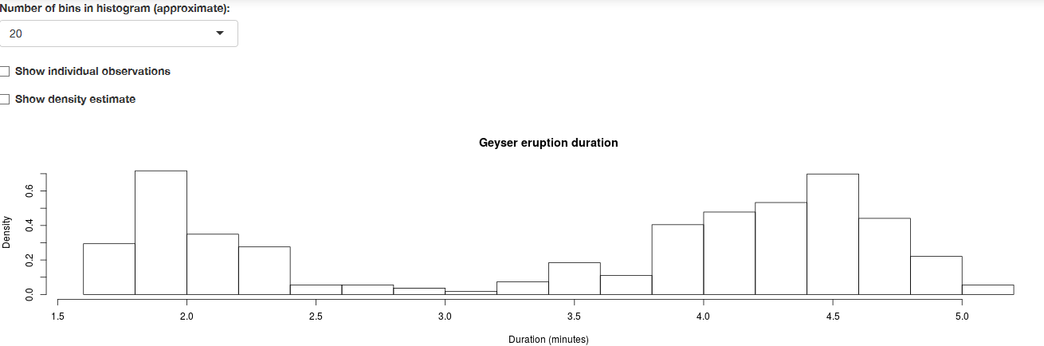
Quick overview of shiny
Package for easily building interactive web apps with R
Can also run locally using Rstudio
All your usual R tools are available
Try it yourself – File >> New Project >> Shiny Web Application
- Loads up with a premade app on the faithful dataset

Slide 11
Design brief
Select Cluster
Delta Q for sectors in selected cluster
Igraph of cluster
Drop down of clusters
Select Sector
Drop down of sectors
Add sector to cluster
Remove sector from cluster
Delta Q gain for graph if sector added to cluster
Heatmap of cluster
Year
Drop down of years

Slide 12
Show off the app

Slide 13
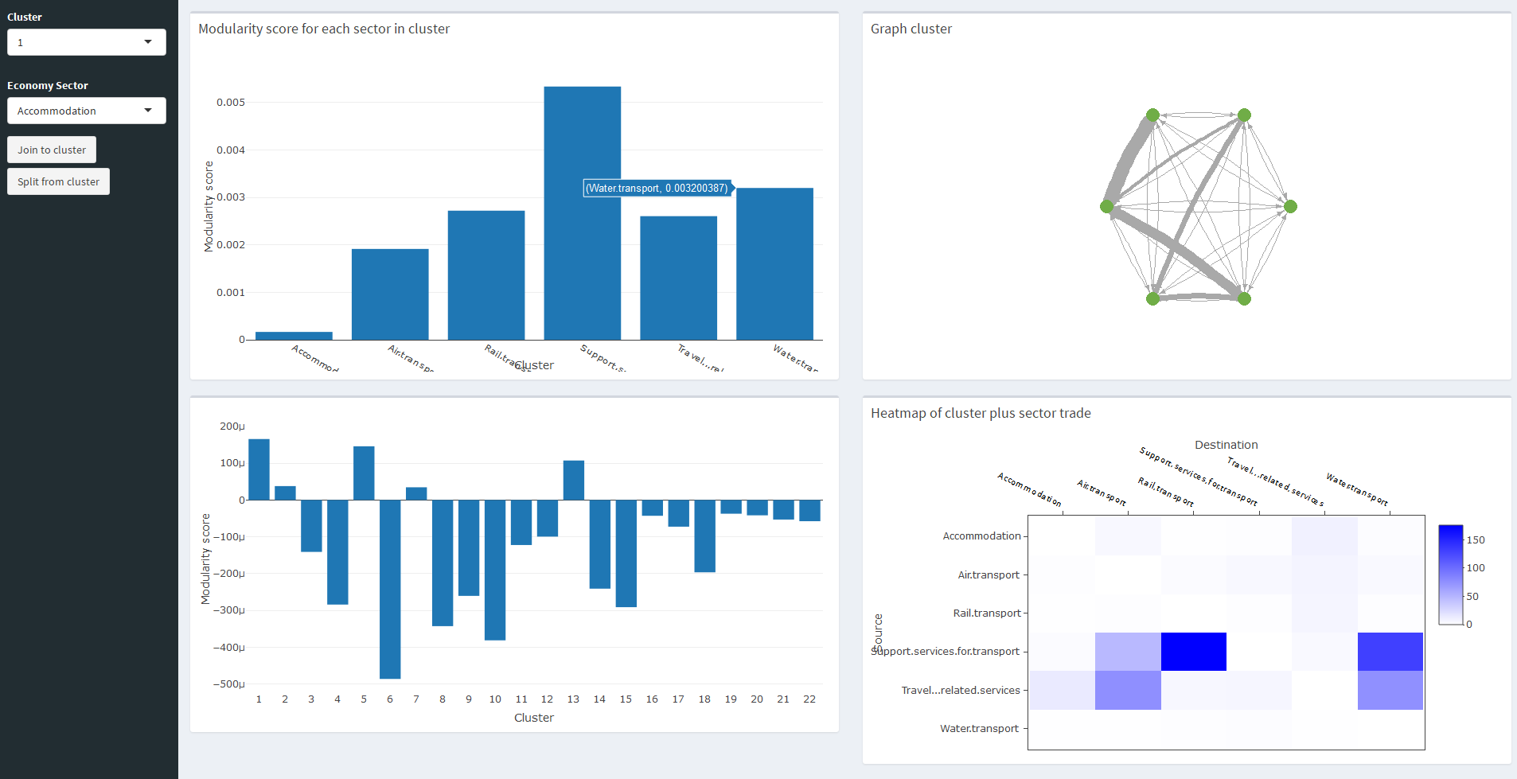
Here we’re examining “Accommodation” – very weak links scores to five clusters

Slide 14
Quick anatomy of packages
Overall engine: shiny
Layout: shinydashboard
Behind the scenes data manipulation
dplyr
Graph diagram
igraph
Barplots and Heatmap
plotly

Slide 15

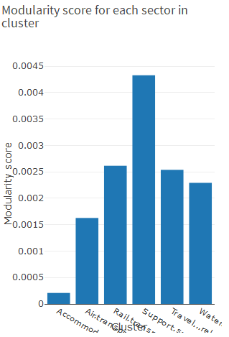
Shiny – great for building iteratively
Easy to add a new user input, and new graph to an existing
Add a new drop down list in the UI
The selected result is handed to the server
We then filter the dataset by that
And generate an graph for output
That graph is then handed to the UI again
And displays it to the viewer
selectInput(“cluster_select",
label="Cluster",
choices = cluster_list)
box(title = "Modularity score for each sector in cluster",
plotlyOutput("ClusterPlot")
output$ClusterPlot <- renderPlotly({
number_clusters <- ncol(temp_results)
cluster <- input$cluster_select
cluster_name <- get_cluster_names(cluster_data, cluster)
cluster_fit <-louvain_results[cluster_name,cluster]
plot_ly(x = cluster_name, y = cluster_fit,
name = "Louvain score",
type = "bar",
source = "barPlot“)
})

Slide 16
Reactives – breaking the server boundary
By default shiny doesn’t let you edit a dataframe persistently, and changes you make are reset each time the server recalculates
You can get around this with a reactive – a storage object that shiny can keep between server calls
reactiveValues() for values
reactive() for awkward objects
I don’t fully understand how these operate, but I can get them to do what I need them to do

Slide 17
Reactives – breaking the server boundary
Create a reactive
survey_reactive <- reactiveValues(obj = cleaned_survey)))
Use the reactive data
my_data <- survey_reactive$obj
Change your data
my_data[[351, 77]] <- 56
Rebuilt the reactive
survey_reactive$obj <- my_data

Slide 18
Let the experts make expert changes
We use reactives to test out building new clusters manually – adding and subtracting them and seeing how this would change the metrics.
There are a number of decisions by the Louvain algorithm that expert opinion casts some doubt on, and a few manifestly dubious groupings with very weak metrics

Slide 19
Results so far
Getting expert eye onto this data has given us the benefit of their insight
Gas/Electric interaction not meaningful – these companies just buy lots of each others products to market joint electric/gas deals
Weakness of fisheries data
Requested feature – how do these clusters change over time?
Still working out the best way to visualise this, but we will be able to add it in as a new tab or box in the existing dashboard
Make it look nicer

Slide 20
Conclusions
Our cluster analysis is still a work in progress, but is giving exciting results
It’s a good idea to question the results of a data science algorithm
Wrapping up useful bits of code into functions – really useful
Give sensible descriptive names to everything
An interactive shiny dashboard is very useful to help users explore a complex dataset
Scottish Government is a great place to work – keep an eye on
https://applications.work-for-scotland.org/

Slide 21
Final Notes
Louvain algorithm can be used to find clusters in many networks, such as social networks, telephone networks etc.
In the last few weeks we’ve found a new development – the Leiden algorithm that corrects some of the issues with Louvain, but may not be appropriate for a small weighted network like this
Check out some of our other work:
R package for downloading SG data https://github.com/DataScienceScotland/opendatascot
Experimental shiny dashboard for Scotland’s Economy: https://scotland.shinyapps.io/sg-gross-domestic-product-dashboard/

Slide 22
Questions?

