Slide 1
Simulating genetic data in R: an example with deleterious variants (and a pun)
Martin Johnsson
The Roslin Institute, University of Edinburgh
Department of Animal Breeding and Genetics, Swedish University of Agricultural Science
@mrtnj

Slide 2
Why and what to simulate
Toy breeding program with AlphaSimR
The RAGE paper

Slide 3
Simulation
Learning tool
Benchmarking methods
Way to do theory
(Hill & Robertson 1966)

Slide 4
Our mental model of the genome
 | Position 1 | Position 2 | Position 3 | Position 4 | Position 5 | Position 5
Individual 1 | 0 | 1 | 0 | 1 | 0 | 2
Individual 2 | 0 | 0 | 0 | 1 | 0 | 2
Individual 3 | 1 | 1 | 0 | 2 | 0 | 2
Individual 4 | 0 | 2 | 1 | 2 | 0 | 2

Slide 5
… with genotypes drawn from an urn
frequencies <- rbeta(10, 0.1, 1)
genotypes <- sapply(frequencies,
function(f) rbinom(n = 5,
size = 2,
p = f))
[,1] [,2] [,3] [,4] [,5] [,6] [,7] [,8] [,9] [,10]
[1,] 0 1 0 1 0 0 0 0 0 1
[2,] 0 0 0 0 0 0 0 0 0 1
[3,] 0 0 0 1 0 0 1 0 0 2
[4,] 0 0 0 0 0 0 0 0 0 1
[5,] 0 0 0 0 1 0 0 0 0 1

Slide 6
… in a pedigree
We want:
Chromosomes and recombination
Sexes and matings
Traits
Selection

Slide 7
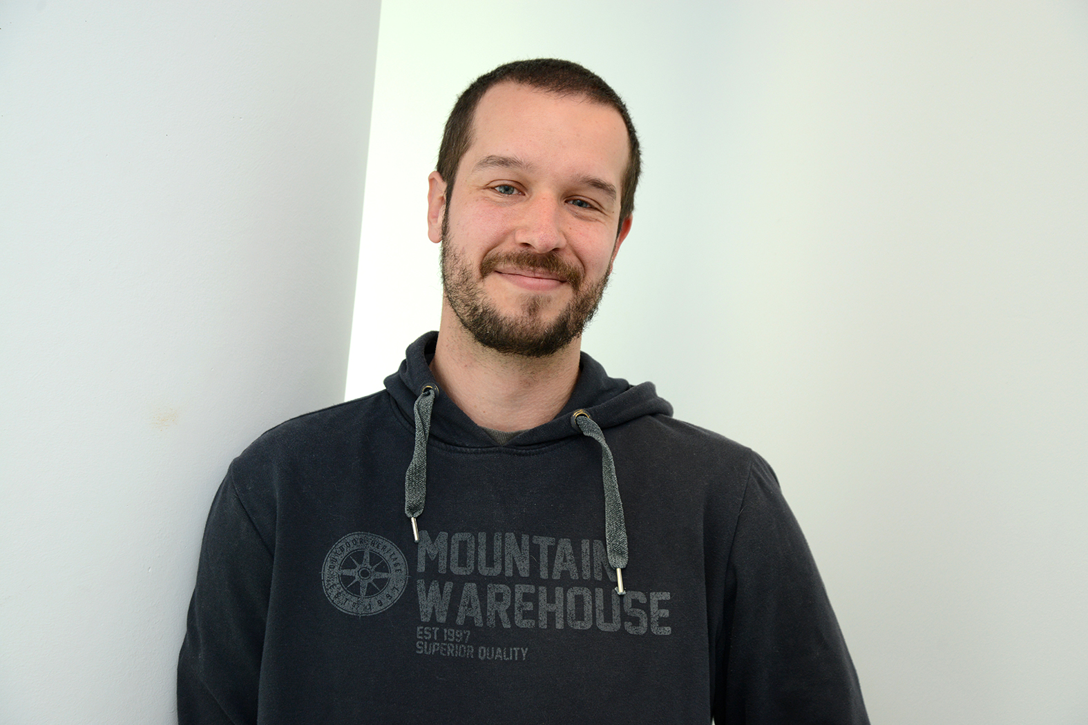
AlphaSimR
Developed by Chris Gaynor at Roslin (I’m so lucky to have him as a colleague!)
Rcpp and Armadillo
On CRAN

Slide 8
Demo
library(AlphaSimR)
FOUNDERPOP <- runMacs(nInd = 1000,
nChr = 10,
segSites = 5000,
inbred = FALSE,
species = "GENERIC")
SIMPARAM <- SimParam$new(FOUNDERPOP)
SIMPARAM$addTraitA(nQtlPerChr = 100,
mean = 100,
var = 10)
SIMPARAM$addSnpChip(nSnpPerChr = 1000)
SIMPARAM$setGender("yes_sys")
pop <- newPop(FOUNDERPOP,
simParam = SIMPARAM)
pop <- setPheno(pop,
varE = 20,
simParam = SIMPARAM)
Make founder chromosomes (Markovian Coalescent Simulator)
Simulation parameters (R6 object)
Our first population!

Slide 9
breeding <- vector(length = 11, mode = "list")
breeding[[1]] <- pop
for (i in 2:11) {
print(i)
sires <- selectInd(pop = breeding[[i - 1]],
gender = "M",
nInd = 25,
trait = 1,
use = "pheno",
simParam = SIMPARAM)
dams <- selectInd(pop = breeding[[i - 1]],
nInd = 500,
gender = "F",
trait = 1,
use = "pheno",
simParam = SIMPARAM)
breeding[[i]] <- randCross2(males = sires,
females = dams,
nCrosses = 500,
nProgeny = 10,
simParam = SIMPARAM)
breeding[[i]] <- setPheno(breeding[[i]],
varE = 20,
simParam = SIMPARAM)
}
Select the best 25 males and 500 females
Cross them to give 10 offspring each (pretend this is pigs)
Add environmental noise to trait values

Slide 10
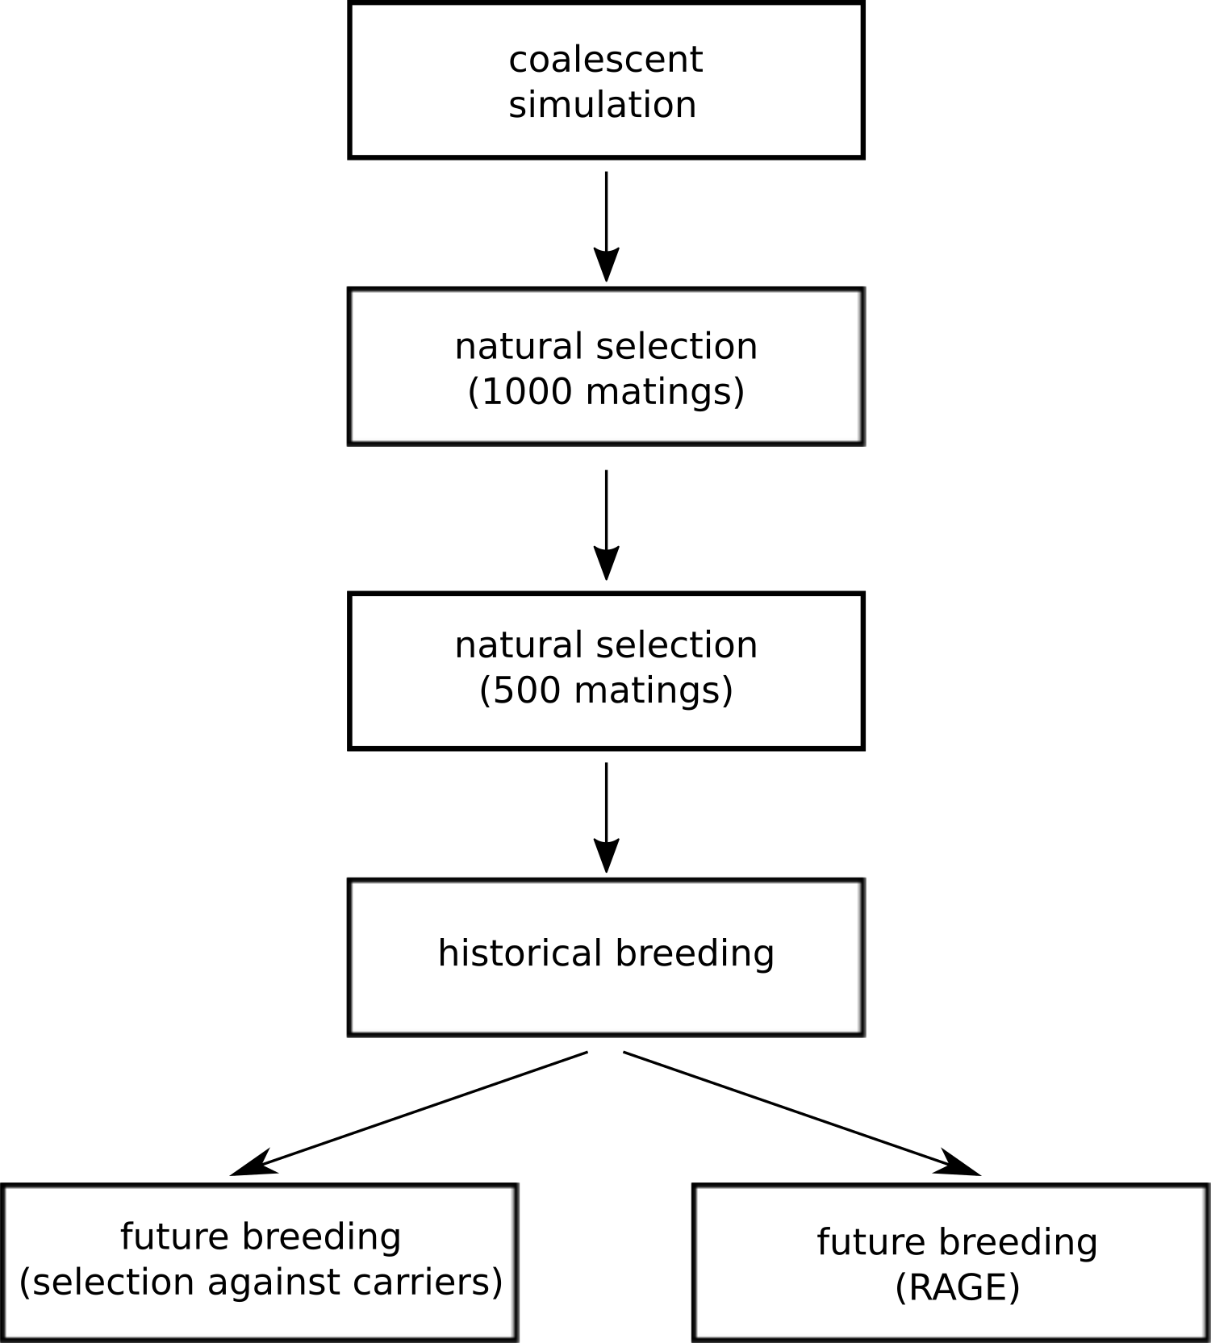
Removal of alleles by genome editing (RAGE)
Breeding goal trait
Fitness trait
Discover 75% of deleterious variants
Notes:
As sequence data accumulates, we get the opportunity to identify variants directly from sequence data. There is a series of bioinformatic methods to do this.
Guessing causative variants from sequence data alone is hard, but getting at deleterious variants could be possible (as opposed to the more subtle, often regulatory, variants that we believe cause beneficial variation).
So we’ve come up with a strategy to do this

Slide 11
Preprint and code
Johnsson et al (2018) bioRxiv
https://bitbucket.org/hickeyjohnteam/rage

Slide 12
Poking the internals (C++)
condition.cpp:
// Calculates genetic values for multiplicative condition effects
arma::vec calcGvCondition(const arma::Mat<unsigned char>& geno,
const arma::vec& a,
const arma::vec& d,
double intercept){
arma::vec output(geno.n_rows);
for (int i = 0; i < output.n_elem; i++) { // each individual
double survival = 1;
for (int j = 0; j < geno.n_cols; j++) { // each locus
switch (geno(i, j)) {
case 1 : survival = survival * (1 - a(j) * d(j)); break;
case 2 : survival = survival * (1 - a(j));
}
}
output(i) = survival;
}
return output + intercept;
}

Slide 13
Running on the Eddie cluster
Grid engine job scheduling
Bash script at head node that sends job scripts that run Rscript …
sim_three_blocks_codominant.sh:
## Load simulations
for LOCI in 5000 10000 15000;
do
for I in {1..10};
do
qsub scripts/qsub_three_blocks_codominant.sh \
simulations/3bc/load/ $I $LOCI FALSE 0 0 FALSE 0
done
done

Slide 14
… that take many arguments
sim_three_blocks_codominant.R:
args <- commandArgs(trailingOnly = TRUE)
if (length(args) != 8) {
stop("Usage: Rscript sim_three_blocks_codominant.R out_path file_suffix number_loci do_breeding n_edits discovery do_avoidance n_avoid")
}
out_path <- args[1]
file_suffix <- paste(args[2], args[3], sep = "_")
L <- as.numeric(args[3])
do_breeding <- as.logical(args[4])
n_edits <- as.numeric(args[5])
discovery <- as.numeric(args[6])
do_avoidance <- as.logical(args[7])
n_avoid <- as.numeric(args[8])

Slide 15
Plotting: ggplot2
plot_average <- ggplot() +
geom_line(aes(x = gen, y = average, colour = case, linetype = case),
data = combined_average) +
facet_wrap(~ dominance) +
theme_bw(base_size = 12) + ggtitle("Fitness effects of genome editing and selection") +
xlab("Generation") + ylab("Average fitness") +
xlim(1,10) + scale_x_continuous(breaks = c(1, 5, 10)) +
scale_colour_manual(values = c("#E69F00", "#56B4E9", "#009E73",
"#0072B2", "#D55E00", "#CC79A7")) +
scale_fill_manual(values = c("#E69F00", "#56B4E9", "#009E73",
"#0072B2", "#D55E00", "#CC79A7")) +
theme(panel.grid = element_blank(),
strip.background = element_blank(),
legend.position = "bottom",
legend.title = element_blank())

Slide 16
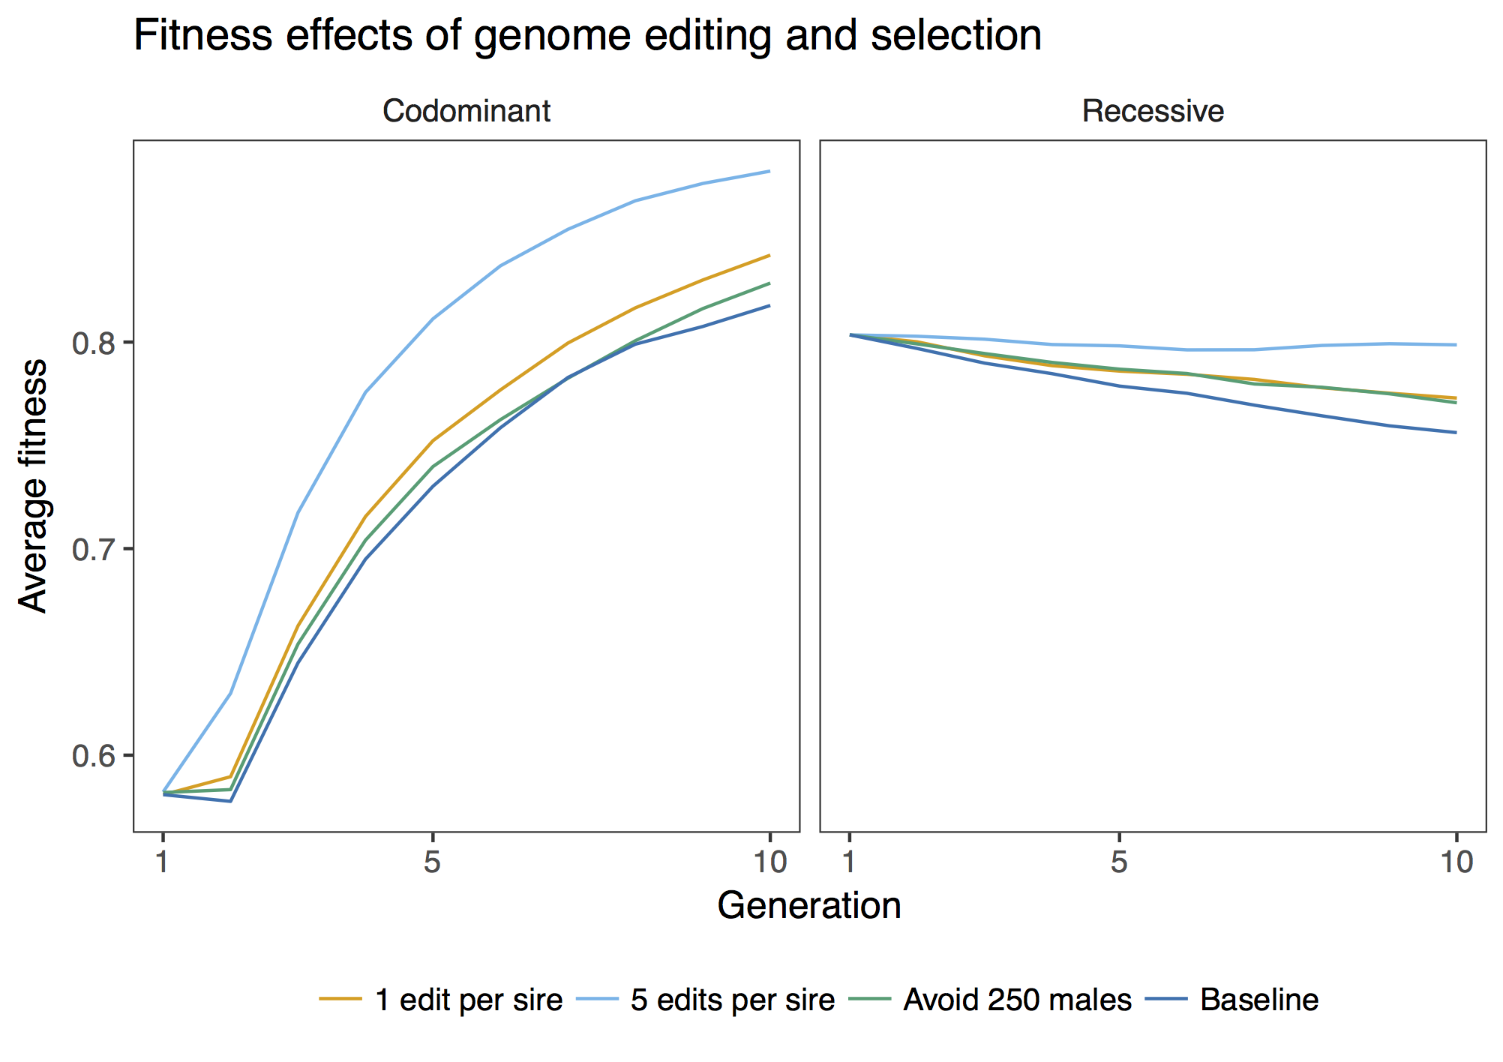

Slide 17
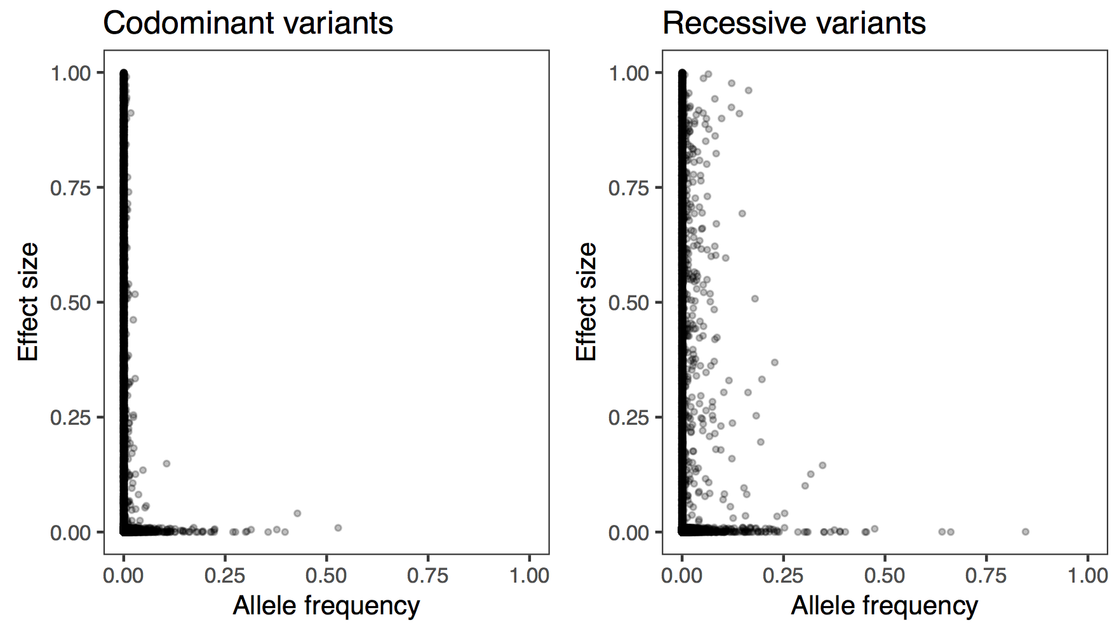
Notes:
What variants should you edit first?

Slide 18
Simulation is useful
AlphaSimR can help you simulate pretty complicated things
It might be possible to improve livestock fitness by new breeding strategies

Slide 19
martin.johnsson@roslin.ed.ac.uk
@mrtnj
https://OnUnicornsAndGenes.blog

