Slide 1
Types of Data
Descriptive Statistics

Slide 2
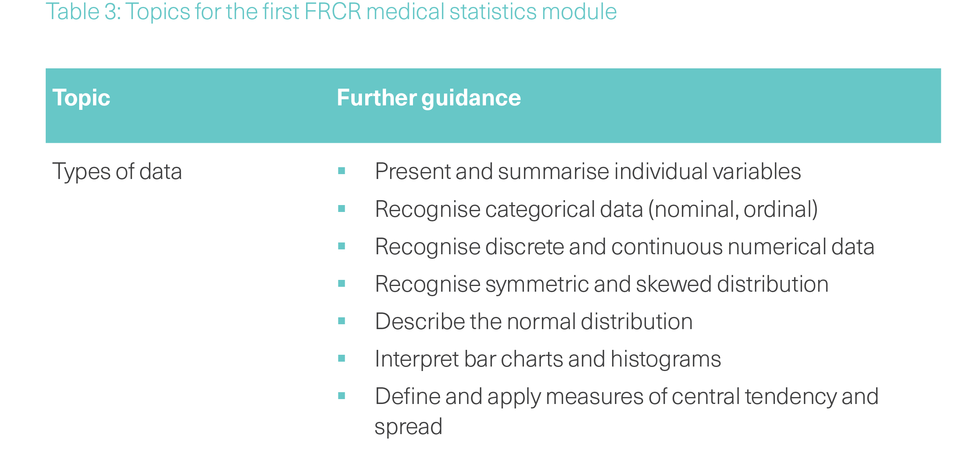

Slide 3
What is Statistics?

Slide 4
Statistics is the science of
collecting data
summarizing data
presenting data
and interpreting data
Using data to estimate the magnitude of associations
and test hypotheses

Slide 5
What is Statistics?
“Statistics…is the core science of evidence-based practice”
Martin Bland

Slide 6

Population
Random Sample
Select random sample
Use sample to make an inference about the population

Slide 7
Types of Analysis
Descriptive (epidemiology, pure statistics)
  “What happened?”
  Focus: Past/Historical
  Action: Reporting and Visualisation
Predictive (Statistical inference)
  “What will happen?”
  Focus: Future/Probabilities
  Action: Forecasting and Risk
Causal (Causal Inference)
  “Why did it happen?”
  Focus: Cause and Effect
  Action: Intervention and Strategy

Slide 8
Frequentist vs Bayesian
Feature | Frequentist Approach | Bayesian Approach
Probability is... | A fixed, long-term frequency. | A personal degree of certainty.
Parameters | Fixed but unknown (e.g., "The average height is X"). | Random variables (e.g., "The average height is a range").
Testing Goal | To reject the Null Hypothesis. | To update the probability of a hypothesis.
Best For... | Large datasets, regulatory trials, objective standards. | Small datasets, "peeking" at results, incorporating expert knowledge.

Slide 9
Descriptive statistics
Summarising and presenting data.
Essential before any predictive or inferential analysis is conducted
Allows “a feel” for the data
Helps form subjective impressions of answers to research questions.

Slide 10
Dataset
A collection of data is called a “dataset”
Contains information on subjects we are interested in:
Individuals: age, height, weight, town, PS, time since diagnosis
Hospitals: number of nurses, number of beds, death rate, LOS
Countries: population size, literacy rates, GDP, life expectancy

Slide 11
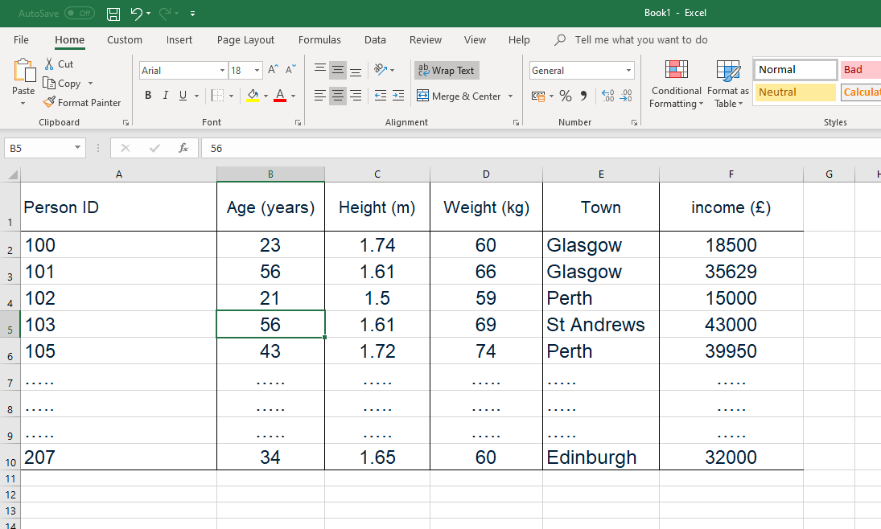
For computer analysis the data must have a clear structure
Columns of information are called ‘variables’
One piece of information per cell
Consistently recorded
Can be numeric or alphabetic

Slide 12
Types of Data
To produce descriptive statistics appropriately requires knowledge of different data types.
Broadly, data are either numerical or categorical

Slide 13
Numerical (quantitative)
Values are counts or measurements
Discrete
Values arise from counting process
(e.g. number of tumours)
Continuous
Values arise from measuring process
(e.g. height, tumour size, planning treatment volume, age, overall survival, weight, FEV1)

Slide 14
Categorical (qualitative)
tells us which category an individual belongs to
Ordinal scale
,
Nominal scale
Categories distinguished by name with intrinsic ordering
(e.g performance status, toxicity)
Categories distinguished by a name with no intrinsic ordering
(e.g. sex, histology, cancer type, postcode)

Slide 15
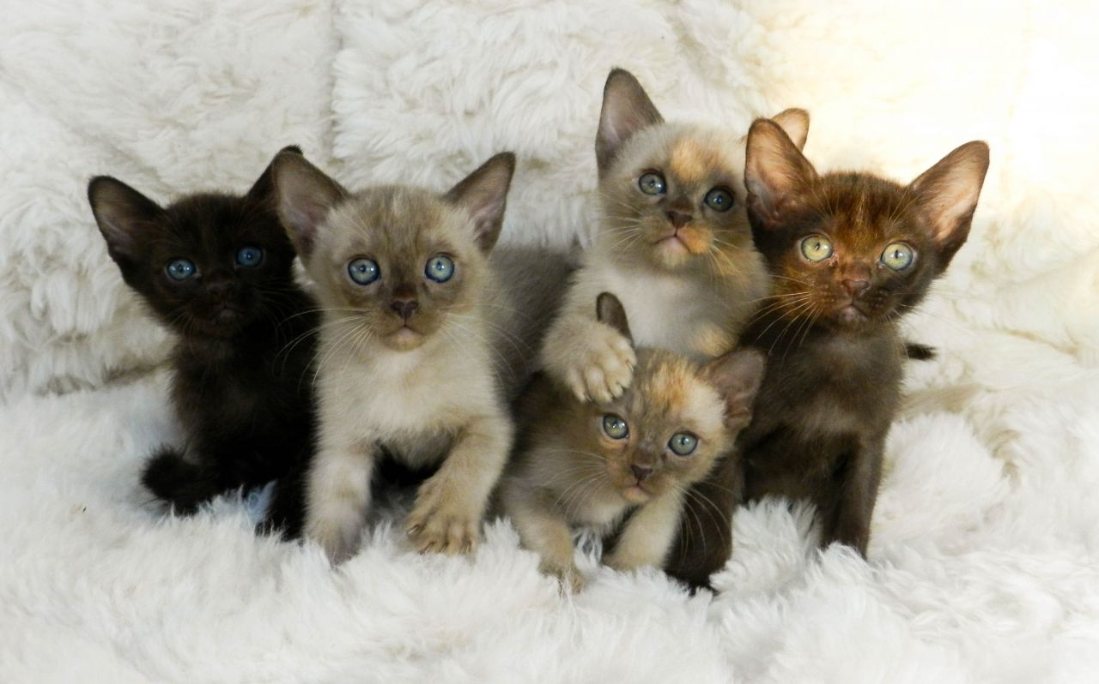
A sample of 6 week old Burmese kittens
Identify 2 continuous variables and 2 categorical variables

Slide 16
Binary variables
A categorical measure with only two categories (for example alive or dead) is called dichotomous.
Sometimes the categories of a dichotomous variable are labeled 0 and 1, and called a binary variable.

Slide 17
Paired data
Usually, we compare 2 separate groups of individuals.
Sometimes data may consist of paired of observations from the same individuals
Tumour size before or after treatment
PS recorded on same patients by 2 separate clinicians
Pain score recorded on 2 separate occasions
It is important to be able to recognise ‘paired’ data

Slide 18
Graphics and descriptive statistics
Identify the main features of data
Detect outliers
Identifying data which has been recorded incorrectly
Includes frequency tables, histograms, bar charts, pie charts, scattergraphs, contingency tables, box plots

Slide 19
Frequency Distribution Tables
Frequency count - a count of the number of times something occurs
Within a data set we list the data values and count how many times each value occurs.
A frequency distribution table lists data values and the frequency each value occurs

Slide 20
Frequency Distribution Tables
Number of brain metastases | Number of patients (n) | percent of patients (%)
1 | 19 | 59.4
2 | 4 | 12.5
3 or more | 9 | 28.1
Total | 32 | 100
The most frequent category is called the mode.
The percentages sometimes expressed proportions (0.594, 0.125, 0.281).

Slide 21
Grouped Frequency Distribution Tables
When there are many data values - data are grouped
(e.g – age groups 20-29, 30-39, 40-49, 50-59, 60-69, etc).
The frequency distribution table then includes data groupings and the frequency of each group.

Slide 22
Histogram (numeric data)
y axis
group width
frequency
or
% relative
frequency
midpoint of
x axis
group
Values of variable

Slide 23
Histogram (numeric data)
Height of 5,628 women aged 25-64

Slide 24
Histogram (numeric data)
Height of 5,628 women aged 25-64

Slide 25
Negatively skewed
(long tail to the left)
Positively skewed
(long tail to the right)
Symmetric (bell shaped) histogram
Long tail to left
Long tail to right

Slide 26
Dotplot (numeric data)
30
25
20
psa
(ng/mL)
15
10
5
0
initial
week 18
psa levels among prostate cancer patients before and after treatment with SABR

Slide 27
Box plot (numeric data)
y axis
maximum value
Sometimes the tail length is up to 1.5 times the IQR. Data points greater than this are shown as ‘outliers’
Upper quartile Q
3
25% of data values
above this line
values of variable
Median Q
2
50% of data values
below this line
Lower quartile Q
1
25% of data values
below this line
minimum value

Slide 28
Box plot
Women
Men
10
8
Neutrophil
lymphocyte
ratio
6
4
2
0
102 patients with NSCLC prior to treatment with SABR

Slide 29
Scattergraph (numeric data)
20
15
white blood cells
10
5
0
0
100
200
300
400
500
platelets
Blood counts among 102 patients with NSCLC prior to treatment with SABR

Slide 30
Bar chart (categorical data)
y axis
frequency
or
% relative
frequency
1st
category
2nd
category
…
k^{th} category
x axis
Variable values

Slide 31
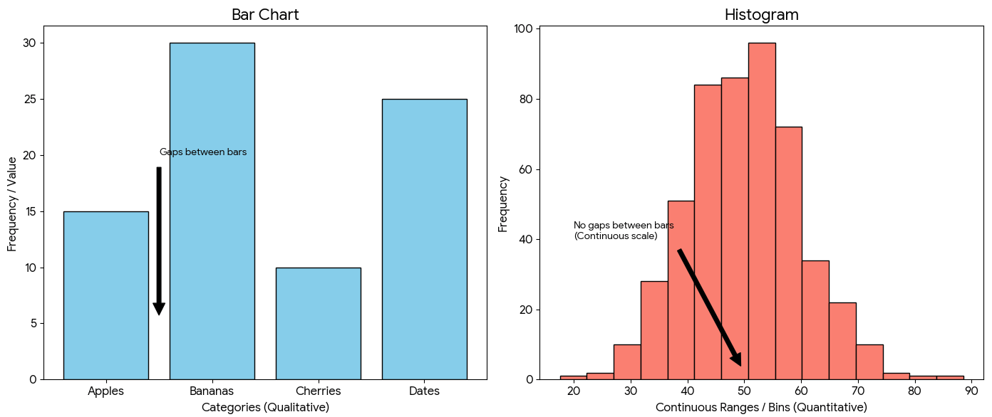

Slide 32
Bar chart
Frequencey (n)
Stage
Stage among 93 patients with lung cancer treated with radical radiotherapy

Slide 33
Pie Chart (nominal data)
right lower lobe (20%)
left upper lobe (38%)
right middle lobe (1%)
right upper lobe (30%)
left lower lobe (11%)
Location of tumour among 93 patients with lung cancer who received radical radiotherapy

Slide 34
Contingency Tables
relationship between two categorical variables
Sex | Total (n)
Women | 60
Men | 42
Total | 102
Status at two years | Women (n) | Men (n) | Total (n)
Alive | 48 | 29 | 77
Dead | 12 | 13 | 25
Total | 60 | 42 | 102
Status at two years | Total (n)
Alive | 77
Dead | 25
Total | 102
102 patients with NSCLC treated with SABR

Slide 35
Contingency Tables
relationship between two categorical variables
Status at two years | Women (n) | Men (n) | Total (n)
Alive | 48 | 29 | 77
Dead | 12 | 13 | 25
Total | 60 | 42 | 102
Status at two years | Women (n) | Men (n) | Total (n)
Alive | 48 (80%) | 29 (69%) | 77 (75%)
Dead | 12 (20%) | 13 (31%) | 25 (25%)
Total | 60 (100%) | 42 (100%) | 102 (100%)

Slide 36
Status at two years | Women (n) | Men (n) | Total (n)
Alive | 48 (80%) | 29 (69%) | 77 (75%)
Dead | 12 (20%) | 13 (31%) | 25 (25%)
Total | 60 (100%) | 42 (100%) | 102 (100%)
column %
Status at two years | Women (n) | Men (n) | Total (n)
Alive | 48 (62%) | 29 (38%) | 77 (100%)
Dead | 12 (48%) | 13 (52%) | 25 (100%)
Total | 60 (59%) | 42 (41%) | 102 (100%)
row %
Status at two years | Women (n) | Men (n) | Total (n)
Alive | 48 (47%) | 29 (28%) | 77 (75%)
Dead | 12 (12%) | 13 (13%) | 25 (25%)
Total | 60 (59%) | 42 (41%) | 102 (100%)

Slide 37
Clustered (grouped) bar charts
35
women
60
women
men
men
30
50
25
40
n
20
%
30
15
10
20
5
10
0
0
0
1
2
3
0
1
2
3
Performance status
Performance status
102 patients with NSCLC treated with SABR

Slide 38
Stacked (component), percentage component bar charts
women
women
120
men
100
men
100
80
80
n
%
60
60
40
40
20
20
0
0
0
1
2
3
0
1
2
3
Performance status
Performance status
102 patients with NSCLC treated with SABR

Slide 39
Illustrating data
Continuous data
Histograms, scatter plots, box-plots, dot plots
Categorical (nominal) data
Bar charts, pie charts, frequency tables

Slide 40
Descriptive measures
A descriptive measure is a numerical value, which summarises a set of data
number of patients in a sample is n
We represent the individual values of a variable X with a small letter x.
the value for patient 1 is x₁
the value for patient 2 is x₂
the value for patient n is x_{n}

Slide 41
Measures of Location or Central Tendency
Referred to as ‘average’ values
mean, median, and mode.

Slide 42


Sample mean ($\overline{x}$) is calculated as
Sum of all values
$$mean=\frac{\sum{x}}{n}$$
Σx =x₁ + x₂ + x₃ + …+ x_{n}
is the sum of all values across the subjects, and n is the total number of subjects.

Slide 43
10 patients with lung cancer had a pretreatment PET scan and SUV_{max} was measured.
Original Data: 1.8, 8.9, 2.7, 9.4, 5.4, 16.0, 5.8, 17.9, 13.1, 6.6
The mean SUV_{max} = 1.8+8.9+2.7+9.4+5.4+16.0+5.8+17.9+13.1+6.6 = 8.8
10

Slide 44
Sample median is the middle value when the observations are ranked from lowest to highest.
If n is even, it is the mean of the middle two values.
Its interpretation is that 50% of data values are above the median; 50% are below the median.
Sample mode is the most frequently occurring value. This term is seldom used.

Slide 45
Original Data: 1.8, 8.9, 2.7, 9.4, 5.4, 16.0, 5.8, 17.9, 13.1, 6.6
Ordered Data: 1.8, 2.7, 5.4, 5.8, 6.6, 8.9, 9.4, 13.1, 16.0, 17.9
1000.0
median SUV_{max} = (6.6+8.9)/2 =7.75

Slide 46
Neither the mean nor the median is sufficient as a numerical summary.
Example: - 2 datasets
Set A : 9.2 9.3 9.5 9.7 9.8 10.0 10.1 10.4 10.5 11.8
Set B : 6 7 7 8 8 9 9 10 11 11 12 13 14 15
Set A
Set B
Each set has a mean of 10.0 units
Spread of values is different.
How should spread be measure?

Slide 47
Measures of Dispersion
How “concentrated” or “spread out” are the data.
They describe the degree to which the data vary about their average value.
range, standard deviation, and interquartile range.

Slide 48
Measures of Dispersion
Range is the difference between the smallest (minimum) and largest (maximum) values
Interquartile range (IQR) is simply the lower quartile and upper quartile (Q1, Q3). Sometimes it is expressed as the value of Q3-Q1.

Slide 49
Original Data: 1.8, 8.9, 2.7, 9.4, 5.4, 16.0, 5.8, 17.9, 13.1, 6.6
Ordered Data: 1.8, 2.7, 5.4, 5.8, 6.6, 8.9, 9.4, 13.1, 16.0, 17.9
median SUV_{max} = (6.6+8.9)/2 =7.75
Q1=5.4 and Q3=13.1
Interquartile range (IQR) is (5.4 to 13.1) or 13.1-5.4 =7.7

Slide 50

Measures of Dispersion
Standard deviation (SD or sd) is a measure of how far away observations are from the sample mean.
distance from the mean
$$SD=\sqrt{\frac{\sum{{(x−mean)}^{2}}}{n−1}}$$

Slide 51
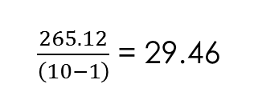
Original Data: 1.8, 8.9, 2.7, 9.4, 5.4, 16.0, 5.8, 17.9, 13.1, 6.6
standard deviation involves subtracting the mean SUVmax (8.8) from each observation
distance from the mean
-7, 0.1, -6.1, 0.6, -3.4, 7.2, -3.0, 9.1, 4.3, -2.2
squaring
Squared distance from the mean
49.0, 0.01, 37.21, 0.36, 11.56, 51.84, 9.0, 82.81, 18.49, 4.84
summing
Sum of Squared distance from the mean
265.12
dividing by n-1
$\frac{265.12}{\left(10−1\right)}$ = 29.46
standard deviation = √29.46 = 5.43
take the square root

Slide 52
Reporting means and medians
Means with SD
mean SUV_{max} 8.8 (SD 5.43)
Medians with IQR
median SUV_{max} 7.75 (IQR 5.4 to 13.1)
Do not mix medians with SD, or means with IQR

Slide 53
Which measure to use
The mode should be used when describing nominal categorical variables.
When the variable is numeric with a symmetric distribution, then the mean is proper measure of center
In the case of skewed distributions, the median is better choice for the measure of center.
The median is less influenced by outliers (extreme values).

Slide 55
The Normal Distribution

Slide 56
Negatively skewed
(long tail to the left)
Positively skewed
(long tail to the right)
Symmetric (bell shaped) histogram
Long tail to left
Long tail to right

Slide 57
Normal distribution
2
1.8
Frequency
height (m)
1.6
1.4
1.2
1.2
1.4
1.6
1.8
2
height (m)
Histogram of height of women attending a weight management service
The characteristic symmetric bell-shape of the Normal distribution.
Normal distribution is completely specified by the mean and standard deviation

Slide 58
The Normal distribution is described by parameters µ and σ,
σ the population standard deviation.
(spread of distribution)
µ
population mean (the center of the distribution)

Slide 59
The Normal distribution is described by parameters µ and σ,
σ the population standard deviation.
This is called a reference range, in this example, it is the range in which 68% of the population lie.
µ the population mean
Area contains 68% of population
µ-σ
µ
µ+σ

Slide 60
The Normal distribution is described by parameters µ and σ,
σ the population standard deviation.
This is called a reference range, in this example, it is the range in which 95% of the population lie.
µ the population mean
Area contains 2.5% of population
Area contains 95% of population
Area contains 2.5% of population
µ-1.96σ
µ
µ+1.96σ

Slide 61
The Normal distribution is described by parameters µ and σ,
σ the population standard deviation.
µ the population mean
68%
95%
µ-2σ
µ-σ
µ
µ+σ
µ+2σ

Slide 62
In a normal distribution 95% of values lie within
a) the range
b) the interquartile range
c) ± 1 standard deviation from the mean
d) ± 1.5 standard deviations from the mean
e) ± 2 standard deviations from the mean
In a normal distribution it is expected that
a) the median and mean will be the same
b) the median will be greater than the mean
c) the median will be smaller than the mean
d) the median cannot be calculated
e) the mean and median will not be the same

Slide 63
Exercise
In excel, calculate the mean and standard deviation

Slide 64
 | SUV_{max}
 | 1.8
 | 8.9
 | 2.7
 | 9.4
 | 5.4
 | 16
 | 5.8
 | 17.9
 | 13.1
 | 6.6
sum= | 87.6
mean= | 8.76

Slide 65
 | SUV_{max} | (SUV_{max}-mean)
 | 1.8 | -6.96
 | 8.9 | 0.14
 | 2.7 | -6.06
 | 9.4 | 0.64
 | 5.4 | -3.36
 | 16 | 7.24
 | 5.8 | -2.96
 | 17.9 | 9.14
 | 13.1 | 4.34
 | 6.6 | -2.16
sum= | 87.6 | 0
mean= | 8.76

Slide 66
 | SUV_{max} | (SUV_{max}-mean) |  | (SUV_{max}-mean)²
 | 1.8 | -6.96 |  | 48.44
 | 8.9 | 0.14 |  | 0.02
 | 2.7 | -6.06 |  | 36.72
 | 9.4 | 0.64 |  | 0.41
 | 5.4 | -3.36 |  | 11.29
 | 16 | 7.24 |  | 52.42
 | 5.8 | -2.96 |  | 8.76
 | 17.9 | 9.14 |  | 83.54
 | 13.1 | 4.34 |  | 18.84
 | 6.6 | -2.16 |  | 4.67
sum= | 87.6 | 0 |  | 265.10
mean= | 8.76 |  | SD= | 5.43

