Slide 1


Data-Driven Chemistry:
Fitting data
Dr Antonia Mey
antonia.mey@ed.ac.uk
Room 214 JBB

Slide 2


Finding the line of best fit: an example
Now the model is the line of best fit that will allow us to identify an unknown concentration
How do we find the line of best fit?

Slide 3
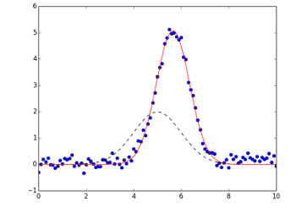
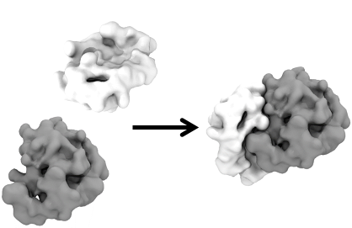
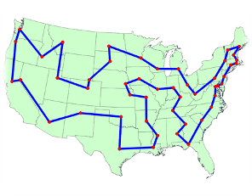
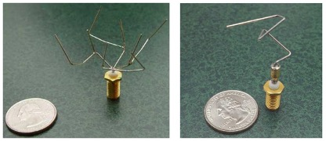
Data Fitting is an Optimisation Problem
Notes:
What is the best way of doing anything? -> mathematically you are solving an optimisation problem:
curve fitting
Antenna shape has been optimised by genetic algorithm to optimise the signal (rather than straight antenna)
Protein docking
Shortest path that goes through all the states touching them only once.

Slide 4
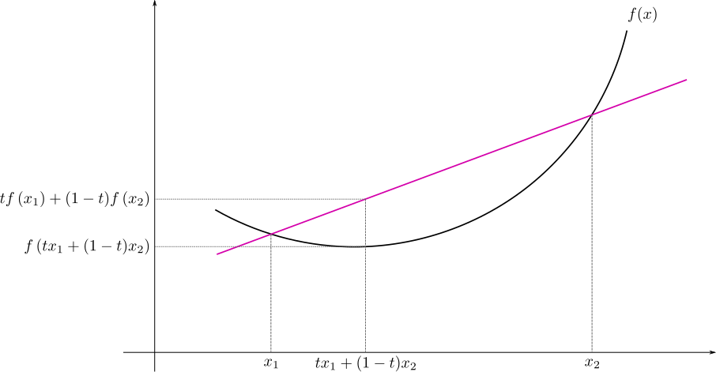
Optimisation problem mathematically
1) Define the parameters x of your problem
2) Let y=f(x) a function associating a score to every parameter combination in a subset of Euclidean space R^{n}
3) find x* such that f(x*) < f(x) for all x (a.k.a. minimization)
Convex function: iff the segments connecting any two points on the function, lie above it
Definitions:
parameters x: (sometimes) degrees of freedom
subset of Euclidean space: search space
f(x): fitness / scoring / objective / cost function
the function has only one minimum
demonstrating that a problem is convex is a big deal!
What is a good objective function?

Slide 5
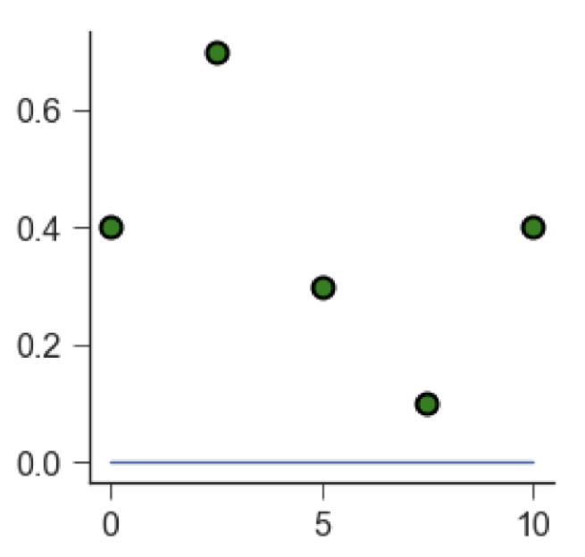
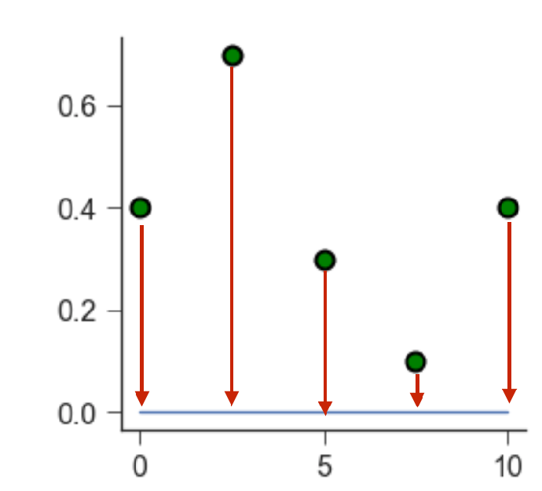
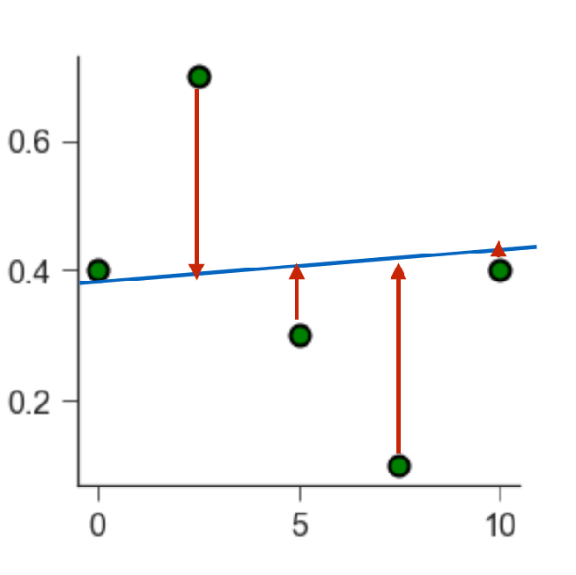
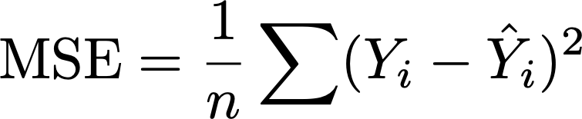



Linear regression means finding the minimum of an objective function
The blue line is meant to fit the green data points.
Red arrows are a called residuals and small arrows mean a good fit.
The objective is to minimise the mean square error
MSE is called the objective function
is the number of data points,
is the observed value (i.e. the measured data point),
is the predicted value (i.e. the value that lies on the line of best fit).

Slide 6
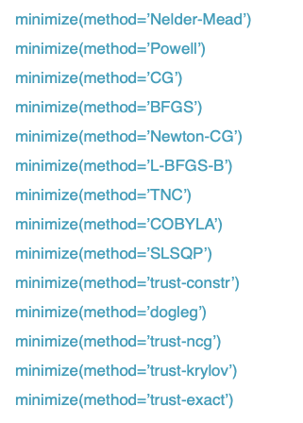
Finding the minimum in high dimensions
Using least squares let’s you find the best solution.
There are different algorithms that let you find the minimum of an objective function.

Slide 7
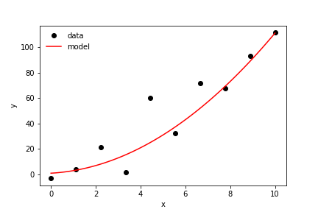


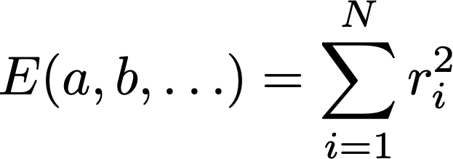

Linear Least Squares: A Summary
Model predicts values for each datapoint
Residuals quantify prediction error
The best model minimizes the sum of squared residuals
Solve:
-> find the minimum

Slide 8
Finding the line of best fit in action

Slide 9
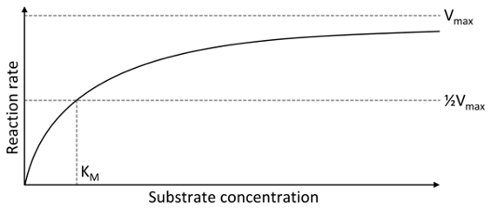
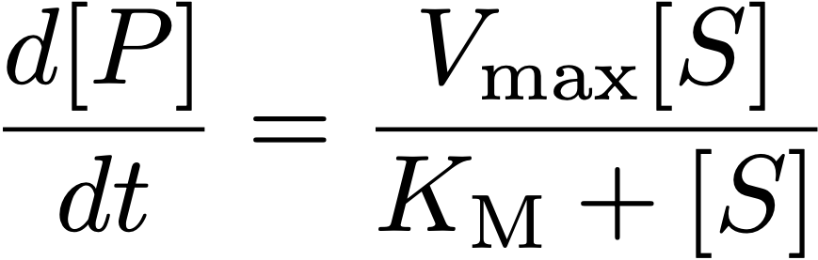
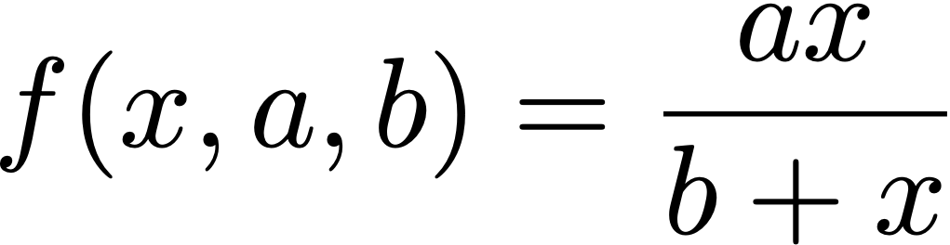
Non-linear Least squares
Non-linear combinations of model parameters, e.g. Michaelis Menten

Slide 10
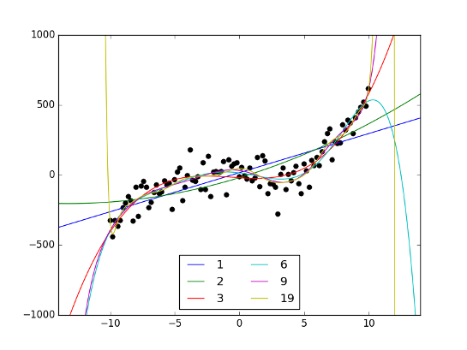
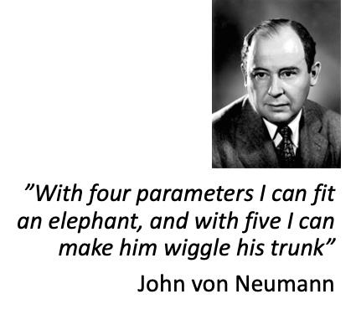
The more parameters the better the fit?
Notes:
Noisy 3rd order polynomial
Blue line matches poorly
3 it looks better
6 is quite accurate around your data
More parameters you add the better your data is explained.
Explaining whatever explains nothing -> overfitting.

Slide 11
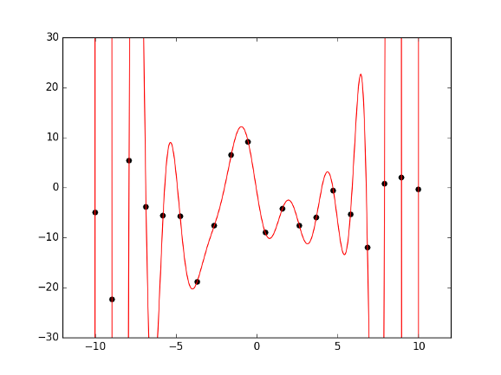
The more parameters the better the fit?
N points can be perfectly fitted with an N-1 order polynomial
Notes:
An N-1 will perfectly through every datapoint, but the usefulness of the model is 0. And the generalisability is also 0.
You don’t want models that only perfectly explain your data.

