Slide 1

Intro to Object Detection
Edinburgh ai

Slide 2
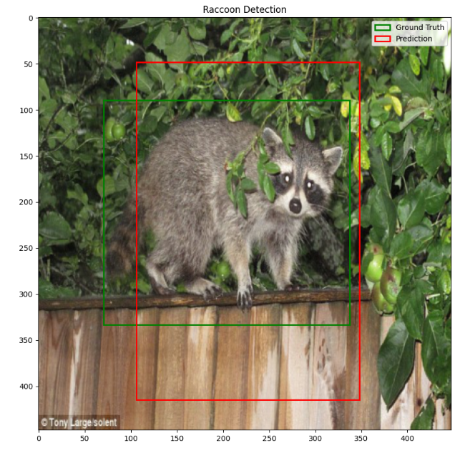
What we’ll be building today

Slide 3
Recap:
What is a Neural Network?
Notes:
Key idea: neural networks only take in vectors of numbers

Slide 4
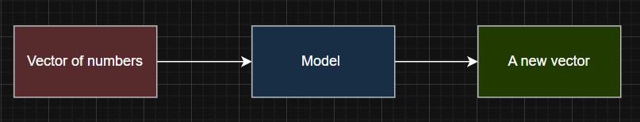
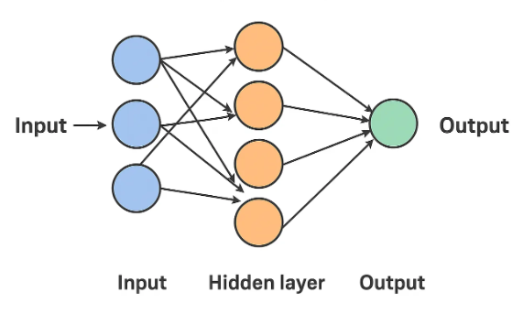
Neural Network overview
Notes:
Neural network takes in a list of numbers and outputs a new list of numbers. We update the weights in the model so that for similar inputs, we get an output corresponding to the similarity in those inputs

Slide 5
If neural networks take in numbers, how do we input an image into one?

Slide 6
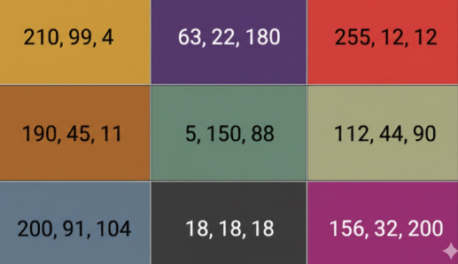
How can we apply a neural network to images?
At its core, an image on a computer is just a matrix of pixels
Each pixel has a Red, a green and a blue value. Together they make a colour.

Slide 7
Convolutional Neural Network
A convolutional is just a neural network that has layers that perform a convolution.
The equation we use for our convolution varies on the dimension of our input.
e.g.
1d convolution – used for audio waves, stock prices
2d convolution – used for 2d images

Slide 8
So, what is a convolution?
Notes:
Use the whiteboard and write the 2d discrete convolution on the whiteboard next to the interactive board

Slide 9
Why do we use convolutions for image processing
Convolutional neural networks are very good at being aware of not just what is in image, but also where.
If we know all the small features in an image and where they are, we can decipher what’s in the image!

Slide 10
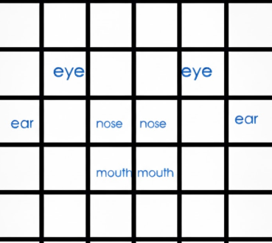
Example: What’s in this image?

Slide 11
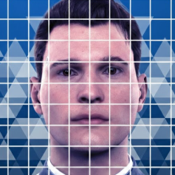
A person! (debatably)
eye
eye
ear
nose
nose
ear
mouth
mouth

Slide 12
How can a neural network classify what this is an image of
We make it so each element in our output vector corresponds to a prediction of what is in the image.
If the model believes the corresponding object is in the image it puts a 1 in its element, if it believes the image doesn’t contain the corresponding object it instead puts a 0.

Slide 13
Example
If the elements of our output vector correspond to:
[dog, cat, horse, snake, rabbit]
If our model believes there is a snake in the image it should output
[0,0,0,1,0]

Slide 14
This is great for telling us what is in an image, but it doesn’t tell us where

Slide 15
YOLO Architecture

Slide 16

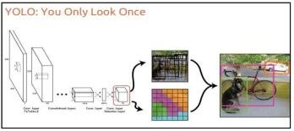
What is YOLO?
In a deep learning context, YOLO (You Only Look Once) is a computer vision architecture used for object detection and location in images and videos.

Slide 17
YOLO makes one main simple change to our classification model
Instead of predicting a vector saying, “yes this is in the image”, it instead predicts a vector containing:
[confidence, object_center_x, object_center_y, box_height, box_width]
Would anyone like to take a guess at what these values mean?

Slide 18
What the elements mean
Confidence – a value between 1 and 0 saying how confident the model is that the image contains the
object_center_x – the x coordinate of the center of the object in the image
object_center_y – the x coordinate of the center of the object in the image
box_width – the width (in pixels) of the bounding box we need to draw around our object
box_height – the height (in pixels) of the bounding box we need to draw around our object
Note: for now, we’ve moved away from being able to detect if multiple types of object are in the image and are now just predicting if 1 type of object is. Later versions of YOLO handle multiple objects but they’re a bit more complex.

Slide 19
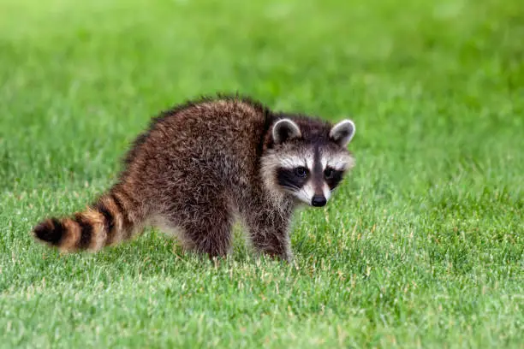
What this looks like on an image
Box
Height
Raccoon center: (252,143)
Box_width

Slide 20
Are there any implications of changing our output vector?

Slide 21
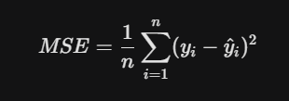
Classification CNN loss function
For the classification CNN, the only thing the model could get wrong is what the image was.
We therefore used a loss function such as Mean Squared Error that punished the model for putting a 1 in the wrong unit in the output vector.
(where n = batch size)

Slide 22
YOLO Loss function
Since for YOLO we’re predicting both if the object is in the image and where it is, there’s effectively now 2 things it can get wrong:
It can give a wrong prediction on if the object is in the image or not
It can give a wrong estimate for where the object is in the image
However, if the image doesn’t actually have the object in it, it is unfair to punish the coordinate loss and instead we only punish the confidence loss

Slide 23
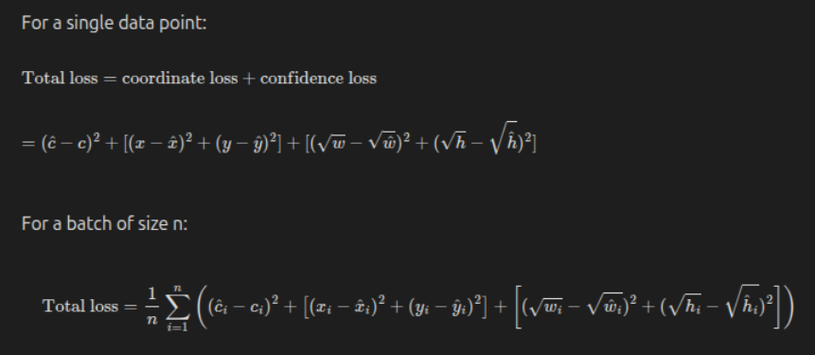
YOLO Loss function - The Maths
You can see a breakdown of it here if you like:
[insert link to obsidian notes here]

Slide 24
Evaluating our YOLO model
In practice, no matter how good our model is, it’s never going to get the bounding boxes absolutely perfect every time.
We need a way of deciding if our model’s bounding box is close enough to the target.
Any ideas?

Slide 25
Intersection over union

Slide 26
Now it’s time for you to try it yourselves!

Slide 27


Kaggle Setup
Go to: https://www.kaggle.com/
Create an account (if you don’t have one already)
Click the create button in the top left and select “Import Notebook” from the dropdown menu.
5. Select “GitHub”
6. In the search prompt field enter: “EdinburghAI/workshops”

Slide 28
Kaggle set up - 2

