Slide 1
Intelligent Crawling
Hieu, Faheem, Patrick
William, Tomasz * 2, Michal

Slide 2
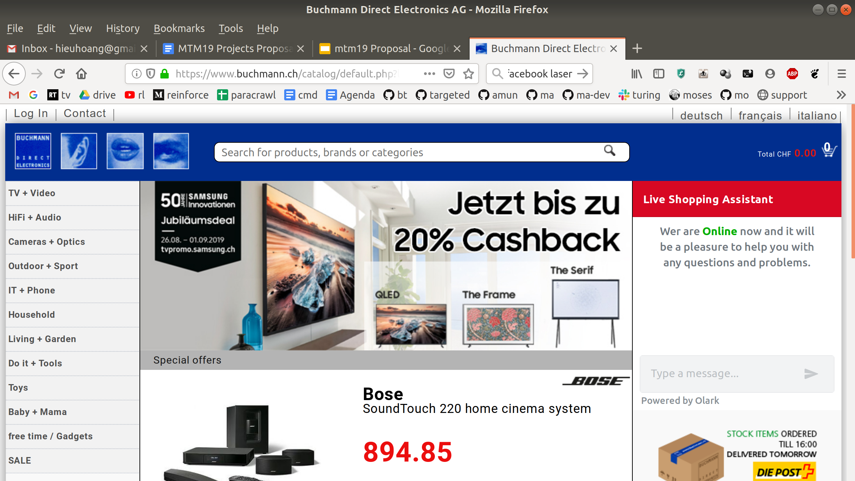
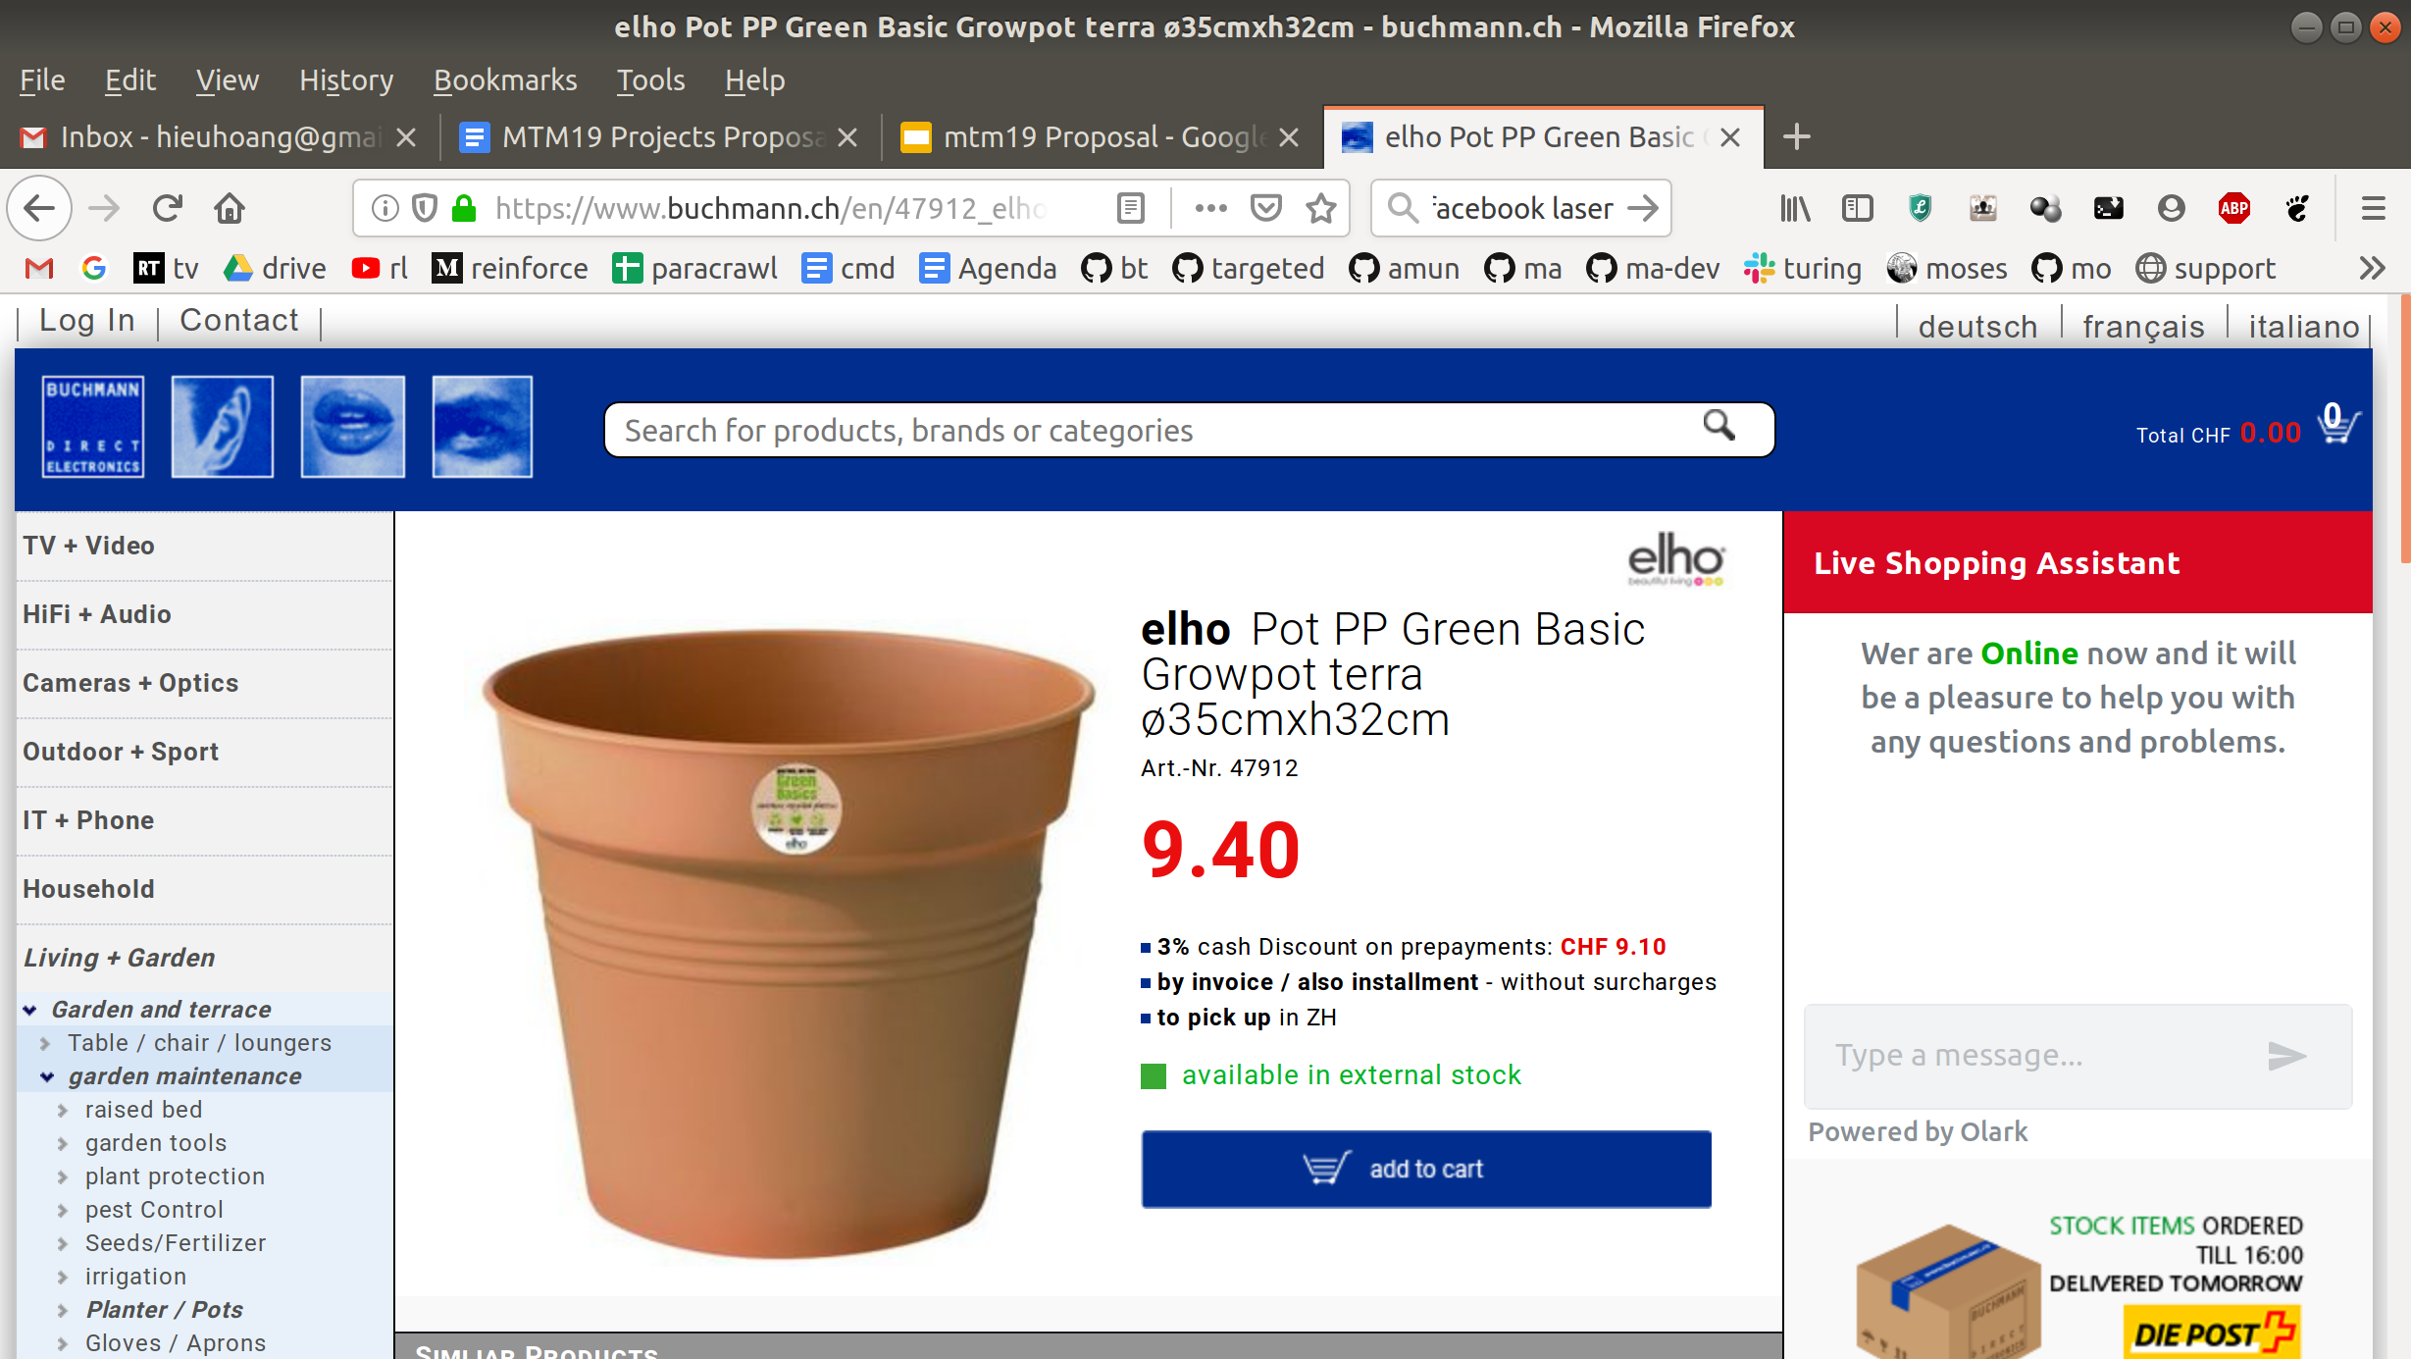
Intelligent Crawling
Link 2
Link 3
Link 4
Link 5
Link 6
Link 7

Slide 3
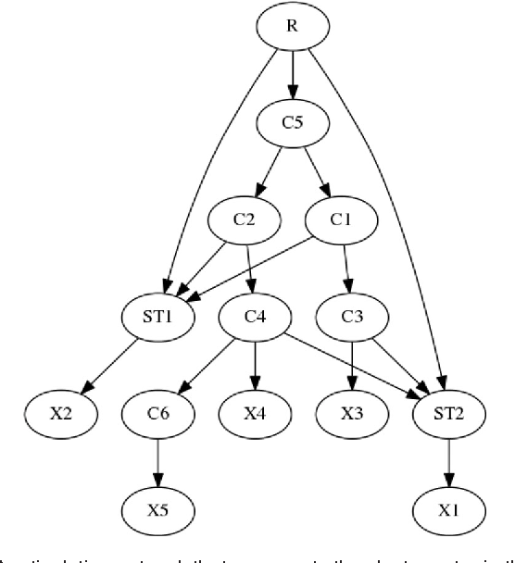
Intelligent Crawling
Search Directed Graph

Slide 4
Inference
Q-Learning
Page
Q(page, link1)
Q(page, link2)
Q(page, link3)
Q-Values - estimate of the total rewards of taking action
Action = argmax Q(page, link)
Reward - +100 if found BOTH matching documents
-1 crawling cost

Slide 5
Q-Learning
Training
Repeatedly do inference
Update Q-Values
Q(page, link) ← (1-α) * Q(page, link)
+ α [reward(new page) + max Q(new page, links)]

Slide 6
Q-Learning
Q-network
Q(page, link) - neural network - 3 layer linear network
RELU activation
Input - ‘state’ of the graph - number of documents downloaded in each lang
Properties of each link - language of the parent document
Output - Q-value - NOT a probability

Slide 7
What we did
Aim - beat the non-intelligent baselines
More features
Link features - depth, order, parents, children
Graph features - total crawled, average depth crawled
Hyperparameters
epochs, learning rate, alpha, etc.
Speed optimization
Calculate Q-values simultaneously
Batch
Change model to output multiple Q-values
Train & test domains
Train on multiple domains

Slide 8
Future Work
Attention
Attend to visited/unvisited link before making a decision.
Other RL Algorithms
Calculate probabilities, not value
Graph Representation
Graph convolution, gated graph network, etc.

Slide 9
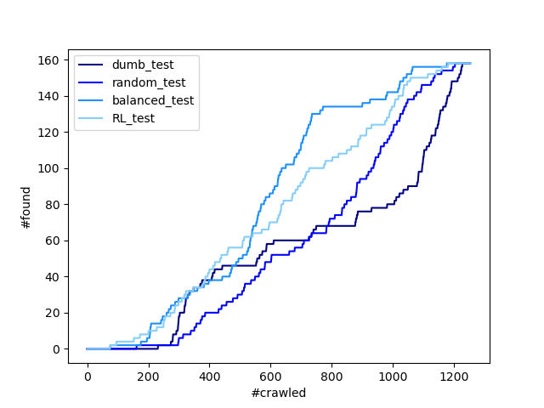
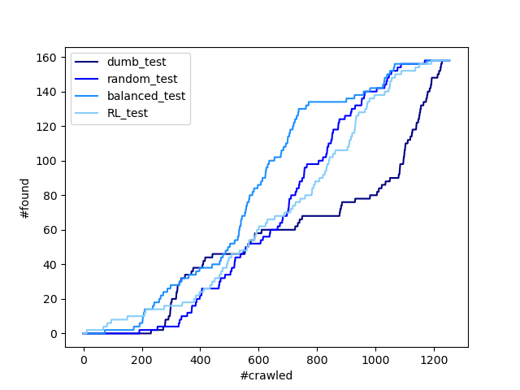
Performance on test data
50 epoch (beat DFS but not balanced)
200 epoch (overfit?)

Slide 10
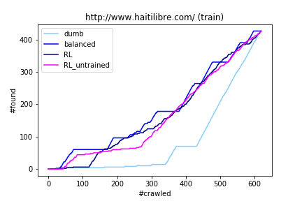
RL is as good as initialised weights?
400 epochs (training RL is hard?)

Slide 11
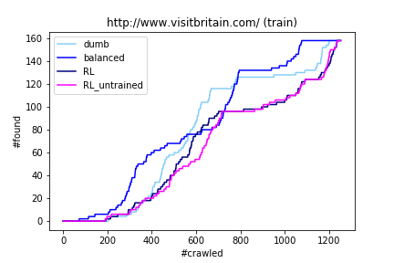
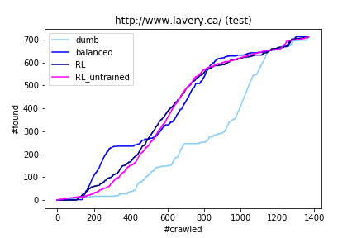
Train on 6 domains, test on 1

