Slide 1
Intelligent Crawling
Farheem, Patrick, William, Tomasz * 2, Michal

Slide 2
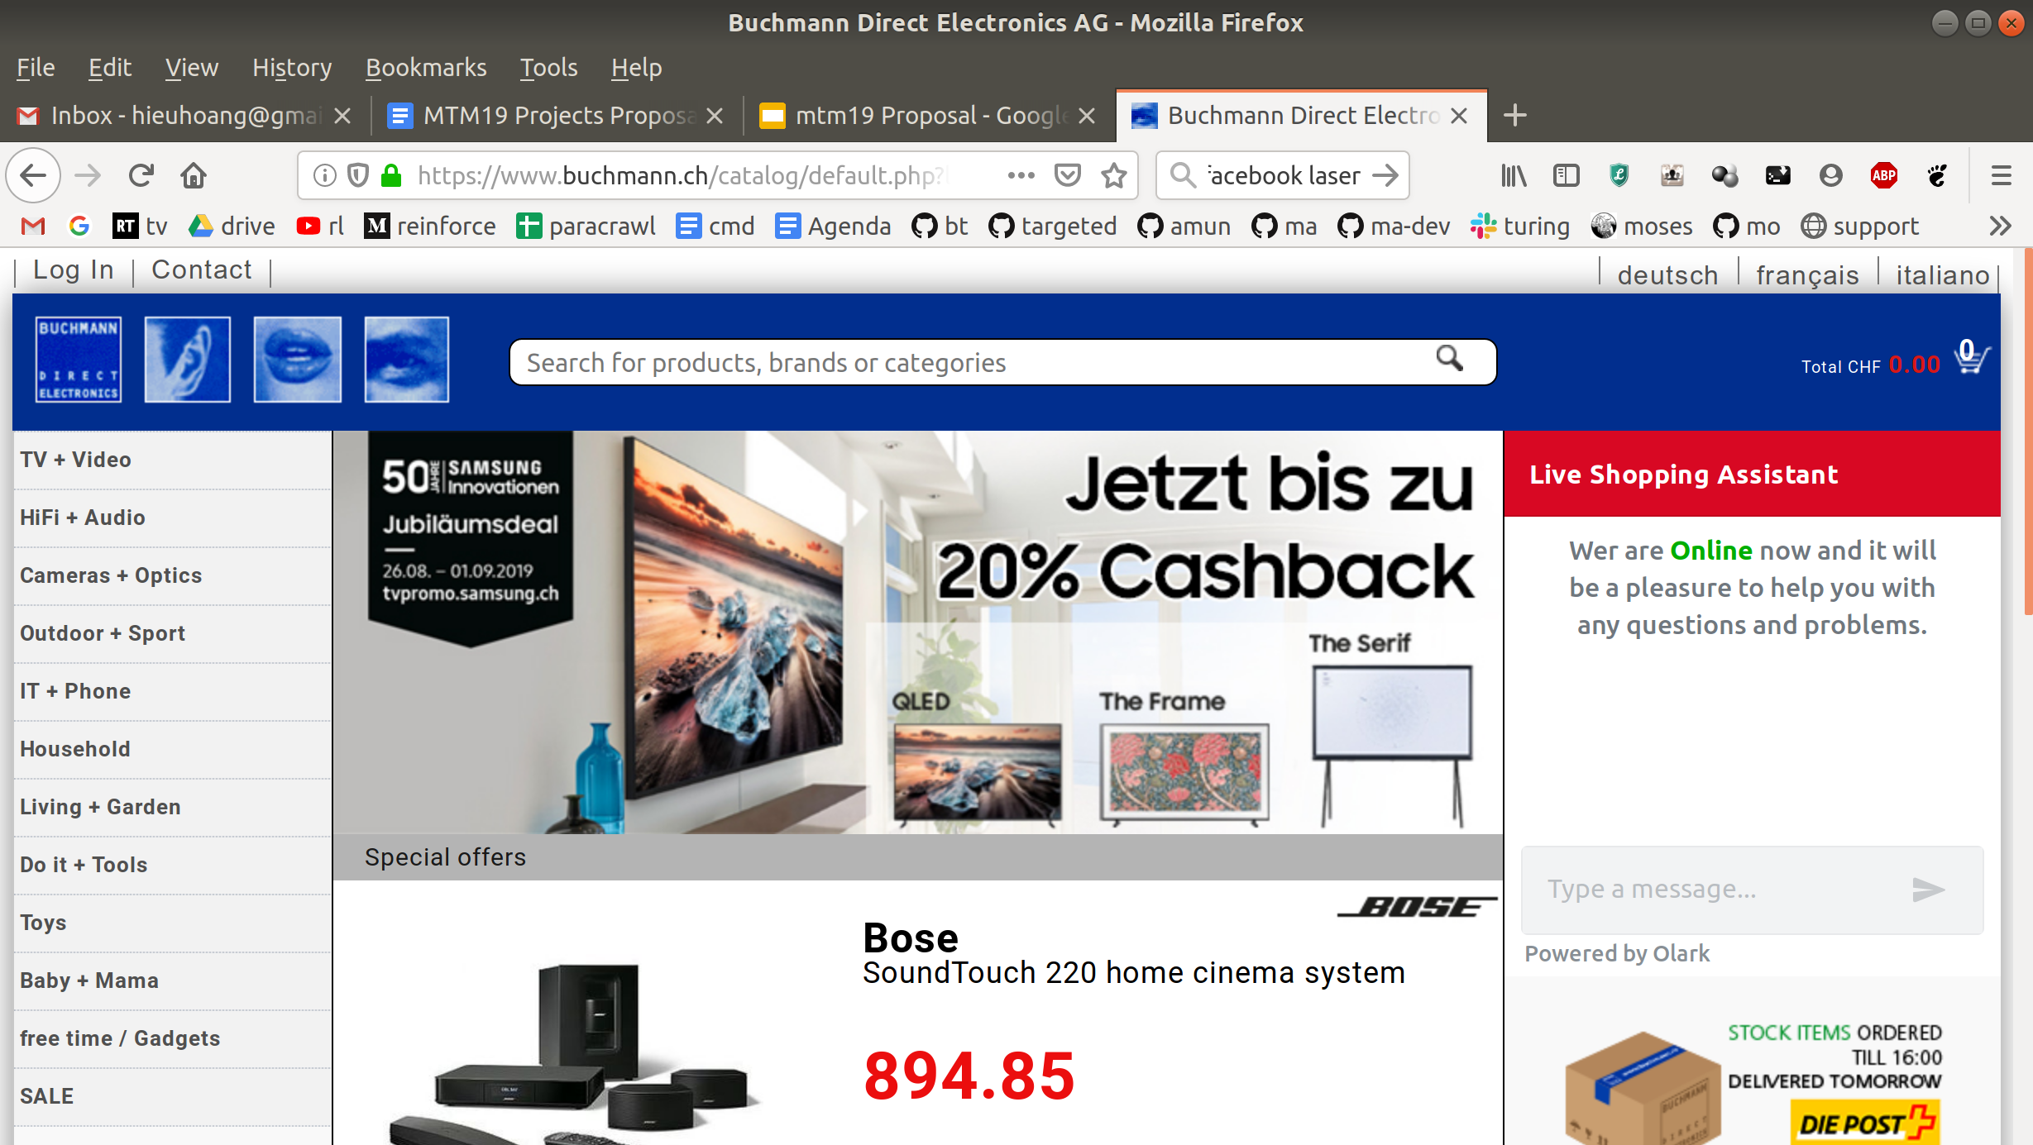
Intelligent Crawling
Link 3
Link 1
Link 2

Slide 3
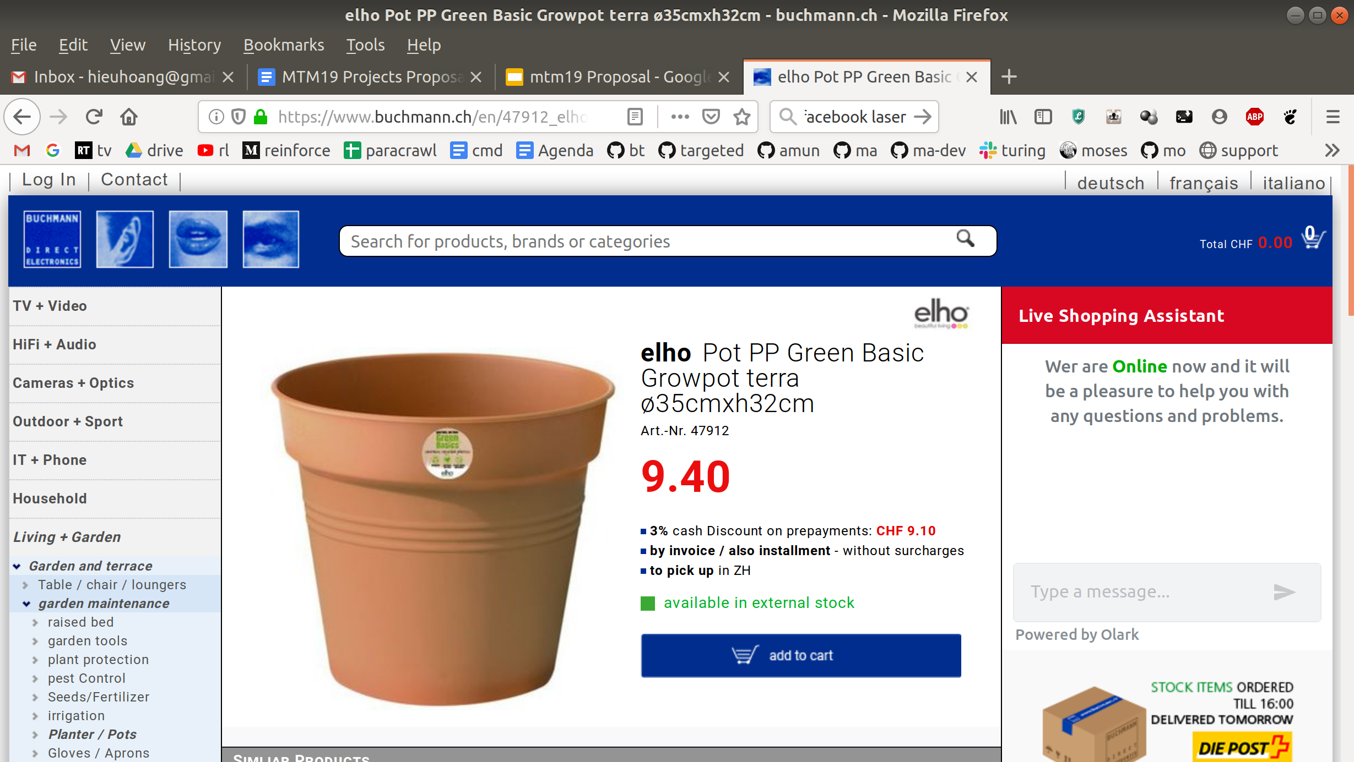
Intelligent Crawling
Link 2
Link 3
Link 4
Link 5
Link 6
Link 7

Slide 4
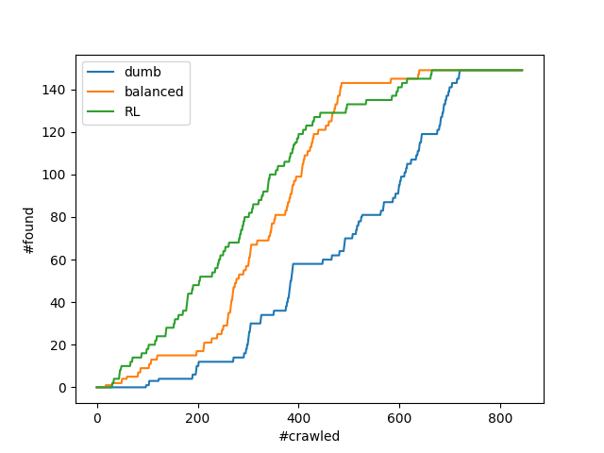
Intelligent Crawling

Slide 5
Balanced Strategy
Same number of FR and EN pages
Links from FR docs more likely to lead to FR doc
No learning required
simple strategy
 | en | fr
#docs | 30 | 4
Download more FR docs!

Slide 6
Reinforcement Learning (RL)
State: number of downloaded documents for each language
Same as ‘balanced’ strategy
Actions: follow link from a document of particular language
Rewards: -1 cost of crawling
+100 parallel documents found

Slide 7
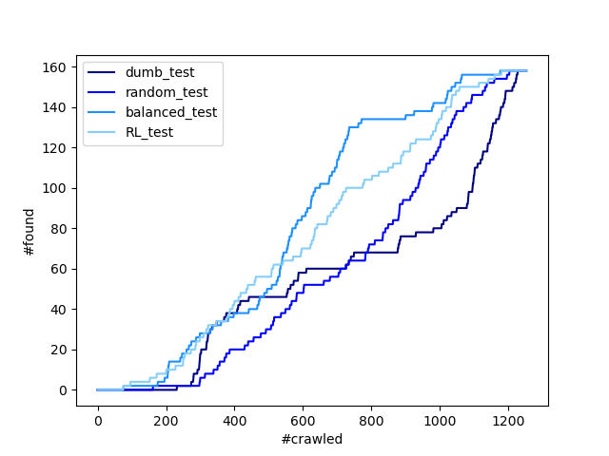
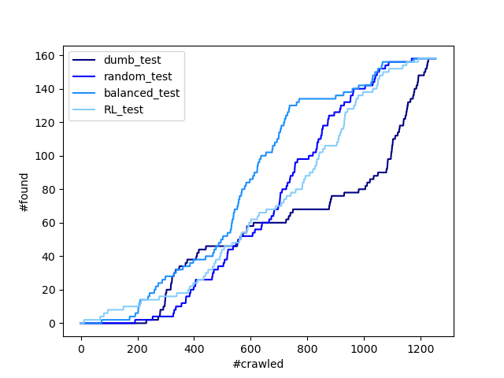
Performance on test data
50 epoch
200 epoch

Slide 8
To-Do’s
More features
Depth
Siblings
Link features
Graph convolution
Train & Test on multiple domains

