Slide 1
Software design
Group 3
Jianning kang, jiayi dong, Hongbin pan, qile guo, xiao zheng

Slide 2
Overall design
Aim: Developing a user-friendly mutation and drug searching website based on the data collecting from PharmGKB.
Development Platform:
Backstage dataset： MySQL
Application server: Tomcat7
Development tool： IDEA，JDK11
Unit test tool：JUnit

Slide 3
Website configuration(homepage)
navigation bar
(hyper link to different function)
title
guidance
(the matter need attention and write in website code directly)

Slide 4
Website configuration(input)
navigation bar
title
Input content(write new vcf file into database)
Content
(show the database the user upload or store in original database)

Slide 5
Website configuration(output)
navigation bar
title
Search bar(filtrate in database via key words)
Database content
(returns the result of summary table from database)

Slide 6
WORKFLOW
Upload, search, sign in/up
Request to access website resources
Interaction
User
See result page
Return information
Browser
Server
Database
Frontend
Backend

Slide 7
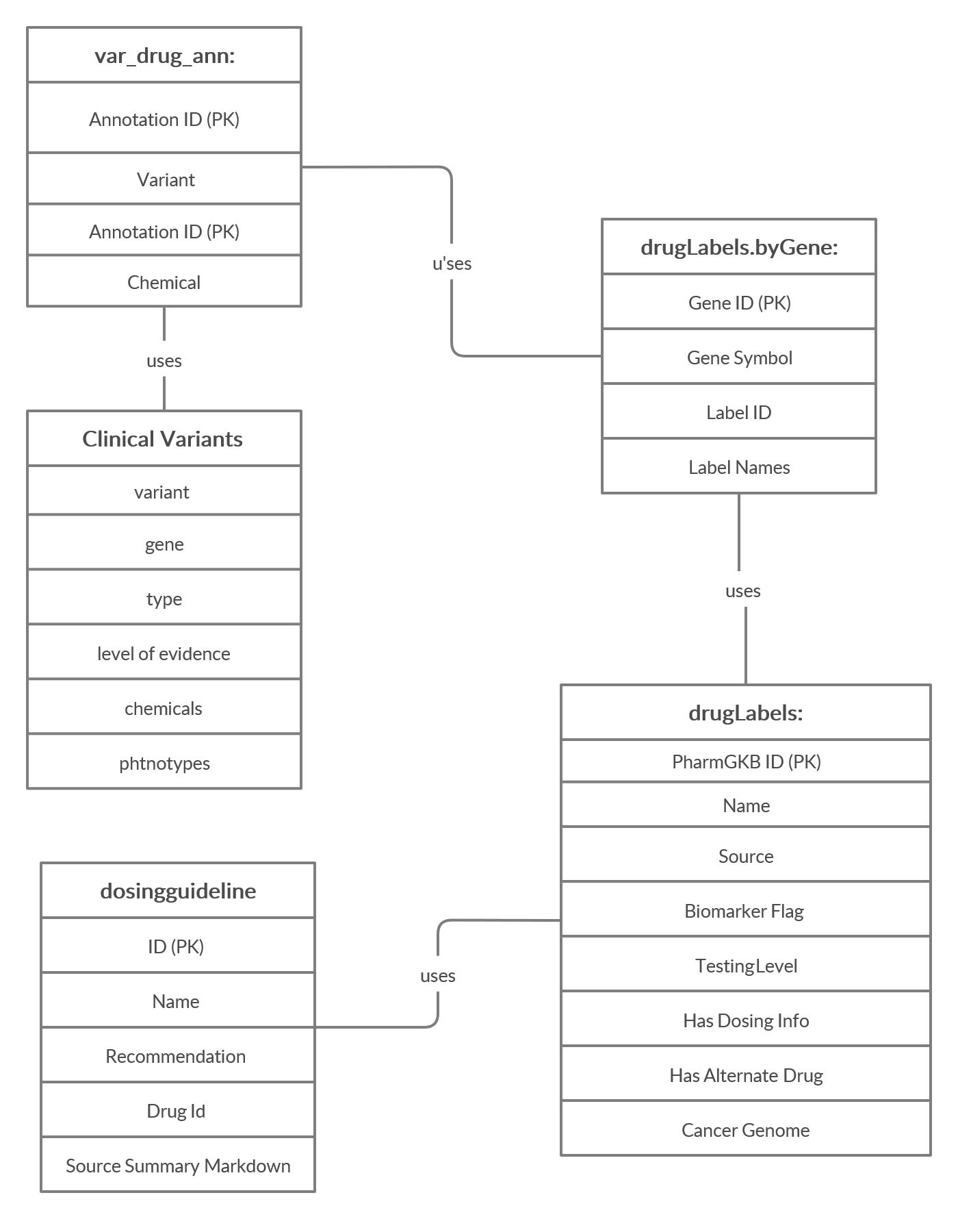
Database structure

Slide 8
Comprehensive tables (clinical & research)
Drugs | VIPs(Very Important Pharmacogenes) or haplotype | Variant and its annotations | Drug label annotations | Strength of Evidence rate
Pathways | VIPs(Very Important Pharmacogenes) or haplotype | Variant and its annotations

Slide 9
Thank you!

