Slide 1
Code review
Group 3
Jianning kang, jiayi dong, Hongbin pan, qile guo, xiao zheng

Slide 2
Introduction
Aim of project:
Developing a user-friendly mutation and drug searching website based on the data collecting from PharmGKB.
Principles：
Maintainability
Modularity
Functionality
Standardability
Security

Slide 3

Group 5

Slide 4
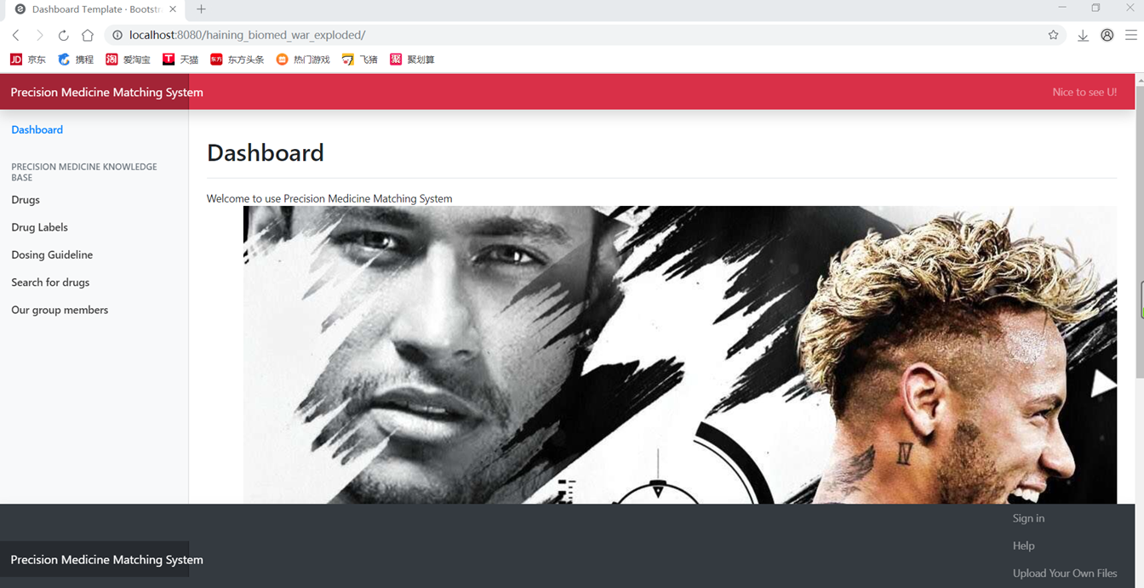
Background of the webpage is unrelated
The homepage background is not related with the dosing guideline
Make the user feeling confusing
functionality
Solution
Change the picture to something about the issue of the website
Add the introduction that explain the relation between picture with website

Slide 5
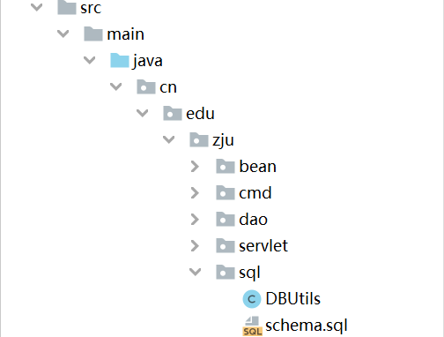
Location of SQL.file
architecture of sql class is not standard standardization
.sql file should be put under the resource directory
or it may cause compiling error
Solution
Put under the resource directory
Maybe better to create another document to illustrate how to run the sql before deploying the website

Slide 6
Group 2

Slide 7
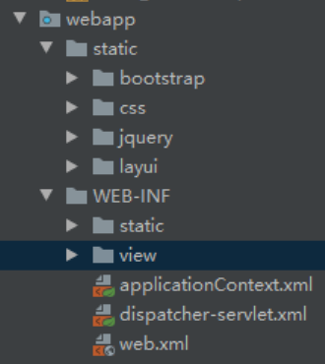
architecture of webapp
architecture of webapp is not standard standardization
bootstrap, css, jquery under static directory is not used
view directory should not be included in WEB-INF directory
static directory in WEB-INF directory is not used
Solution
layui
view
WEB-INF
webapp

Slide 8


Tight coupling
Url & user name & password occur in 2 places Modularity & maintainability
Security
highly coupled
Encapsulate url & username & password in app.properties
Solution
Notes:
3.code redundancy (database)
Modularity
security

