Slide 1
TEsT
Group 3
Jianning kang, jiayi dong, Hongbin pan, qile guo, xiao zheng

Slide 2
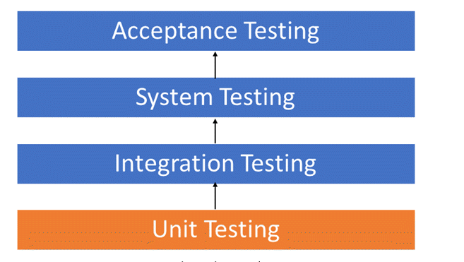
Process of testing

Slide 3
Unit test
What is it?
The test for system with minimum granularity.
Strategy---white box

Slide 4
Unit test --- in spring
Controller:
Model – Controller – User
Monitor HttpRequest → @SpringBootTest, @AutoConfigureMockMvc
DAO & Service
@RunWith, @SpringBootTest
Other components
@JdbcTest
Load classes → @Autowired

Slide 5
integration test
Integration test is defined as a type of testing where software modules are integrated logically and tested as a group. The purpose is to expose defects in the interaction between these software modules when they are integrated. And some functions based on integration modules would be tested.
It focuses mainly on the interfaces and flow of information between the modules. The main strategy is using white(observe all structure of program) and black(input data and only observe result) box method.
Our method of integration test in spring is similar to unit testing. BUT this time, we don't need any mock service, just call API. We should inspect the nodes between modules, and seek the mistake that maybe happen in relation between interface(spring) with database(sql code).

Slide 6

system test
What is it?
The test for system with maximum granularity.
Strategy---black box
The complete simulation of the user’s environment.

