Slide 1
Requirement Analysis
Group 3
Jianning kang, jiayi dong, Hongbin pan, qile guo, xiao zheng

Slide 2
1 introduction
1.1 Purpose
Helping group members and other fellows understand better about task.
1.2 Scope
The website that needs to be developed is called Medguide.
It is purposed by Pro. Xin Chen.
And it is developed by Group 3.
1.3 Definition
VCF: Variant Call Format
ANNOVAR: A mutation caller

Slide 3
2 general description
2.1 Aim
Developing a user-friendly mutation and drug searching website based on the data collecting from PharmGKB.
2.2 User Characteristics
Main users include biomedical researchers and clinical doctors.
Potential users have little knowledge about computer coding and web service.
But have a found knowledge about biomedical, pharmacological or clinical fields.
2.3 General Constraints
No funding
Time limit
Learn from the basic

Slide 4
3 Interface Requirements
Guide well guide the user reach the target quickly
React quickly fluent use flow
Tidy and clear understandability information
Aesthetic beautiful website

Slide 5
3 Interface Requirements
navigation bar
title
Search bar
Database content

Slide 6
4 Functional requirements
Input
User uploads vcf file
Processing
Rank in drug-variant matching (variant number).
If find one drug, search for drugs which treat the similar disease and list.
If variant number is the same, rank in Strength of Evidence rate.
Then list the annotations for drugs, VIPs(Very Important Pharmacogenes) or haplotype and their specific Variant, annotations and Strength of Evidence rate.

Slide 7
4 Functional requirements
Outputs
Result summary page. Client is redirected to this page after loading the vcf file. It returns the result of summary table from database, displaying gene id, drug id, drug label, dosing guideline, etc. For each drug, create a hyperlink targeting to the drug info page.
There are download options, allowing user to download the summary table in .csv format, or the total drug information in .xml format.
Error handling
e.g. User upload file in wrong format, return “file must be in .vcf format”

Slide 8
5 Non-functional Requirements
Performance
Respond to certain users’ actions within 1 min.
Portability
Compatible with widespread browsers, like chrome, firefox and so on.
Reliability
95 percent reliability for a month.
Dynamic:
Data will be updated once a week.
Security
Results will be disposable.

Slide 9
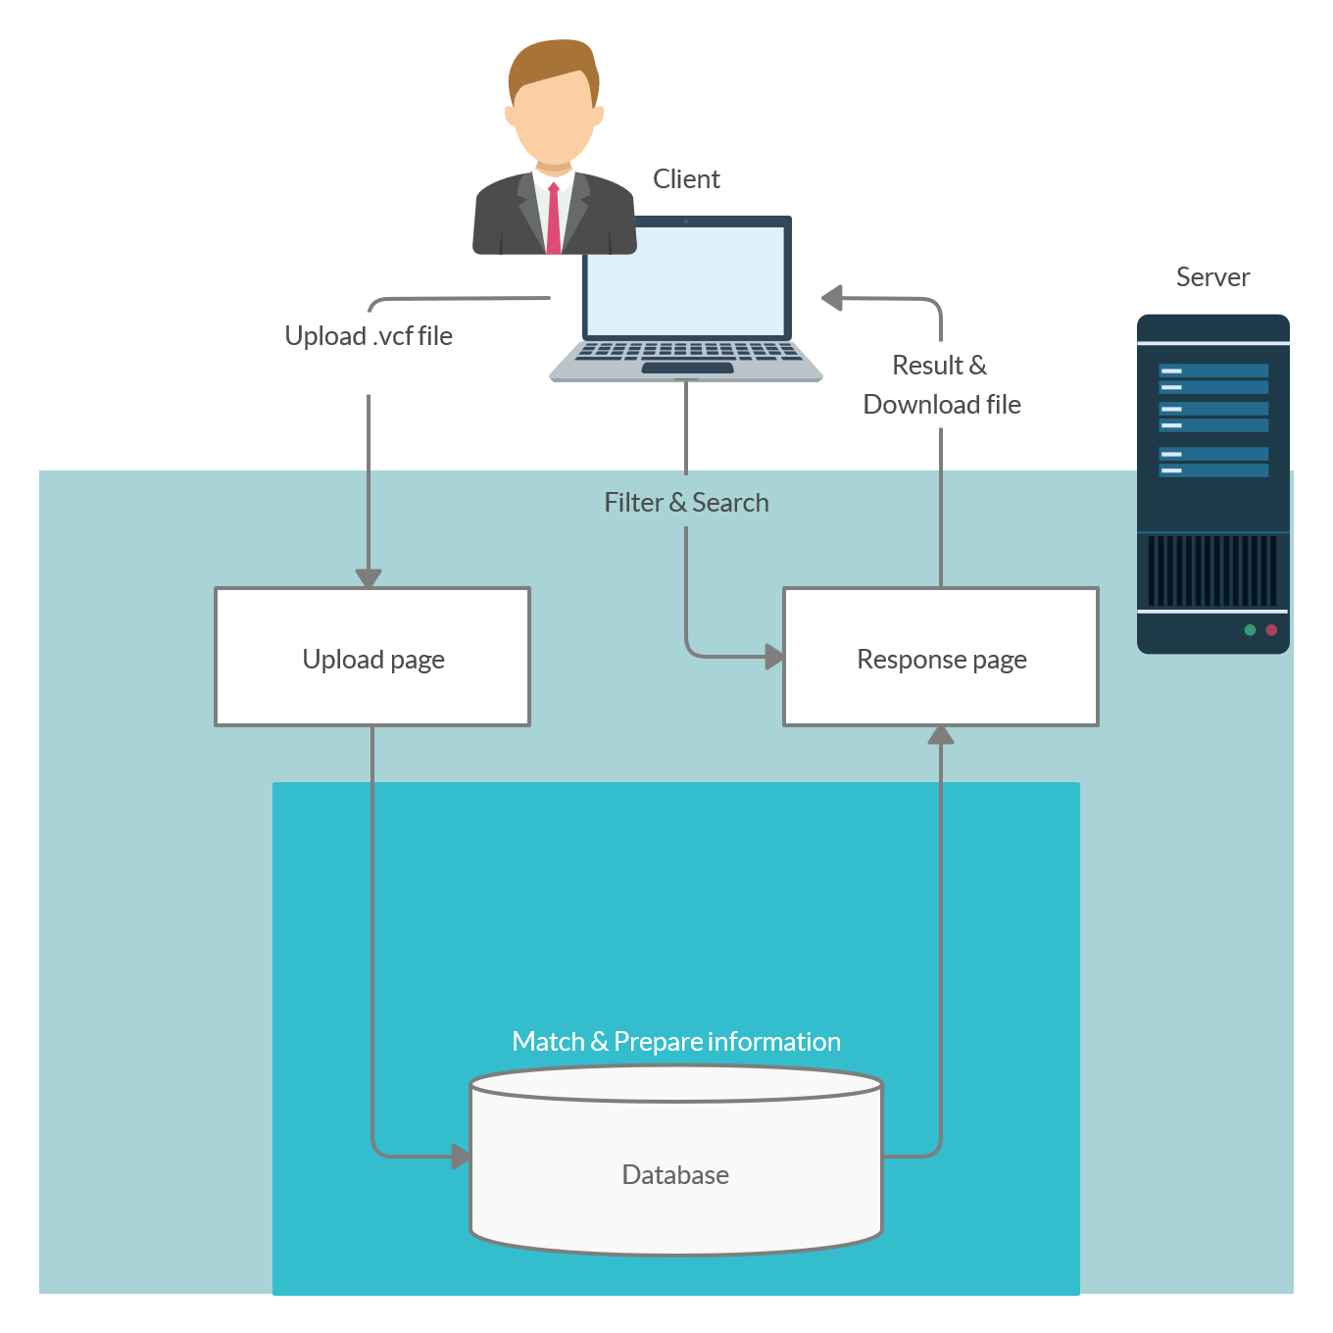
6 Analysis model

Slide 10
Q&A

