Slide 1

Feasibility analysis of a five-point geometric calibration approach
05/08/2026

Slide 2
The current acquisition process captures approximately 140 images in 12 minutes. At every spatial position, the device performs a complete autofocus search before capturing the image.
Target
≥500 images without a proportional increase in acquisition time
Can we estimate the focus surface once and reuse it across the cartridge?
The main limitation is not image capture itself. The device moves to each position, performs a complete autofocus search and then captures the image. If we increase the number of images from 140 to 500, the number of autofocus operations, and therefore the acquisition time, also increases substantially.

Slide 3
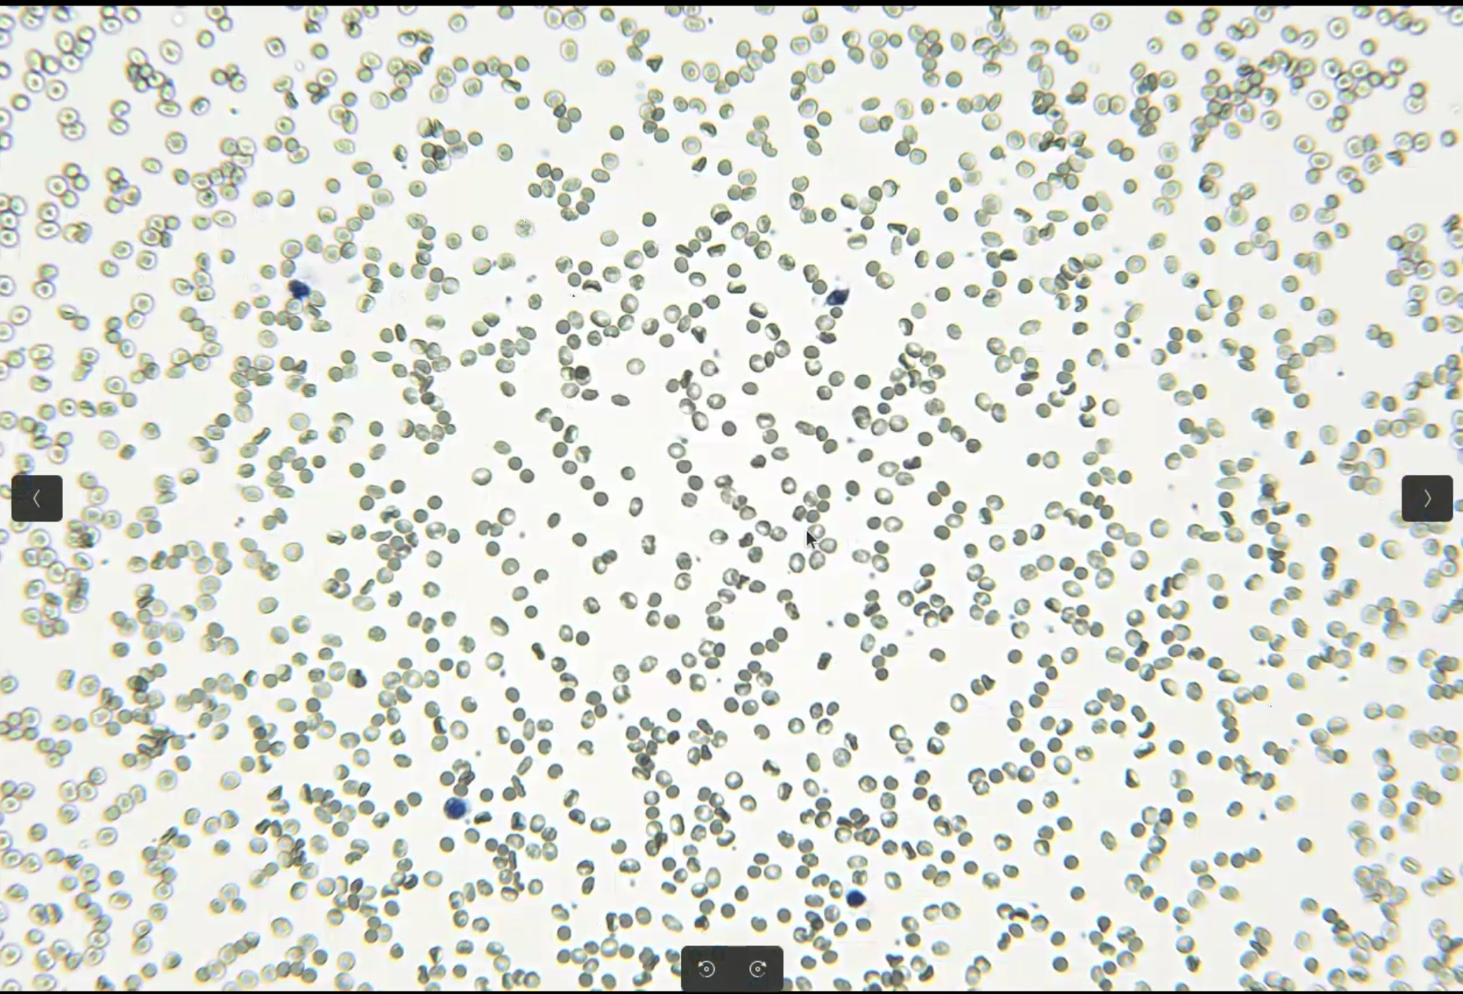
Approach 1 — Five-Point Focus Calibration
Main information
images_collection_15/20812/input_images/CAP-10102025-130010-x30900-y16600-z2878-fm119_84.jpg
We selected 10 batches from each of Collections 4–15, yielding 120 batches in total.
Collections | # of images
4 | 1400
5 | 1400
6 | 1266
7 | 1400
8 | 1390
9 | 1400
10 | 1400
11 | 1400
12 | 1400
13 | 1400
14 | 1400
15 | 1400

Slide 4
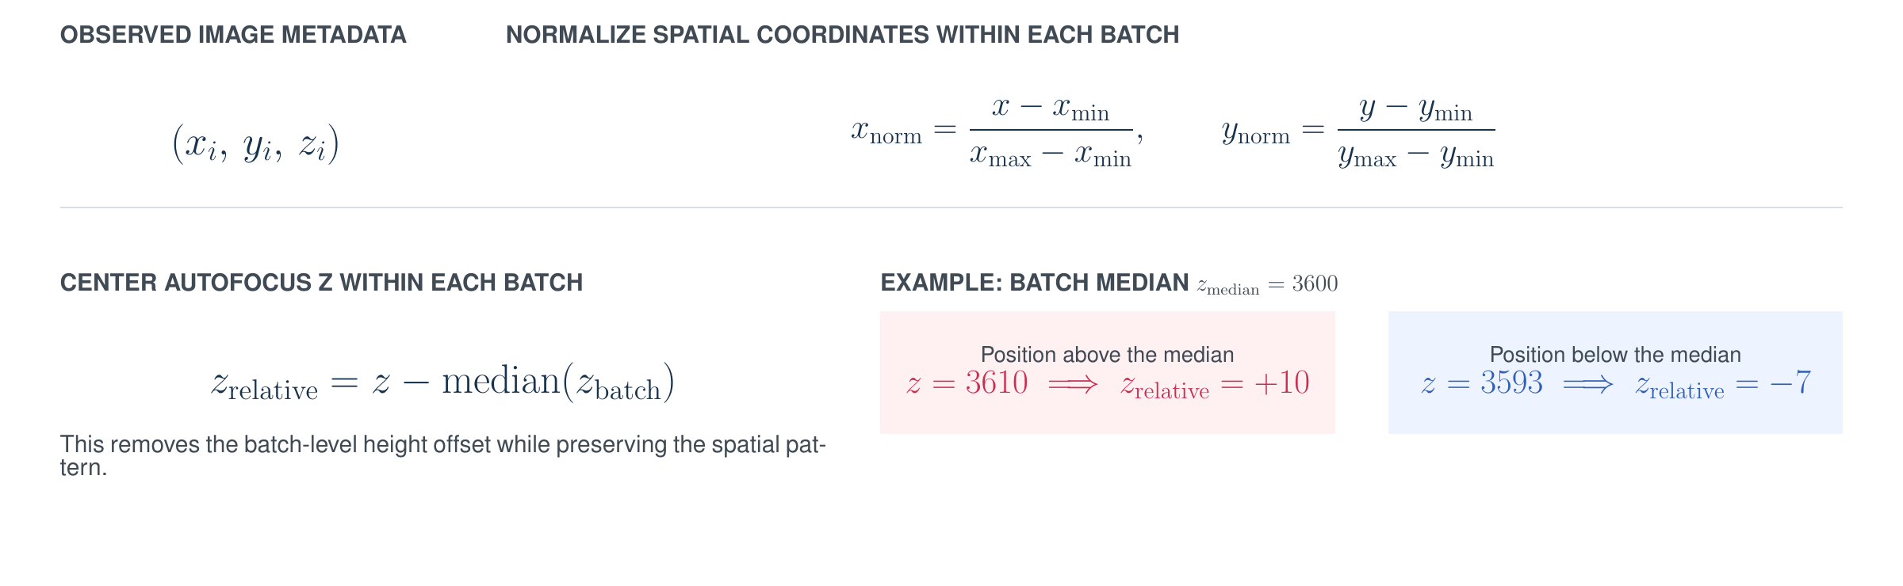
Approach 1 — Five-Point Focus Calibration

Slide 5
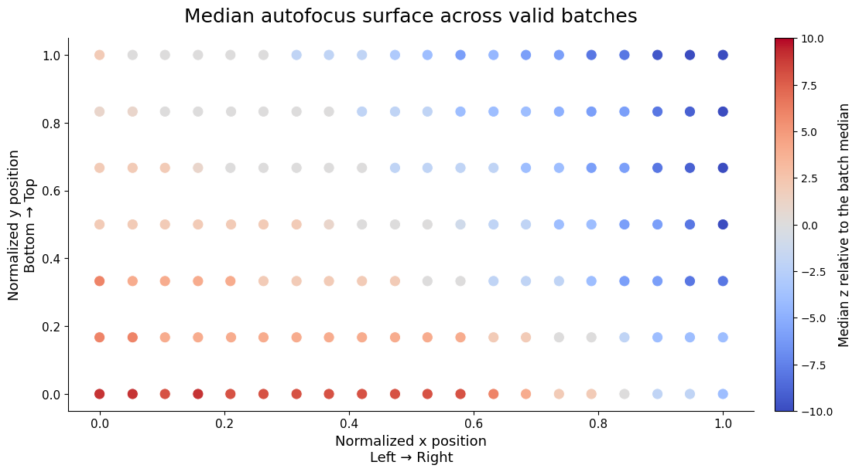
Approach 1 — Five-Point Focus Calibration

Slide 6
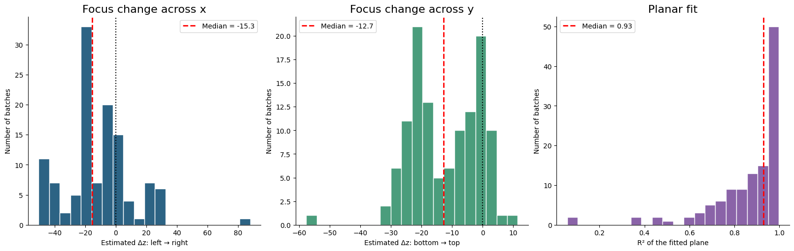
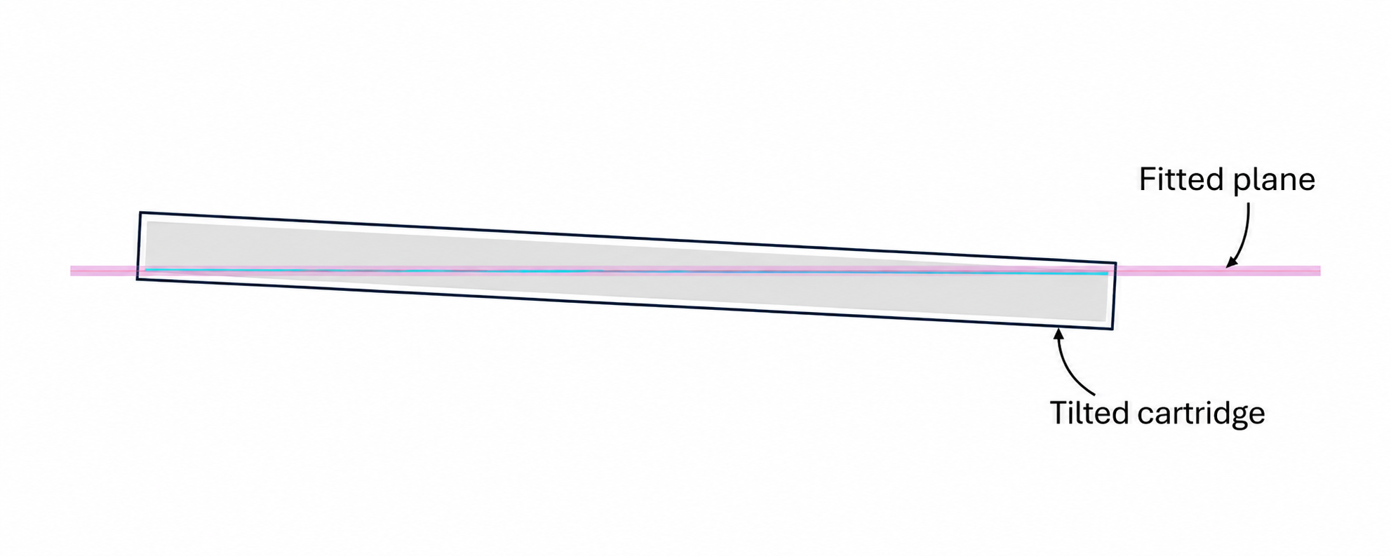
Approach 1 — Five-Point Focus Calibration

Slide 7
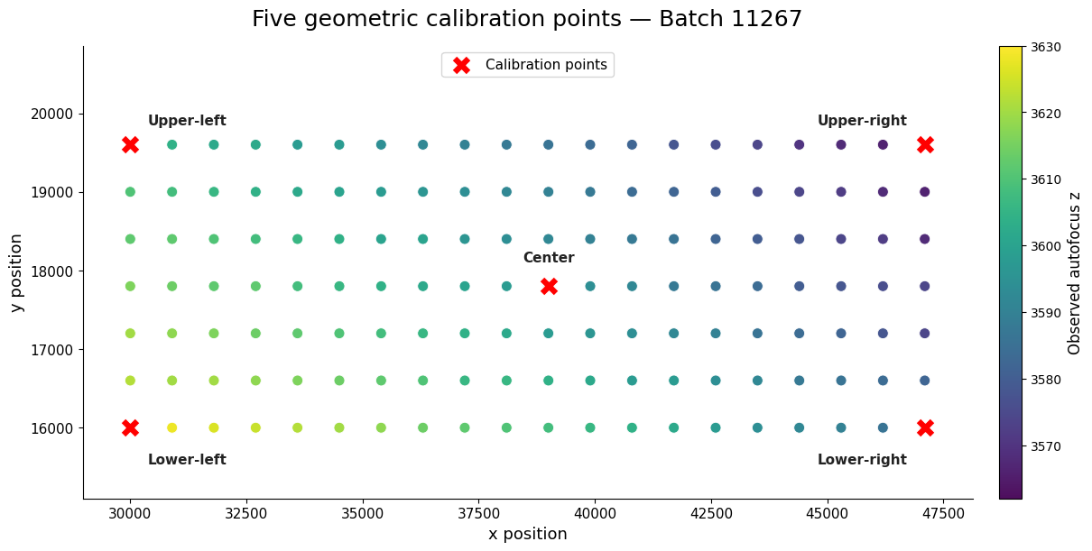
Approach 1 — Five-Point Focus Calibration
Because the autofocus surface is approximately planar, we next test whether five autofocus measurements are sufficient to estimate a batch-specific focus plane.

Slide 8
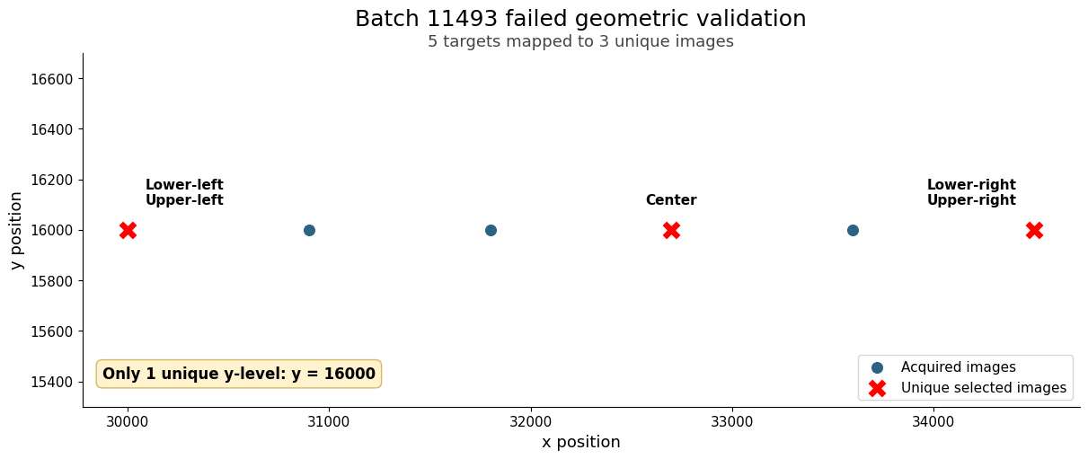
Approach 1 — Five-Point Focus Calibration
collection | batch_id | n_images | unique_x | unique_y | xmin | xmax | ymin | ymax
6 | 11493 | 6 | 6 | 1 | 30000 | 34499 | 16000 | 16000

Slide 9
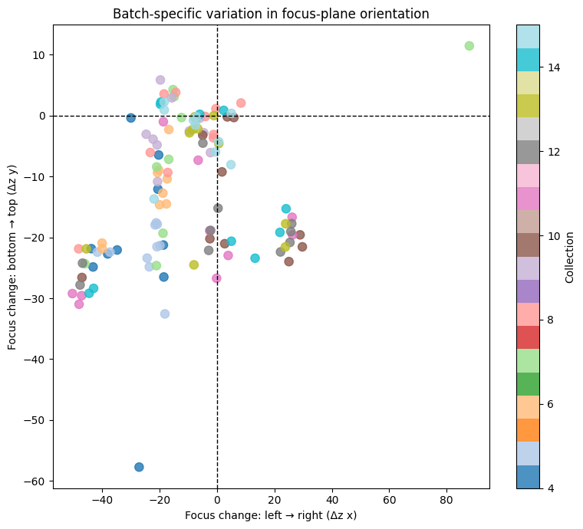
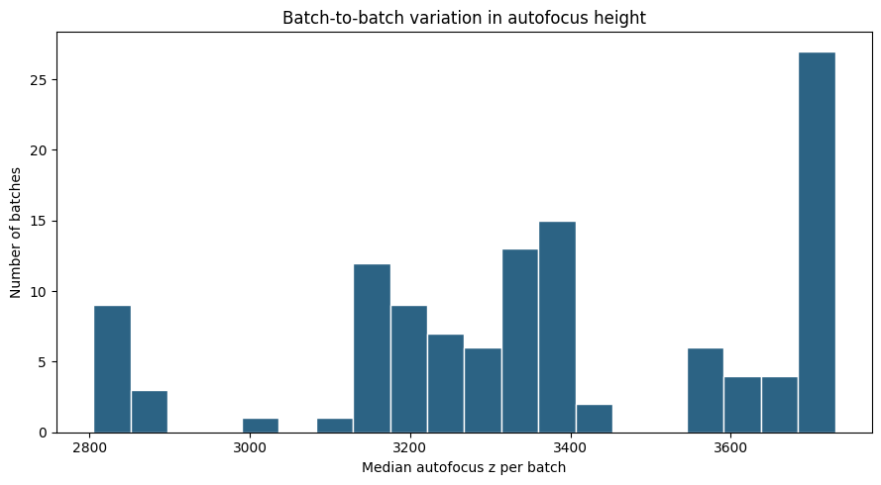
Focus-plane parameters vary across batches

Slide 10
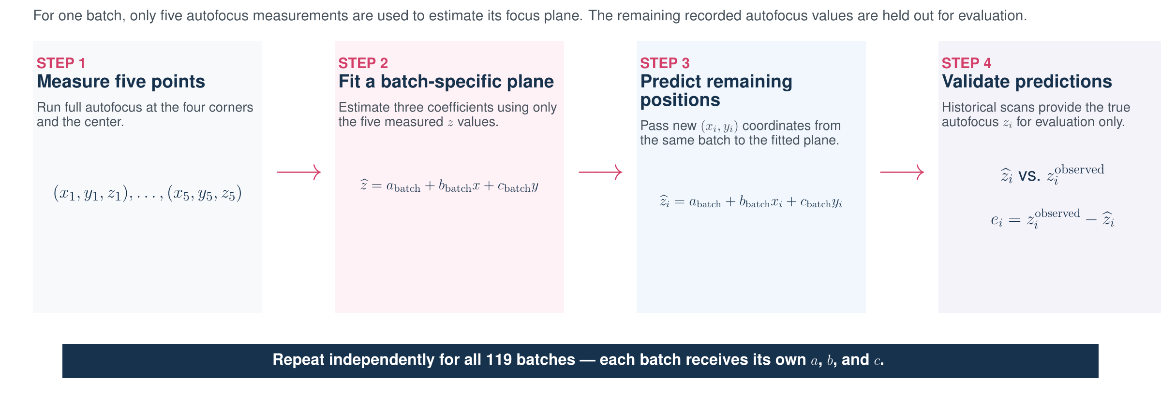
Approach 1 — Five-Point Focus Calibration

Slide 11
Approach 1 — Five-Point Focus Calibration
Five-Point Plane Prediction — 119 Valid Batches
Metric | Median | Mean
MAE | 1.56 z | 1.78 z
RMSE | 1.98 z | 2.18 z
P95 absolute error | 3.83 z | 4.11 z
Maximum error | 5.05 z | 5.63 z
R² | 0.887 | 0.780
A batch-specific plane fitted from only five autofocus measurements predicts the remaining positions with a median absolute error of 1.56 z-units.

Slide 12
Approach 1 — Five-Point Focus Calibration
Prediction Accuracy by Autofocus Tolerance
Allowed error | Predictions within tolerance
±1 z | 39.3%
±2 z | 66.6%
±3 z | 82.5%
±4 z | 90.7%
±5 z | 95.4%
±6 z | 97.5%
±10 z | 99.8%
The practical relevance of ±5 z-units must be validated against image quality.
Z_real​=3600, Z_predicted = 3603, |3600 – 3603| = 3 z-units
1 z-unit = ? μm

Slide 13
Collections
A planar approximation is a good baseline, but it is not sufficiently expressive for a ±3 z-unit requirement. But, Later collections show better agreement with the planar approximation.
Collection | Median within ±3
4 | 65.2%
5 | 55.6%
6 | 71.1%
7 | 84.4%
8 | 93.1%
11 | 93.0%
13 | 94.4%
14 | 99.6%
15 | 95.6%

Slide 14
Next steps
All points (140)
Model | Mean MAE | Mean P95 | Median ±3 | Mean ±3
Plane | 1.48 | 3.47 | 95.0% | 88.24%
Bilinear | 1.45 | 3.40 | 95.0% | 89.08%
Quadratic | 0.97 | 2.35 | 99.29% | 95.78%
Therefore, five autofocus measurements are not sufficient to independently estimate all six parameters.
Mathematically, at least six well-positioned calibration points are required. From an engineering perspective, we would test seven and nine points to provide additional redundancy and robustness.

Slide 15
Next steps
7 or 9 autofocus points​→Fit quadratic​→Predict remaining 133/131​→Compare with observed z
Calibration | Model | Mean MAE | Mean P95 | Within ±3
5 points | Plane | 1.78 | 4.11 | 82.45%
7 points | Quadratic | 1.34 | 3.56 | 90.19%
9 points | Quadratic | 1.20 | 3.15 | 92.39%
All points | Quadratic Oracle | 0.97 | 2.35 | 95.78%

Slide 16
Next steps
Collection | Mean ±3 | Median ±3 | Min ±3
4 | 86.3% | 94.3% | 61.1%
5 | 80.9% | 77.9% | 69.5%
6 | 93.3% | 98.5% | 84.0%
7 | 92.3% | 98.1% | 65.6%
8 | 98.0% | 99.6% | 92.4%
9 | 95.0% | 95.4% | 85.5%
10 | 94.9% | 96.6% | 87.8%
11 | 96.3% | 99.6% | 72.5%
12 | 84.6% | 82.1% | 70.2%
13 | 96.0% | 99.2% | 81.7%
14 | 95.8% | 100% | 74.0%
15 | 95.4% | 98.1% | 74.0%

Slide 17
Next steps
Increase the number of points
Batch | 9 points | Oracle | Gap
12811 | 65.6% | 94.3% | +28.6
12517 | 75.6% | 97.1% | +21.6
11164 | 61.1% | 82.1% | +21.1
18540 | 71.8% | 92.1% | +20.4
20250 | 74.0% | 92.9% | +18.8

Slide 18
Next steps
Increase the number of points (NOT ENOUGH, THE STRUCTURE IS DIFFERNTE)
Batch | 9 points | Oracle
11242 | 61.1% | 57.9%
20926 | 74.0% | 72.9%
11375 | 77.1% | 73.6%
11352 | 77.9% | 77.9%
11342 | 81.7% | 81.4%
failure_type | count
Target achieved | 71
Surface/data-limited | 31
Calibration-limited | 17

Slide 19
Next steps
failure_type | count
Target achieved | 71
Surface/data-limited | 31
Calibration-limited | 17
collection | Calibration-limited | Surface/data-limited | Target achieved
4 | 2 | 4 | 4
5 | 0 | 8 | 2
6 | 1 | 3 | 5
7 | 2 | 1 | 7
8 | 1 | 1 | 8
9 | 2 | 2 | 6
10 | 4 | 0 | 6
11 | 1 | 1 | 8
12 | 1 | 7 | 2
13 | 1 | 1 | 8
14 | 0 | 2 | 8
15 | 2 | 1 | 7

Slide 20
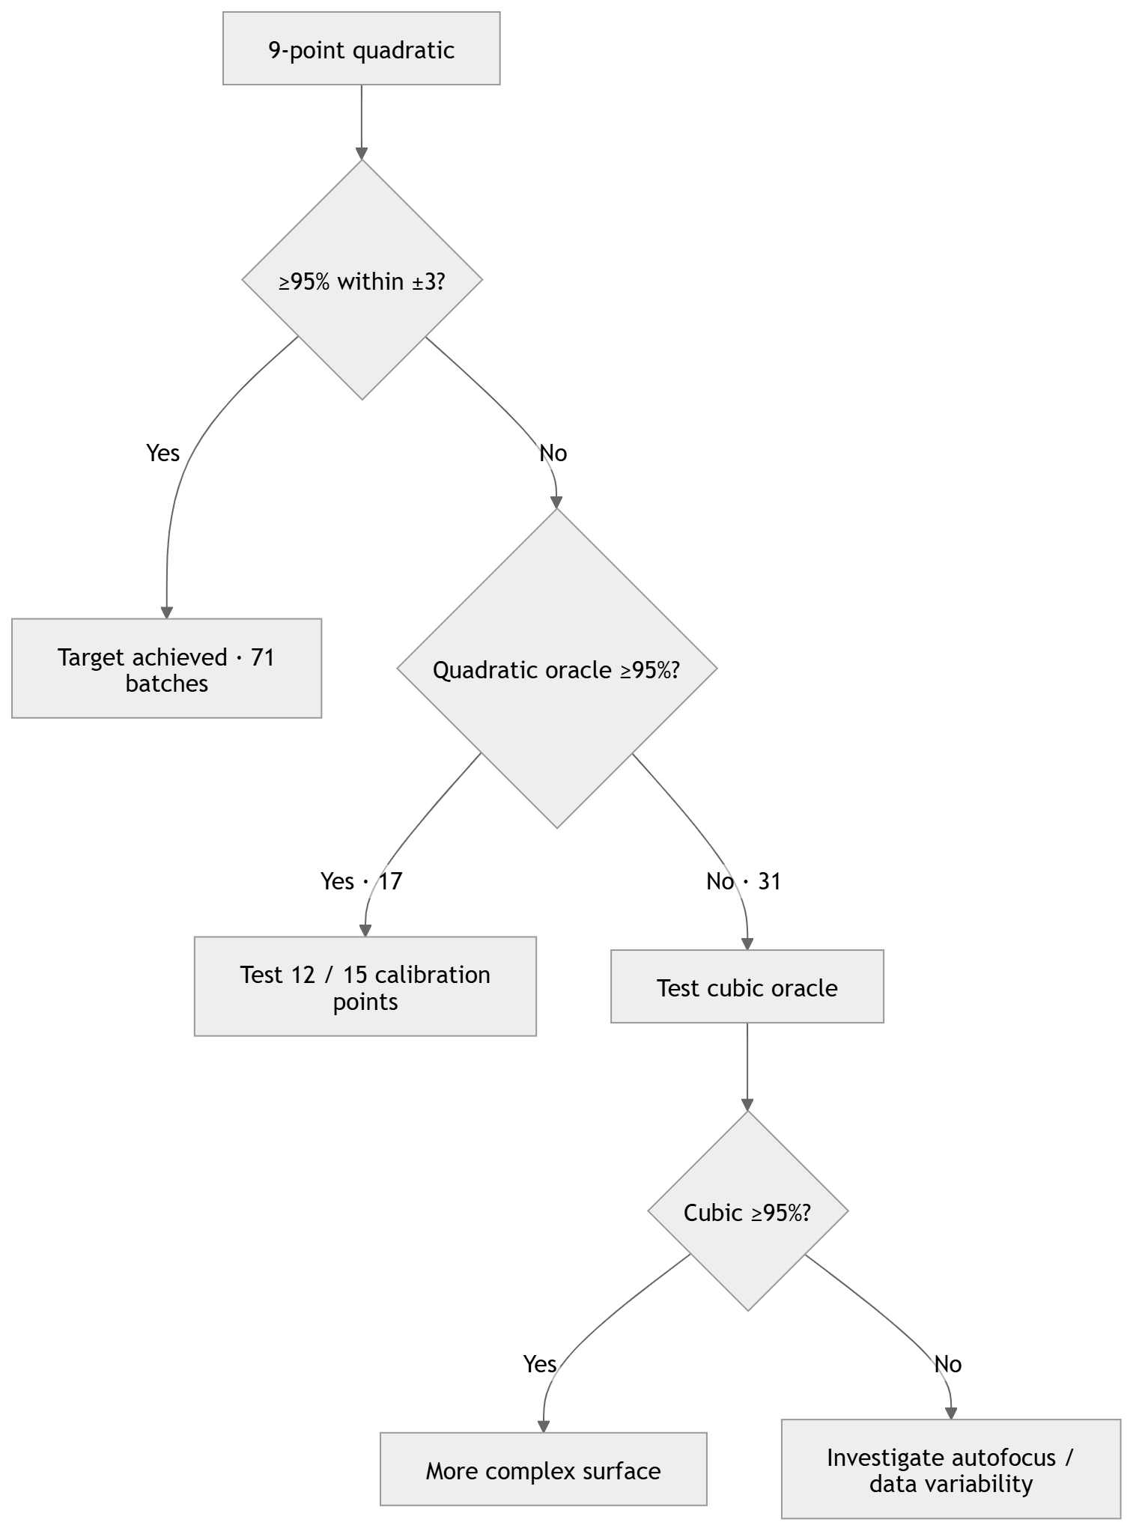
Next steps

Slide 21
Next steps
Prediction accuracy depends not only on the number of calibration points, but also on their spatial distribution. Greater coverage along the y-axis consistently improved performance.
Calibration layout | Autofocus points | Mean within ±3 | Median within ±3 | Batches ≥95%
3×3 | 9 | — | — | 0 / 17
4×3 | 12 | 92.33% | 92.97% | 2 / 17
3×4 | 12 | 93.66% | 94.53% | 7 / 17
5×3 | 15 | 91.81% | 94.40% | 4 / 17
3×5 | 15 | 94.31% | 94.40% | 7 / 17
4×4 | 16 | 93.45% | 94.35% | 8 / 17
5×5 | 25 | 94.99% | 95.65% | 9 / 17
Full-data quadratic | ~140 | ≥95%* | ≥95%* | 17 / 17

Slide 22
Next steps
Strategy | Calibration | Mean MAE | P95 | Overall ±3 | Median batch ±3
Plane | 5 points | 1.78 | 4.11 | 82.45% | 88.15%
Quadratic | 9 points | 1.20 | 3.15 | 92.39% | 97.71%
Quadratic | 25 points | 1.05 | 2.67 | 94.68% | 99.13%
Quadratic Oracle | ~140 | 0.97 | 2.35 | ~95.78% | 99.29%

Slide 23
Next steps
$$\boxed{9/12 \text{collections} \text{have} \text{mean} \text{performance} >95\%}$$
Collection | Mean ±3
4 | 88.96%
5 | 84.78%
6 | 95.46%
7 | 98.26%
8 | 98.35%
9 | 96.61%
10 | 96.00%
11 | 97.22%
12 | 88.61%
13 | 97.57%
14 | 98.00%
15 | 96.52%

Slide 24
Next steps
Tolerance | Accuracy
±1 | 61.37%
±2 | 86.98%
±3 | 94.68%
±4 | 97.63%
±5 | 98.83%
±6 | 99.38%
±10 | 100%

Slide 25
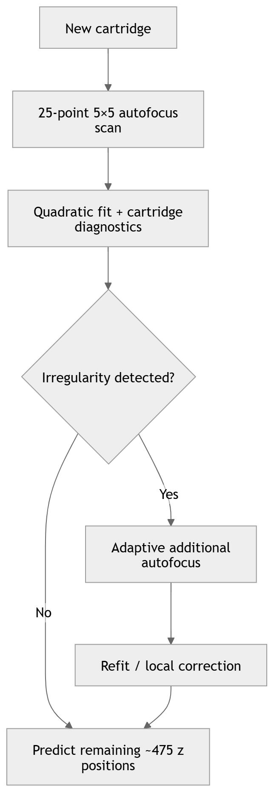
Next steps

Slide 26
Next steps
Is quadratic curvature sufficient?
Evaluated on the 31 batches that failed the quadratic-oracle target.
Model | Points used | Mean within ±3 | Median within ±3 | Mean MAE | Batches ≥95%
Quadratic oracle | ~140 | 85.53% | 88.57% | 1.65 | 0 / 31
Cubic oracle | ~140 | 91.75% | 94.29% | 1.29 | 12 / 31
Higher-order curvature explains a subset of the difficult batches: cubic modelling recovered 12 of 31 quadratic failures. However, 19 batches remain below target even with a full-data cubic fit, suggesting local surface irregularities, autofocus variability, or measurement noise beyond smooth geometric curvature.

