Slide 1
Agenda
Introduction and Welcome to Pedro
Calibration status (Martin/Oksana)
V7 Renovation – Data Storage (Open Discussion) - 1) whether or not we have any labelling coming up (and data to support it) and 2) whether the labelled data in V7 platform is backed up anywhere
Focal Sensitivity Analysis — Edison
Variance Analysis — Santiago
Recalibration Update — Mario
Additional Updates and Discussion — Abi and Oksana

Slide 2
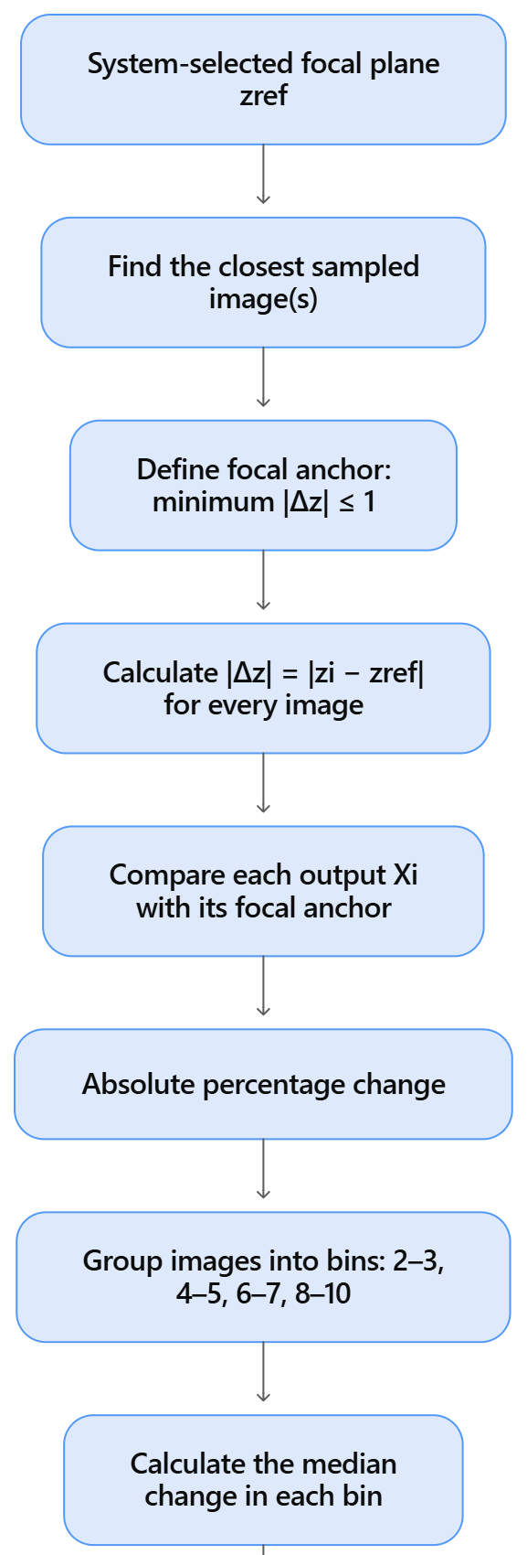
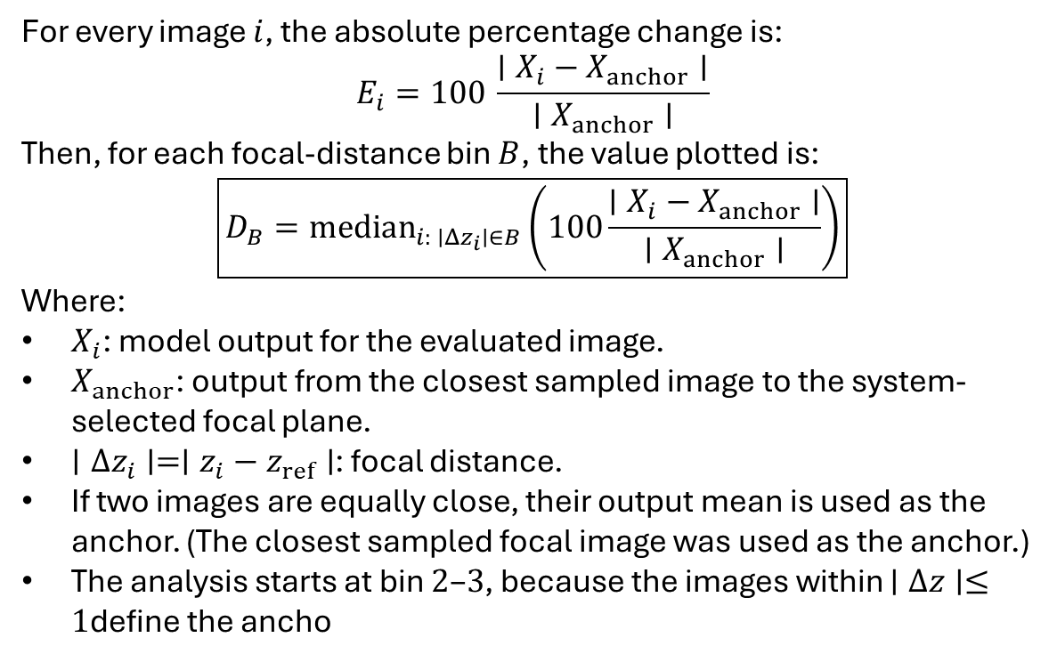
Focal Degradation Analysis
For every image $i$, the absolute percentage change is:
$$E_{i}=100 \frac{∣X_{i}−X_{anchor}∣}{∣X_{anchor}∣}$$
Then, for each focal-distance bin $B$, the value plotted is:
$$\boxed{D_{B}={median}_{i: ∣Δz_{i}∣∈B}\left(100\frac{∣X_{i}−X_{anchor}∣}{∣X_{anchor}∣}\right)}$$
Where:
$X_{i}$: model output for the evaluated image.
$X_{anchor}$: output from the closest sampled image to the system-selected focal plane.
$∣Δz_{i}∣=∣z_{i}−z_{ref}∣$: focal distance.
If two images are equally close, their output mean is used as the anchor. (The closest sampled focal image was used as the anchor.)
The analysis starts at bin $2\text{–}3$, because the images within $∣Δz∣≤1$define the ancho

Slide 3
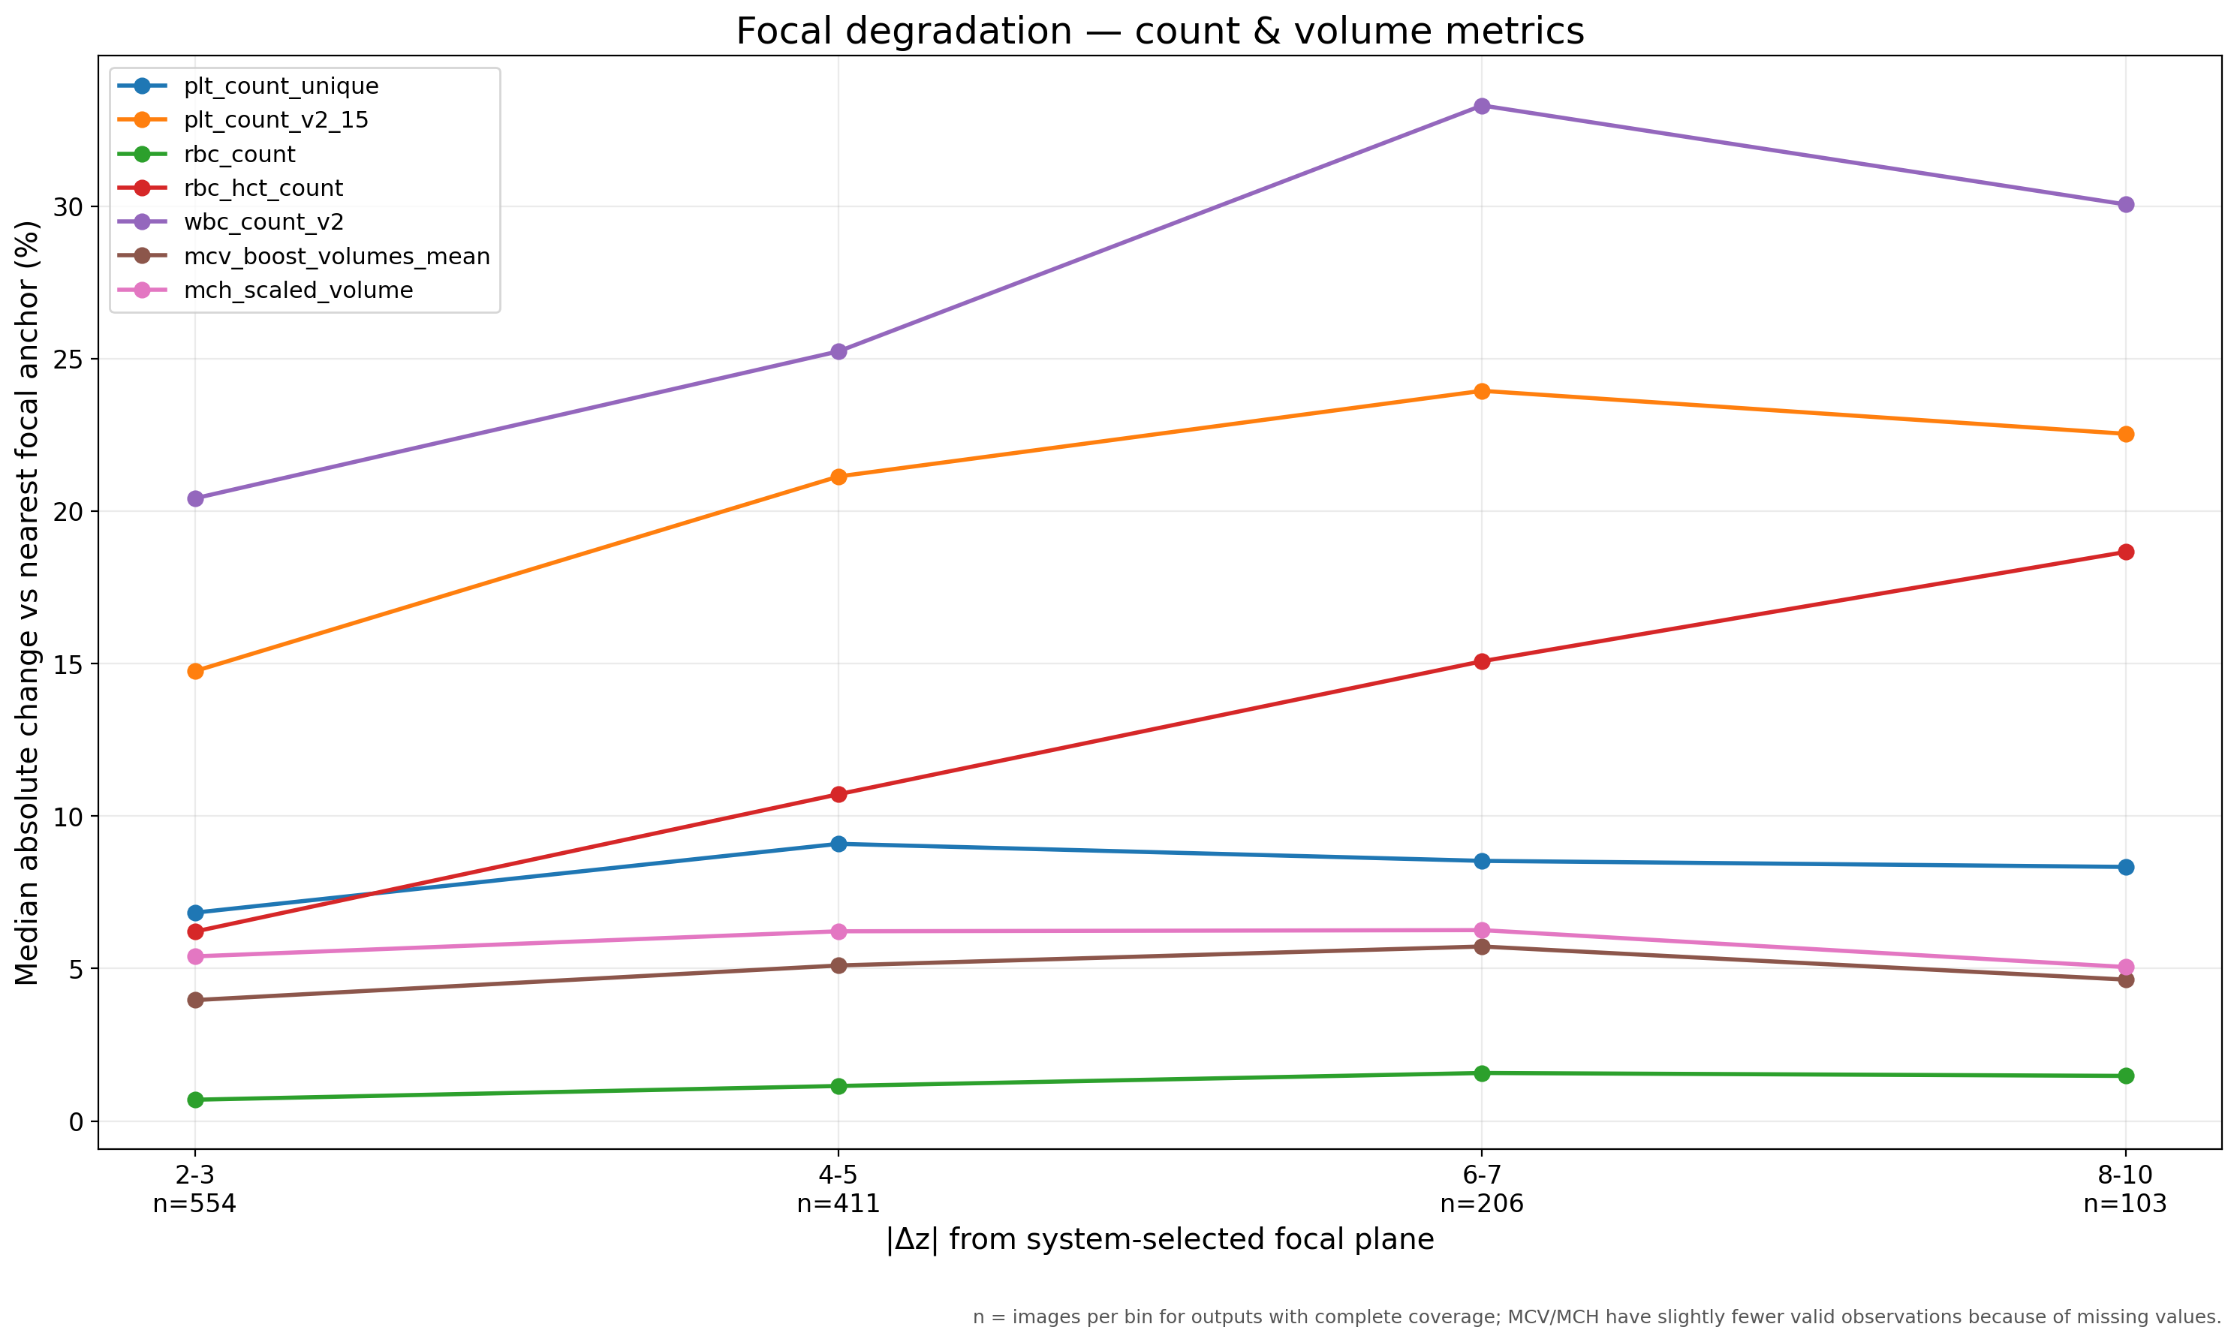
The graph measures the magnitude of the change, not whether the output increased or decreased.

Slide 4
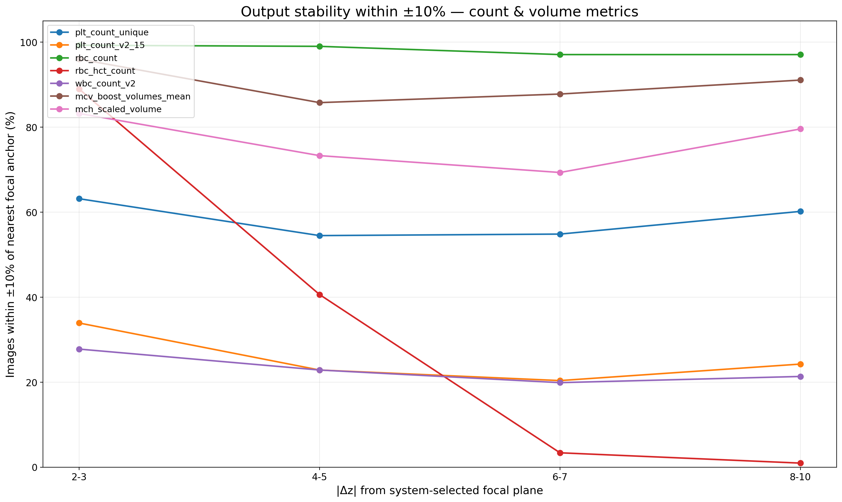
Proportion of images whose output stays within ±10% of the in-focus anchor as the image moves away from the system-selected focal plane.

Slide 5
Output | Median | Within ±10% | Outside ±10% | Interpretation
PLT raw | 8.3% | 60.2% | 39.8% | Low median, moderate stability: close to the threshold, but with wide spread.
PLT v2.15 | 22.5% | 24.3% | 75.7% | High median, low stability: degradation across the board.
RBC | 1.5% | 97.1% | 2.9% | Low median, high stability: genuinely robust.
HCT | 18.7% | 1.0% | 99.0% | High median, extremely low stability: degradation is essentially systematic.
WBC v2 | 30.1% | 21.4% | 78.6% | High median, low stability: degradation across the board.
MCV boost mean | 4.7% | 91.2% | 8.8% | Low median, high stability: robust behaviour.
MCH scaled volume | 5.1% | 79.0% | 21.0% | Low median, moderate stability: typically stable, but with a problematic tail.
Low median + high stability — robust: defocus barely moves the output. RBC, MCV boost mean.
Low median + moderate stability — typically fine, with a tail of unstable cases. MCH scaled volume, PLT raw.
High median + low stability — widespread degradation: the error is both large and scattered. WBC v2, PLT v2.15.
High median + near-zero stability — systematic drift: the output moves in one direction with defocus, so almost every image clears the threshold. HCT.

