Slide 1
Customer Flight Booking Prediction

Slide 2
Objective:
To predict whether customers will book a flight based on historical booking data using a Random Forest Classifier.
Dataset:Total Records: 16,500
Class Distribution:
Will Not Book (0): 14,042 instances (approx. 85%)
Will Book (1): 2,458 instances (approx. 15%)

Slide 3
Random Forest Classifier Results:
Overall Accuracy: 85%
Precision:
Class 0 (Will Not Book): 86%
Class 1 (Will Book): 48%
Recall:
Class 0 (Will Not Book): 98%
Class 1 (Will Book): 9%
F1-Score:
Class 0 (Will Not Book): 92%
Class 1 (Will Book): 15%

Slide 4
Key Insights:
High accuracy (85%) in predicting whether a customer will not book, but low recall for bookings (Class 1), indicating that many potential bookings are being missed by the model.
Class imbalance is affecting performance, as the majority of the data (85%) belongs to the "Will Not Book" class.
Recall for Class 1 (Will Book) is only 9%, showing that the model struggles to identify customers who are likely to book.

Slide 5
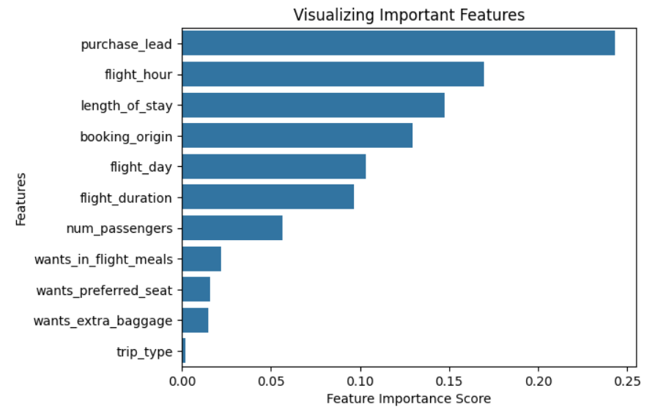
Important Features

Slide 6
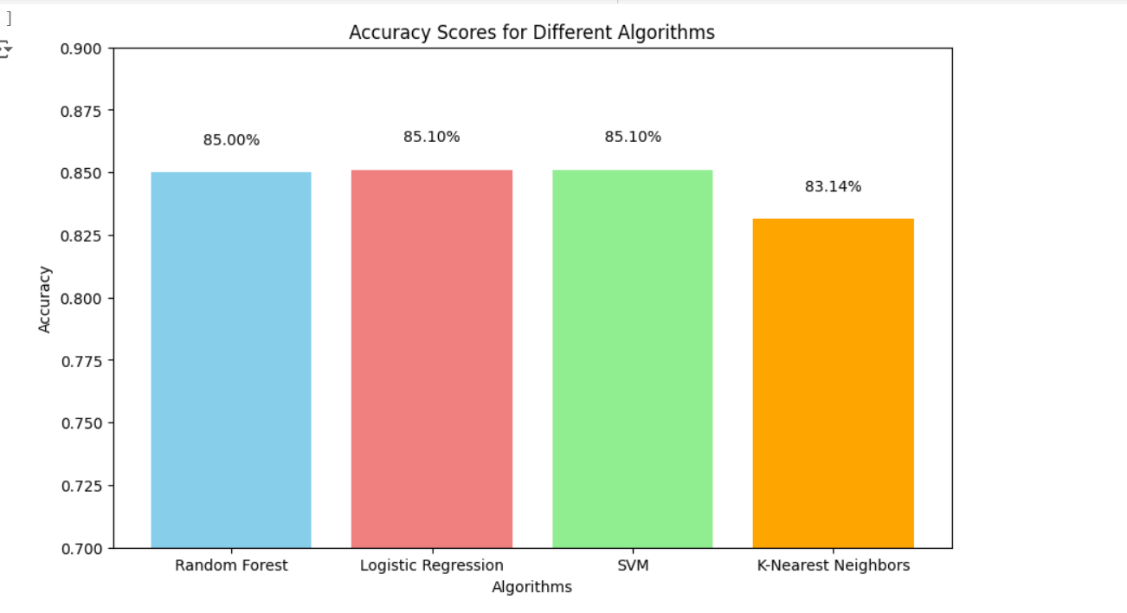
Accuracy score

