Slide 1
Sentiment Analysis Results of Customer Reviews

Slide 2
1. Key Metrics:
Overall Accuracy: 88%
Negative Sentiment:
Precision: 0.90
Recall: 0.96
F1-Score: 0.93
Positive Sentiment:
Precision: 0.76
Recall: 0.51
F1-Score: 0.61
Support (Number of Reviews):
Negative: 515
Positive: 115

Slide 3
2. Insights:
Performance Overview:
The model performs well overall with an 88% accuracy.
The negative class is detected with high precision and recall (90% precision, 96% recall).
The positive class has a lower recall (51%), meaning many positive reviews are misclassified as negative.
Class Imbalance:
There's a significant imbalance between negative (515) and positive (115) reviews, which may explain the lower performance in detecting positive reviews.

Slide 4
3. Recommendations:
Consider balancing the dataset (oversampling the positive class or undersampling the negative class) to improve model performance.
Fine-tune a transformer model to improve accuracy on the positive class or experiment with class-specific thresholds for improving recall.

Slide 5
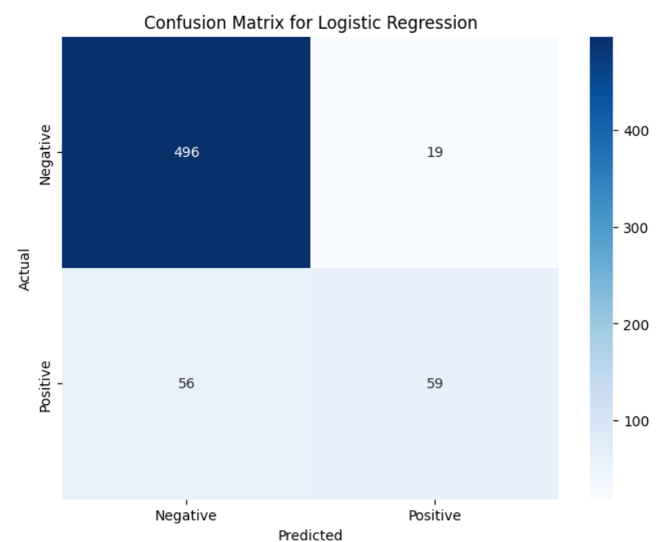
Confusion Matrix

Slide 6
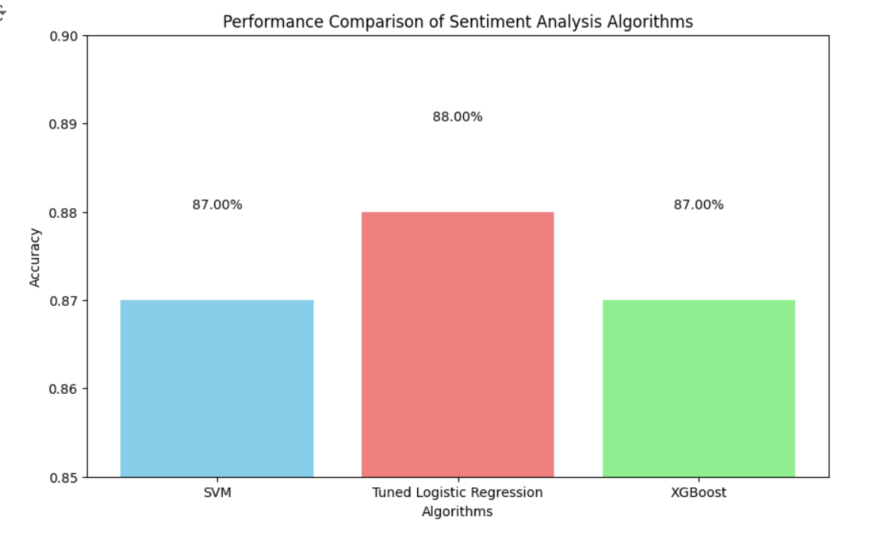
Performance Analysis

Slide 7
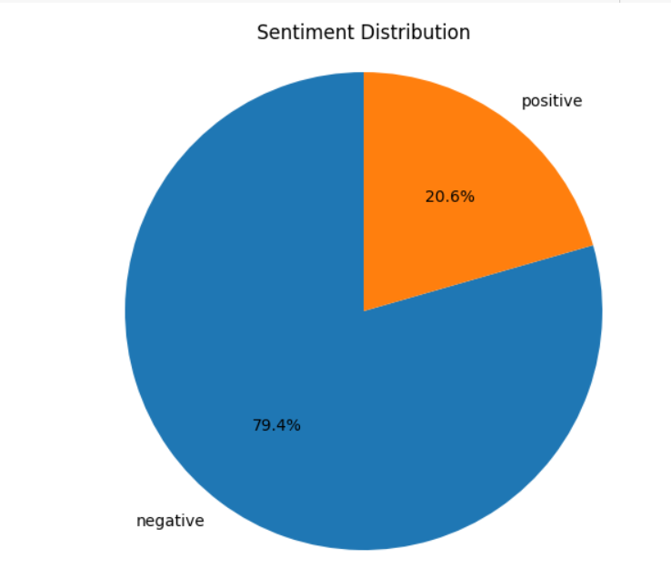
Class Distribution

Slide 8
Updated Sentiment Analysis Results of Customer Reviews
Key Metrics:
Overall Accuracy: 83%
Negative Sentiment:
Precision: 0.86
Recall: 0.79
F1-Score: 0.82
Support: 128 reviews
Positive Sentiment:
Precision: 0.81
Recall: 0.88
F1-Score: 0.84
Support: 131 reviews

Slide 9
Insights
Performance Overview:
After applying undersampling, the model's performance is more balanced with an accuracy of 83%.
The positive class shows improvement in recall, increasing from 51% to 88%, indicating better detection of positive reviews.
The negative class also maintains strong performance, though with a slight drop in recall.
Balanced Class Representation:
The undersampling technique has effectively balanced the number of positive (131) and negative (128) reviews, improving the model's overall performance in both classes.

Slide 10
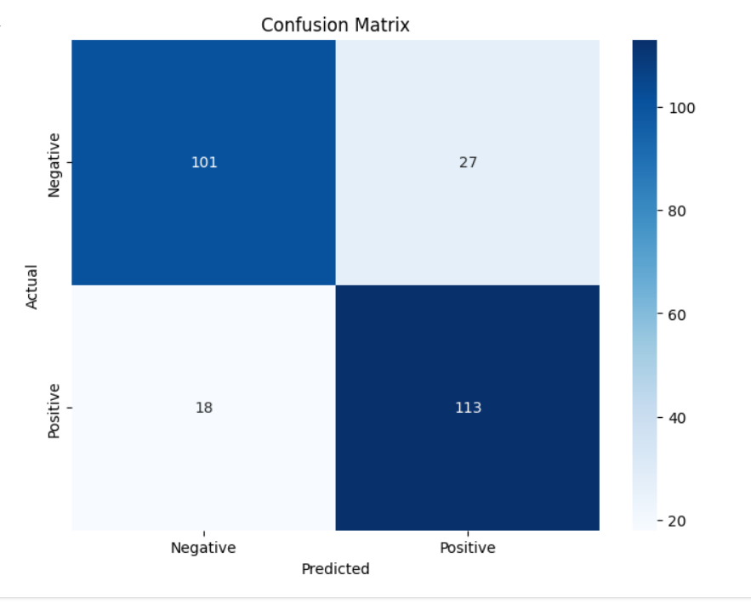
Confusion Matrix

Slide 11
Recommendations
With balanced data, the model shows good performance in both sentiment classes.
Future steps could involve further experimentation with advanced models like transformers or ensemble techniques to improve accuracy beyond 83%.

