Slide 1


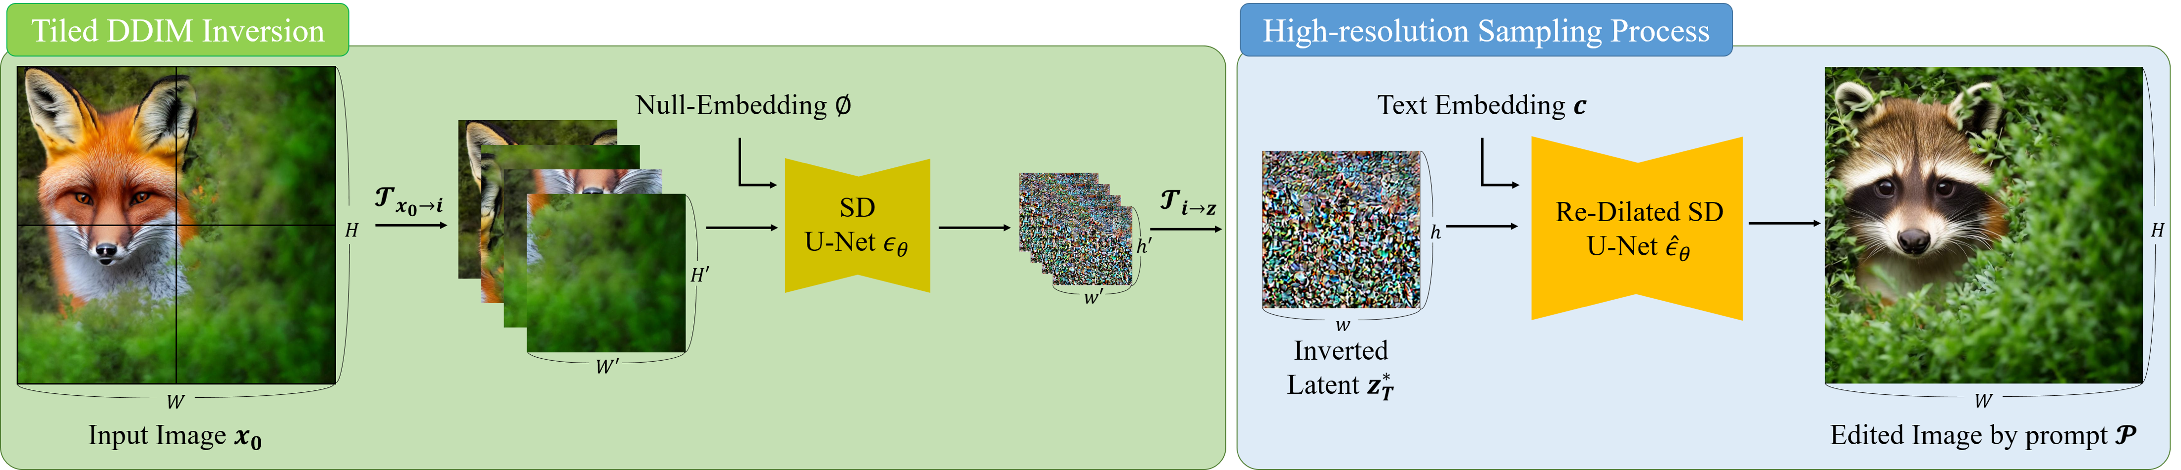
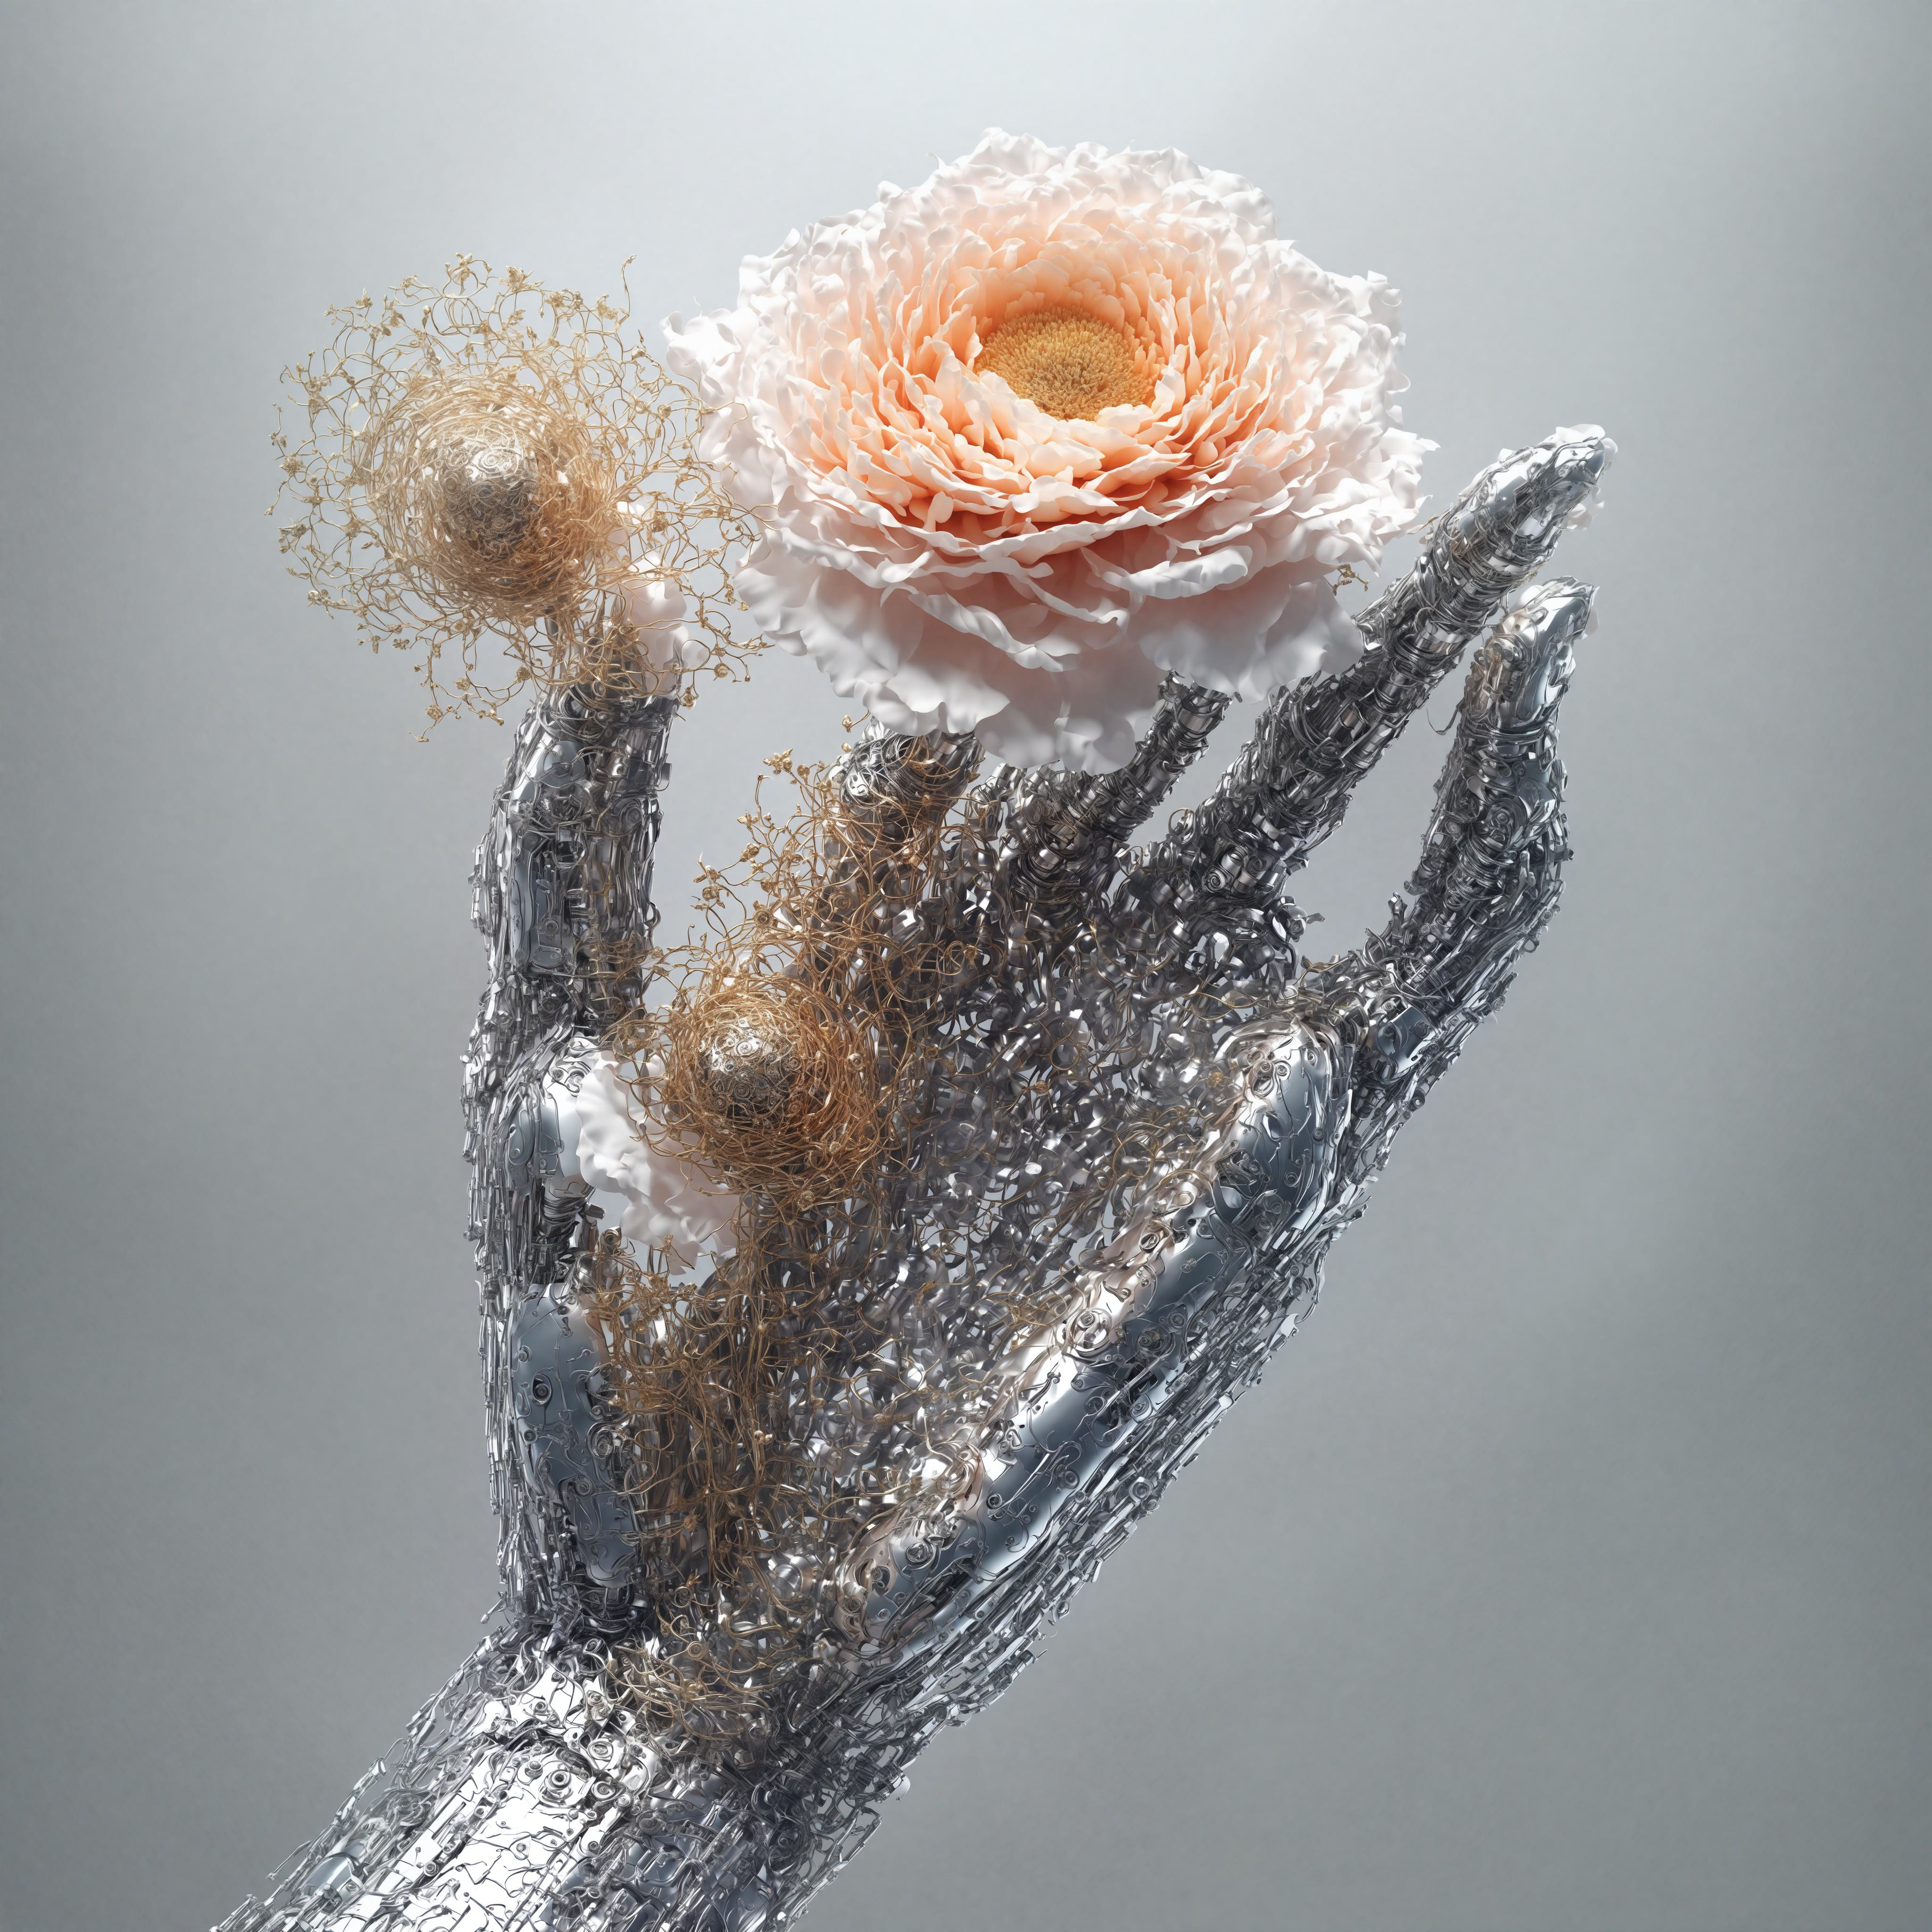
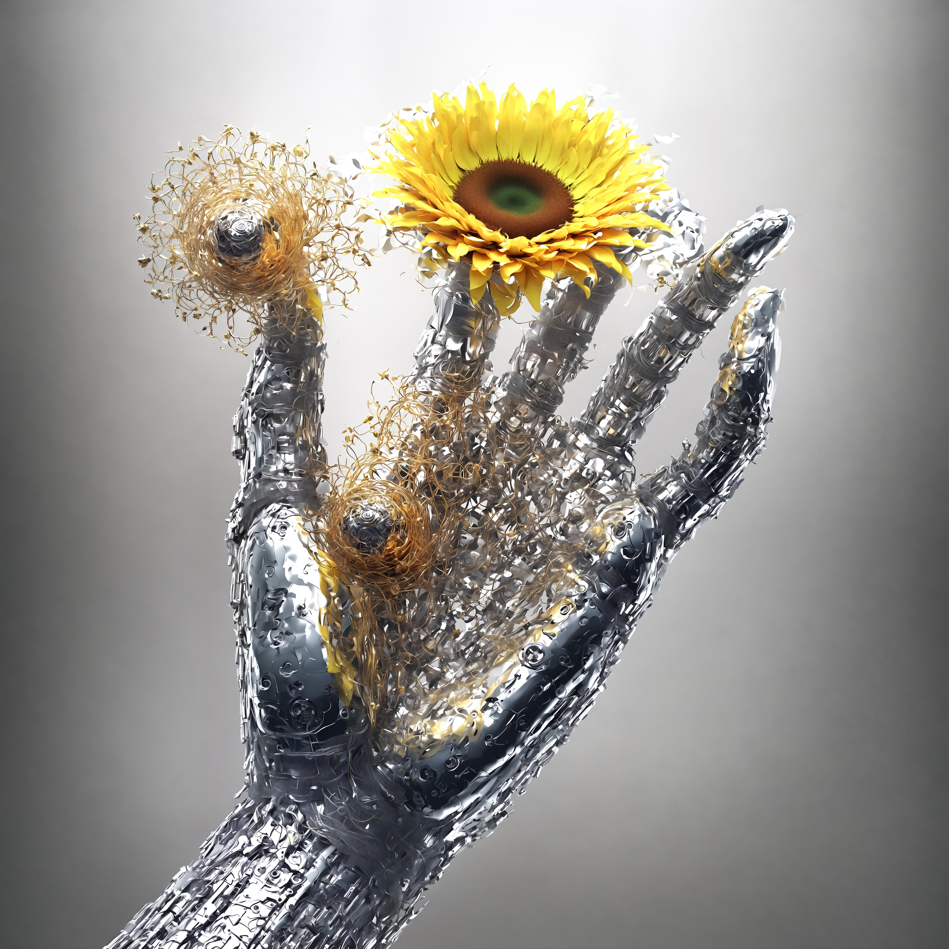



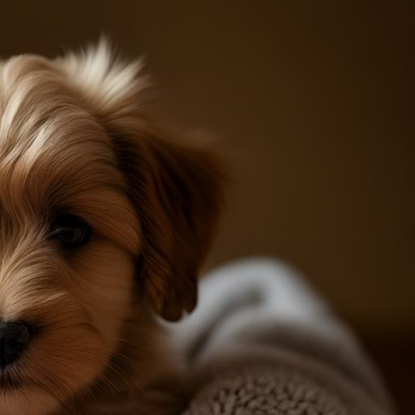




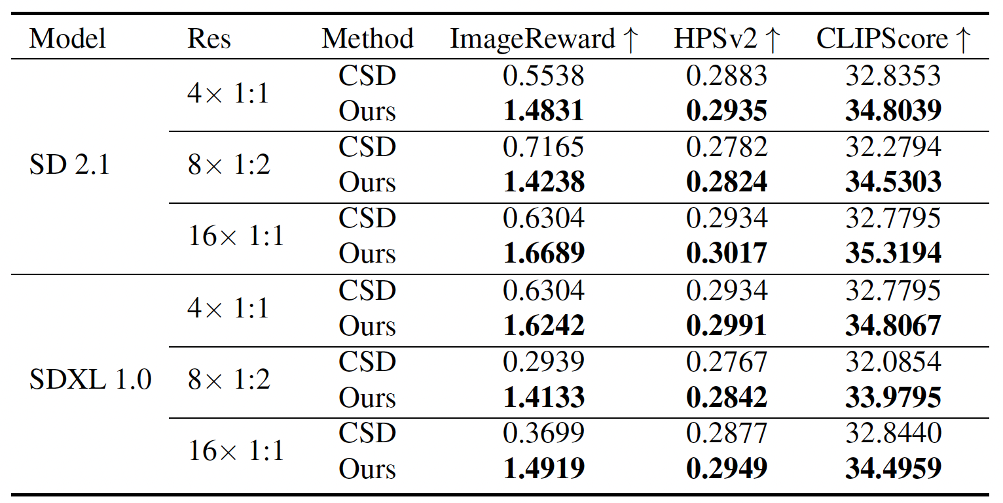
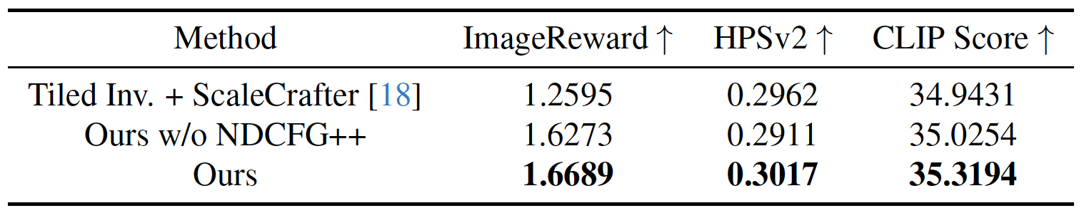


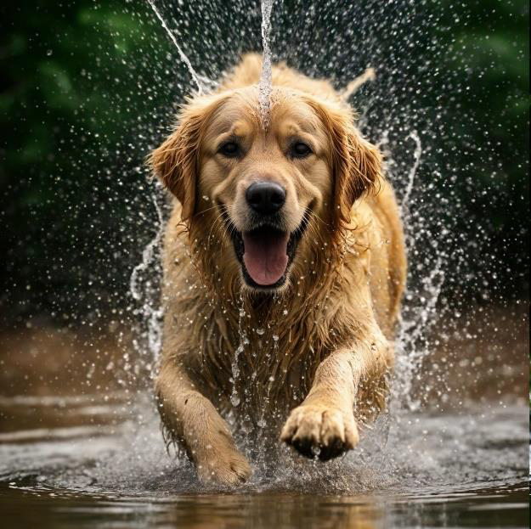
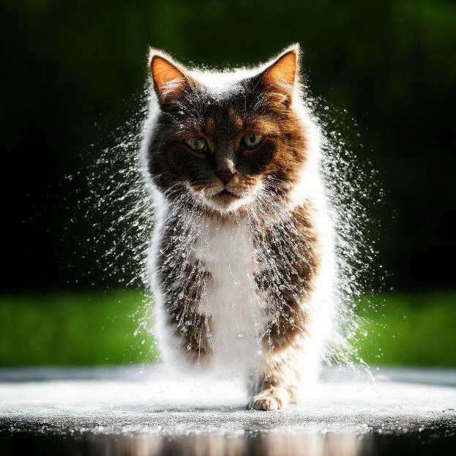
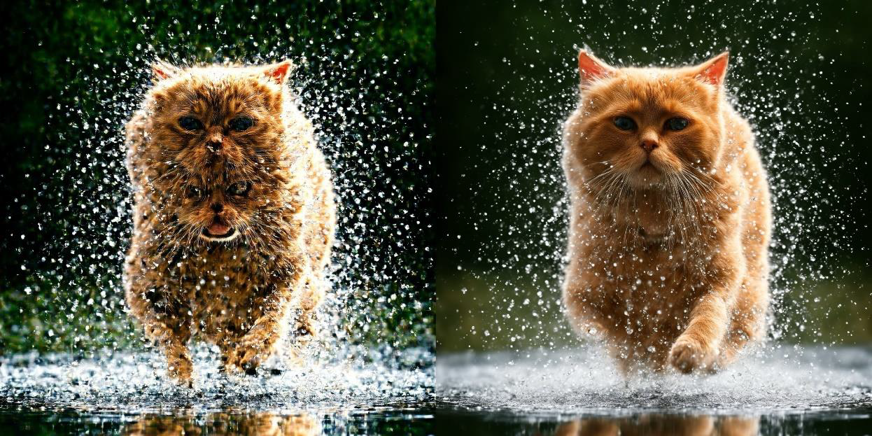
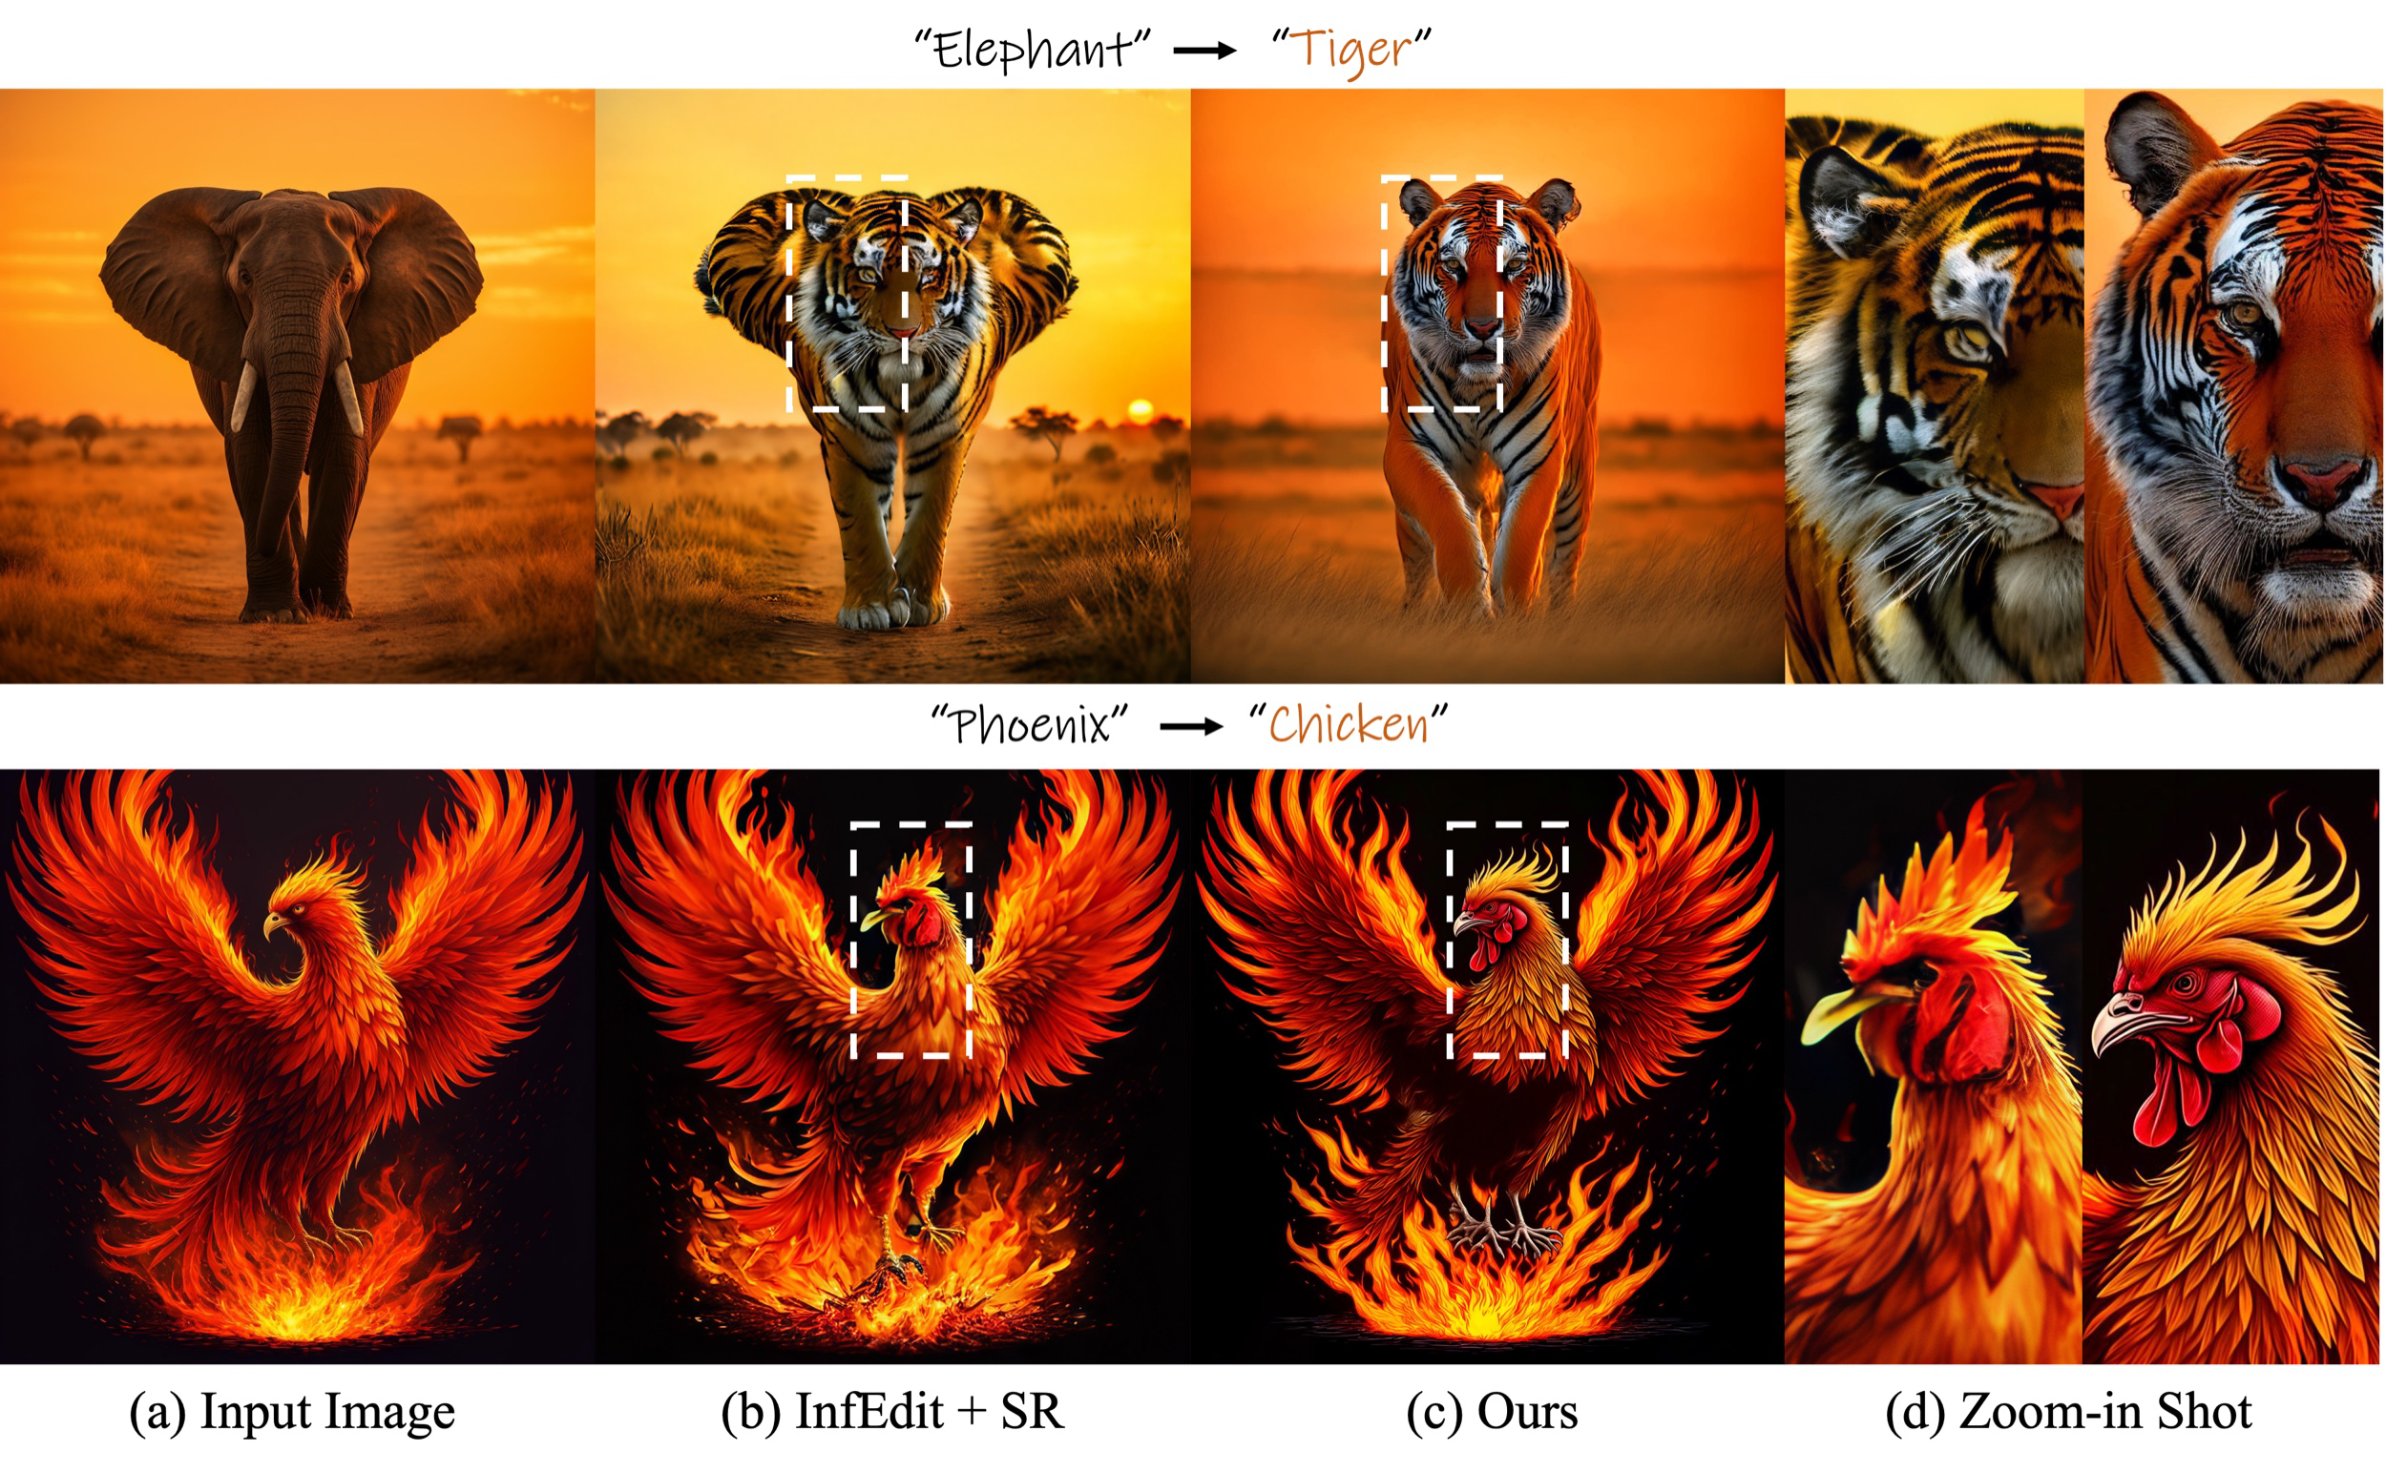

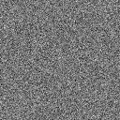




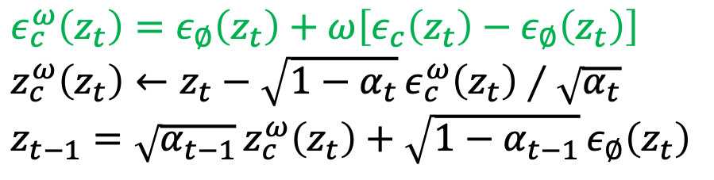
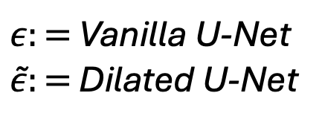

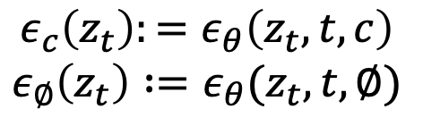


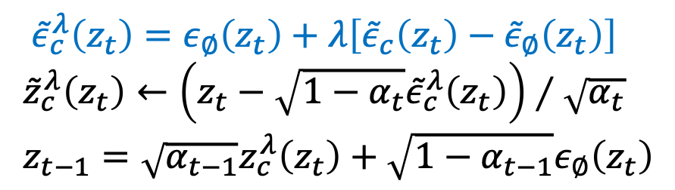
1
2
3
4
EditCrafter: Tuning-free High-Resolution Image Editing via Pretrained Diffusion Model
${\text{Kunho} \text{Kim}}^{1}$ ${\text{Sumin} \text{Seo}}^{2}$ ${\text{Yongjun} \text{Cho}}^{3}$ ${\text{Hyungjin} \text{Chung}}^{4}$
medipixel
Project Page
Motivation
EditCrafter Pipeline
Results
Problem: Editing resolution is still the bottleneck
Make a fixed resolution generator act as a high-resolution editor
Qualitative Results: SDXL 16× (4096×4096)
For more, check our project page!
Diffusion based editing methods inherit the 512×512 / 1024×1024 training resolution limit.
Real applications need arbitrary aspect ratios and 2K ~ 4K outputs with fine detail preservation.
Naïve patch-wise editing breaks global structure, causing seams and object repetitions.
Beyond image generation, there has been an emergence of high-resolution image generation. Nevertheless, the field of high-resolution image editing remains relatively underexplored.
“Flower” -> “Sunflower”
Tiled DDIM Inversion
① Split high-resolution image $x₀$ into non-overlapping tiles $S$ matching the T2I diffusion model’s training resolution.
② Invert each tile independently with guidance scale $ω=0$ (no text conditioning)
→ avoids prompt–patch mismatch that arises from partial object content.
③ Concatenate the per-tile inverted latents to form edit-friendly high-resolution latent $z_{T}^{∗}$.
→ Tiled text-guidance-free inversion preserves identity of the original input image.
High-Resolution Reverse Diffusion with NDCFG++
① Adopt re-dilated convolutions throughout U-Net to expand the receptive field for higher-resolution latents while reusing pretrained parameters.
② Manifold-Constrained Noise-Damped CFG (NDCFG++):
• Small guidance scale $λ ∈ [0, 1]$ — interpolation (stays on manifold)
vs. NDCFG's large $ω ≥ 1$ — extrapolation (may deviate).
• Renoising with vanilla noise estimator $ε_{θ}$ → smoother editing trajectory.
• Applied for initial timesteps $(t ≤ τ)$; standard CFG++ for remaining steps.
NDCFG++ interpolates between unconditional and conditional predictions, keeping estimates closer to the data manifold and producing faithful edits that preserve background textures and object identity in high-resolution editing.
Each patch is edited independently without knowledge of the whole image
4096
1024
1024
4096
”puppy” -> ”kitten”
Quantitative Results
Ablation Study
[2]
Original Image
Edited Image
by CSD [1]
Challenge
(a) Input Image
(b) Tiled Inv.
+ ScaleCrafter
(c) Ours w/o d NDCFG++
(d) Ours
1. How can we invert a high-resolution image into a latent using a fixed-size pretrained diffusion model?
Comparison to SOTA Editing Method with Super-Resolution Upsampler
User Study Preference
Pretrained text-to-image diffusion models trained on 512×512 or 1024×1024 images.
Direct DDIM inversion of high-resolution images yields poor latent.
???
SD U-Net $ε_{θ}$
$ε:=$ Vanilla U-Net
$\tilde{ε}:=$ Dilated U-Net
$$ε_{c}\left(z_{t}\right):=ε_{θ}\left(z_{t}, t, c\right)$$
$$ε_{∅}\left(z_{t}\right) :=ε_{θ}(z_{t}, t, ∅)$$
72.6%
27.4%
CSD
2048
Trained on 512 × 512
256
EditCrafter
61.1%
38.9%
InfEdit + StableSR
2. If we succeed in creating an edit-friendly high-resolution latent, how can we guide the reverse process from this latent using a fixed-size pretrained diffusion model?
$ε_{c}^{ω}\left(z_{t}\right)=ε_{∅}\left(z_{t}\right)+ω\left[ε_{c}\left(z_{t}\right)−ε_{∅}\left(z_{t}\right)\right]$
$z_{c}^{ω}\left(z_{t}\right)←z_{t}−\sqrt{1−α_{t}} ε_{c}^{ω}\left(z_{t}\right)∕\sqrt{α_{t}}$
$z_{t−1}=\sqrt{α_{t−1}} z_{c}^{ω}\left(z_{t}\right)+\sqrt{1−α_{t−1}} ε_{∅}\left(z_{t}\right)$
92.4%
ProxEdit + StableSR
Vanilla CFG
7.6%
The fixed-size U-Net cannot process high-resolution latents directly.
Patch-wise reverse diffusion guided by a single prompt causes object repetition → CFG propagates the object to every patch even where it is absent.
High $ω$ / Extrapolate / Use vanilla U-Net 𝜖
???
SD U-Net $ε_{θ}$
Small $λ$ / Interpolate / Use dilated U-Net $\tilde{ε}$
${\tilde{ε}}_{c}^{λ}\left(z_{t}\right)=ε_{∅}\left(z_{t}\right)+λ\left[{\tilde{ε}}_{c}\left(z_{t}\right)−{\tilde{ε}}_{∅}\left(z_{t}\right)\right]$
${\tilde{z}}_{c}^{λ}\left(z_{t}\right)←\left(z_{t}−\sqrt{1−α_{t}}{\tilde{ε}}_{c}^{λ}\left(z_{t}\right)\right)∕\sqrt{α_{t}}$
$z_{t−1}=\sqrt{α_{t−1}}z_{c}^{λ}\left(z_{t}\right)+\sqrt{1−α_{t−1}}ε_{∅}\left(z_{t}\right)$
[1] Kim et al., Collaborative Score Distillation for Consistent Visual Synthesis, NeurIPS 2023.
[2] He et al., ScaleCrafter: Tuning-free Higher-Resolution Visual Generation with Diffusion Models, ICLR 2024.
[3] Wang et al., Exploiting Diffusion Prior for Real-World Image Super-Resolution, IJCV 2024.
[4] Xu et al., Inversion-Free Image Editing with Natural Language. In CVPR, 2024.
[5] Han et al., ProxEdit: Improving Tuning-Free Real Image Editing with Proximal Guidance. In WACV, 2024.
Trained on 512 × 512
NDCFG++
256
2048

