Slide 1

Movies & Shows Comparison
By: Satya Sakuntala NagaSravya Mattapalli, Zack Crowley, Edith Lotterman and Kevin Ybarra

Slide 2

What data did we use?
“Netflix Movies and TV Shows” dataset from Kaggle
Merged with “Netflix Titles” dataset from Kaggle to populate specific information for each movie and TV show
API call from OMDB to fill in all “NAN” values that were not in the “Netflix Titles” merge

Slide 3
What questions did we ask?
What are the most popular genres?
What are the most popular TV Shows and Movies?
Is there a difference in popularity between English vs Non-English Movies and Films?

Slide 4
Delete
Edith line graph
Kevin category breakdown
Kevin chi squared
Zack top 10 most watched shows
Satya popularity by weeks

Slide 5
Final Dataset
Merged the two datasets and performed an API call on OMDB
Deleted rows with null values
Cleaned up countries, runtime, and genre categories
Broke genre down by type and searched for top 6 genre types
Final Dataset
Full Country Name
Columns for drama, comedy, action, family, crime, and romance added
Ratings from PG to Not-Rated
2069 total rows
Shows that had multiple seasons in top 10 were grouped for some analysis

Slide 6

Research Approach

Slide 7
Exploratory Analysis

Slide 8
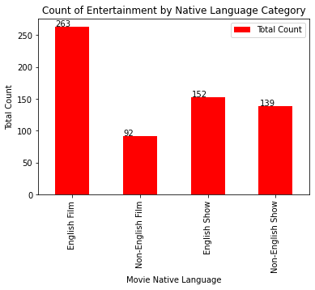
Dataset Overview

Slide 9
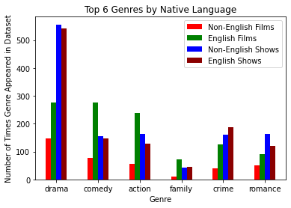
Genre Breakdown

Slide 10
Genre Breakdown
 | Non-English Films | English Films | Non-English Shows | English Shows
drama | 147 | 275 | 556 | 543
comedy | 76 | 276 | 154 | 146
action | 55 | 238 | 163 | 129
family | 11 | 73 | 42 | 46
crime | 41 | 126 | 160 | 187
romance | 51 | 90 | 162 | 119

Slide 11
Conclusions

Slide 12
Next Steps

